Slide 1
Lock Guardian
Krzysztof Uszko Hubert Rydz Maciej Kasprzyk

Slide 2
EXISTING SOLUTIONS
Encryption
Endpoint Monitoring
SOC
Next-Gen Firewall

Slide 3















EXISTING SOLUTIONS
Encryption
Endpoint Monitoring
SOC
Next-Gen Firewall

Slide 4
“Sounds good… However”

Slide 5
PROBLEM VS. SOLUTION
Solution that will let company secure any of their assets…
What if our solution is feasible to protect all of them? 😎

Slide 6

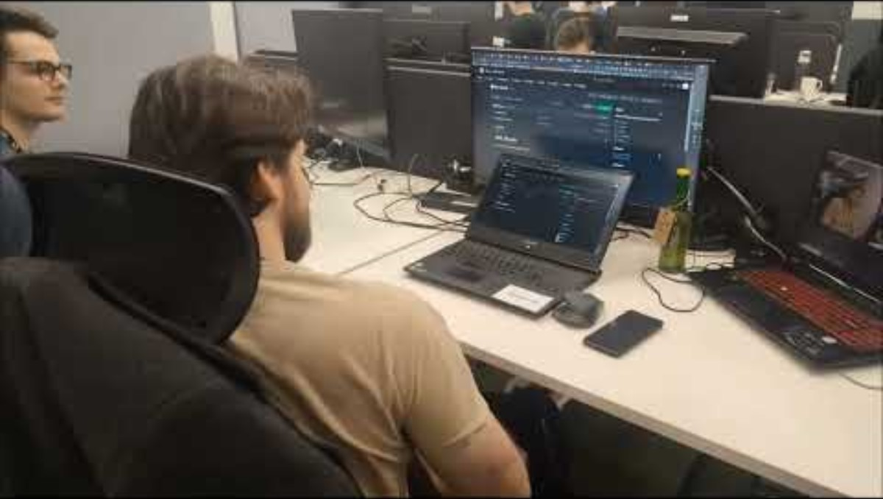
PoC

Slide 7
THEM
COMPETITIVE ADVANTAGE
US
No such solution on the market.
Easy to implement. Easy to maintain.
Low effort big income.

Slide 8
PRIVACY CONCERNS
According to Polish law, it is possible to monitor workplaces with previous employee’s approval.
Interrupting personal space is prohibited – we do not violate it.
Sources: https://sip.lex.pl/akty-prawne/dzu-dziennik-ustaw/kodeks-pracy-16789274/art-22-2 https://dlafirm.pracuj.pl/blog/monitoring-w-miejscu-pracy

Slide 9
FINANCE & INFRASTRUCTURE
It is way cheaper than investing a lot in mandatory training.
Possibility of building on top of an existing monitoring system.

Slide 10



PRODUCT OVERVIEW
Screen locking
Data Gathering & Statistics
Adversary detection
Stigmatization

Slide 11



IMPLEMENTATION
Assigned workplaces
Open space offices

Slide 12

FUTURE PLANS
Data driven reports
Advanced reporting of employee’s security breaches.
Badges detection
Detecting unprivileged office access.
Security empowerment
Engaging users into security awareness through gamification.

Slide 13
THANKS
Do you have any questions?

