Slide 1

Team Name: Hackclasher
Team Members:
Narasimha Maiya G S
NIKIL B S
SHASHANK G
KARTHIK K

Slide 2

Money Laundering and Technology
Notes:
2
2

Slide 3
What is Money laundering & How it works?
Notes:
3
3
This section could provide a basic introduction as to what money laundering is.

Slide 4

Money laundering is a process that criminals use in an attempt to hide
the illegal source of their income. By passing money through complex transfers and transactions, or through a series of businesses, the money is “cleaned” of its illegitimate origin and made to appear as legitimate business profits.
The Need to Launder Money
A major business problem of large, organized criminal enterprises – such as drug smuggling operations – is that they end up with huge amounts of cash that they need to conceal in order to avoid attracting investigations by legal authorities. The recipients of such large amounts of cash also do not want to have to acknowledge it as income, thereby incurring massive income tax liabilities.
To deal with the problem of having millions of dollars in cash obtained from illegal activities, criminal enterprises create ways of “laundering” the money to obscure the illegal nature of how it is obtained. In short, money laundering aims to disguise money made illegally by working it into a legitimate financial system, such as a bank or business.
Notes:
4
4
https://www.youtube.com/watch?v=257wV-AbKaE
A video, such as this, may help vary the ways you deliver the training.

Slide 5
How Money Laundering Works..?
Money laundering typically occurs in three phases:
Initial entry or placement is the initial movement of an amount of money earned from criminal activity into some legitimate financial network or institution.
Layering is the continuing transfer of the money through multiple transactions, forms, investments, or enterprises, to make it virtually impossible to trace the money back to its illegal origin.
Final integration is when the money is freely used legally without the necessity to conceal it any further.
Notes:
5
5
You may want to provide an overview of the risk to the accountancy sector. Below is a summary of the National risk assessment of money laundering and terrorist financing 2017 (conducted by HM Treasury and the Home Office).This highlighted that the accountancy sector (together with other professional services such as lawyers) was a crucial gateway for criminals looking to disguise the origin of their funds.
https://www.gov.uk/government/publications/national-risk-assessment-of-money-laundering-and-terrorist-financing-2017
In relation to the accountancy sector, the report highlighted the following areas:
Accountancy services are attractive to criminals due to the ability to use them to gain legitimacy, create corporate structures or transfer value.
Accountancy services are assessed as high risk for money laundering but low risk for terrorist financing.
There are inconsistencies in the supervision of accountants.
Trust and company service provider (TCSP) services are judged to be at a higher risk of being used to facilitate money laundering when provided by an accountancy firm rather than by a specialised company formation agent. This is due to criminals also looking to exploit the accountancy firm for wider services.
It should be noted that the accountancy sector has offered some criticism of the National risk assessment due to its failure to include supporting details and underlying data on some of its conclusions – for example, the perception that the sector has completed a low level of suspicious activity reports (SARs).

Slide 6
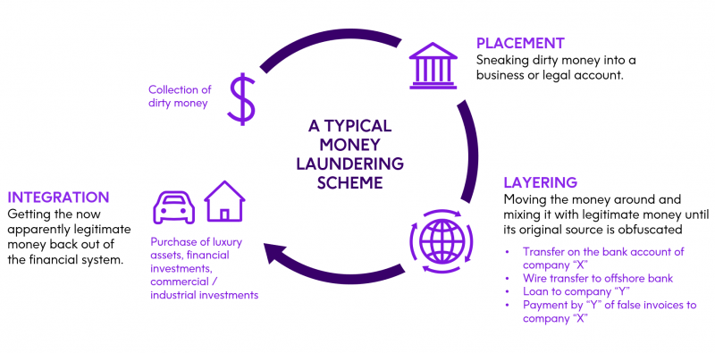
Notes:
6
6
NCA video: Money laundering: How trusted professionals can help law enforcement: https://www.youtube.com/watch?v=qln3ADE-PxU

Slide 7
A Bit Deep insight of the problem…
Notes:
7
7
You could summarise the relevant law and regulations and how it is applicable to your firm and its employees – for example, the Money Laundering Regulations, Proceeds of Crime Act and the Terrorist Financing Act.
You should also consider tipping off and employees’ legal obligations to report suspicious activity.

Slide 8
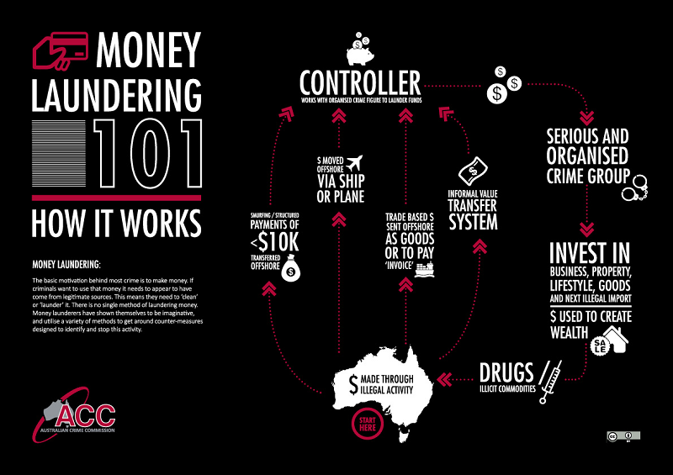
Notes:
8
8

Slide 9
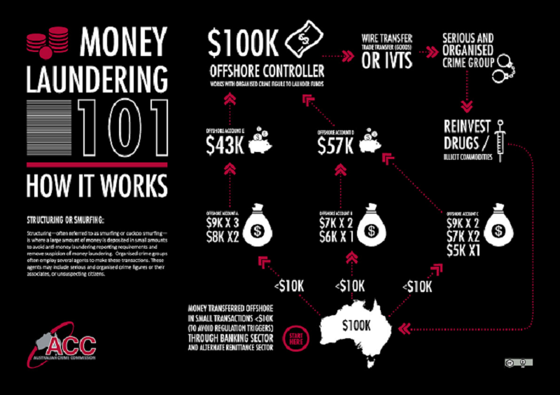
Smurfing and structuring
Smurfing is a common placement technique. Cash from illegal sources is divided between 'deposit specialists' or 'smurfs' who make multiple deposits into multiple accounts (often using various aliases) at any number of financial institutions. In this way, money enters the financial system and is then available for layering. Suspicion is often avoided as it is difficult to detect any connection between the smurfs, deposits and accounts.

Slide 10
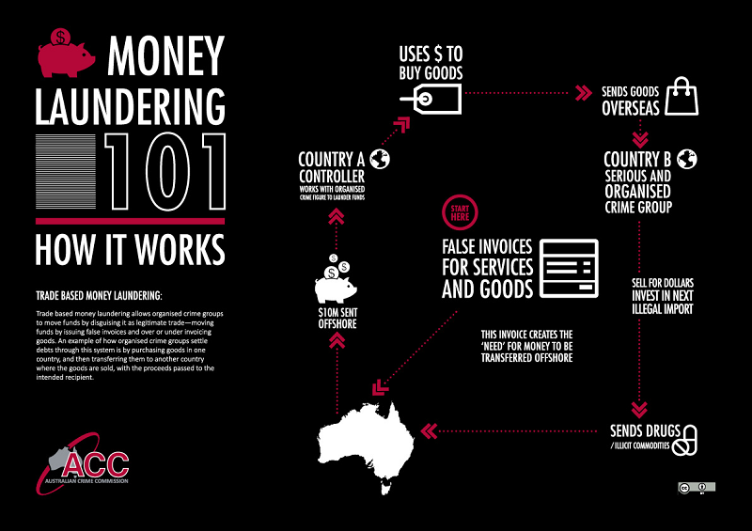

Slide 11
So what can be done to stop this…!
Notes:
11
11
This section could cover who the MLRO is and what they do – and how staff must report suspicious activity to them.

Slide 12


Slide 13
How AML works..?
Notes:
13
13
This section could cover how to identify suspicious activity. This is the most important part of your training – so a considerable amount of time should be spent on this section.

Slide 14
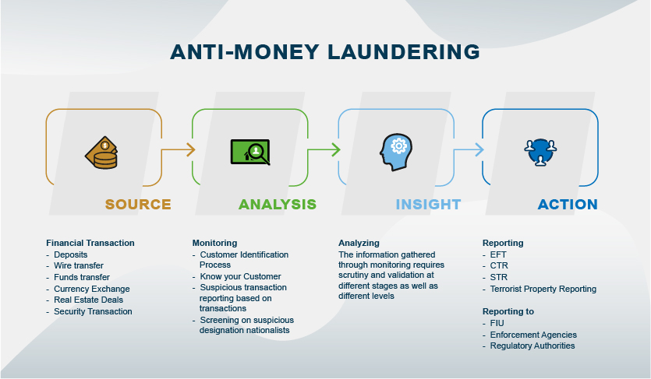

Slide 15
How can Tech tools help…?
Notes:
15
15
This section could cover how you onboard a client – for example, what information and documents your staff should review. You should then advise on potential red flags (eg if a client is being evasive). You could also cover ongoing monitoring.

Slide 16

Why Is Technology Important to Anti-Money Laundering?
The war between the various financial sectors and money laundering has led financial institutions to set up technologically intelligent weapons. Thus, these institutions aim to use sophisticated analytical technologies such as machine learning to combat various financial crimes effectively. Furthermore, financial institutions are confronted with criminals and regulators who are imposing increasingly severe sanctions for offenses. Branches, which fear supervisor sanctions and damage to their reputation, are more dedicated than ever in their efforts to combat money laundering and the financing of terrorism (AML / CFT).

Slide 17
Machine Learning in Anti-Money
Laundering
The compliance teams who are under all this pressure from regulators believe that "machine learning" is the miracle solution for the AML. Sanction Scanner would like to point out that machine learning is not new as a concept, but recent is its use in combating money laundering. Its usefulness is particularly important for reducing the number of false positives (false alerts) that are generated through traditional AML devices.
Also, the areas of AML / CFT that are likely to be covered by these new technologies are very numerous, in particular:
Customer knowledge (KYC), which involves due diligence and adequate customer profiles, such as verifying the origin of funds
Monitoring of transactions, which includes investigations of alerts.
Thus, new technologies will play a potentially huge role in the field of AML / CFT, but they cannot entirely replace human judgment, which remains very important in these processes. Therefore, the aim will be to enrich the existing AML / CFT devices with the various technologies of artificial intelligence (AI).

Slide 18
How it is approached and Existing Technique..?
Notes:
18
18
This section could cover how staff should recognise and report suspicious activity.

Slide 19
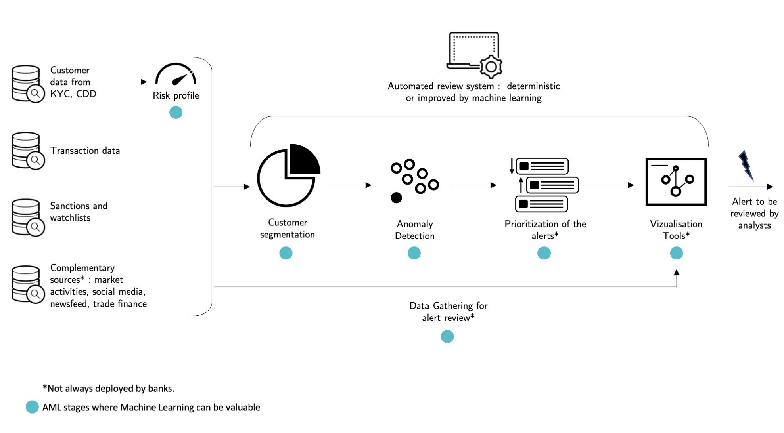

Slide 20
How can we enhance this existing model

Slide 21
Our Algorithm….
As Technology advanced Financial crimes took a new different dimension and some loop holes in technology and Governance procedures were exploited by the Money launderers
Over the years and over the number of money laundering cases reported and filed and when analyzed these reports , we can see common money smurfing techniques and strategies these money launderers use and the GDP increase in a Decentralized systems and The amount of money used in smurfing , transactions in dormant accounts and many other similar factors
we can structure the data obtained from these cases and clean the unwanted data and analyze them for further processing and we can train our Machine Learning model with this data to detect suspicious activities in banking and prepare SAR’s (Suspicious Activity Report) we can also integrate this with the above existing model for better accuracy.

Slide 22
THANK YOU….!

