Slide 1

BANDITS

Slide 2

ANUSHA B
BHUMIKA M
CHAITANYA SHIVARAJU
MANASA G L
TEAMMATES

Slide 3


T
R
A
N
S
F
O
R
M
I
N
G
INTO AMAZING
EXPERIENCES

Slide 4

E-LEARNING is not intended to replace conventional methods and learning in classrooms.
Its aim is to create an augmented learning environment where technology is used to deliver a combined range of teaching and learning techniques by maximizing the individual’s participation .
Achieving the goals in the learning and teaching process as a greener world.

Slide 5
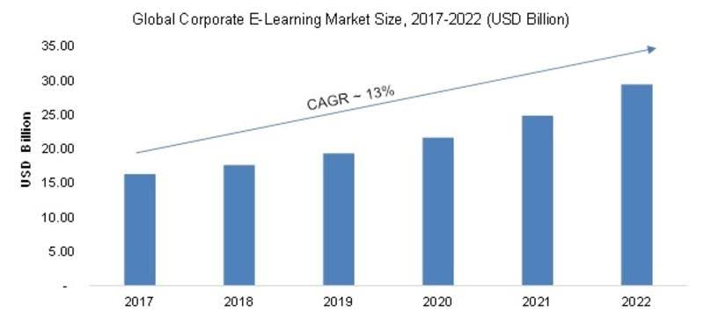
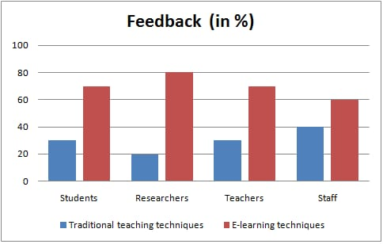

Slide 6
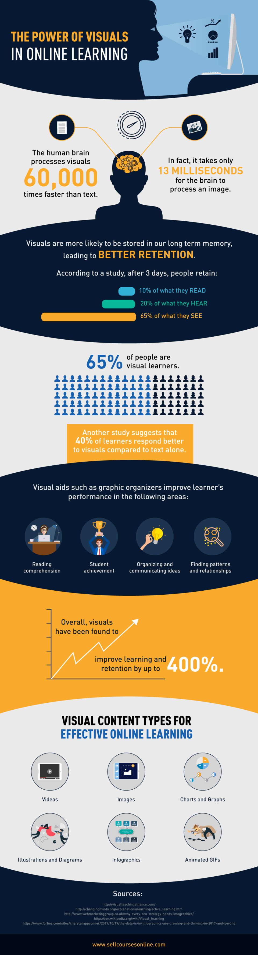

Slide 7
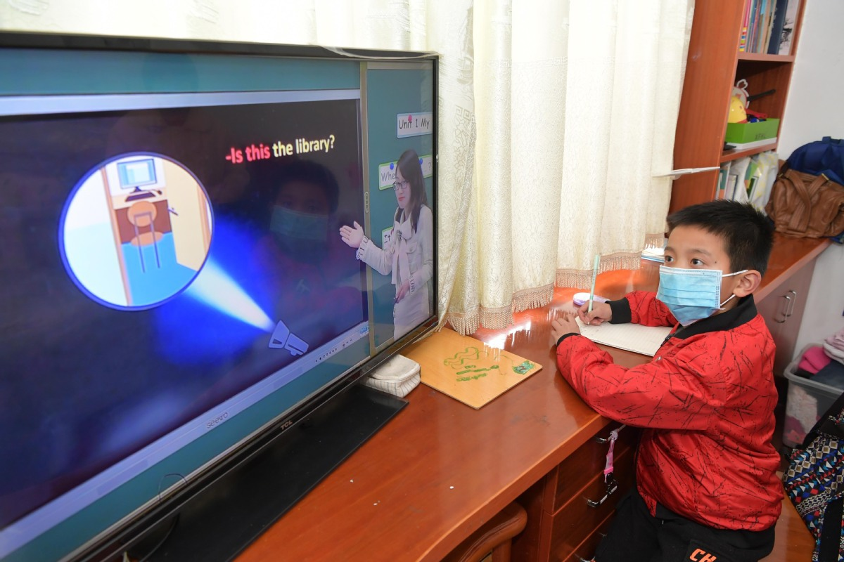
EFFECTIVE SOLUTION -

Slide 8

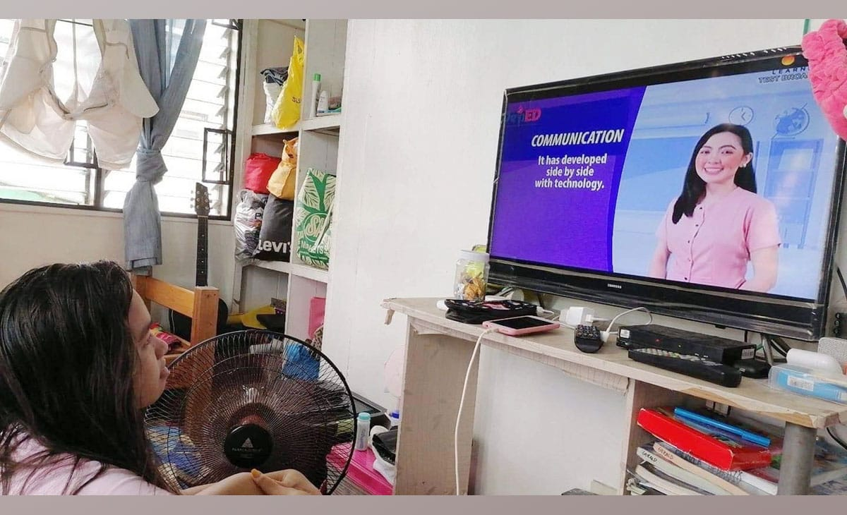
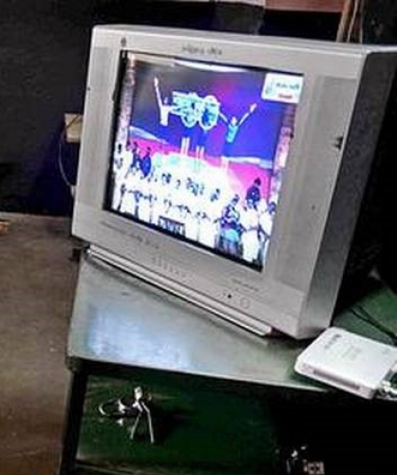
EFFECTIVE WAY OF E-LEARNING EXPERIENCE THROUGH TELEVISION

Slide 9

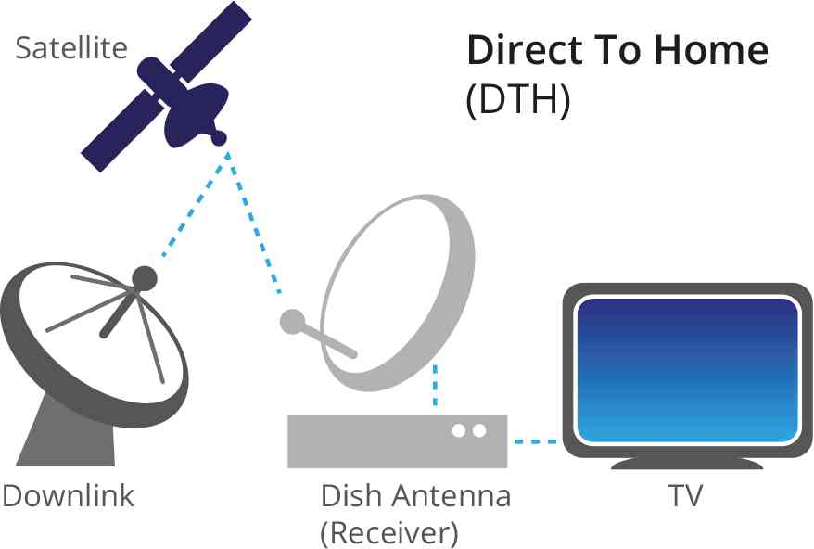



Creating a TV Channel
FREE CHANNEL
THROUGH SATELLITE
VIRTUALIZATION
TECHNOLOGY

Slide 10

EXPERIENCED EDUCATOR WITH TECHNICAL SKILLS
PARTNERSHIP WITH OTHER CHANNELS
SMOOTH
PROGRESS OF OUR CHANNEL
SAVED RECORDINGS,
LIVE-TELECAST
1
2
3
4
5
6
7
8
RECOGNIZED
CHANNEL
VIRTUAL VISUALISATION THROUGH VIRTUAL NETWORK SIGNALS FROM SATELLITES
WELL-ORGANIZED TIME DURATION
BEST DISPLAY & SOUND QUALITY THROUGH AR
UPGRADED VERSION’S according TO THE NEW INNOVATIONS

Slide 11
TV-CHANNEL
FREE CHANNEL
USER
FRIENDLY
AVAILABLE
IN DIFFERENT
MEDIAS
BENIFICIAL TO ALL GENERATIONS
VISUALIZATION TECHNOLOGIES
ACADEMIC
& PERSONAL
DEVELOPMENT
AUGMENTED
REALITY

Slide 12
ADVANTAGES FOR LEARNER’S
Provides a safe learning environment
Bridges the gap between theory and practice
Increases engagement levels
Assessing complex learning is easier

Slide 13


SPONSOERS PRODUCTS WILL BE ADVERTIZED DURING THE
TEACHING PROCESS

Slide 14

V-T.V
THANK YOU

