Slide 1
Crafts
Entropy presents

Slide 2
The Problem
The lack of industry specific knowledge among learners and the demotivating engagement in the existing edtech platforms has been a challenge for companies, learners and hirers

Slide 3
The Proposal
The solution we propose is a platform where a learner can choose a field of interest and gets access to quality resources or choose to be mentored by a professional and is challenged with 5 or more project ideas to complete. Upon completion of these projects a portfolio is created which can be viewed by hirers, thus being awarded a potential client/job.

Slide 4
The Objectives
Learners get access to some of the best open source learning experiences
The hirers can look at the work done by learners and potentially hire them for work
The project based challenges are industry standard in each respective field so that the learners gain experience as per industry standards
1-1 Mentoring sessions from professionals to boost a learner’s skillset
Enable peer to peer learning for higher engagement and better learning experience

Slide 5
The Tech Stack
Front-end: HTML, CSS, ReactJS, Material UI
Back-end/Server : Firebase

Slide 6
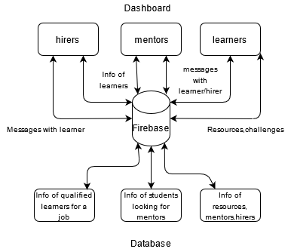
The Architecture

Slide 7
Use Cases
Learners get an option to get beginners knowledge in any field they are interested in.
Access to a unified library consisting of platforms which are unique/free/highly recommended to learn from in the industry.
Mentorship opportunities for anyone who’s a professional in their field, they can choose or be requested to mentor from learners in their specific field.
Thus the platform will be bridging the gap between industry standards and new learners in the field.
For completing the specified industry standard projects, the learners will be able to get hired for work from hirers.

Slide 8
Constraints
The learner’s knowledge highly depends on by “who” he is being mentored by and from which platform he chooses to learn from.
Updation of project challenges to keep up with the industry standards.
Hirers authenticity.
Coverage of all fields which can be taught through digital experiences.
Due to the Open sourced nature of the platform, it is highly dependent on its contributors.
Dependence on Google’s Cloud Services for database and authentication of users.

Slide 9
THANK YOU!

