Slide 1


Slide 2
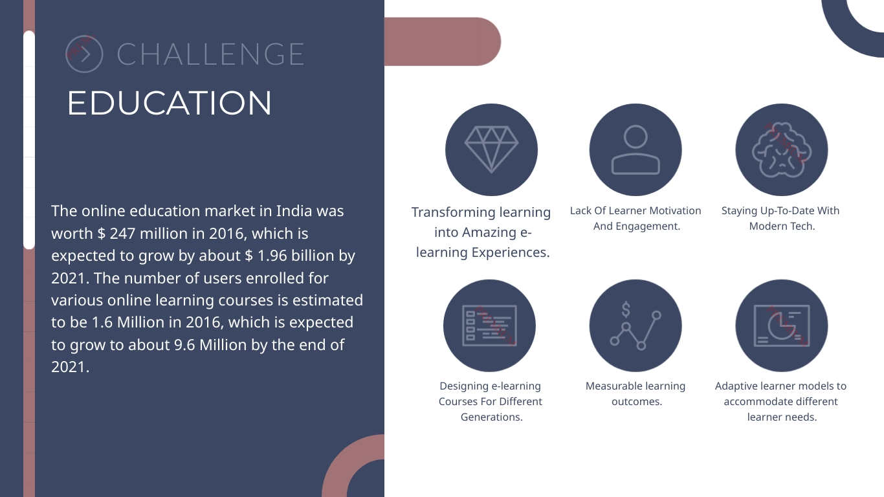

Slide 3

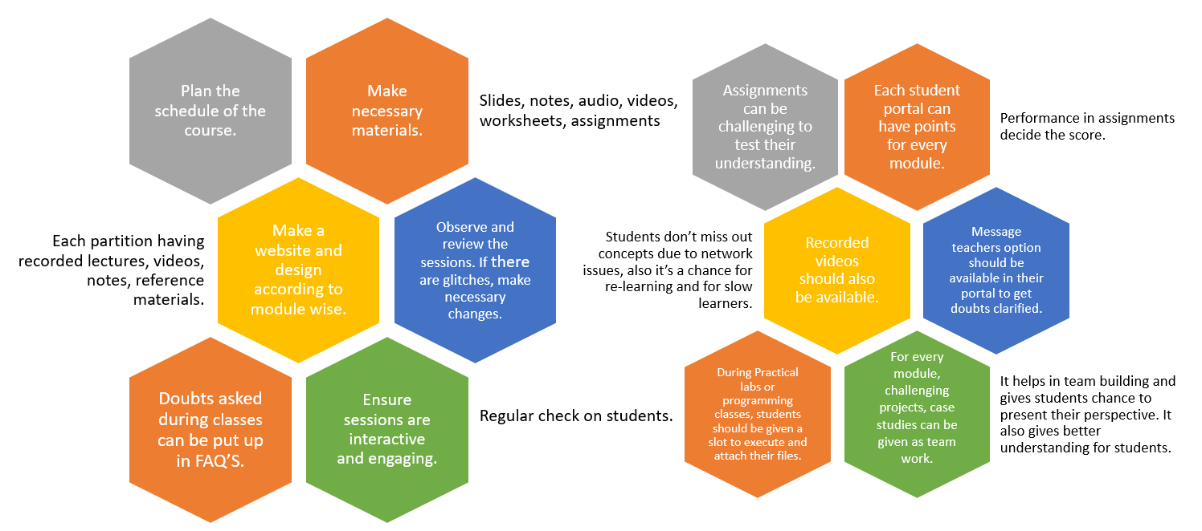

Slide 4

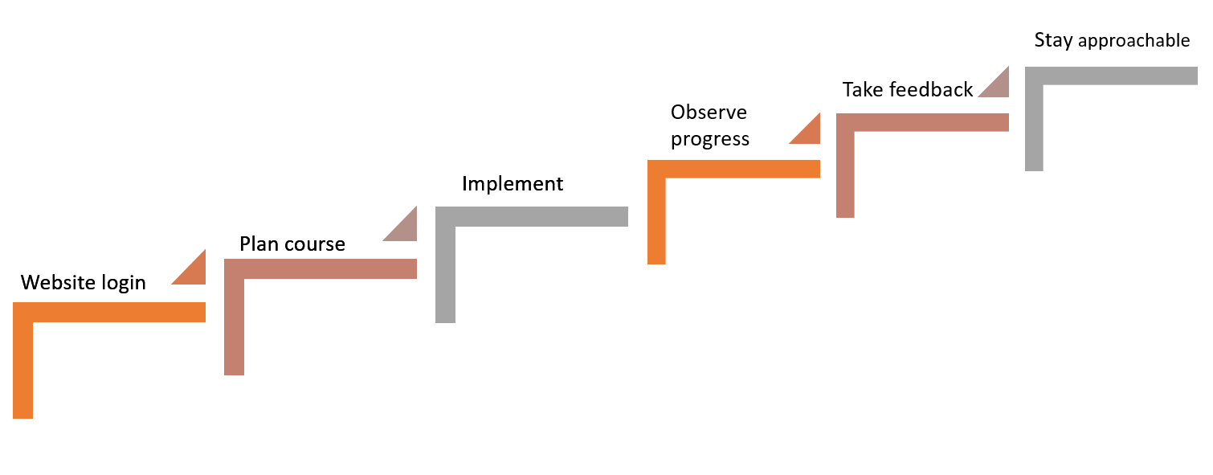
STEPS FOR TRANSFORMATION
Doubts and clarifications can be done through chat or any other means. Keeping in touch with the students is necessary.
Regular feedback is necessary as this is a new method.
Understanding and knowledge gained by the students should be checked regularly and sessions should be dynamic.
Teachers can put their ideas and plan to action and utilise new tools.
Teacher break the course module wise and make lesson plan and gather resources.
Students and teachers can be given assess to their portal.

Slide 5

Boon
In covid-19 situation, 500 million students have been affected. All schools and colleges have been shut down. Online learning has come to the rescue.
Bane
No face to face interaction. Misinterpretation can happen.
Online learning can make studying so incredibly interesting, that students might not even feel that they are studying.
Online learning involves getting training from any location and any time.
If students want to listen a lecture again, they can watch recorded sessions.
No time commitment. Since there is no one to inspect their studies, they might not complete their work and leave it unfinished harming their own selves in the long run.
Students without proper internet connection and other devices cannot rely on online learning.
Students are free from regulations and boundaries of proper classroom environment, it is quite obvious that they start taking things lightly.

Slide 6
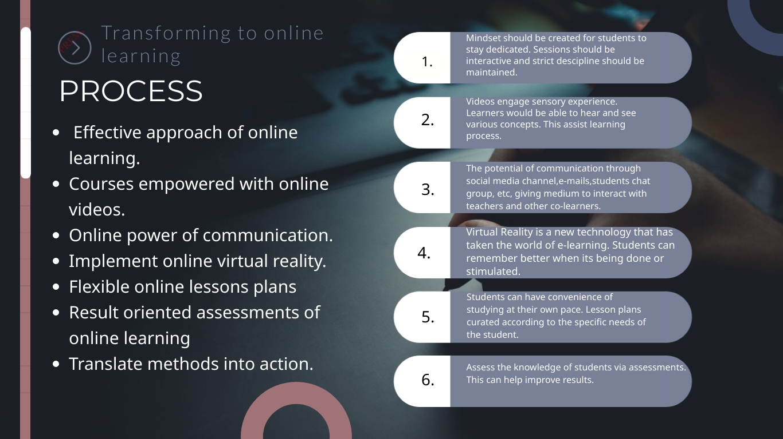

Slide 7
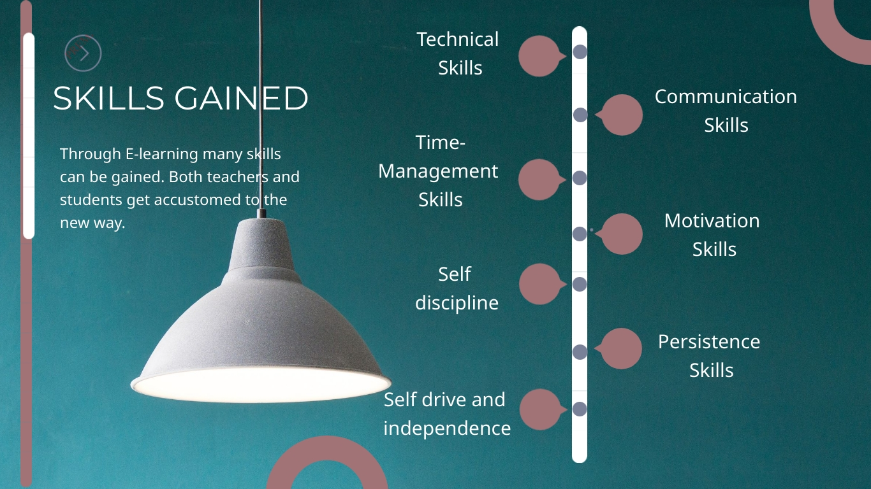

Slide 8


Slide 9
Profile
Courses
Assignments
Logout
Welcome John!
Happy Learning!
Announcement 1
Announcement 2
Announcement 3
Announcement 4
Schedule
Upcoming events
Assignment Deadline

Slide 10
Welcome John!
Happy Learning!
courses
Welcome John!
Happy Learning!
Management and entrepreneurship in it industry
Computer networks
Python programming
Unix programming
+
Java
Web application
Automata

Slide 11


ass
Python Programming
Dashboard
Videos challenges assignments saved notes
Module 1 – Introduction and basic concepts
Module 2 – Dictionary and tuples
Module 3 – Regular expression
Module 4 – Data types
Module 5 – pdf and word document
Videos
View more+
Challenge for the week
Attempt task duration: 15mins
due: 15 april

Slide 12
Assignments
Python assignment-1 due: 17 april
Upload now 10 points

Slide 13
THANKYOU

