Slide 1
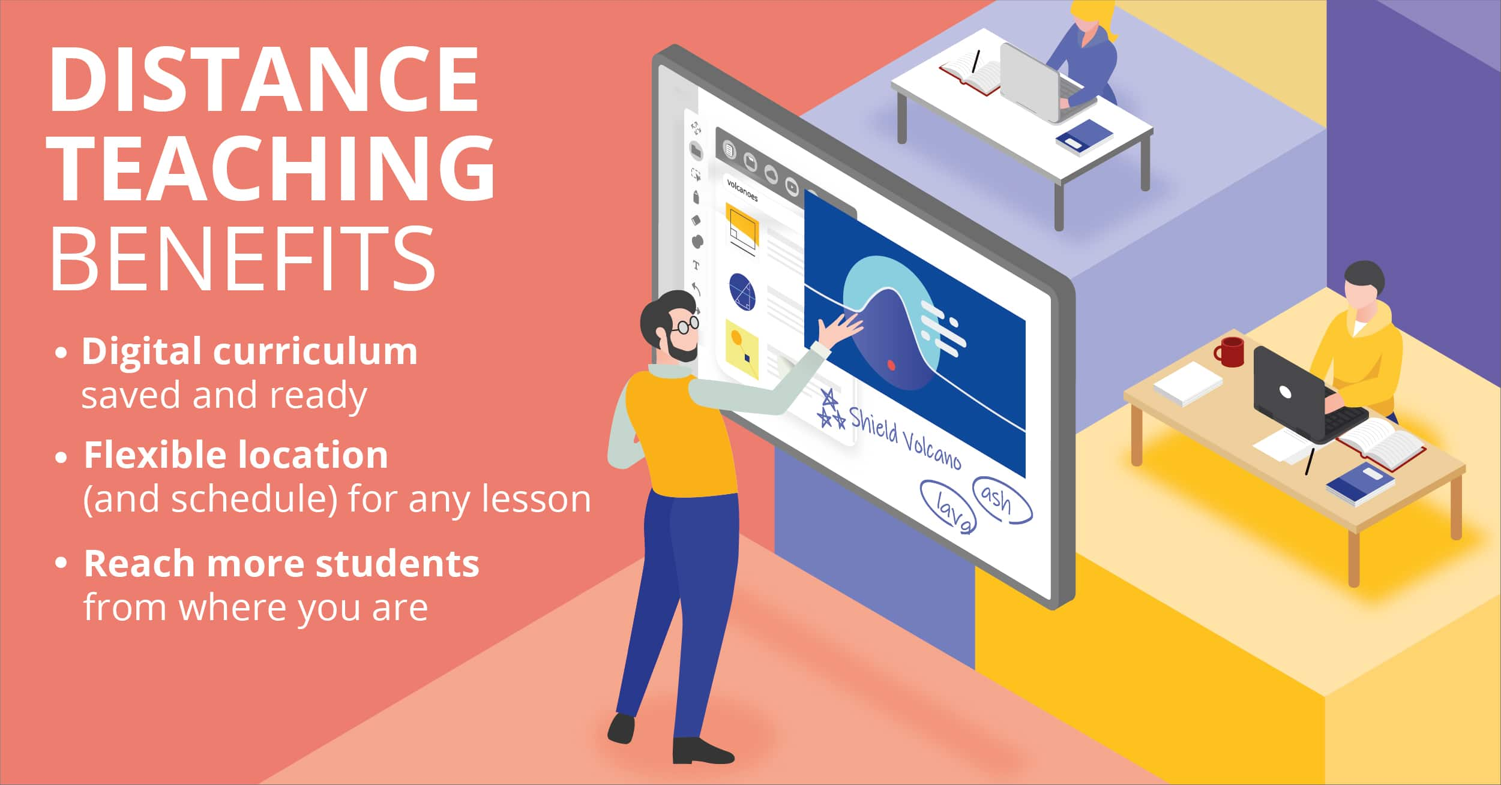
Category – Education
Team Name – Eduu
Team Leader Name –K ARUN
College Name – K S Institute of Technology
An idea to create an interface for the Educational institutes
to make effective e-Learning

Slide 2
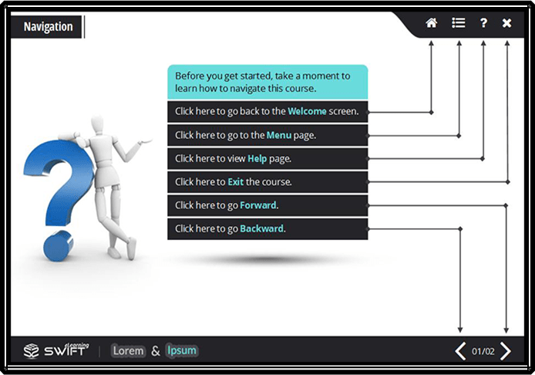
3 TIPS FOR EFFECTIVE USER INTERFACE DESIGN FOR ELEARNING

Slide 3
Keep it Simple
I’ve always been a big fan of simplicity in design. The funny thing about simplicity is how hard it is to achieve. It’s only after an eLearning course has gone through several iterations of design is simplicity ultimately obtained. Naturally, when you’re new to eLearning, it’s easy to overly complicate your course design—navigation might be clunky or there are several ways to advance from one slide to another.

Slide 4
Be Consistent
Good user interface design works on a subconscious level. For example, let’s say you build a course with orange buttons. Subconsciously, the learner establishes that orange = button, and they expect that for the duration of the course. The moment you introduce a button of a different color, let’s say green, the learner’s subconscious is now forced to determine the meaning of this new color. If no discernable meaning exists, it can ultimately confuse and distract the learner.

Slide 5
Test Your Work
The development of an eLearning course is a lot like engineering a piece of machinery—you have a lot of moving parts that must work together flawlessly. You don’t want to wait until you’ve delivered your course to your learners to learn that something doesn’t function properly!
When it comes to user interface design for eLearning, test your work early and often—it’s the reason all eLearning authoring tools have an option for previewing! When designing a highly-interactive eLearning course, get in the habit of previewing your work as you go. Does the course or interaction work as expected? What happens if you try to “break” the interaction or do something against the intended design? It’s through testing that you’ll discover “holes” or broken components of your course.

Slide 6
TEAM PROFILE:
KILARI ASHWIK
KILARI JASWANTH
B DEVA DEEKSSHITH
K ARUN

