Slide 1

BANDITS

Slide 2

ANUSHA B
BHUMIKA M
CHAITANYA SHIVARAJU
MANASA G L
TEAMMATES

Slide 3


T
R
A
N
S
F
O
R
M
I
N
G
INTO AMAZING
EXPERIENCES

Slide 4

E-LEARNING is not intended to replace conventional methods and learning in classrooms.
Its aim is to create an augmented learning environment where technology is used to deliver a combined range of teaching and learning techniques by maximizing the individual’s participation .
Achieving the goals in the learning and teaching process as a greener world.

Slide 5
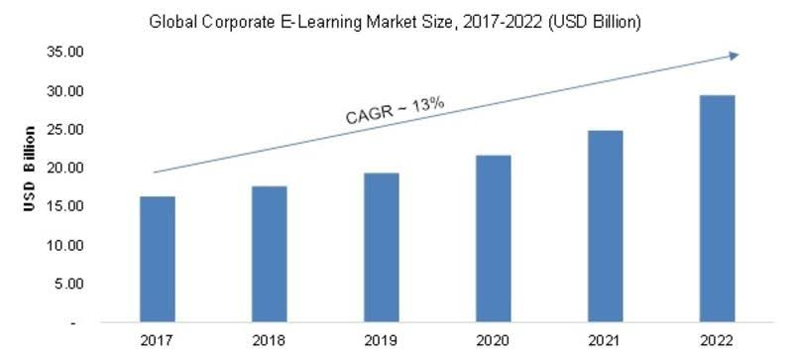
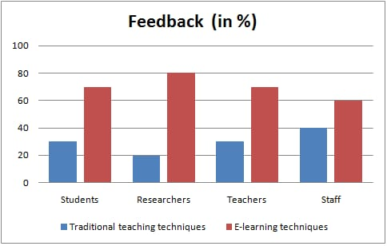

Slide 6
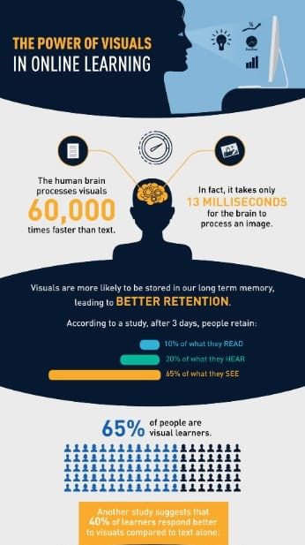
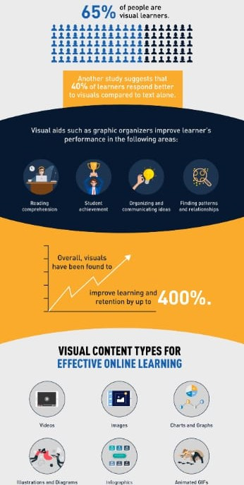

Slide 7
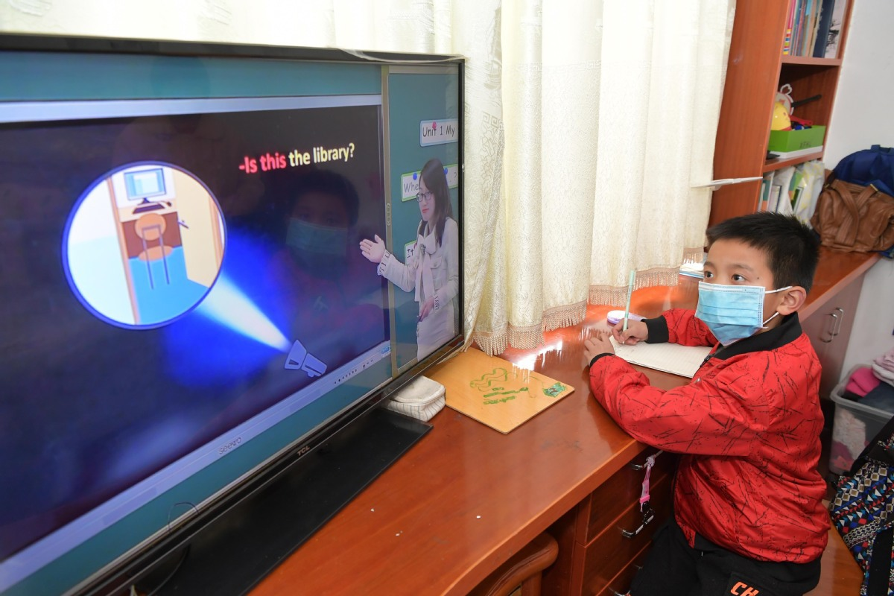
EFFECTIVE SOLUTION -

Slide 8

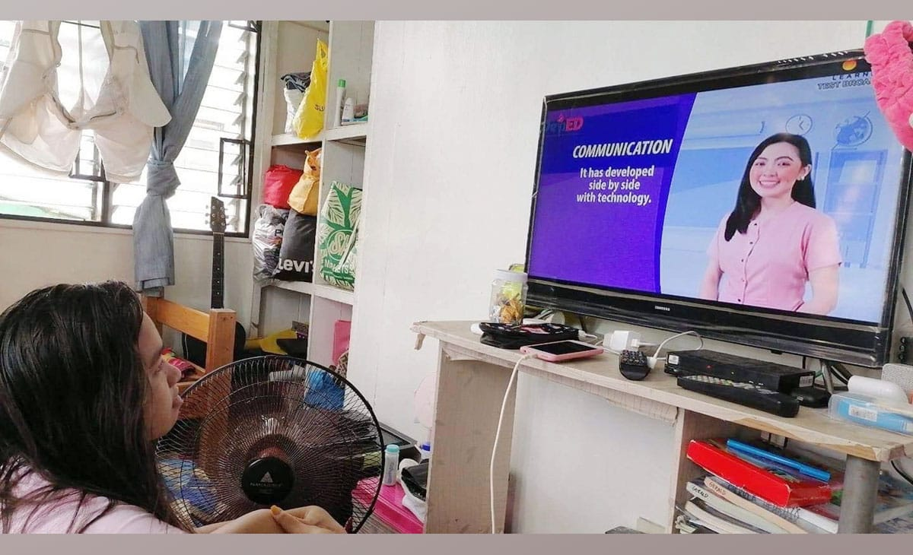
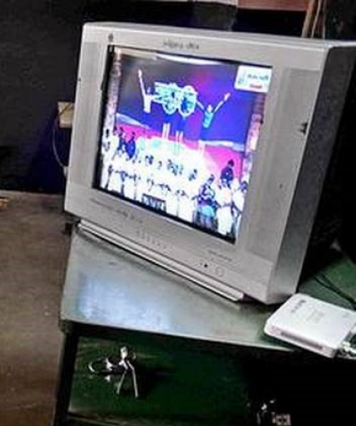
EFFECTIVE WAY OF E-LEARNING EXPERIENCE THROUGH TELEVISION

Slide 9

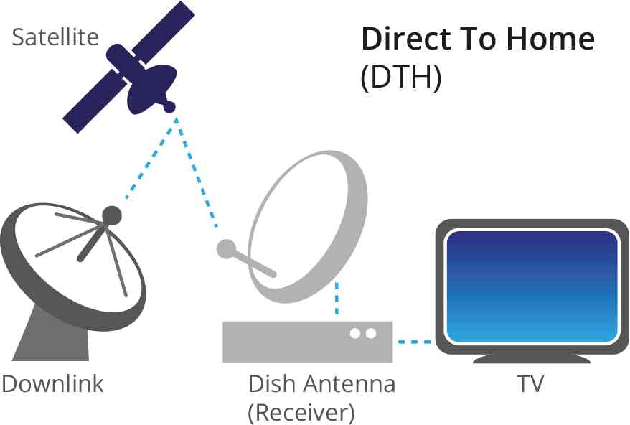



Creating a TV Channel
FREE CHANNEL
THROUGH SATELLITE
VIRTUALIZATION
TECHNOLOGY

Slide 10


EXISTING CHANNELS
OUR CHANNELS
Low display quality due to lack of special effects.
Sound quality is low
Absence of Augmented Reality
Channels will be provided only in particular medias.
May or may not applicable to all generations
We provide best display quality with advance features.
Best Sound quality with high frequency
We use Augmented Reality
Our CHANNEL will be provided in different media.
Beneficial to all generations

Slide 11





VIRTUAL VISUALIZATION THROUGH NETWORK AND SIGNALS
WELL ORGANISED
CHANNEL
USER
FRIENDLY
ACADEMICS
INCLUDING COMPETATIVE EXAMS
AND PERSONAL DEVELOPMENT
FREELY AVAILABLE

Slide 12
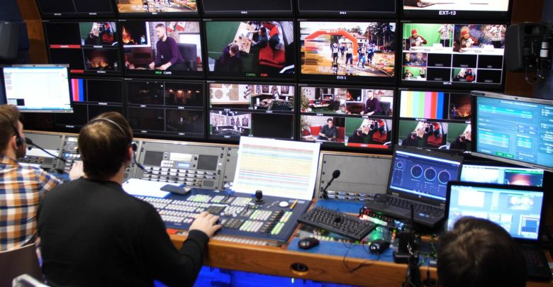
SPONSERS
SPONSOERS PRODUCTS WILL BE ADVERTIZED DURING THE
TEACHING PROCESS

Slide 13

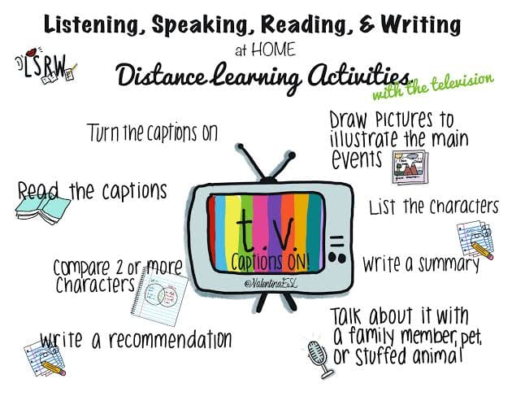
OUR CHANNEL

Slide 14
THANK YOU

