Slide 1

TEAM CODEZILLAS
TOPIC : EDUCATION

Slide 2
CONTENTS
Proposal……………………………………………………..3
Key Features of our website……………………………….4
Grades based Learning content ………………………….4
Login/Register section……………………………………...5
Assessment………………………………………………….5
Mentorship………………………………………………….6
Feedback…………………………………………………….6
Tools used to create the website…………………………….7

Slide 3
E-LEARNING PLATFORM TO ACCOMMODATE DIFFERENT LEARNER NEEDS :
Our E-learning interactive platform mainly focuses on learners with the following disabilities:
Dyslexia
Autism
Down Syndrome
The best way to train these kids is through a method called as Augmentative and Alternative Communication (AAC), which we have incorporated in our website. The website is designed with creative and contrasting color pallets.

Slide 4
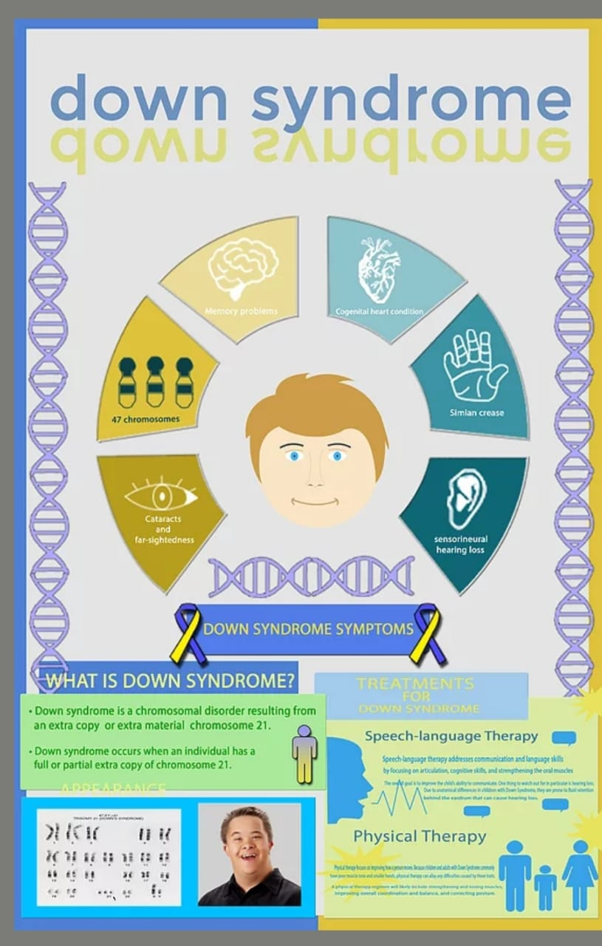

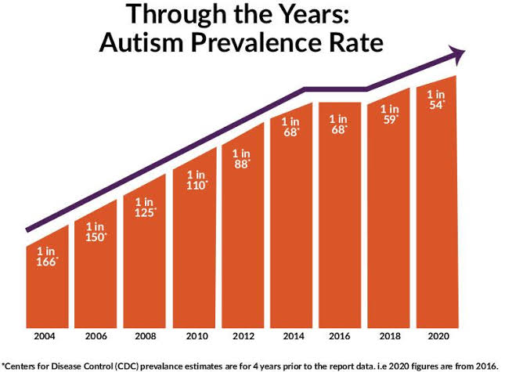

Slide 5
Key Features of our website:
Grades : We have divided the learning content based on two different age groups.
Grade - Ⅰ : Age (7-11) - These set of students are taught by flashcards with audios which includes:
1.Alphabets
2.Numbers
Grade - ⅠⅠ : Age (12-15) - These set of students are taught shapes, words, gestures and expressions.

Slide 6
Login/Register: The register and login page is setup in the homepage. We’ve incorporated backend to store the pupil and their parent’s credentials to monitor the performance of the pupil.
Assessment :
Interactive games and quiz have been designed to improve their knowledge and test their learning.
Such as the following:
Drag and Drop: The recognition of the image should be done and has to be dragged and dropped on the corresponding word.
Scrambled words: The letters in a word will be scrambled hence, the same has to be arranged in the correct order to obtain a meaningful word.
Pictionary: The picture will be displayed, the same should be visualized by the pupil and the relevant word/phrase has to be mentioned beside the respective images.

Slide 7
Performance analysis: This section includes graphical/statistical representation, where the parents can keep track of their children's performance in various sections of a subject.
Mentorship: The parents can schedule a meeting with the pupil’s mentor for online classes or for the counselling sessions for their children , the recorded sessions will be available on the same portal.
Feedback: Parents can give feedback from the portal, stating what sections he/she feels is not student friendly, or any such issues regarding the functionality of the platform, etc..

Slide 8
Tools used to create the website:
HTML
CSS
JavaScript
PHP
MySQL

Slide 9
THANK YOU

