Slide 1
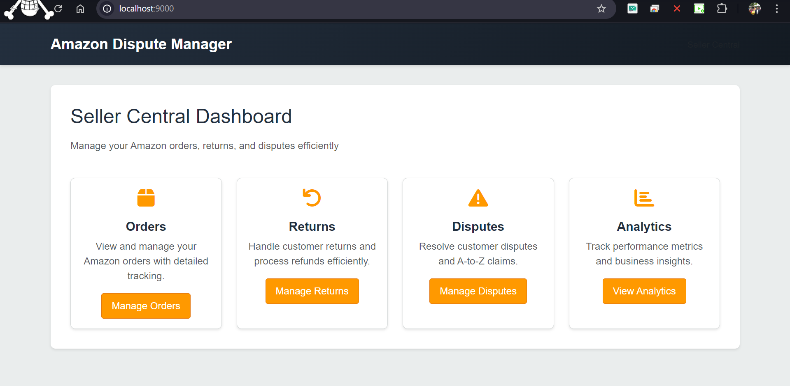
1. Homepage

Slide 2
1) Order Dashboard

Slide 3
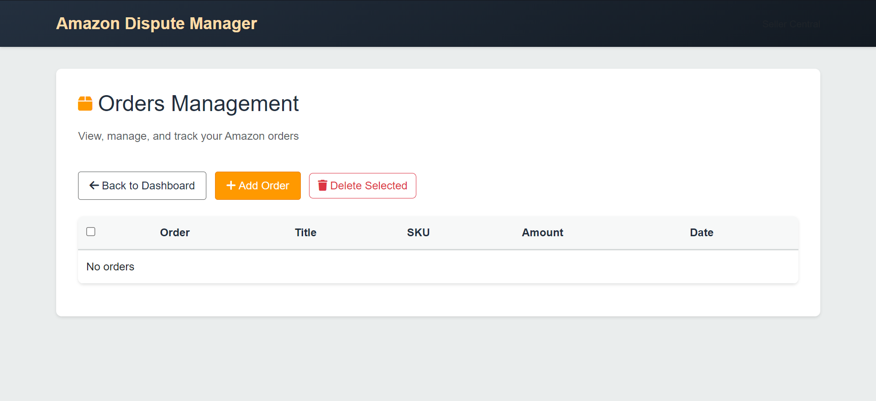
2. Order Management
On click adds new order

Slide 4
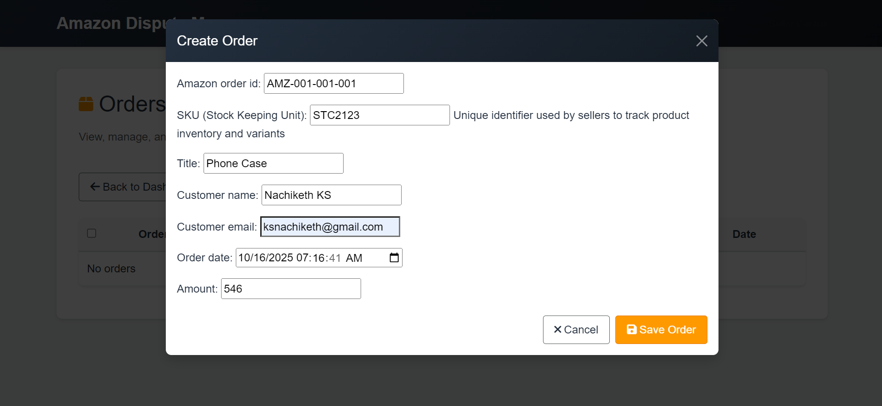
3. Create Order : User Form

Slide 5
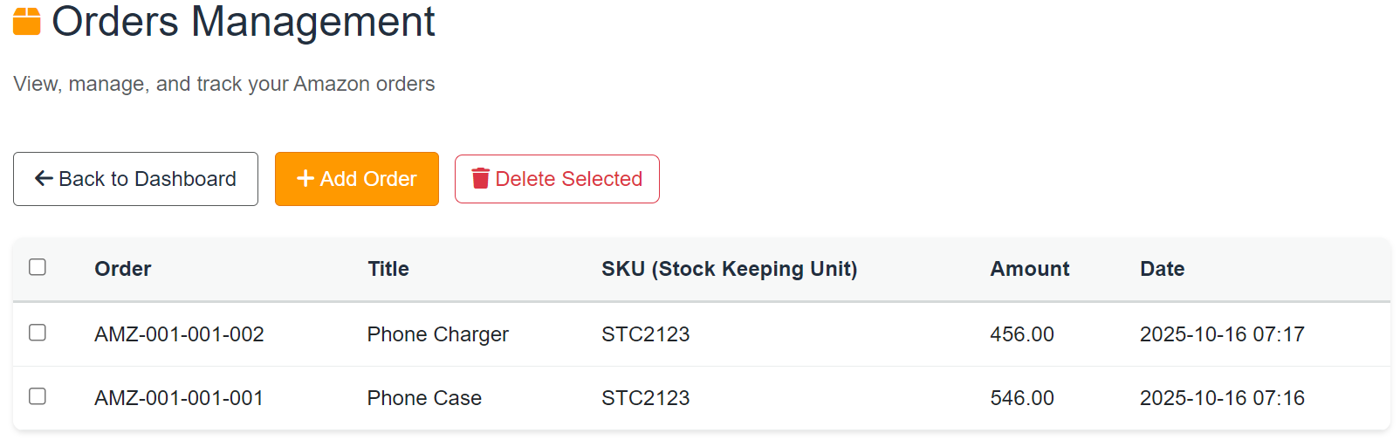
4. Orders Visible After Addition

Slide 6
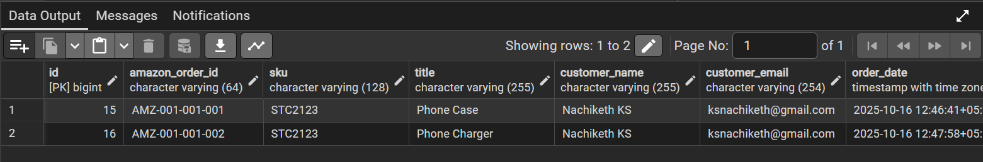
5. Orders Visible In Postgre After Addition

Slide 7
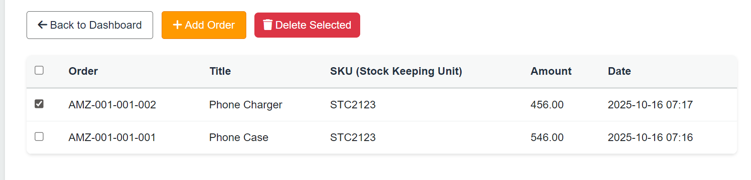
6. Orders Can be deleted : Will be reflected in Postgre as well

Slide 8
2) Return Dashboard

Slide 9
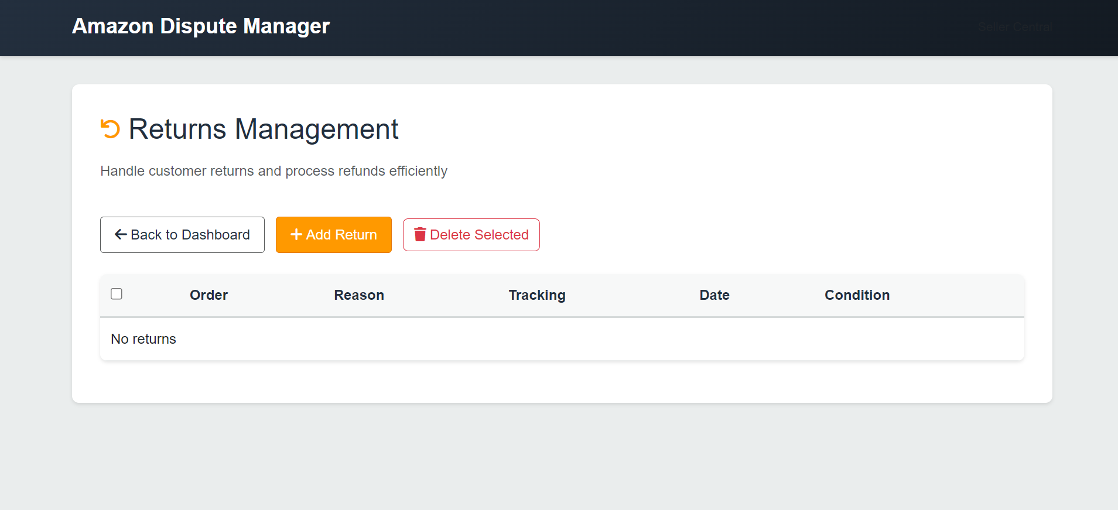
7. Returns

Slide 10
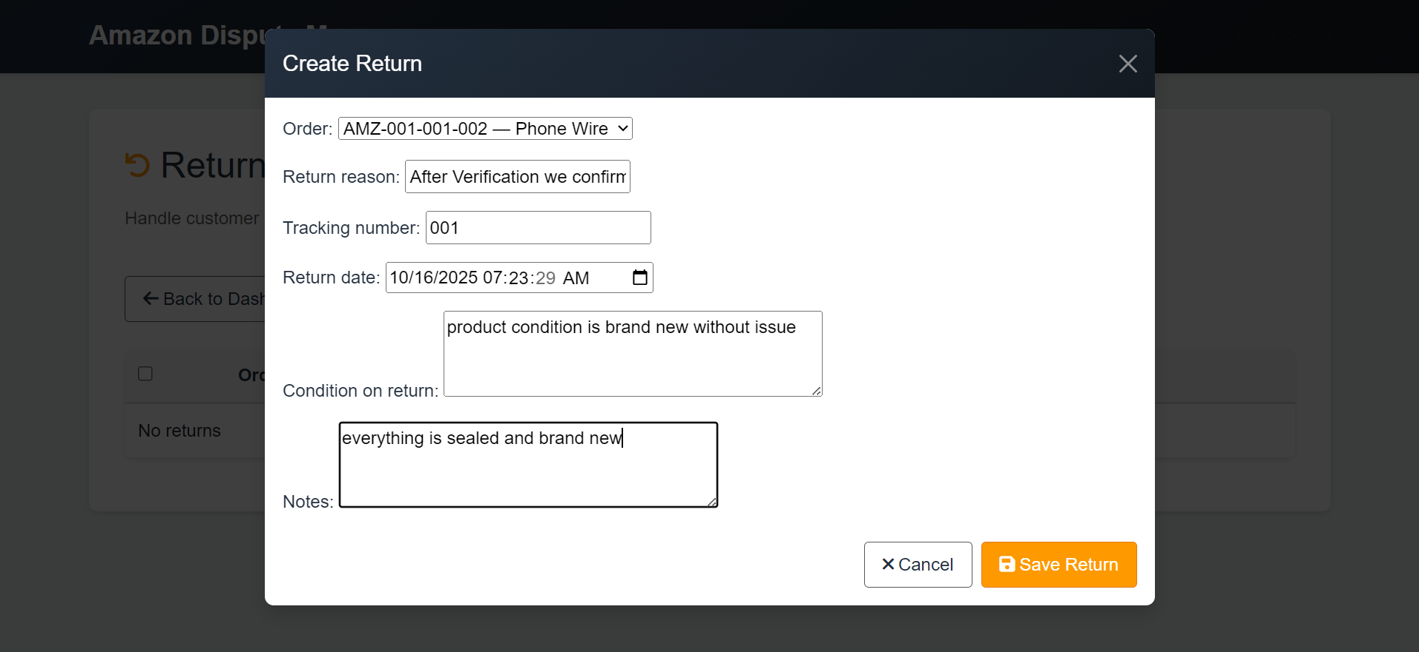
8. Create Return Form

Slide 11
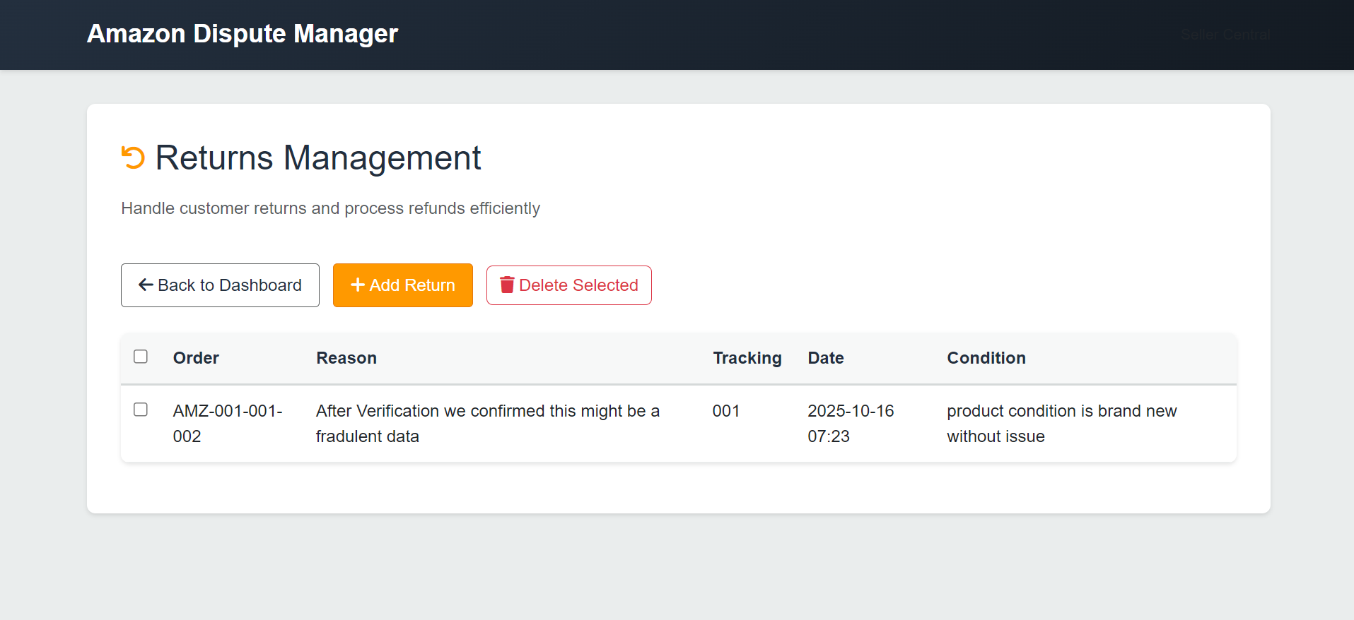
9. After Addition : Return Records Visible

Slide 12
3) Disputes Dashboard

Slide 13
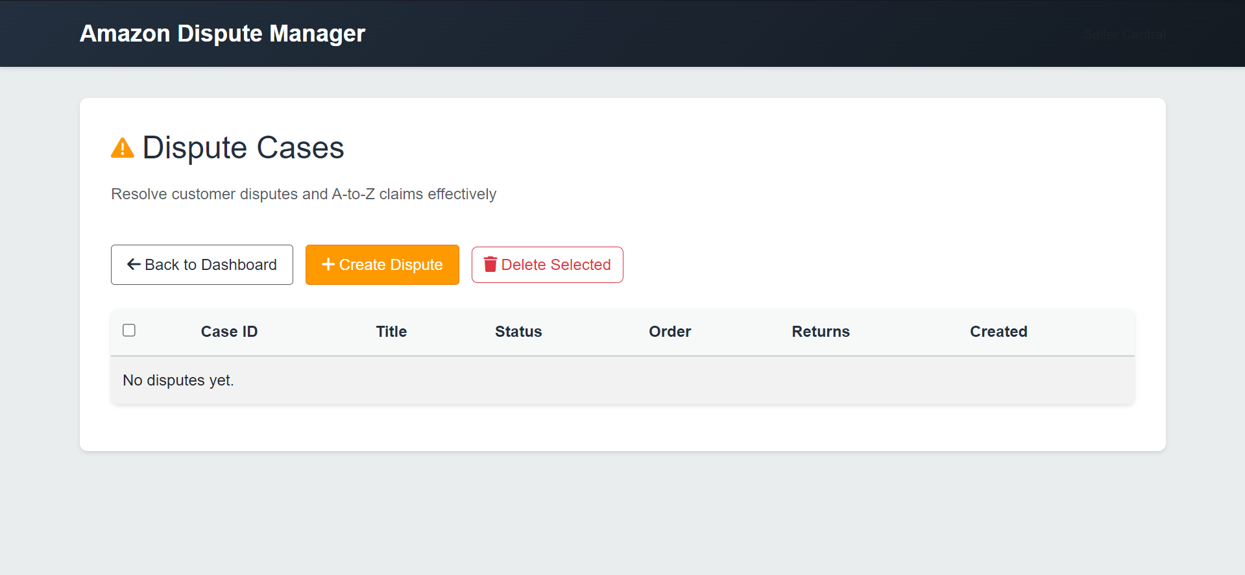
10. Disputes Cases

Slide 14
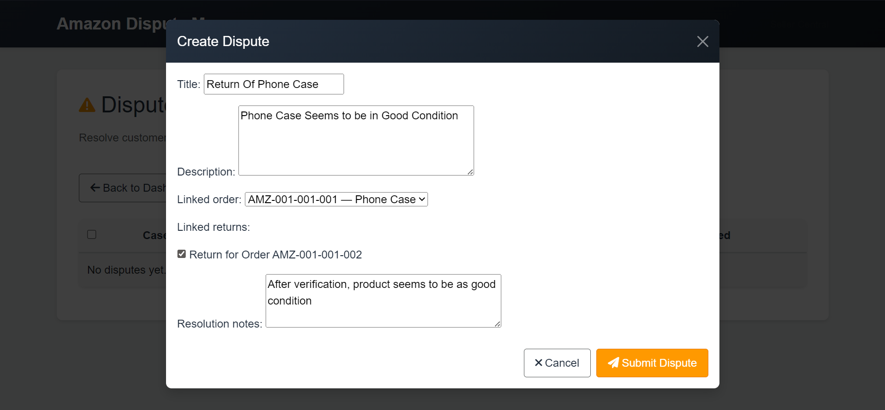
11. Disputes Cases Form

Slide 15
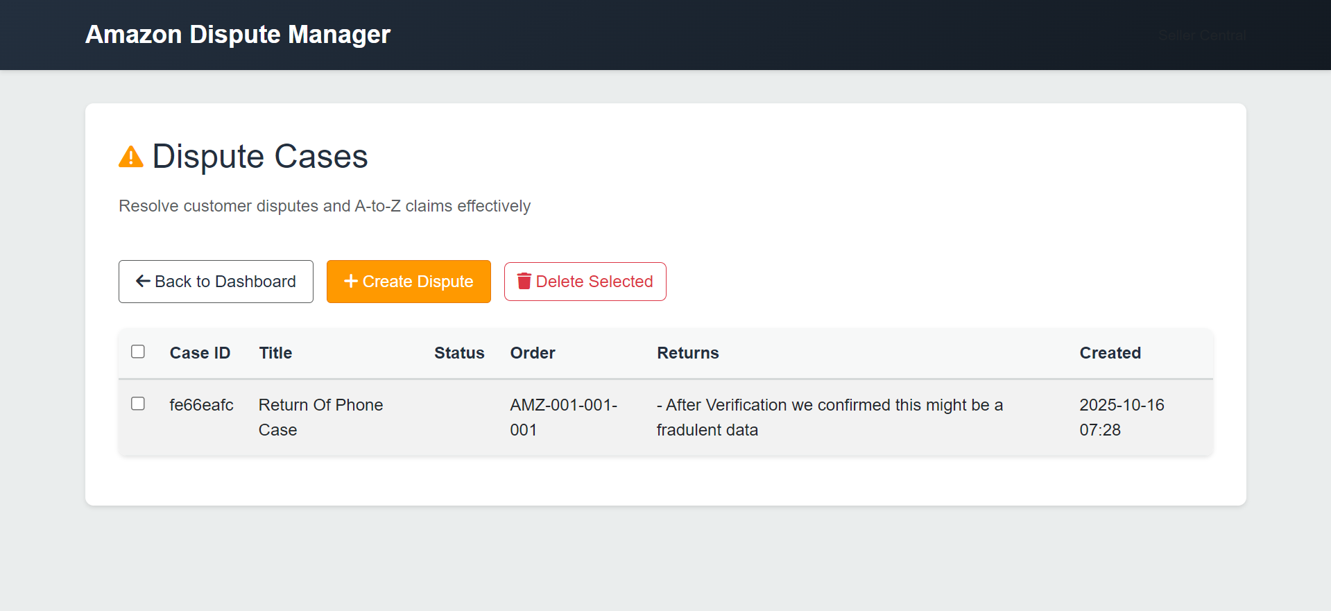
12. After Addition : Dispute Records Visible

Slide 16
4)Analytics (Bonus)

Slide 17
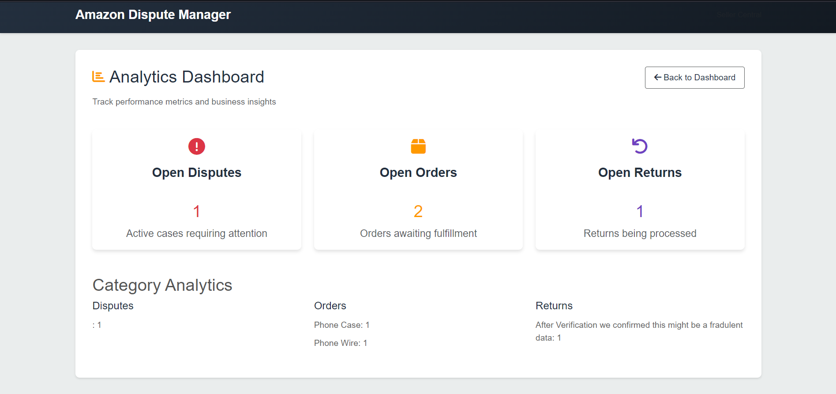
13. Analytics Dashboard

