Slide 1
Enhancing Multilingual Communication: A Machine Translation and Question Answering Initiative
Team Mates:
MANIDEEP NELAPATI - 11697590
THARUN KURAVADI SATHISH BABU – 11659825

Slide 2
Introduction
Topic/Area: Neural Machine Translation (NMT)
My project focuses on implementing a Neural Machine Translation (NMT) system using Transformer architecture.
NMT systems have revolutionized language translation tasks by leveraging deep learning techniques to translate text from one language to another.
The Transformer model, known for its self-attention mechanism, has significantly improved translation quality compared to traditional approaches.
My project aims to explore the design, implementation, and performance of such a system for translating Hindi text to English, with potential applications in cross-language communication and content localization.

Slide 3
Problem statement
The problem statement revolves around the challenge of building an accurate and efficient Neural Machine Translation (NMT) system specifically tailored for translating Hindi text to English.
The hypothesis is that by implementing a Transformer-based architecture and leveraging a large bilingual corpus, we can achieve higher translation accuracy and faster inference times compared to conventional approaches.
The objective is to address the limitations of existing translation systems, such as poor performance with complex sentence structures and limited vocabulary coverage, by harnessing the power of deep learning and attention mechanisms.

Slide 4
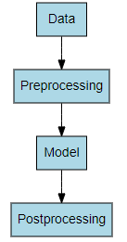
Methodology:
Data Loading and Preprocessing:
Load the bilingual dataset consisting of Hindi and English sentence pairs.
Preprocess the data by removing punctuation, tokenizing, and converting text into numerical representations.
Model Training:
Implement a Transformer-based neural network architecture.
Train the model on the preprocessed dataset using an optimization algorithm such as Adam.
Evaluation:
Evaluate the trained model on a separate validation set to measure translation accuracy.
Analyze the performance of the model using various metrics such as BLEU score and translation accuracy.
Inference:
Perform inference on new Hindi sentences to generate English translations.
Assess the quality of translations and compare them with ground truth references.

Slide 5
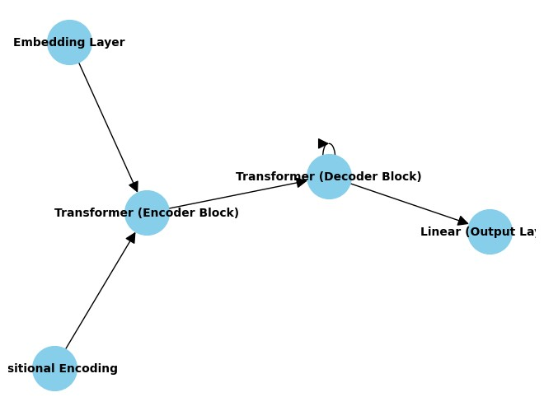
Architecture Diagram of Model
Embedding Layers:
Convert input tokens into dense numerical representations (embeddings) for both Hindi and English sentences.
Positional Encoding:
Inject positional information into the embeddings to capture the order of words in the input sequences.
Transformer Encoder:
Encode the input Hindi sequence using a stack of encoder layers, each equipped with multi-head self-attention mechanisms and feedforward neural networks.
Transformer Decoder:
Decode the encoded representation into the output English sequence using a stack of decoder layers.
Output Layer:
Predict the probability distribution of the next word in the output sequence using a linear layer followed by softmax activation.

Slide 6
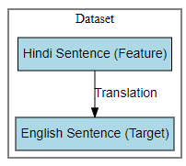
Description/Representation of Dataset:
The dataset consists of bilingual sentence pairs, with each pair containing a Hindi sentence and its corresponding English translation. Here's an overview of the dataset representation:
Format: CSV (Comma-Separated Values)
Columns:
Hindi Sentence: Contains the original Hindi text.
English Sentence: Contains the corresponding English translation.

Slide 7
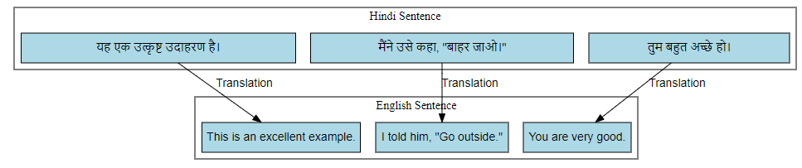

Slide 8
Data Pre-processing:
The data pre-processing stage involves preparing the raw dataset for model training by applying various transformations and cleaning steps. Here's an overview of the pre-processing pipeline:
Tokenization: Split each sentence into individual words or tokens to facilitate further processing.
Cleaning: Remove punctuation, special characters, and non-alphanumeric symbols from the text to ensure uniformity and readability.
Normalization: Convert all text to lowercase to standardize the representation of words and reduce vocabulary size.
Numerical Encoding: Map words to numerical indices using vocabulary mappings to represent text data in a format suitable for model input.
Padding: Ensure all sequences have the same length by padding shorter sentences with a special token (e.g., <PAD>), allowing for efficient batch processing during training.
Splitting: Divide the dataset into training, validation, and testing sets to evaluate model performance and generalization ability.

Slide 9
Implementation-Pseudocode
Initialize vocabulary objects for Hindi and English.
Define functions for sentence length, mixed language detection, and sentence preprocessing.
Load and clean the dataset, discarding sentences exceeding a predefined maximum length and those containing mixed languages.
Tokenize and preprocess sentences, adding special tokens for start-of-sequence, end-of-sequence, and padding.
Convert sentences to tensors, mapping words to numerical indices based on vocabulary mappings.
Define the Transformer model architecture, including embedding layers, positional encoding, transformer layers, and output linear layer.
Implement methods for generating masks for padding and future tokens.
Train the Transformer model using the Adam optimizer and cross-entropy loss function.
Iterate through batches of training data, computing gradients, and updating model parameters.
Save the trained model for future use.
Implement translation functions to predict English translations for Hindi sentences.
Utilize Google Translate API to translate Hindi sentences to Tamil for evaluation.
Evaluate translation accuracy by comparing predicted translations with ground truth English sentences.

Slide 10
Implementation(cont.)
Data Loading and Preprocessing: Load the dataset and preprocess the text by removing punctuation, tokenizing, and converting words to numerical indices.
Model Architecture Definition: Define the architecture of the Transformer model, including embedding layers, positional encoding, transformer layers, and output linear layer.
Training: Train the Transformer model using the Adam optimizer and cross-entropy loss function. Iterate through batches of training data, compute gradients, and update model parameters to minimize the loss.
Translation: Implement translation functions to predict English translations for Hindi sentences. Additionally, use the Google Translate API to translate Hindi sentences to Tamil for evaluation purposes.
Evaluation: Evaluate translation accuracy by comparing predicted translations with ground truth English sentences. Calculate performance measures such as accuracy and visualize the results for analysis.

Slide 11
Implementation Libraries:
PyTorch: Used for building and training the Transformer model.
NLTK: Utilized for text preprocessing tasks such as tokenization and stop word removal.
Googletrans: Integrated for translating Hindi sentences to Tamil for evaluation purposes.
Wikipedia-API: Employed for retrieving Wikipedia summaries for text translation testing.

Slide 12
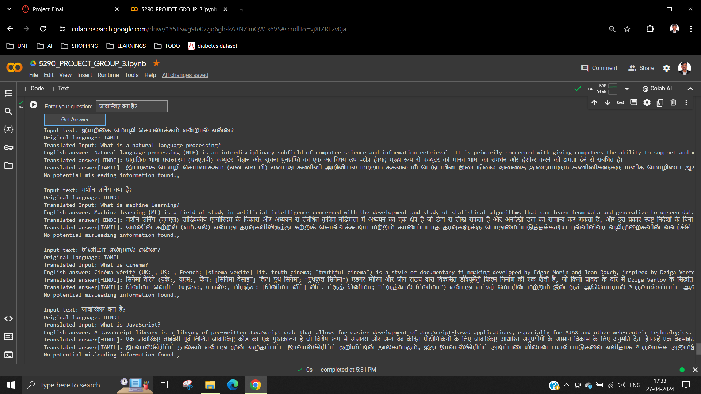
Results
Performance Measures:
Translation Accuracy: Measured the accuracy of translations on a validation set by comparing the predicted English translations with the ground truth. Higher accuracy indicates better translation performance.

Slide 13
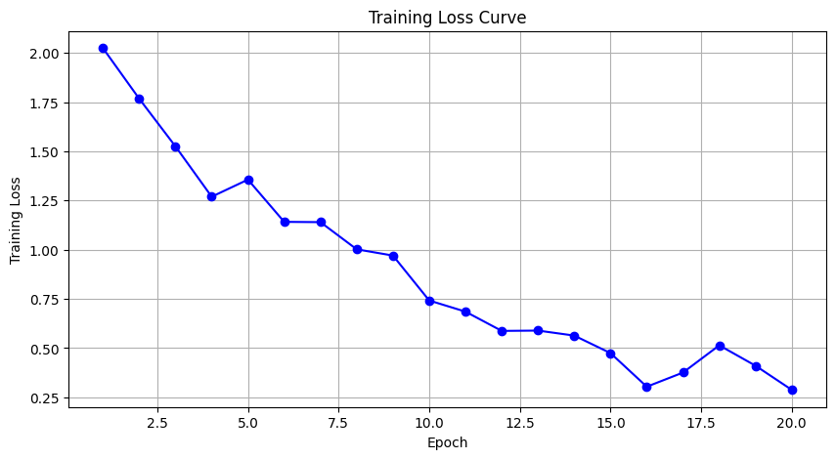
Results
Visual Diagrams for Results:
Training Loss Curve: Plot the training loss curve over epochs to visualize the convergence of the model during training. Lower loss values indicate better convergence.
Explanation:
Training Loss Curve: The training loss curve illustrates the model's convergence during training. A decreasing curve indicates that the model is learning and improving over time. Lower loss values signify better convergence and indicate that the model is effectively minimizing prediction errors.

Slide 14
Project Management: Implementation Status Report
THARUN KURAVADI SATHISH BABU
Responsibilities: Data Preprocessing and Visualization Analysis
Contributions: Loaded and cleaned datasets, performed tokenization, built vocabularies for Hindi and English, and visualized data distributions, training loss curves, and translation examples to analyze model performance.
MANIDEEP NELAPATI
Responsibilities: Transformer Model Implementation and Translation Function
Contributions: Implemented Transformer model architecture using PyTorch, including embeddings, attention mechanisms, and training loop. Developed a function to translate Hindi sentences to English using the trained model, integrating NLP techniques.

Slide 15
Issues/Concerns:
Resource Constraints: Limited computational resources impacted the speed of training and experimentation.
Data Quality: Some issues were encountered during data preprocessing, including missing values and inconsistent formatting, which required manual intervention.
Model Complexity: The complexity of the transformer model architecture posed challenges in terms of optimization and debugging.

Slide 16
References:
Vaswani, A., Shazeer, N., Parmar, N., Uszkoreit, J., Jones, L., Gomez, A. N., ... & Polosukhin, I. (2017). Attention is all you need. In Advances in neural information processing systems (pp. 5998-6008).
Devlin, J., Chang, M. W., Lee, K., & Toutanova, K. (2018). BERT: Pre-training of deep bidirectional transformers for language understanding. arXiv preprint arXiv:1810.04805.
Brown, T. B., Mann, B., Ryder, N., Subbiah, M., Kaplan, J., Dhariwal, P., ... & Agarwal, S. (2020). Language models are few-shot learners. arXiv preprint arXiv:2005.14165.
Pedregosa, F., Varoquaux, G., Gramfort, A., Michel, V., Thirion, B., Grisel, O., ... & Vanderplas, J. (2011). Scikit-learn: Machine learning in Python. Journal of machine learning research, 12(Oct), 2825-2830.
Hunter, J. D. (2007). Matplotlib: A 2D graphics environment. Computing in science & engineering, 9(3), 90-95.
Kingma, D. P., & Ba, J. (2014). Adam: A method for stochastic optimization. arXiv preprint arXiv:1412.6980.

Slide 17
THANK YOU

