Slide 1
Exploring Global Data Science Trends
Investigating the Relationship Between Population and Data Science Salaries

Slide 2
Introduction
Domain The domain of this project revolves around data science and employment trends, particularly focusing on the relationship between population demographics and data science salaries globally.

Slide 3
Workflow Diagram &Explanation
Data Collection: Gathered "Data Science Salaries" and "Countries Table" datasets.
Data Loading: Used Pandas to import datasets into Python for analysis.
Data Cleaning: Addressed missing values, outliers, and inconsistencies for data accuracy.
Data Merging: Combined datasets based on shared attributes like "employee_residence" and "country."
Data Analysis: Employed analytical techniques to explore global trends in data science salaries and employment, including examining variations in salaries across countries and analyzing data scientist demographics.
Data Visualization: Utilized Matplotlib and Seaborn to create visual representations of analyzed data for easier interpretation and understanding of trends.

Slide 4
Data Abstraction:
Dataset (Type and Attributes):
The datasets used are "Data Science Salaries" and "Countries Table," both of which are in CSV format.
Data Science Salaries Dataset:
Contains information about data science salaries, including attributes like employee_residence, job_title, and salary_in_usd etc.
Countries Table Dataset:
Contains information about countries, including attributes like country and population data for the years 2022 and 2023 etc.
Number of Records:
The number of records in each dataset will be provided to give an idea of the dataset's size and scope(Countries Table Dataset have 234 records, Data Science Salaries Dataset 6599)

Slide 5
DATA TRANSFORMATION:
Merging Datasets: Combined "Data Science Salaries" and "Countries Table" based on common attributes like "employee_residence" and "country" to facilitate comprehensive analysis.
Handling Missing Values:Addressed missing values through data cleaning techniques, ensuring data accuracy for analysis.
Standardizing Data Formats:Ensured consistency and comparability across datasets by standardizing data formats, such as converting salary data to a common currency format like USD.
Creating Derived Variables:Enriched analysis by deriving variables from existing attributes, offering nuanced insights into population demographics and data science salaries.

Slide 6
Task Abstraction
The task involves analyzing the relationship between population size and data science demand and salary structures globally.
Actions include merging datasets, investigating the relationship between population and the number of data scientists employed, analyzing variations in data science salaries across countries, and exploring local trends in data science demand and salary structures.

Slide 7
Workflow DiagramW22W
Start Analysis
Merge Datasets
Analysing variations in Data Science Salaries Across Counties
Investigating Relationship Between Population and Data Scientists Employed
Data visualization
Explore Local Trends in Data science Demand and salary Structures
End Analysis

Slide 8
Implementation using Tools
1.Scatter Plot for Population vs Number of Data Scientists:
Tool Used: Seaborn and Matplotlib
Implementation: Seaborn's scatterplot() function is used to create the scatter plot, and Matplotlib is employed for labeling axes and adding a legend.
Bar Plot for Average Data Science Salary by Country:
Tool Used: Seaborn and Matplotlib
Implementation: Seaborn's barplot() function is utilized to generate the bar plot, and Matplotlib is used for customizing labels, titles, and rotation of x-axis ticks.
Line Plot for Local Trends in Data Science Salary:
Tool Used: Seaborn and Matplotlib
Implementation: Seaborn's lineplot() function is employed to create the line plot, and Matplotlib is used for labeling axes, adding a title, and managing the legend's placement.
Interactive Features with D3.js: Although D3.js is not directly used in the Python code, it is employed to create interactive features for data visualization on web platforms. D3.js allows for the creation of dynamic and interactive visualizations that can enhance the exploration and understanding of data.

Slide 9
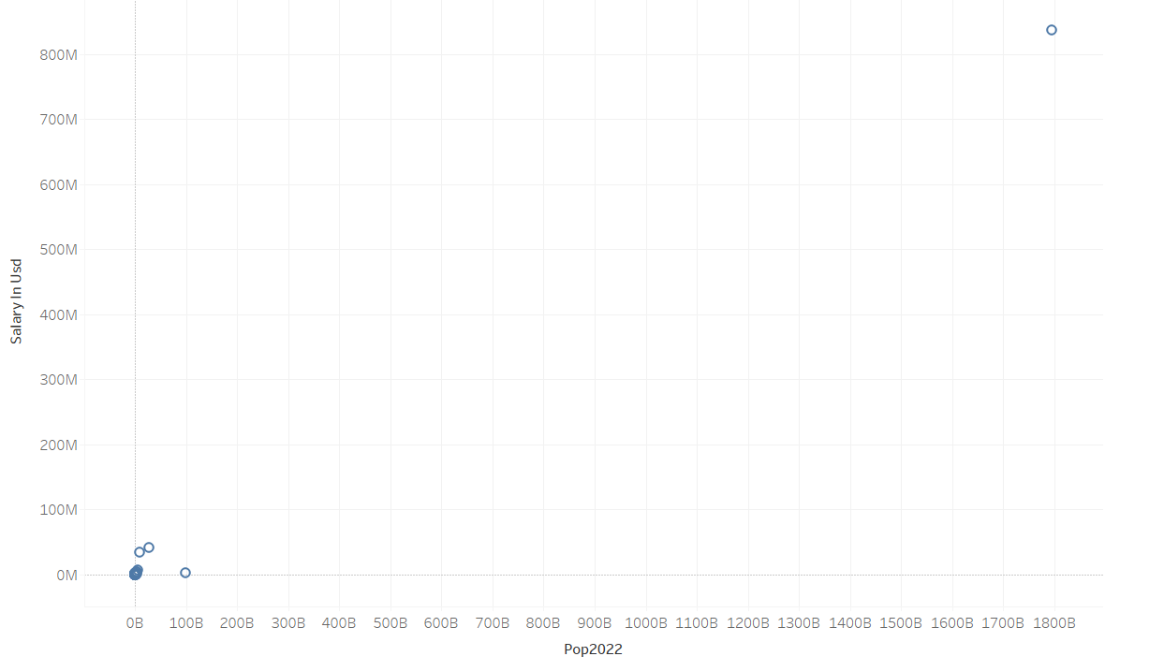
Result for Analysis using Tableau:
This plot aims to explore the relationship between the population size of countries and the number of data scientists employed in each country
Tableau visualization:

Slide 10
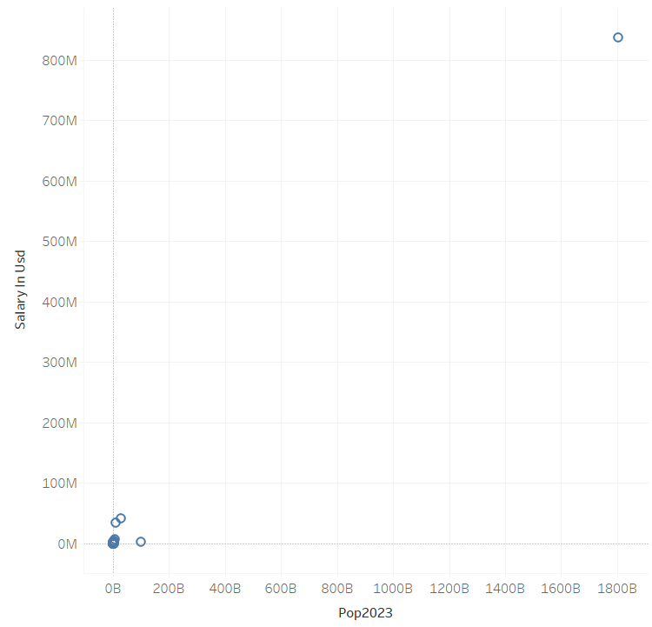
Population vs. Data Science Salary (2023) in tableau Two scatter plots are created where one for population data in 2022 and another for population data in 2023. The x-axis represents population size, while the y-axis represents the number of data scientists. Each point represents a country, and the legend distinguishes between the two years

Slide 11
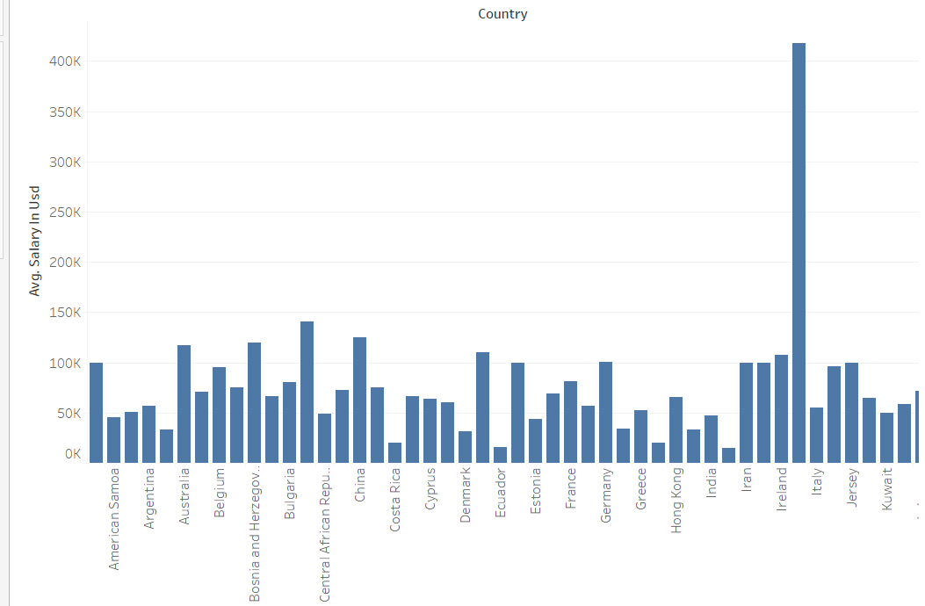
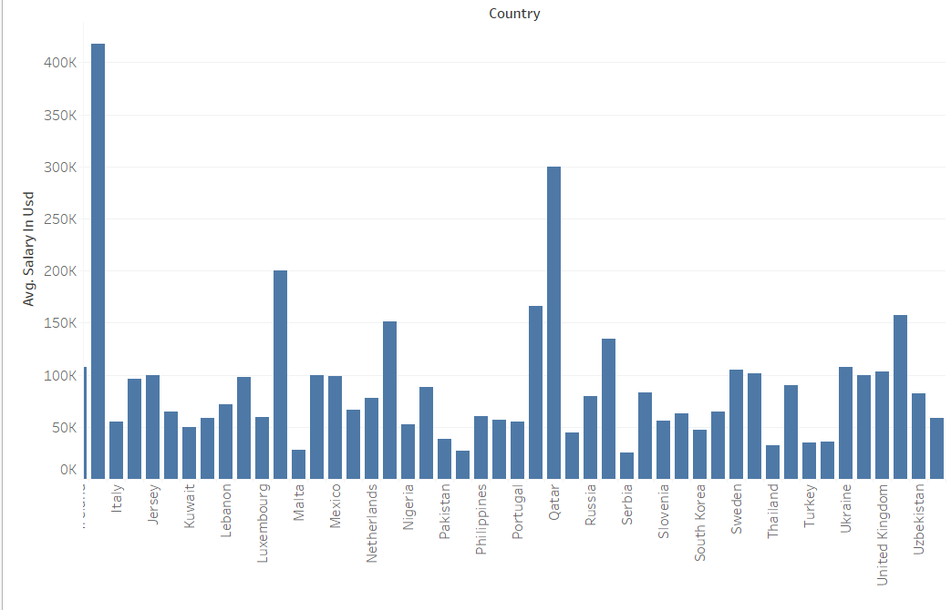
AVERAGE DATA SCIENCE SALARY BY COUNTRY: This plot visualizes the average data science salary across different countries.A bar plot is genearated . The x-axis displays the countries,and the y-axis shows the average salary in USD. The bars represent the average salary for each country,and the plot is rotated for better readability.

Slide 12
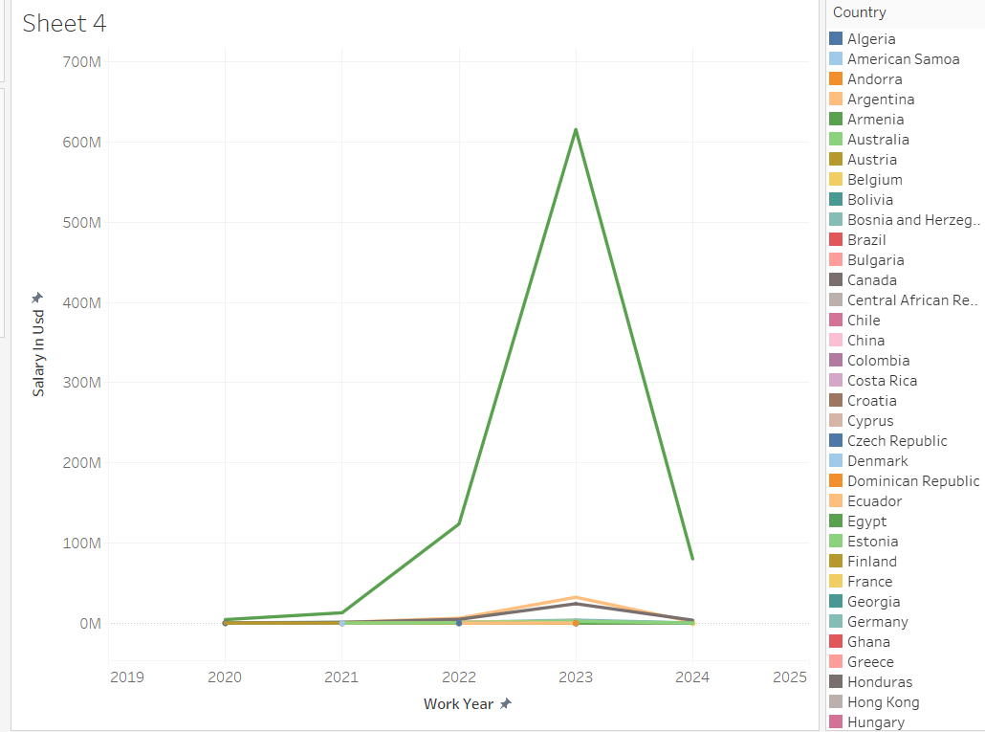
LOCAL TRENDS IN DATA SCIENCE SALARY This plot examines the local trends in data science demand and salary structures over the years for each country. A line plot is created. The x-axis represents the years, the y-axis shows the average salary in USD, and each line represents a country. Different colors are used to distinguish between countries, and a legend is added to identify each country’s trend over time.

Slide 13
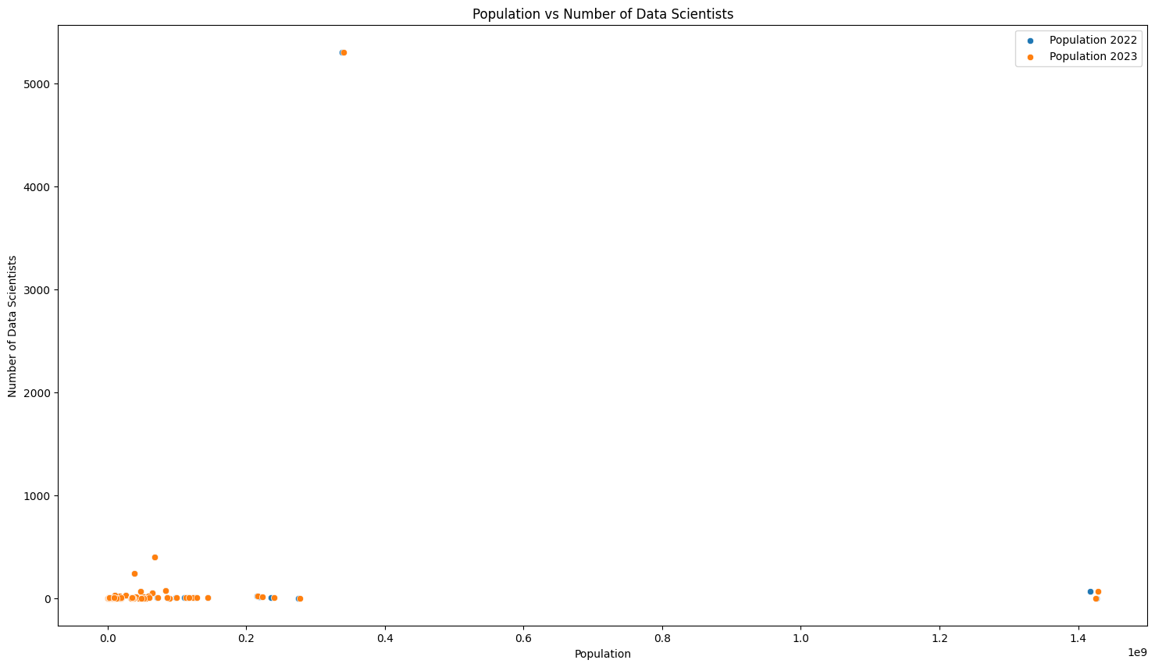
Result for Analysis using python code:
This is the scatter plot that shows the number of data scientists and the population size for two years, 2022 and 2023. All the orange points are shows in population 2023 and the blue points are shows in the population 2022.

Slide 14
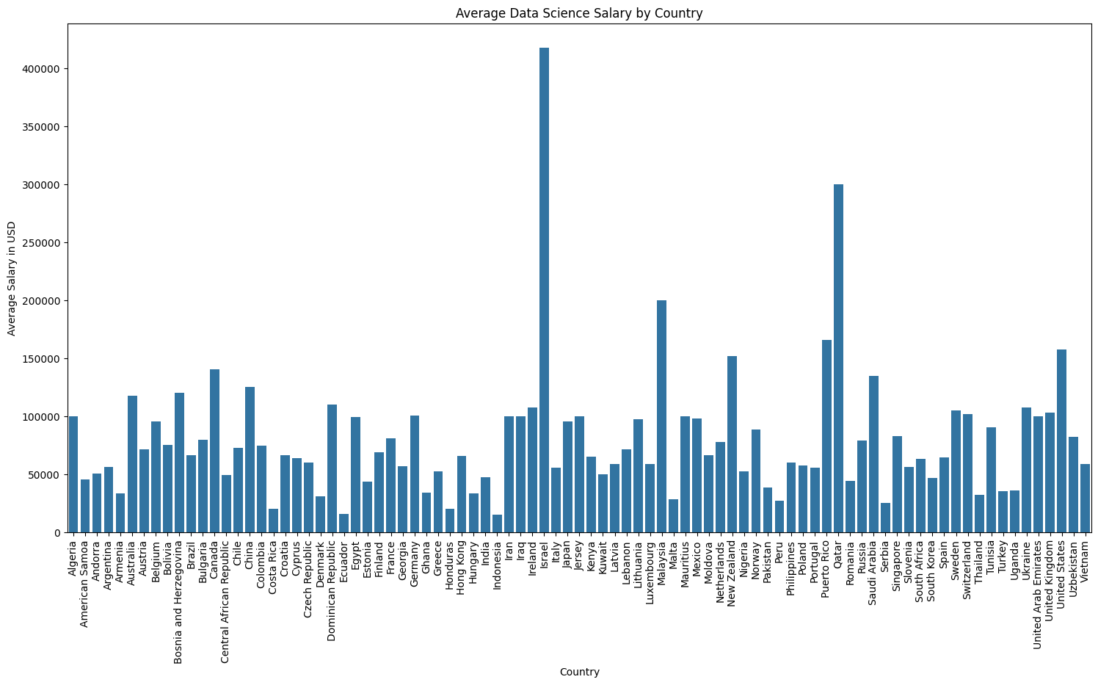
This is the bar plot that shows the countries and the average salary of data science jobs by country in US dollars. Average salary has impact of parity rate and demand for data science skills.

Slide 15
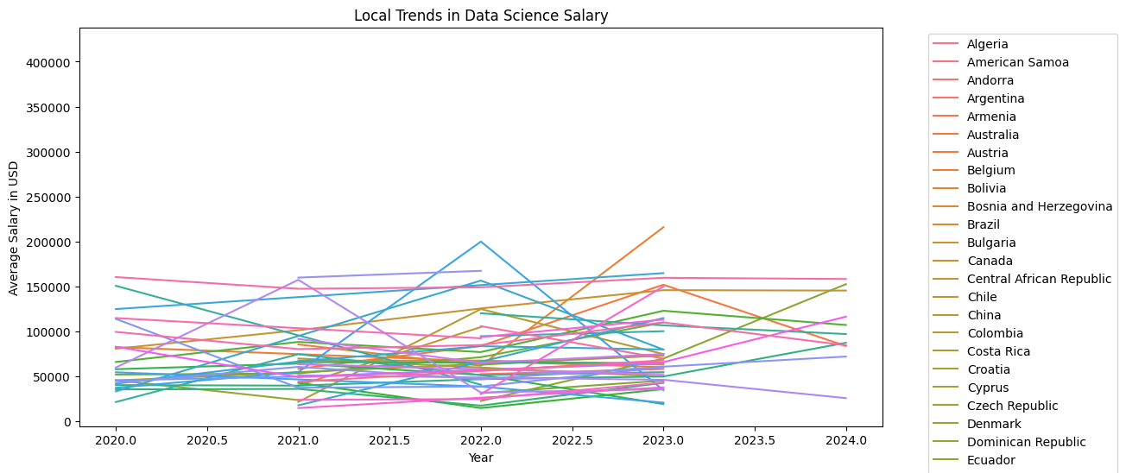
This is the line graph that shows the trends of average data science job salaries across the different countries from the year 2020-2024. There is a wide range of salary trends across different countries.

Slide 16
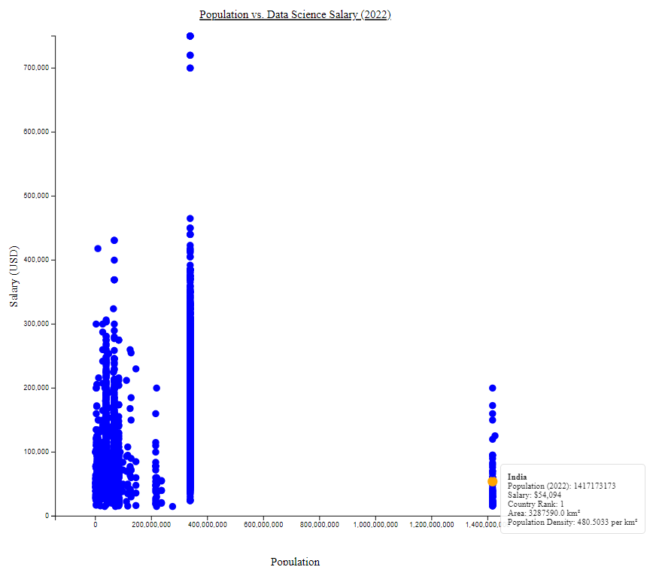
D3.js visualization: Two scatter plots are created where one for population data in 2022. The x-axis represents population size, while the y-axis represents the number of data scientists. Each point represents a country. On hovering it displays features of particular countries' population, salary, country Rank, Area and Population density. FOR D3.js vis Weblink: http://localhost:63342/datavis/web.html?_ijt=qaq179ruemh0d8vf6hgi2mrsbq

Slide 17
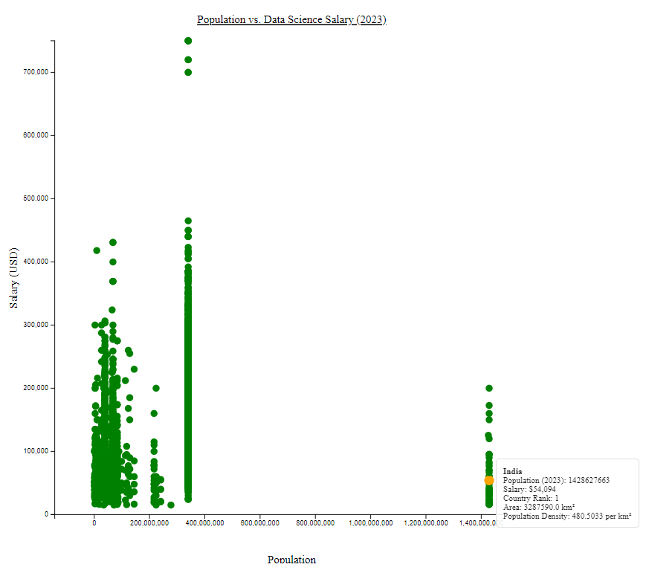
Population vs. Data Science Salary (2023) in D3.js The data point for India is highlighted on the graph. It shows that in India (population of 1,428,627,663 in 2023), the average data science salary is $54,094. This is the highest data science salary listed although it isn't necessarily the peak salary

Slide 18
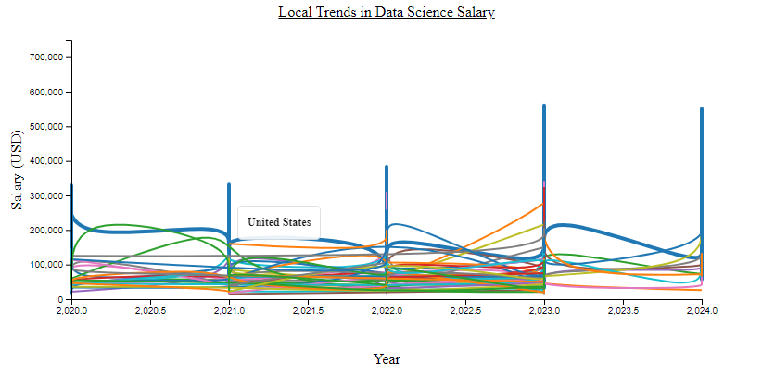
It shows a relationship between two variables - data science salary (likely average) and population. Each data point likely represents a country. The highlighted point emphasizes a specific country, probably here in plot its United States. It shows United States's population on the horizontal axis and its corresponding average data science salary on the vertical axis.

Slide 19
Contributions:
THARUN RAMULA
Responsibility: Data Collection and Preparation, Documentation and Presentation
Contribution: Collected and loaded datasets, performed data cleaning and merged datasets based on common attributes. Prepared project documentation, including workflow diagrams and implementation status reports, and contributed to the creation of the PowerPoint presentation summarizing the project findings.
KEERTHI REDDY PAPIAHGARI
Responsibility: Data Analysis and Visualization in code
Contribution: Investigated the relationship between population size and the number of data scientists employed, analyzed variations in data science salaries across countries, and created visualizations using Python with Matplotlib and Seaborn.
THARUN KURAVADI SATHISH BABU
Responsibility: Data Analysis and Visualization in tableau
Contribution: Implemented Tableau visualization to understand the relation between population in countries and their salaries, and also relationship between work year and its salary from the datasets.
LAKSHMI DEEPIKA PAGADALA
Responsibility: Data Analysis and Visualization in d3.js
Contribution: Implemented interactive features using D3.js for visualizations, integrated visualizations into a webpage for presentation, and ensured the smooth deployment of the project.

Slide 20
References:
https://www.prb.org/resources/human-population/
https://researchfdi.com/resources/articles/the-effects-of-globalization-on-economic-development/
https://www.kaggle.com/datasets/rajkumarpandey02/2023-world-population-by-country
https://www.kaggle.com/datasets/sazidthe1/data-science-salaries

Slide 21
THANK YOU

