Slide 1
Bibbin’s Adventures
(CSCI 205 Edition)
PNNSD (Post Neural Net Stress Disorder)
Kartikeya Sharma, Logan Stiles,
Claudia Shrefler, Jason Kang

Slide 2
Need a reason not to do your homework?
Play Bibbin’s Adventures (CSCI 205 Edition)!
Player can immerse themselves in the game
Explore alternate reality based off a familiar context

Slide 3
RPG (Role-Playing Game)
Inspired by Dragon Quest and Freddi Fish
User can:
Choose character
Talk with NPCs (non-playable characters)
Battle NPCs
Use equipment / weapons
Move between rooms
DEFEAT FINAL BOSS TO WIN!

Slide 4
UML Analysis

Slide 5
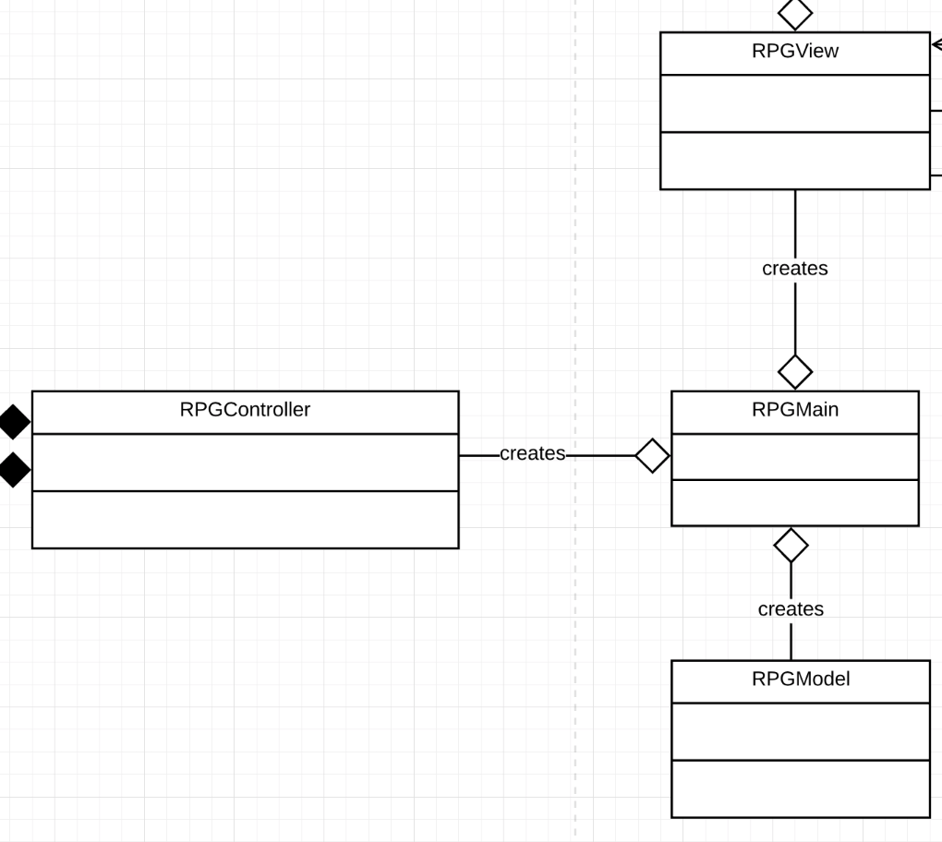

Slide 6
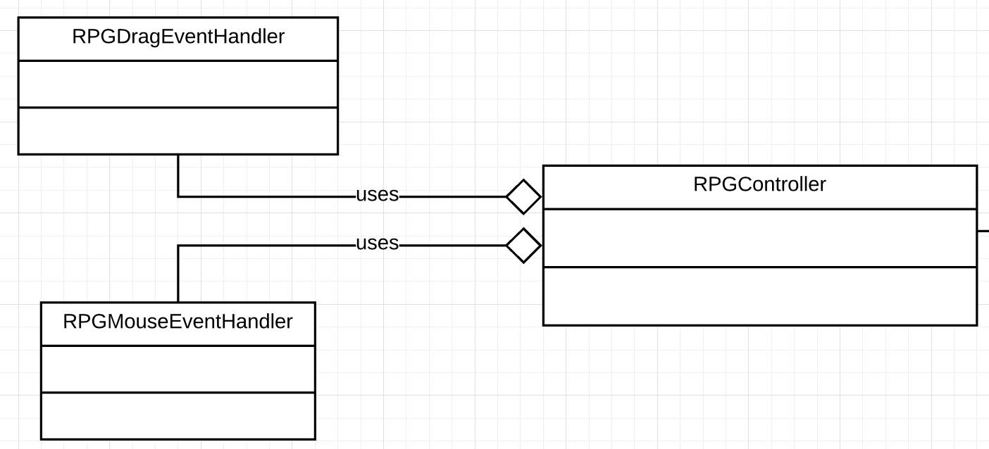

Slide 7
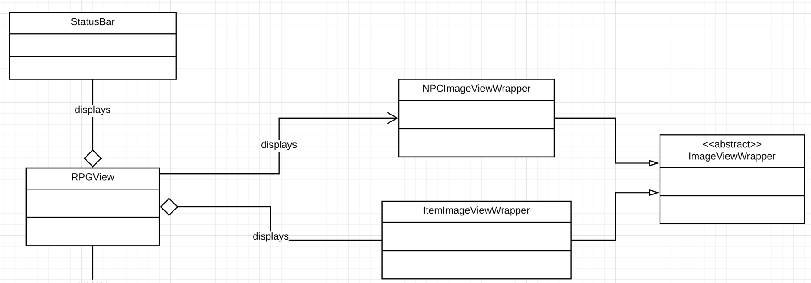

Slide 8
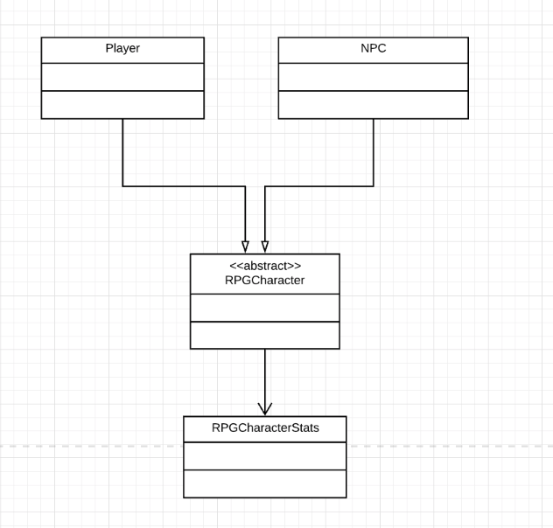

Slide 9
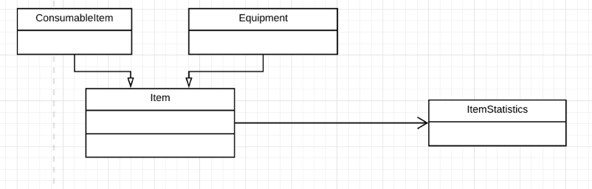

Slide 10
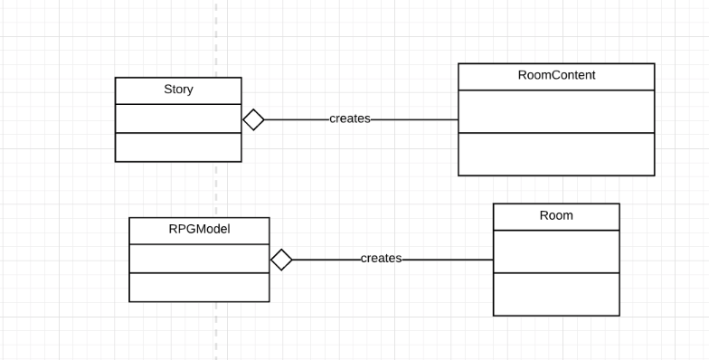

Slide 11
Interesting Data Structures
ItemStatistics & RPGCharacterStatistics (encapsulation)
Status Bar (display of numerical model)
EnumMap<ImageKey, ItemImageViewWrapper> in RPGView
Story (designers | developers)

Slide 12
Interesting Algorithms
Drag and Drop: listen for both MouseEvents and DragEvents
Threading: attack, sound, counter-attack, play another sound
Item Handling
Changing: inventory, room, and equipped
Signaling blank armor/shield/weapon
Tooltip

Slide 13
Graphical User Interface

Slide 14
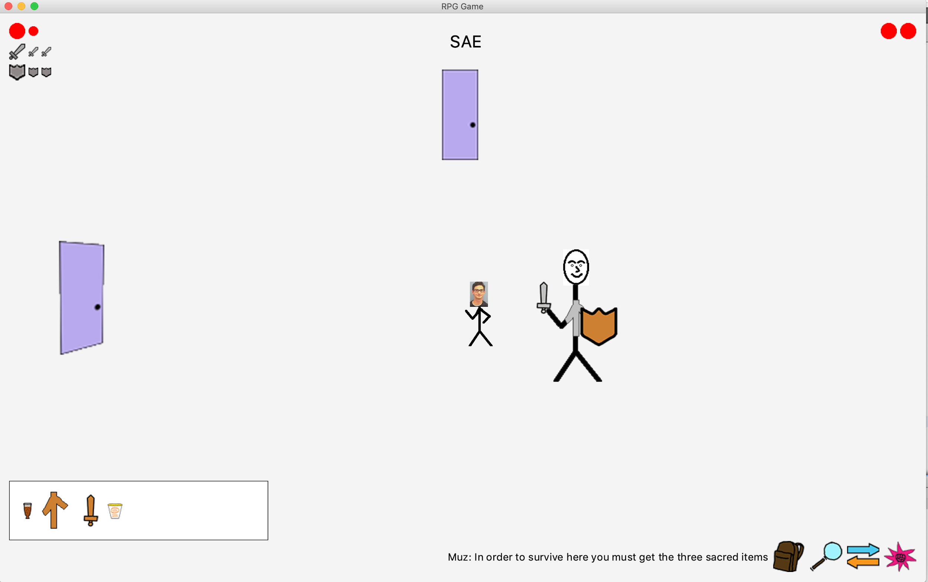

Slide 15
Demo

Slide 16
Scrum / Agile Experience
Important user stories:
As a player, I can move between rooms to complete my tasks
As a player, I can talk with friendly NPCs to learn what my next task is
As a player, I can fight hostile NPCs to complete tasks
As a player, I can have items that help me complete tasks
As a player, I can see my inventory to know what items I am able to use
As a player, I can see my updated statistics on the screen to know how much health I have left in the game and chance of defeating NPCs during battle

Slide 17
Strengths / Challenges
Strengths:
Clear vision for project defined early
Modify tasks to keep others updated
Dynamic storyline
Challenges:
Communication with group (over break); individual strengths
Prioritizing tasks
SCRUM
Upkeep with backlogs, UMLs, Task Boards, etc.
Starting subsequent sprints vs. refactoring/testing
Git

Slide 18
Final Sprint Updates
Add view pane (click image to select player)
Change player image
Finalize story (NPC statistics progressively higher)

Slide 19
Changes for 2.0?
Animated player movement
Add room background scenes
More rooms, more tasks
Multiplayer mode

Slide 20

Questions?
Notes:
Thank you for letting us use your photoshopped photo, Professor Dancy!

