Slide 1
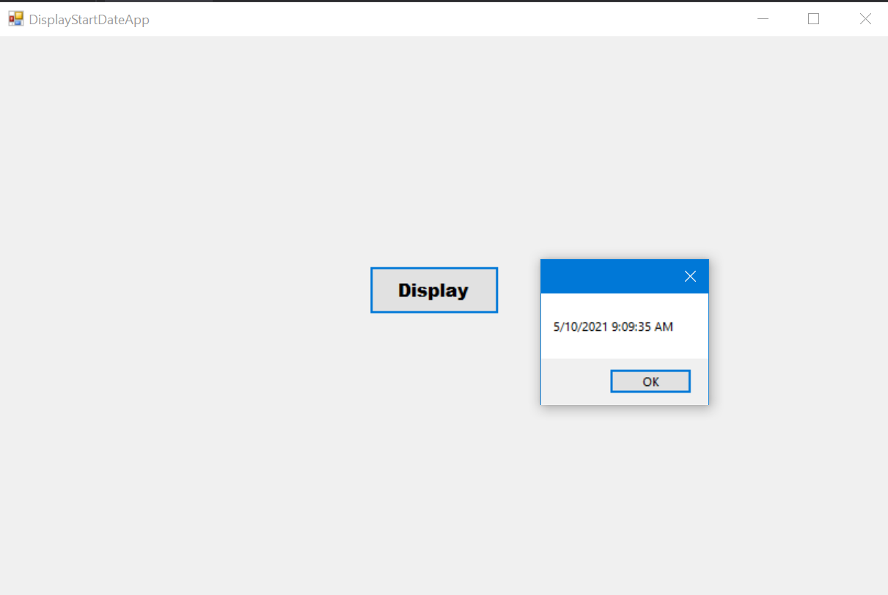
using System;
using System.Windows.Forms;
namespace HelloForm
{
public partial class Form1 : Form
{
public Form1()
{
InitializeComponent();
startDateTime = DateTime.Now; // "실행될 때" 현재시간, 변동 x
}
DateTime startDateTime;
public DateTime GetStartDateTime()
{
return startDateTime;
}
private void Form1_Load(object sender, EventArgs e)
{
}
private void button1_Click(object sender, EventArgs e)
{
MessageBox.Show(GetStartDateTime().ToString());
}
}
}

Slide 2
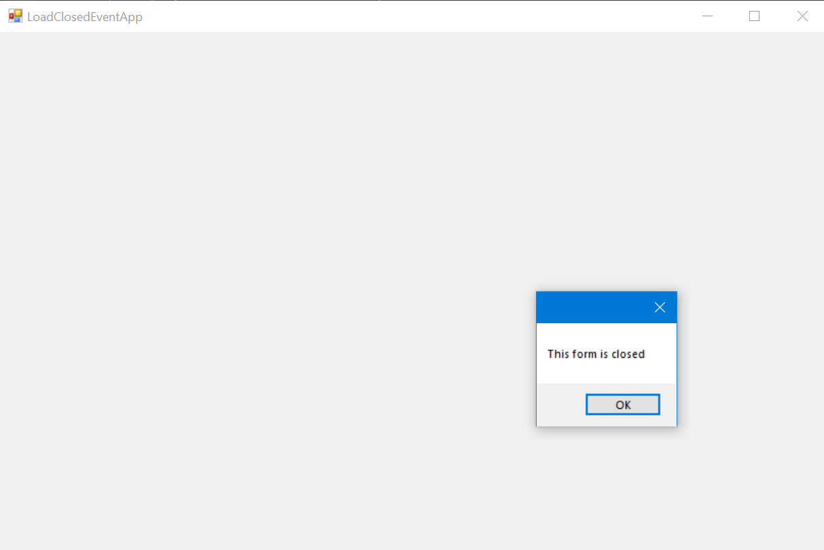
using System;
using System.Windows.Forms;
namespace HelloForm
{
public partial class Form1 : Form
{
public Form1()
{
InitializeComponent();
}
private void Form1_Load(object sender, EventArgs e)
{
MessageBox.Show("This form is loaded");
}
private void Form1_FormClosed(object sender, FormClosedEventArgs e)
{
MessageBox.Show("This form is closed");
}
}
}

Slide 3
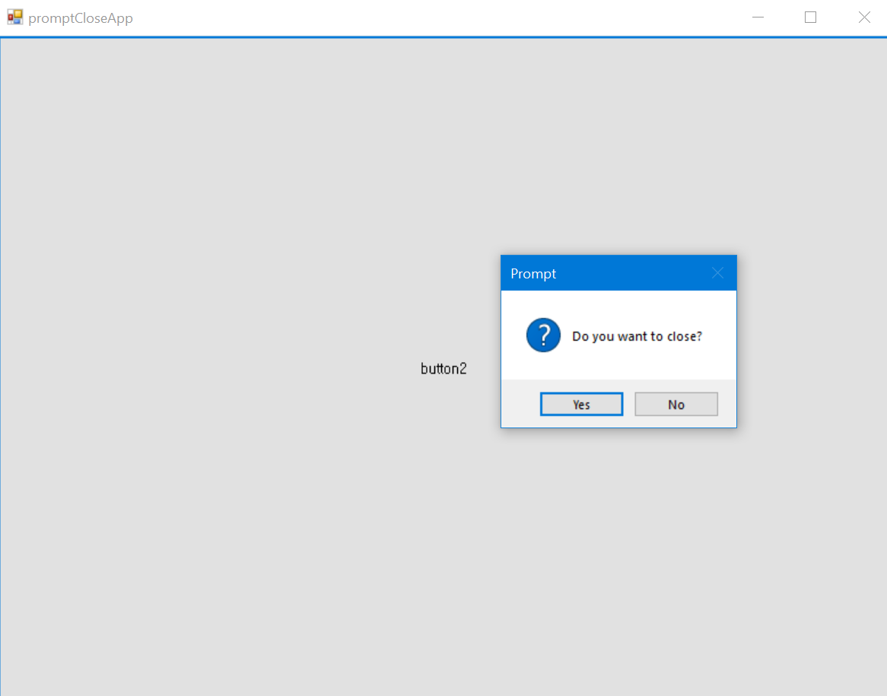
using System;
using System.Windows.Forms;
namespace HelloForm
{
public partial class Form1 : Form
{
public Form1()
{
InitializeComponent();
}
private void Form1_FormClosing(object sender, FormClosingEventArgs e)
{
if (MessageBox.Show("Do you want to close?",
"Prompt",
MessageBoxButtons.YesNo,
MessageBoxIcon.Question) == DialogResult.Yes)
{
e.Cancel = false;
}
else
{
e.Cancel = true;
}
}
private void button2_Click(object sender, EventArgs e)
{
Close();
}
}
}

Slide 4
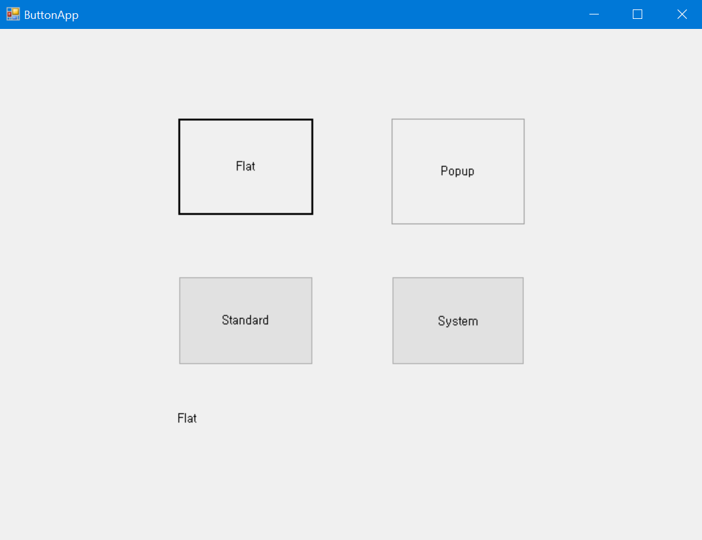
using System;
using System.Windows.Forms;
namespace HelloForm
{
public partial class Form1 : Form
{
public Form1()
{
InitializeComponent();
}
private void button8_Click(object sender, EventArgs e)
{
label2.Text = FlatStyle.Flat.ToString();
}
private void button7_Click(object sender, EventArgs e)
{
label2.Text = FlatStyle.Popup.ToString();
}
private void button9_Click(object sender, EventArgs e)
{
label2.Text = FlatStyle.Standard.ToString();
}
private void button10_Click(object sender, EventArgs e)
{
label2.Text = FlatStyle.System.ToString();
}
}
}

