Slide 1
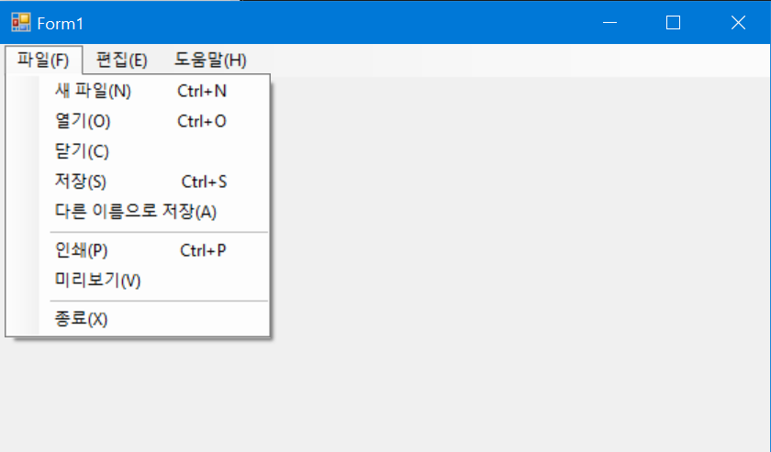
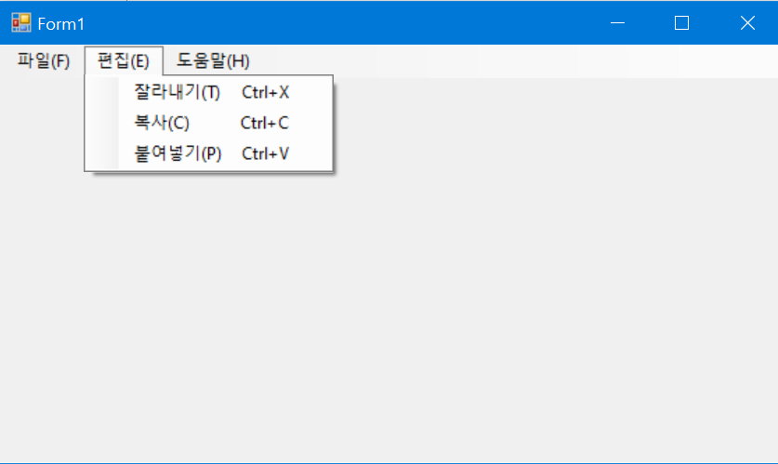
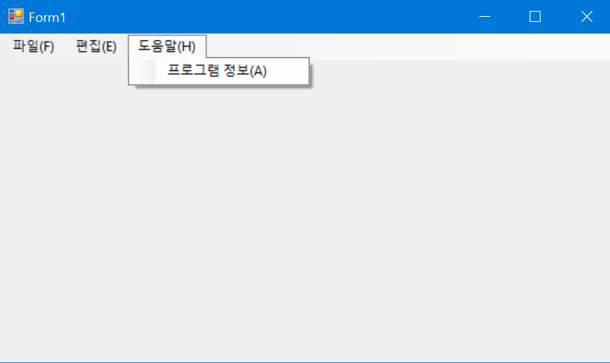
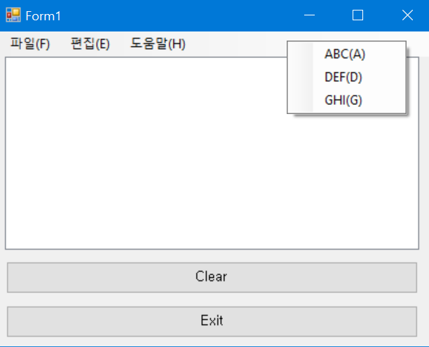
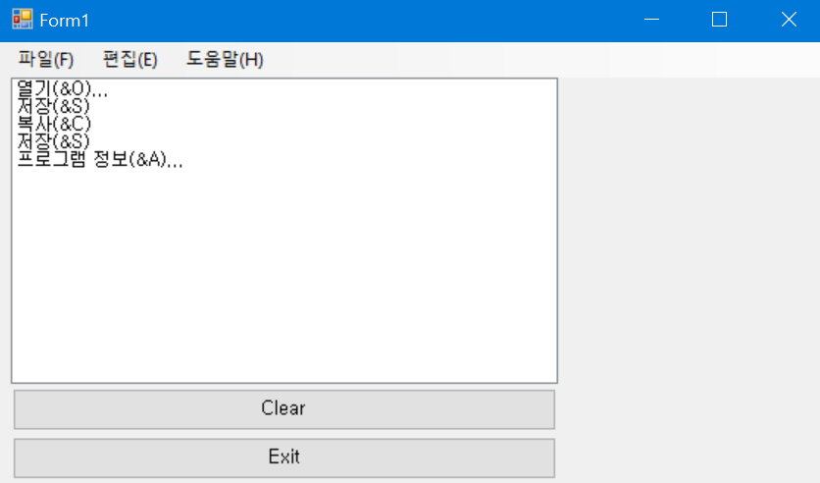

Slide 2
using System;
using System.Windows.Forms;
namespace WindowsFormsApp2
{
public partial class Form1 : Form
{
public Form1()
{
InitializeComponent();
}
private void listBox1_SelectedIndexChanged(object sender, EventArgs e)
{
}
private void button1_Click(object sender, EventArgs e)
{
listBox1.Items.Clear();
}
private void button2_Click(object sender, EventArgs e)
{
Application.Exit();
}
private void 새파일NToolStripMenuItem_Click(object sender, EventArgs e)
{
listBox1.Items.Add(((ToolStripMenuItem)sender).Text);
}
private void 열기OToolStripMenuItem_Click(object sender, EventArgs e)
{
listBox1.Items.Add(((ToolStripMenuItem)sender).Text);
}
private void 닫기CToolStripMenuItem_Click(object sender, EventArgs e)
{
listBox1.Items.Add(((ToolStripMenuItem)sender).Text);
}
private void 저장SToolStripMenuItem_Click(object sender, EventArgs e)
{
listBox1.Items.Add(((ToolStripMenuItem)sender).Text);
}
private void 다른이름으로저장AToolStripMenuItem_Click(object sender, EventArgs e)
{
listBox1.Items.Add(((ToolStripMenuItem)sender).Text);
}
private void 인쇄PToolStripMenuItem_Click(object sender, EventArgs e)
{
listBox1.Items.Add(((ToolStripMenuItem)sender).Text);
}
private void 미리보기VToolStripMenuItem_Click(object sender, EventArgs e)
{
listBox1.Items.Add(((ToolStripMenuItem)sender).Text);
}
private void 종료XToolStripMenuItem_Click(object sender, EventArgs e)
{
listBox1.Items.Add(((ToolStripMenuItem)sender).Text);
}
private void 잘라내기TToolStripMenuItem_Click(object sender, EventArgs e)
{
listBox1.Items.Add(((ToolStripMenuItem)sender).Text);
}
private void 복사CToolStripMenuItem_Click(object sender, EventArgs e)
{
listBox1.Items.Add(((ToolStripMenuItem)sender).Text);
}
private void 붙여넣기PToolStripMenuItem_Click(object sender, EventArgs e)
{
listBox1.Items.Add(((ToolStripMenuItem)sender).Text);
}
private void 프로그램정보AToolStripMenuItem_Click(object sender, EventArgs e)
{
listBox1.Items.Add(((ToolStripMenuItem)sender).Text);
}
}
}

Slide 3
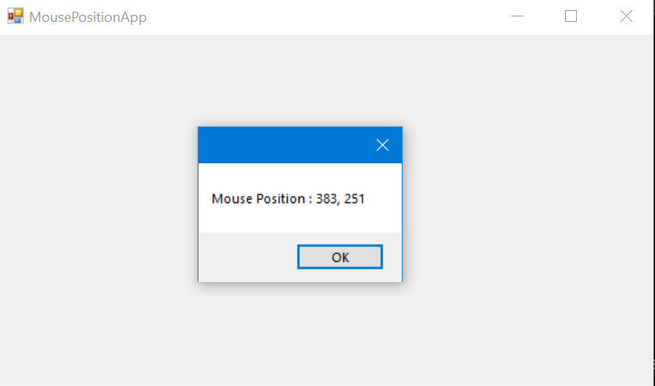
using System;
using System.Data;
using System.Drawing;
using System.Windows.Forms;
namespace MousePosition
{
public partial class Form1 : Form
{
public Form1()
{
InitializeComponent();
}
private void Form1_MouseEnter(object sender, EventArgs e)
{
Point mousePoint = PointToClient(MousePosition);
string msg = "Mouse Position : " + mousePoint.X + ", " + mousePoint.Y;
MessageBox.Show(msg);
}
}
}

Slide 4
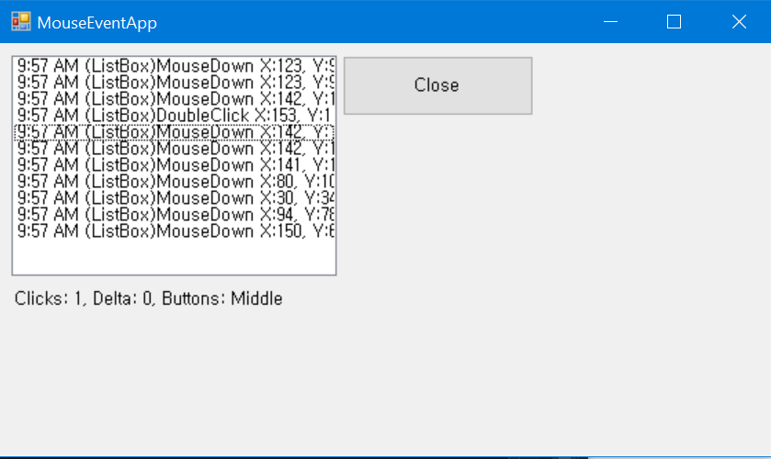
using System;
using System.Windows.Forms;
namespace MouseEventArg
{
public partial class Form1 : Form
{
public Form1()
{
InitializeComponent();
}
private void UpdateEventLabels(string msg, int x, int y,MouseEventArgs e)
{
string message = string.Format("{0} X:{1}, Y:{2}", msg, x, y);
string eventMsg = DateTime.Now.ToShortTimeString();
eventMsg += " " + message;
listBox1.Items.Insert(0, eventMsg);
listBox1.TopIndex = 0;
string mouseInfo;
if (e != null)
{
mouseInfo = string.Format("Clicks: {0}, Delta: {1}, " +
"Buttons: {2}", e.Clicks, e.Delta,
e.Button.ToString());
}
else
{
mouseInfo = string.Format("Clicks: {0}", msg);
}
label1.Text = mouseInfo;
}
private void button1_Click(object sender, EventArgs e)
{
Application.Exit();
}
private void listBox1_MouseDown(object sender, MouseEventArgs e)
{
UpdateEventLabels("(ListBox)MouseDown", e.X, e.Y, e);
}
private void listBox1_MouseDoubleClick(object sender, MouseEventArgs e)
{
Point mousePoint = PointToClient(MousePosition);
UpdateEventLabels("(ListBox)DoubleClick",
mousePoint.X, mousePoint.Y, null);
}
}
}

Slide 5
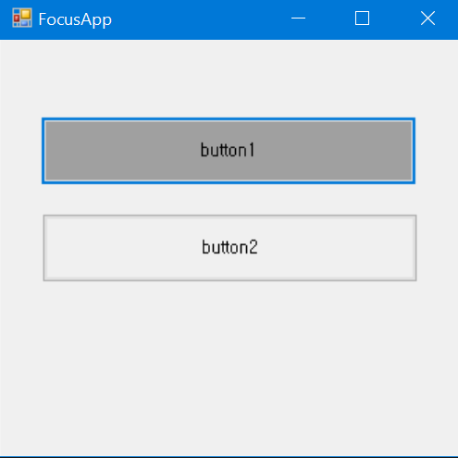
using System;
using System.Windows.Forms;
namespace FocusApp
{
public partial class Form1 : Form
{
public Form1()
{
InitializeComponent();
}
private void button1_Click(object sender, EventArgs e)
{
this.button1.BackColor = SystemColors.Control;
this.button2.Focus();
if (this.button2.Focused)
this.button2.BackColor = SystemColors.ControlDark;
}
private void button2_Click(object sender, EventArgs e)
{
this.button2.BackColor = SystemColors.Control;
this.button1.Focus();
if (this.button1.Focused)
this.button1.BackColor = SystemColors.ControlDark;
}
}
}

Slide 6
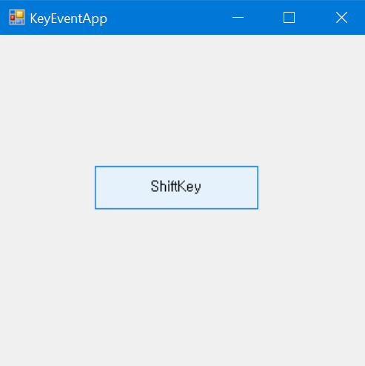
using System;
using System.Windows.Forms;
namespace FocusApp
{
public partial class Form1 : Form
{
public Form1()
{
InitializeComponent();
}
public int xPt, yPt;
public static readonly int MOVE = 10;
private void button1_KeyUp(object sender, KeyEventArgs e)
{
this.xPt = this.button1.Location.X;
this.yPt = this.button1.Location.Y;
switch (e.KeyCode)
{
case Keys.Left:
xPt -= MOVE; break;
case Keys.Right:
xPt += MOVE; break;
case Keys.Up:
yPt -= MOVE; break;
case Keys.Down:
yPt += MOVE; break;
}
this.button1.Text = e.KeyCode.ToString();
this.button1.Location = new Point(xPt, yPt);
}
}
}

Slide 7
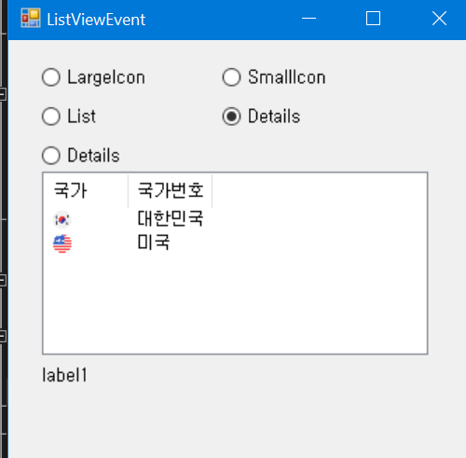
using System;
using System.Windows.Forms;
namespace FocusApp
{
public partial class Form1 : Form
{
public Form1()
{
InitializeComponent();
}
private void radioButton1_CheckedChanged(object sender, EventArgs e)
{
if (radioButton1.Checked)
listView1.View = View.LargeIcon;
}
private void radioButton2_CheckedChanged(object sender, EventArgs e)
{
if (radioButton2.Checked)
listView1.View = View.SmallIcon;
}
private void radioButton3_CheckedChanged(object sender, EventArgs e)
{
if (radioButton3.Checked)
listView1.View = View.List;
}
private void radioButton4_CheckedChanged(object sender, EventArgs e)
{
if (radioButton4.Checked)
listView1.View = View.Details;
}
private void radioButton5_CheckedChanged(object sender, EventArgs e)
{
if (radioButton5.Checked)
listView1.View = View.Tile;
}
private void listView1_Click(object sender, EventArgs e)
{
foreach (ListViewItem item in listView1.SelectedItems)
{
ListViewItem.ListViewSubItemCollection subItem = item.SubItems;
// 각 항목에 대한 부항목을 얻기 위해 SubItems 프로퍼티를 사용
label1.Text = subItem[0].Text + "의 국가번호는 " + subItem[1].Text + "입니다.";
}
}
}
}

Slide 8
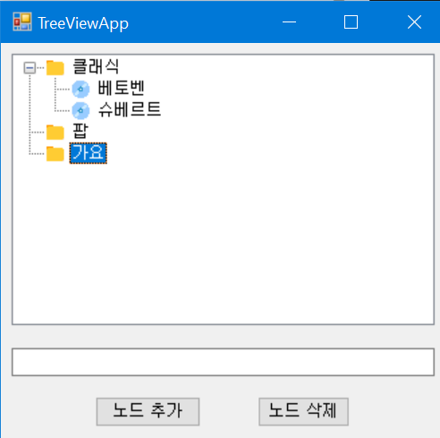
using System;
using System.Windows.Forms;
namespace FocusApp
{
public partial class Form1 : Form
{
public Form1()
{
InitializeComponent();
}
private void button1_Click(object sender, EventArgs e)
{
if (textBox1.Text != "" && treeView1.SelectedNode != null)
{
// 선택된 노드가 있으면, 그 노드의 자식 노드로 추가한다.
treeView1.SelectedNode.Nodes.Add(
new TreeNode(textBox1.Text, 1, 1));
textBox1.Text = "";
textBox1.Focus();
}
}
private void button2_Click(object sender, EventArgs e)
{
treeView1.Nodes.Remove(treeView1.SelectedNode);
}
}
}

Slide 9
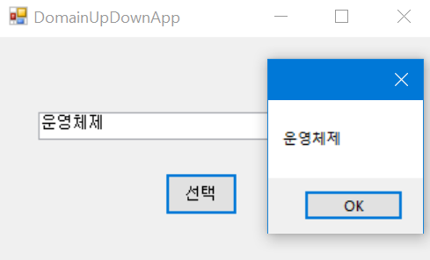
using System;
using System.Windows.Forms;
namespace FocusApp
{
public partial class Form1 : Form
{
public Form1()
{
InitializeComponent();
}
private void button1_Click(object sender, EventArgs e)
{
MessageBox.Show(domainUpDown1.SelectedItem.ToString());
}
}
}

Slide 10
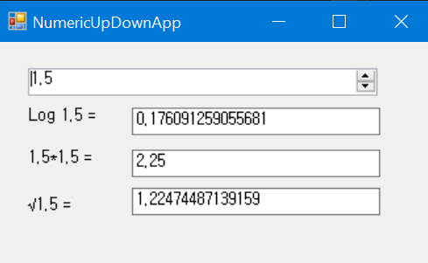
using System;
using System.Windows.Forms;
namespace FocusApp
{
public partial class Form1 : Form
{
public Form1()
{
InitializeComponent();
}
private void numericUpDown1_ValueChanged(object sender, EventArgs e)
{
decimal d = numericUpDown1.Value;
label1.Text = "Log " + d + " = ";
textBox1.Text = System.Math.Log10((double)d).ToString();
label2.Text = d + "*" + d + " = ";
textBox2.Text = System.Math.Pow((double)d, 2).ToString();
label3.Text = "√" + d + " = ";
textBox3.Text = System.Math.Sqrt((double)d).ToString();
}
}
}

Slide 11
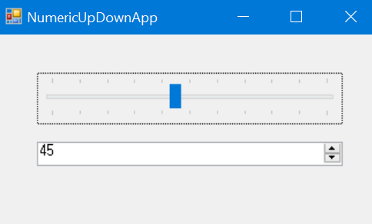
using System;
using System.Windows.Forms;
namespace FocusApp
{
public partial class Form1 : Form
{
public Form1()
{
InitializeComponent();
}
private void trackBar1_Scroll(object sender, EventArgs e)
{
numericUpDown1.Value = trackBar1.Value;
}
private void numericUpDown1_ValueChanged(object sender, EventArgs e)
{
trackBar1.Value = (int)numericUpDown1.Value;
}
}
}

Slide 12
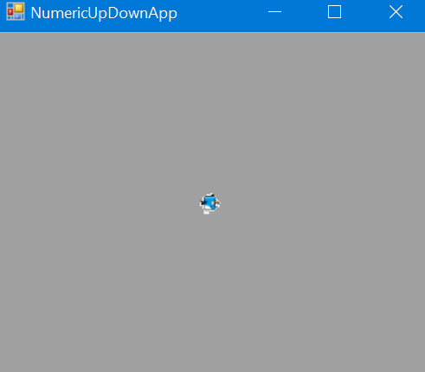
using System;
using System.Windows.Forms;
namespace FocusApp
{
public partial class Form1 : Form
{
public Form1()
{
InitializeComponent();
}
private int index = 0;
private void timer1_Tick(object sender, EventArgs e)
{
index %= imageList1.Images.Count;
label2.Image = imageList1.Images[index++];
}
}
}

