Slide 1
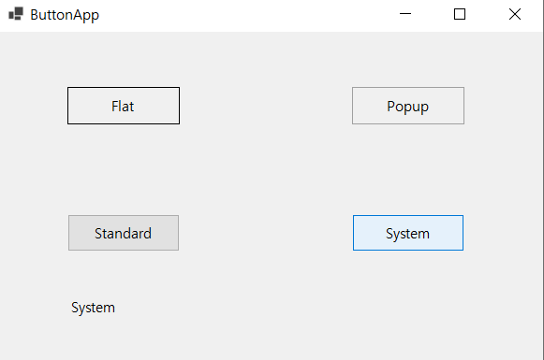
ButtonApp
namespace _0517winform
{
public partial class Form1 : Form
{
public Form1()
{
InitializeComponent();
}
private void Form1_Load(object sender, EventArgs e)
{
}
private void button1_Click(object sender, EventArgs e)
{
label1.Text = FlatStyle.Flat.ToString();
}
private void button2_Click(object sender, EventArgs e)
{
label1.Text = FlatStyle.Popup.ToString();
}
private void button3_Click(object sender, EventArgs e)
{
label1.Text = FlatStyle.Standard.ToString();
}
private void button4_Click(object sender, EventArgs e)
{
label1.Text = FlatStyle.System.ToString();
}
}
}

Slide 2
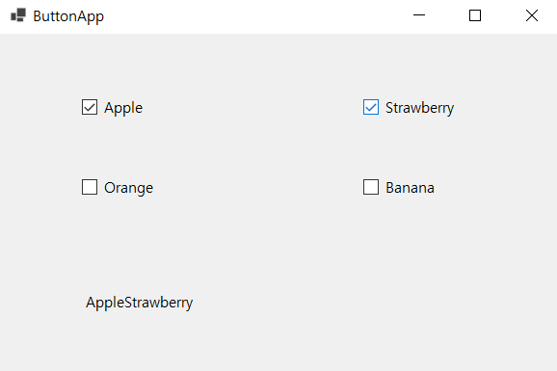
namespace _0517winform
{
public partial class Form1 : Form
{
public Form1()
{
InitializeComponent();
}
private void Form1_Load(object sender, EventArgs e)
{
}
private void UpdateLabel(string s, bool b)
{
if (b)
{
label1.Text += s; // label1의 Text 프로퍼티에 문자열 추가
}
else
{
string strTemp = label1.Text;
int i = strTemp.IndexOf(s);
label1.Text = strTemp.Remove(i, s.Length);
}
}
CheckBox

Slide 3
private void checkBox1_CheckedChanged(object sender, EventArgs e)
{
UpdateLabel(checkBox1.Text, checkBox1.Checked);
}
private void checkBox2_CheckedChanged(object sender, EventArgs e)
{
UpdateLabel(checkBox2.Text, checkBox2.Checked);
}
private void checkBox3_CheckedChanged(object sender, EventArgs e)
{
UpdateLabel(checkBox3.Text, checkBox3.Checked);
}
private void checkBox4_CheckedChanged(object sender, EventArgs e)
{
UpdateLabel(checkBox4.Text, checkBox4.Checked);
}
}
}

Slide 4
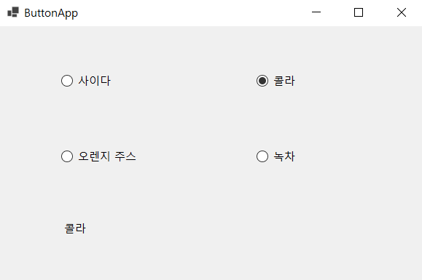
namespace _0517winform
{
public partial class Form1 : Form
{
public Form1()
{
InitializeComponent();
}
private void Form1_Load(object sender, EventArgs e)
{
}
private void radioButton1_CheckedChanged(object sender, EventArgs e)
{
label1.Text = radioButton1.Text;
}
private void radioButton2_CheckedChanged(object sender, EventArgs e)
{
label1.Text = radioButton2.Text;
}
private void radioButton3_CheckedChanged(object sender, EventArgs e)
{
label1.Text = radioButton3.Text;
}
private void radioButton4_CheckedChanged(object sender, EventArgs e)
{
label1.Text = radioButton4.Text;
}
}
}
radioButton

Slide 5
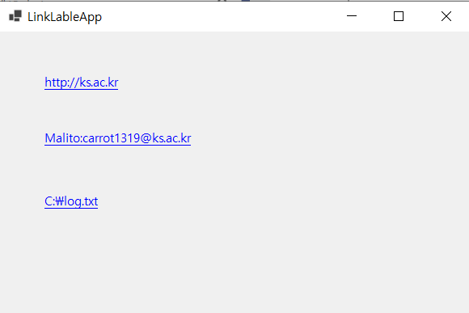
LinkLabel
namespace _0517winform
{
public partial class Form1 : Form
{
public Form1()
{
InitializeComponent();
}
private void Form1_Load(object sender, EventArgs e)
{
}
private void linkLabel1_LinkClicked(object sender, LinkLabelLinkClickedEventArgs e)
{
Process.Start(linkLabel1.Text);
}
private void linkLabel2_LinkClicked(object sender, LinkLabelLinkClickedEventArgs e)
{
Process.Start(linkLabel2.Text);
}
private void linkLabel3_LinkClicked(object sender, LinkLabelLinkClickedEventArgs e)
{
Process.Start("Notepad.exe", linkLabel3.Text);
}
}
}

Slide 6
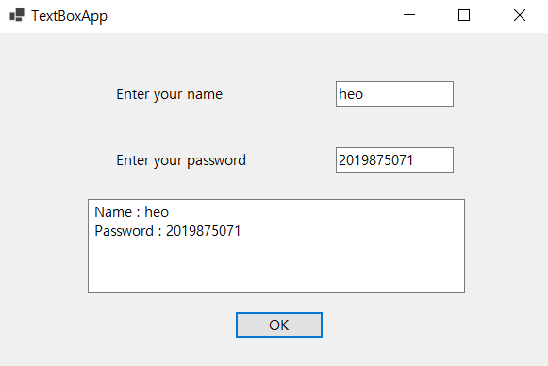
TextBox
namespace _0517winform
{
public partial class Form1 : Form
{
public Form1()
{
InitializeComponent();
}
private void Form1_Load(object sender, EventArgs e)
{
}
private void button1_Click(object sender, EventArgs e)
{
textBox3.Text = "Name : " + textBox1.Text +
"\r\nPassword : " + textBox2.Text;
}
}
}

Slide 7
ListBox
namespace _0517winform
{
public partial class Form1 : Form
{
public Form1()
{
InitializeComponent();
}
private void button1_Click(object sender, EventArgs e)
{
if (textBox1.Text != "")
{
listBox1.Items.Add(textBox1.Text);
textBox1.Text = "";
}
}
private void button2_Click(object sender, EventArgs e)
{
if (listBox1.SelectedIndex > -1)
listBox1.Items.RemoveAt(listBox1.SelectedIndex);
}
}
}

Slide 8
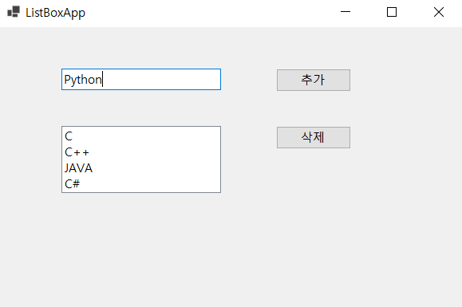
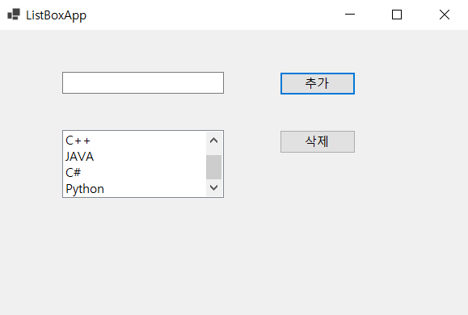
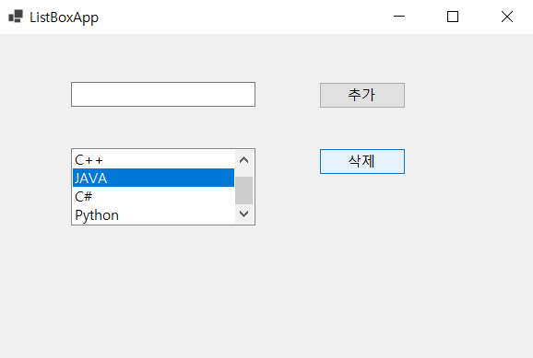
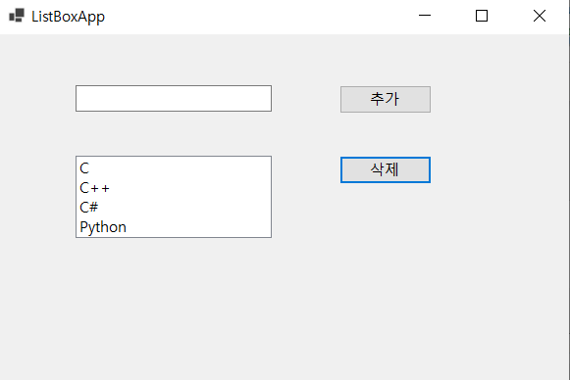
추가
삭제

Slide 9
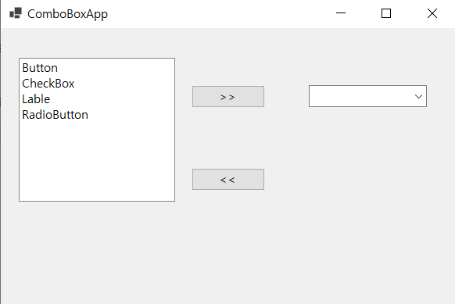
ComboBoxApp
namespace _0517winform
{
public partial class Form1 : Form
{
public Form1()
{
InitializeComponent();
}
private void button1_Click(object sender, EventArgs e)
{
if (listBox1.SelectedItem != null)
{
comboBox1.Items.Add(listBox1.SelectedItem);
listBox1.Items.Remove(listBox1.SelectedItem);
}
}
private void button2_Click(object sender, EventArgs e)
{
if (comboBox1.SelectedItem != null)
{
listBox1.Items.Add(comboBox1.SelectedItem);
comboBox1.Items.Remove(comboBox1.SelectedItem);
}
}
}
}

Slide 10
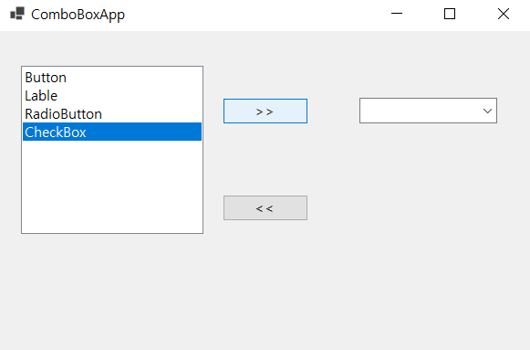
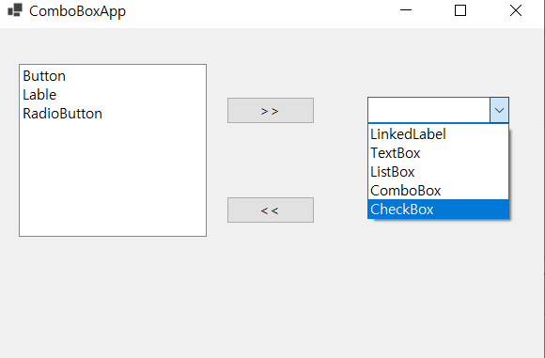
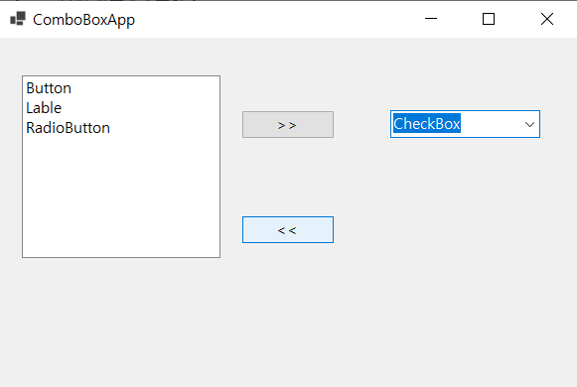
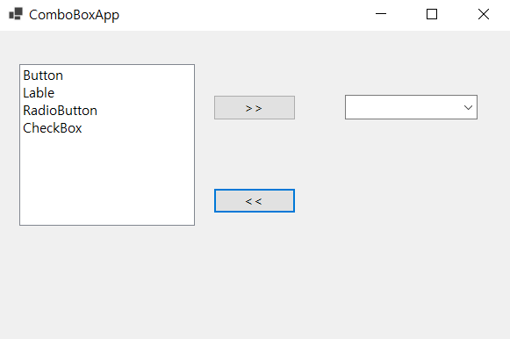
왼 -> 오 이동
오 -> 왼 이동

Slide 11
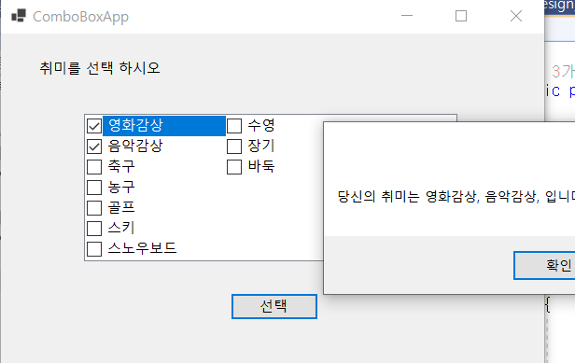
CheckedListBox
namespace _0517winform
{
public partial class Form1 : Form
{
public Form1()
{
InitializeComponent();
}
private void button1_Click(object sender, EventArgs e)
{
string strTemp = "";
foreach (object obj in checkedListBox1.CheckedItems)
{
strTemp += obj.ToString();
strTemp += ", ";
}
MessageBox.Show("당신의 취미는 " + strTemp + "입니다.");
}
}
}

Slide 12
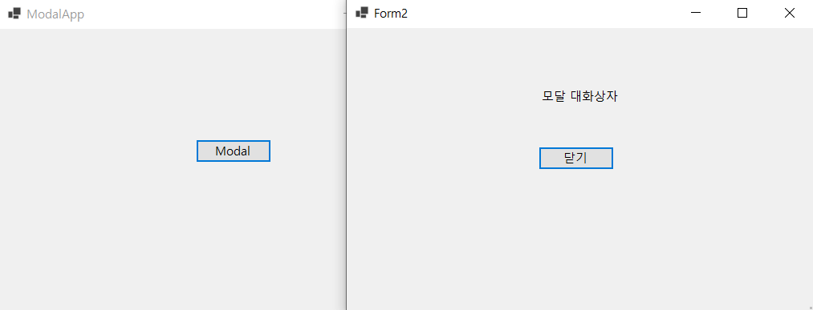
Mordal
namespace _0517winform
{
public partial class Form1 : Form
{
public Form1()
{
InitializeComponent();
}
private void button1_Click(object sender, EventArgs e)
{
Form2 form2 = new Form2();
form2.ShowDialog();
}
}
}
namespace _0517winform
{
public partial class Form2 : Form
{
public Form2()
{
InitializeComponent();
}
private void close_button_Click(object sender, EventArgs e)
{
Close();
}
}
}

Slide 13
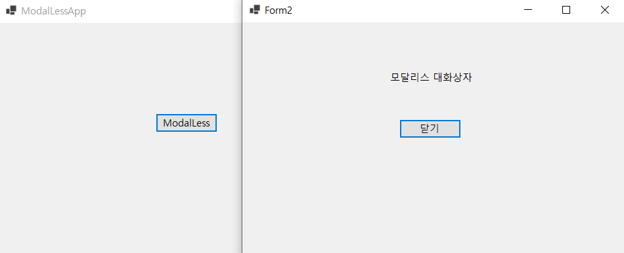
MordalLess
namespace _0517winform
{
public partial class Form1 : Form
{
public Form1()
{
InitializeComponent();
}
private void button1_Click(object sender, EventArgs e)
{
Form2 form2 = new Form2();
form2.Show();
}
}
}
namespace _0517winform
{
public partial class Form2 : Form
{
public Form2()
{
InitializeComponent();
}
private void close_button_Click(object sender, EventArgs e)
{
Close();
}
}
}

Slide 14
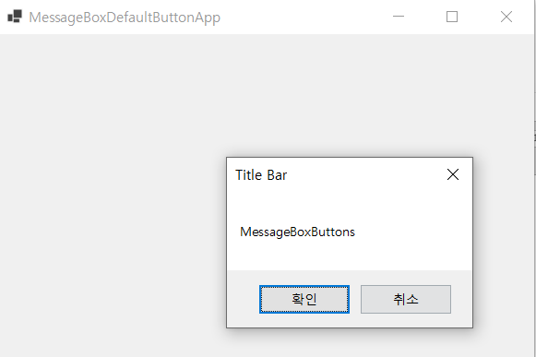
MessageBox
namespace _0517winform
{
public partial class Form1 : Form
{
public Form1()
{
InitializeComponent();
}
private void Form1_Click(object sender, EventArgs e)
{
MessageBox.Show("MessageBoxButtons", "Title Bar",
MessageBoxButtons.OKCancel);
}
}
}

Slide 15
공통 대화상자 - 열기 대화상자 (1)
namespace _0517winform
{
public partial class Form1 : Form
{
public Form1()
{
InitializeComponent();
}
private void button1_Click(object sender, EventArgs e)
{
OpenFileDialog openFileDialog1 = new OpenFileDialog();
openFileDialog1.InitialDirectory = @"C:\";
openFileDialog1.Filter
= "텍스트 파일(*.txt)|*.txt|모든 파일(*.*)|*.*";
openFileDialog1.FilterIndex = 1;
openFileDialog1.RestoreDirectory = true;
openFileDialog1.ShowDialog();
textBox1.Text = openFileDialog1.FileName;
}
}
}

Slide 16
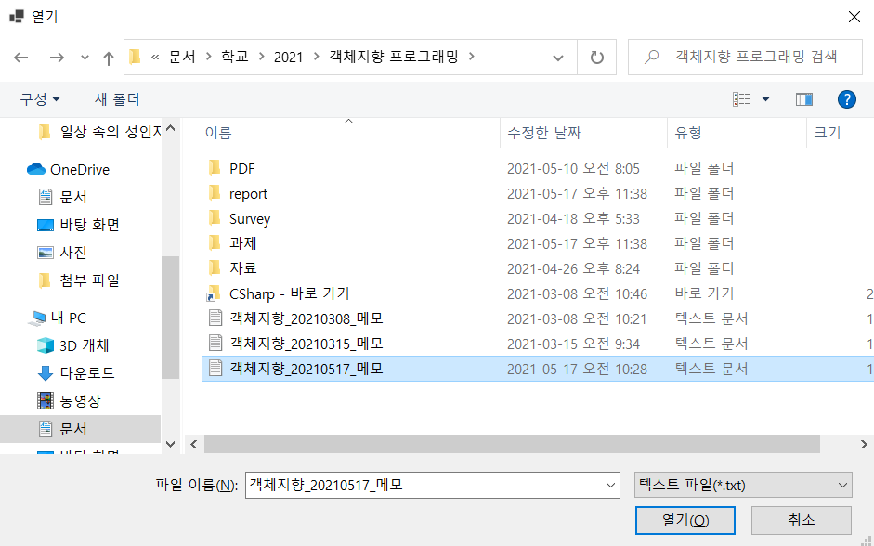
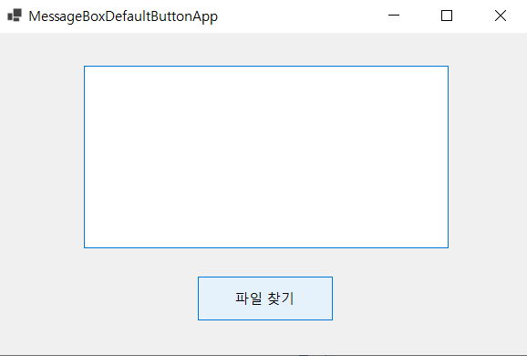
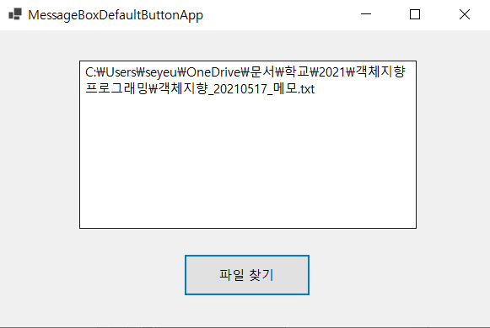
(1)
(2)
(3)

Slide 17
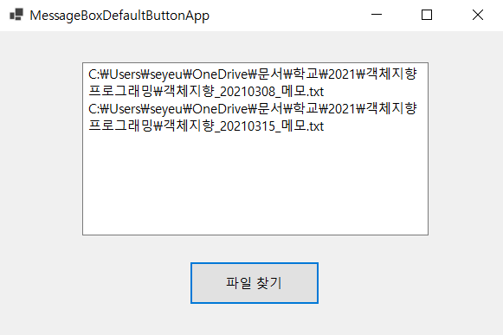
공통 대화상자 - 열기 대화상자 (2)
private void button1_Click(object sender, EventArgs e)
{
OpenFileDialog openFileDialog1 = new OpenFileDialog();
openFileDialog1.InitialDirectory = @"C:\";
openFileDialog1.Filter
= "텍스트 파일(*.txt)|*.txt|모든 파일(*.*)|*.*";
openFileDialog1.FilterIndex = 1;
openFileDialog1.RestoreDirectory = true;
openFileDialog1.Multiselect = true;
openFileDialog1.ShowDialog();
foreach (string strTmp in openFileDialog1.FileNames)
{
textBox1.Text += strTmp;
textBox1.Text += "\r\n";
}
}
다수의 파일 선택 가능.

Slide 18
Mission-code
Form1
Form2
namespace _0517winform
{
public partial class Form2 : Form
{
public Form2()
{
InitializeComponent();
}
private void button1_Click(object sender, EventArgs e)
{
Close();
}
public void received2(string str)
{
this.label1.Text = str;
label1.Invalidate();
}
}
}
namespace _0517winform
{
public partial class Form1 : Form
{
public Form1()
{
InitializeComponent();
}
private void submit_Click(object sender, EventArgs e)
{
Form2 frm2 = new Form2();
frm2.received2(textBox1.Text);
frm2.ShowDialog();
}
}
}

Slide 19
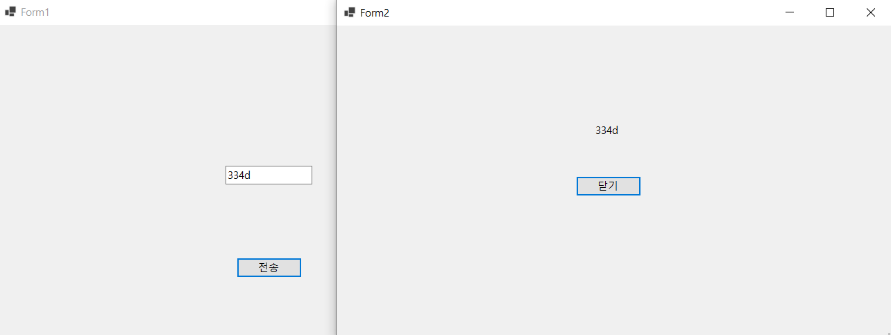
Mission-Image

