Slide 1

SAMSUNG PRISM
Generative AI
Hackathon
3rd Edition 2026 – 27
Theme ID - 03
Team Name - chocXlate
College Name – Vellore Institute Of Technology, Vellore
Member Name & Email 1- Umika Sood, umika.sood2025@vitstudent.ac.in
Member Name & Email 2- Kartikay Singhal, kartikay.singhal2025@vitstudent.ac.in
Submission Github link - https://github.com/ks26-lab/Android-voice-assistant

Slide 2
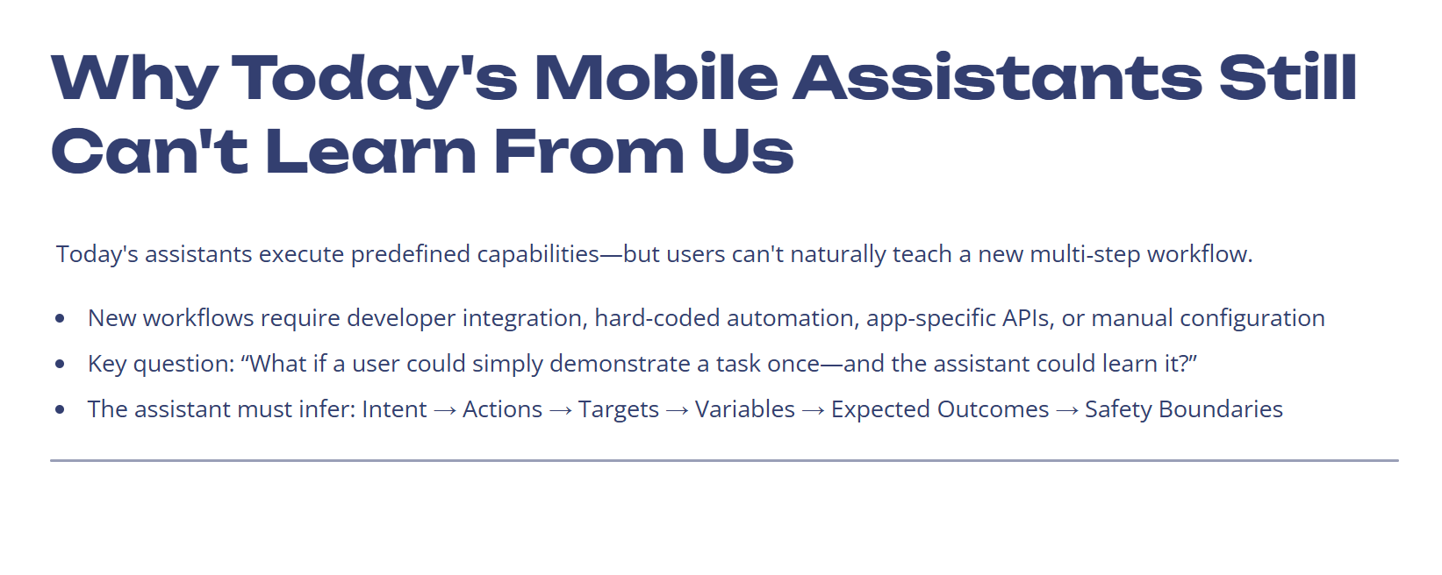
Theme

Slide 3
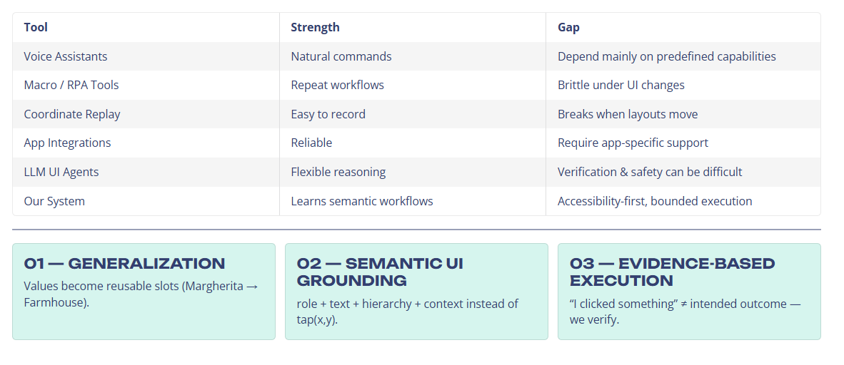
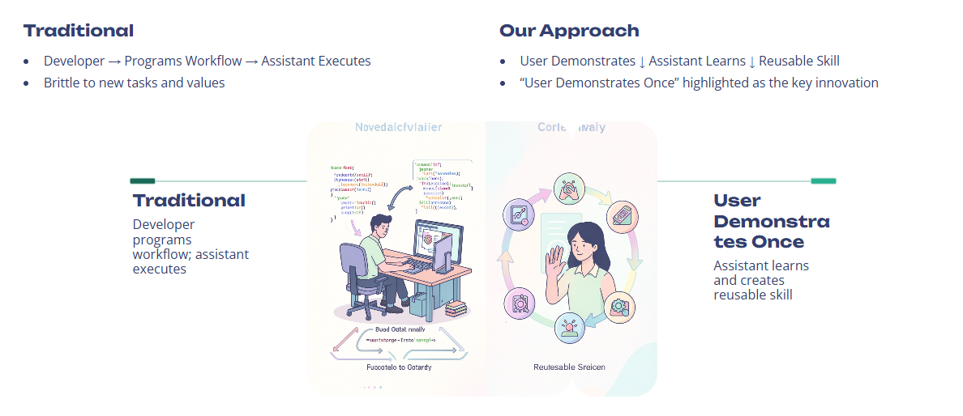
Existing Solutions & Gaps

Slide 4
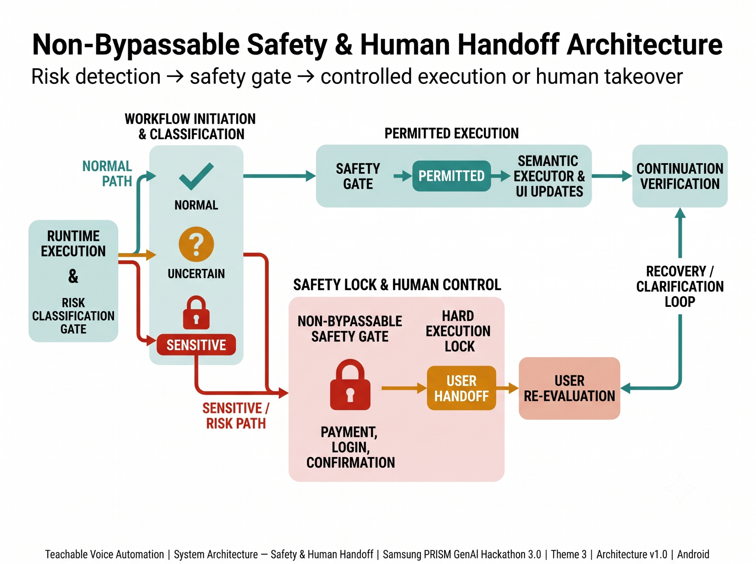
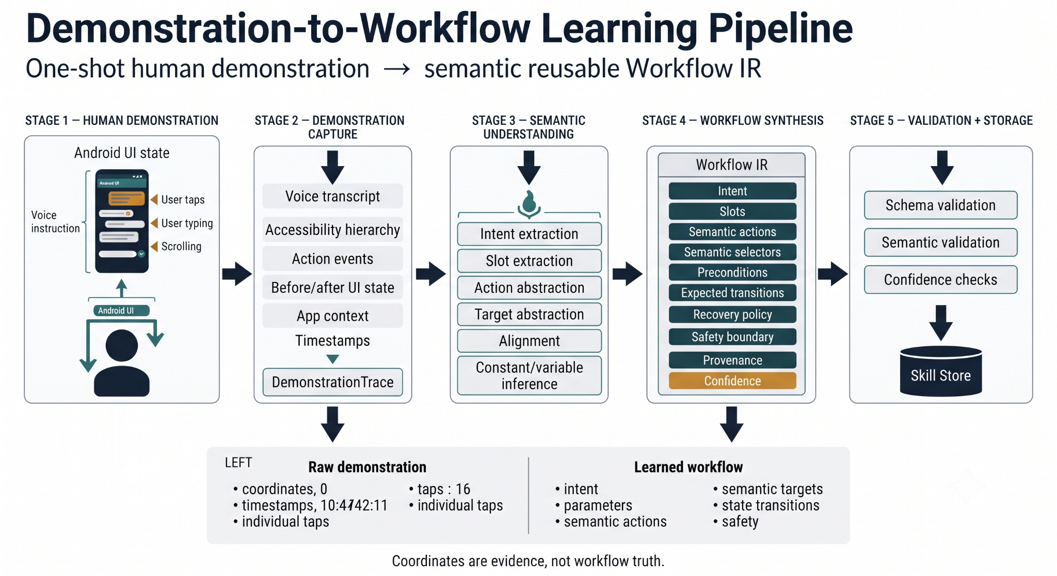
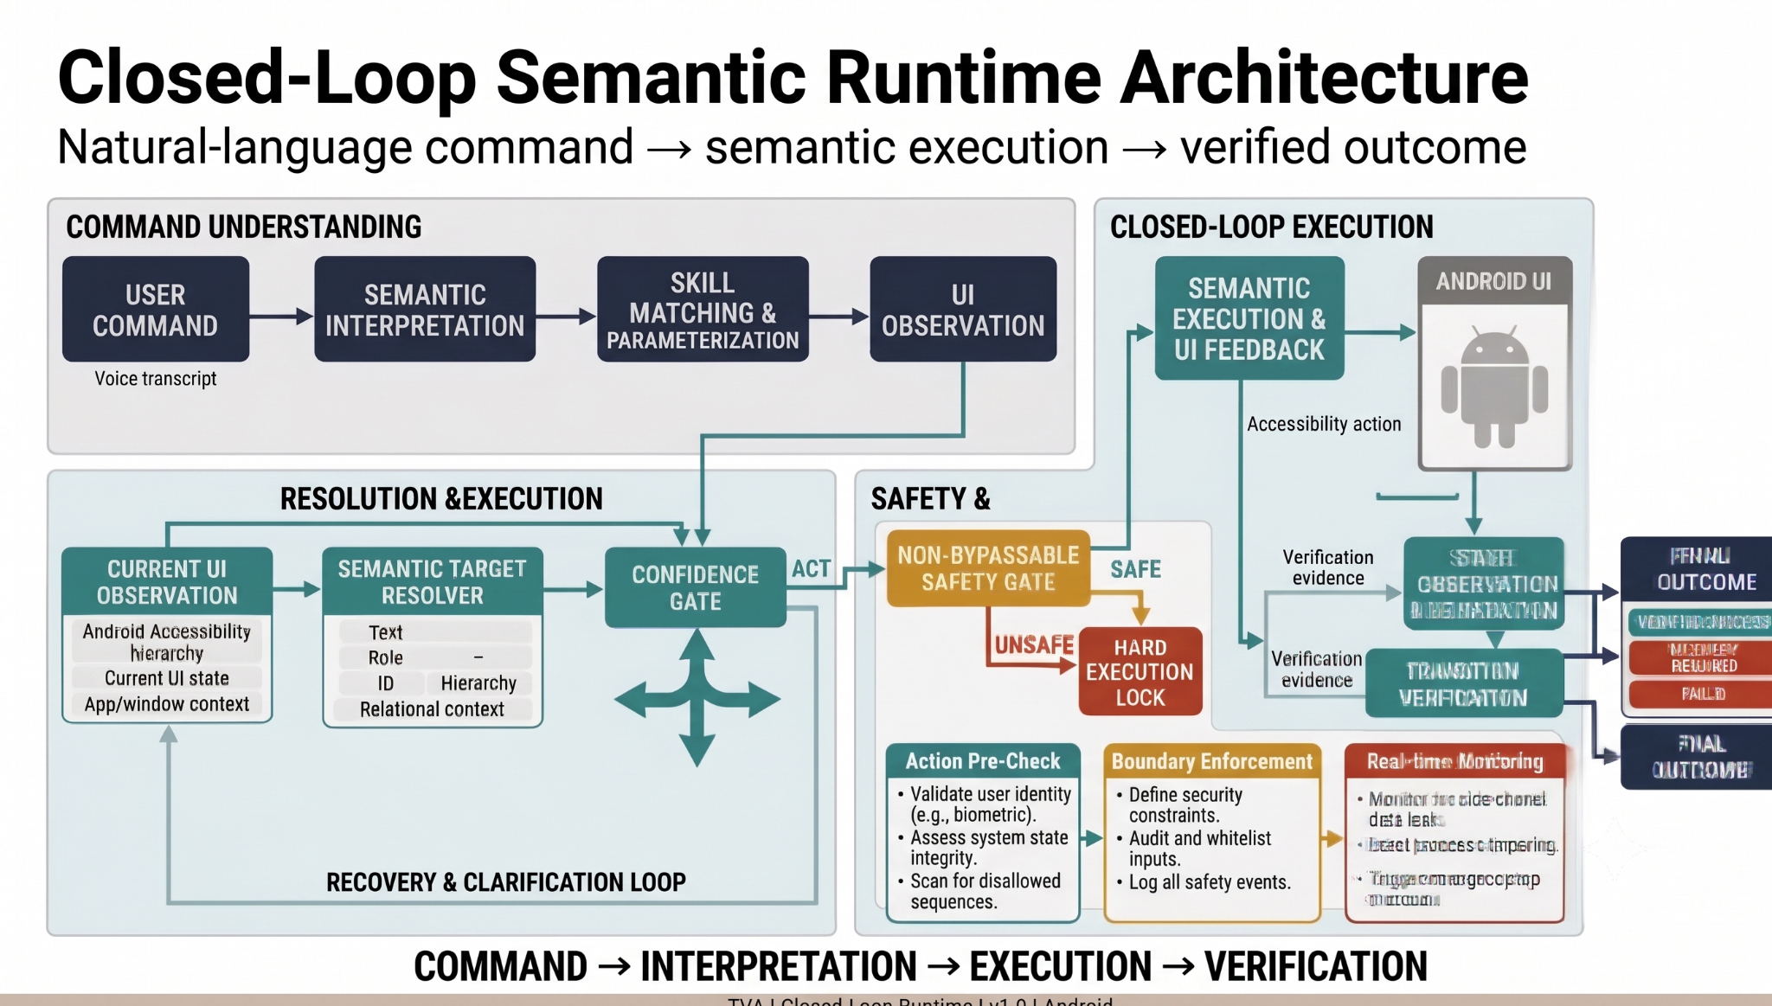
Our Solutions & Architecture Diagram

Slide 5
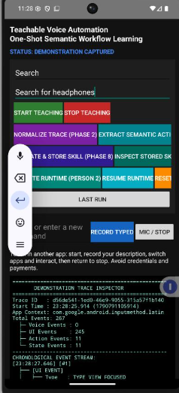
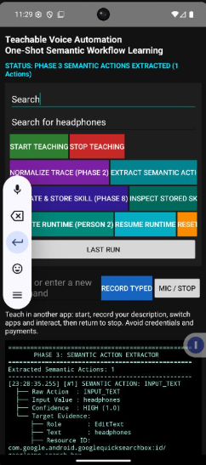
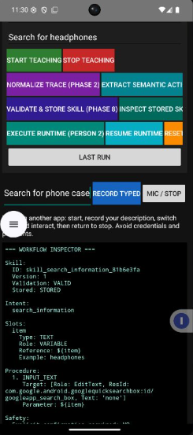
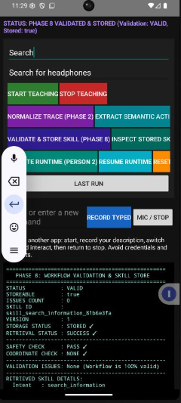
Demo & Product Walkthrough

Slide 6
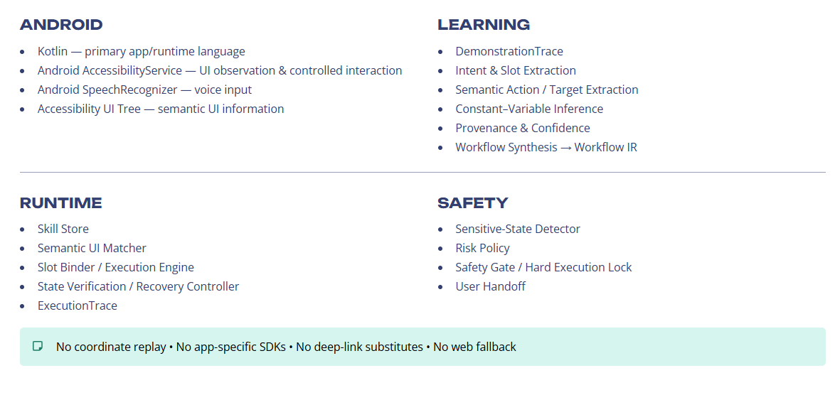
Tools and tech stack used

Slide 7
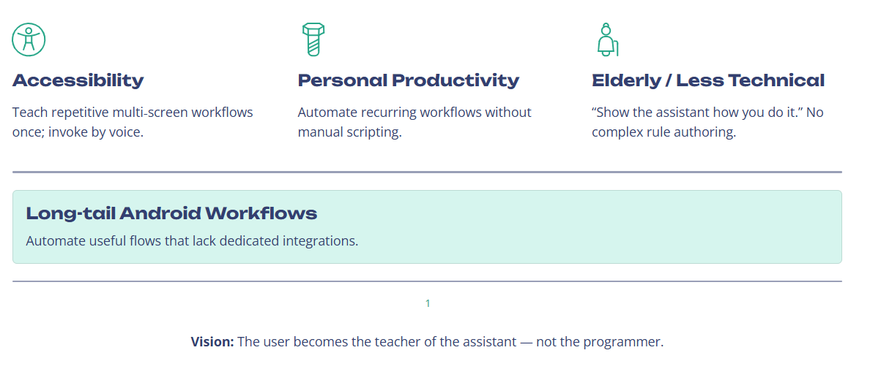
Impact & Use case

Slide 8
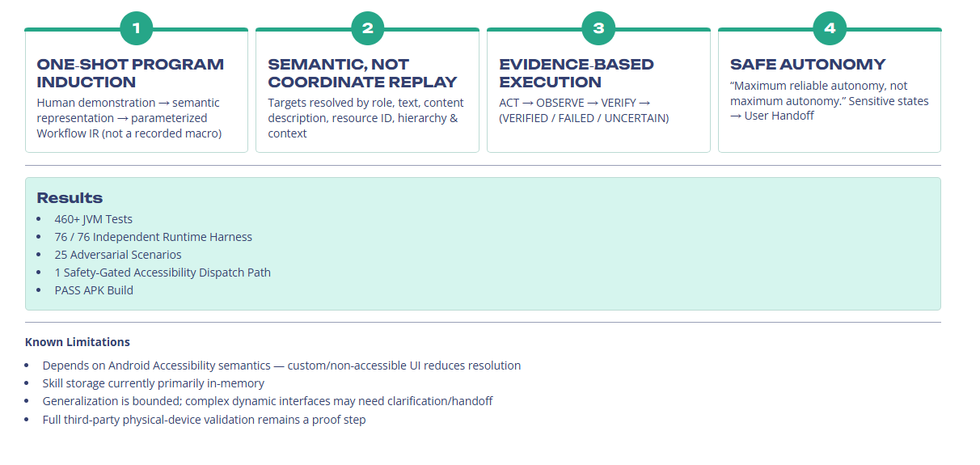
Innovation highlights, results and limitations

Slide 9
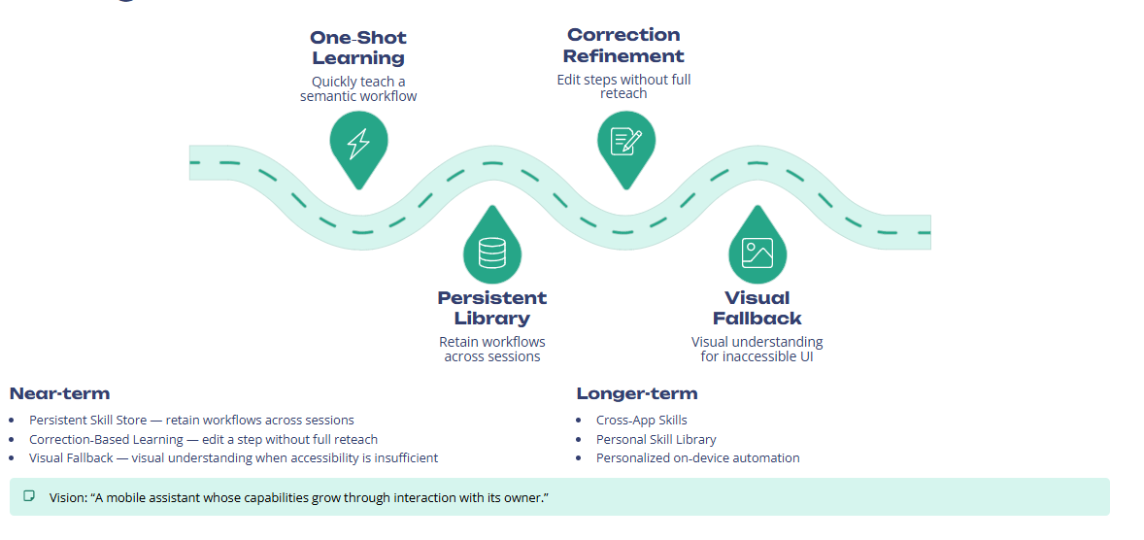
What’s next

Slide 10
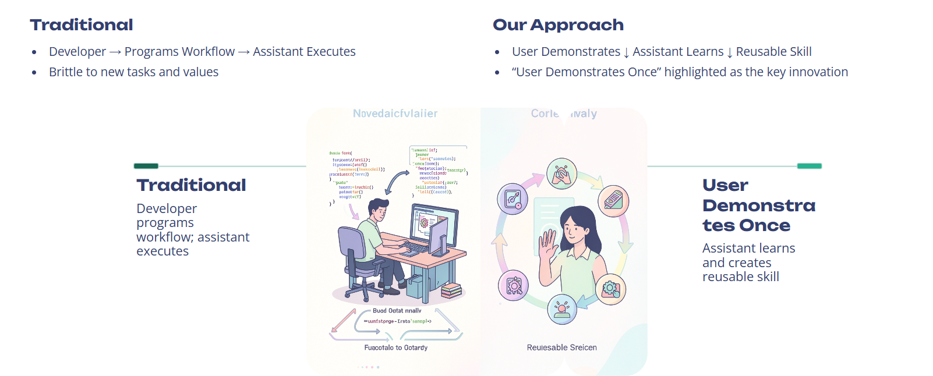
Brownie points slide( differentiation)

Slide 11
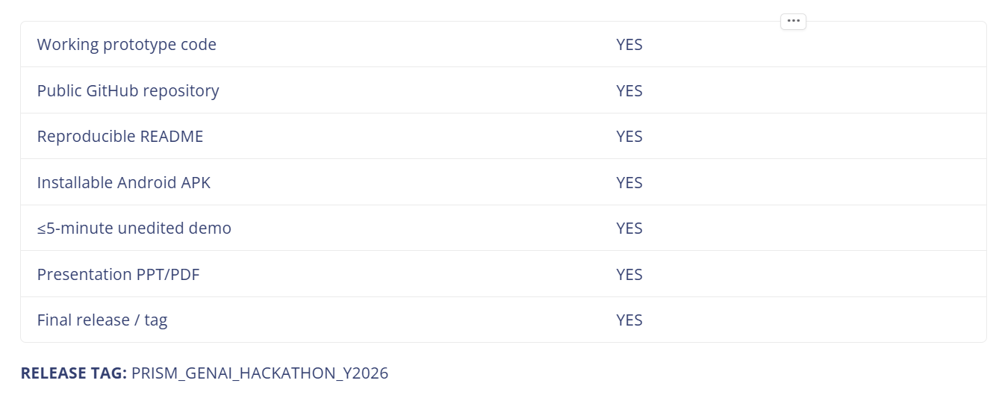
Checklist- Updated on Public GitHub
Working prototype code — public or shared GitHub repo (Y/N)
README with reproducible setup instructions (Y/N)
Demo video, max 5 minutes (YouTube or Drive link)
Presentation file (PPT or PDF) (Y/N)

Slide 12
Thank you
Organised by the Language AI Team and the PRISM Team, Samsung R&D Institute India
Notes:
Closing slide. Add the Google Form URL and a contact email before sharing. Edition 2 organising team for reference: Language AI - Sourabh Tiwari, Gaurav, Sanjeeth Pothireddy, Gorang Maniar; PRISM - Binny Lakra, Prakhar Chandrakar, Vishu Kumar; Kick-off and mentors - Giridhar Jakki, Deepraj Prabhakar Patkar (Language AI), Srimanu Prasad Nagaraju, Ashish Kumar (Tech Strategy).

