Slide 1
Python in Finance 2 - Final Project:
Prediction of 10-Year Treasury Notes prices
Stelmaszek Karolina 11942491
Ferrand Adrien 11942895
Logi Marco 11942485

Slide 2
Goal: predict the change in yield of 10-Year Treasury Notes
Data:
https://fred.stlouisfed.org/series/DGS10 (10-Year Treasury Notes yields)
https://fred.stlouisfed.org/series/NASDAQ100 (NASDAQ Index)
https://www.federalreserve.gov/ (Speeches and press releases of Federal Reserve Board)
From: Mid January 2006 to Mid June 2020 (with later adjustments)

Slide 3
Data preparation
Web scraper - Selenium (wait and download_sites functions) - no API!
A couple of articles omitted (very untypical structure)
Number of press releases: 3624 (all_pressreleases.csv)
Number of speeches: 809 (all_speaches.csv)
Changes in yields of treasury bonds and NASDAQ index saved in indexes2.csv

Slide 4
feature_engineering.ipynb
Two classes:
Preprocessing - introduces some relatively simple methods to get insight into the given table, methods:
change_time - changes data format from e.g. 10 May, 2020 to 2020-05-10
most_commons - finds the most common values in a column
most_common_unigrams_in_titles - finds the most common unigrams in titles
count_sentiment - computes sentiment for a given column
TextFeatures - computes new text features. Method: add_features, that calls following methods:
count_sentences - counts the number of words and sentences
count_categories - counts percentages of nouns, verbs, adjectives and adverbs
compute_ngrams - returns the most common unigrams, bigrams and trigrams for each article

Slide 5
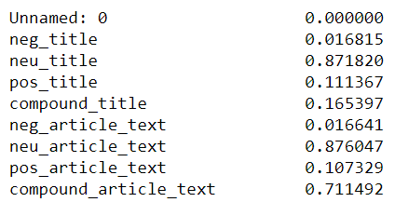
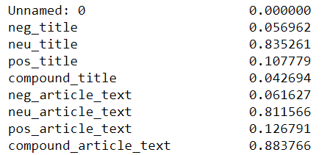
Sentiment analysis
Press Speech

Slide 6
New features
sentiment scores (positive, neutral, negative, compound) for columns with titles and texts
author_bin (if not None, than 1) - for press, for speech - check if a person in position of Governor, Chairman or Vice Chairman is the author
release_bin (if not For immediate release, than 1) - only for press
4 columns that show if a word (approval, termination, credit, result for press) appeared in the title - 3 for speech
percentages of nouns, verbs, adjectives in articles’ texts
6 columns that show if a bigram/trigram was the most frequent bigram/trigram for the article (3 for speech)
number of articles posted in a day

Slide 7
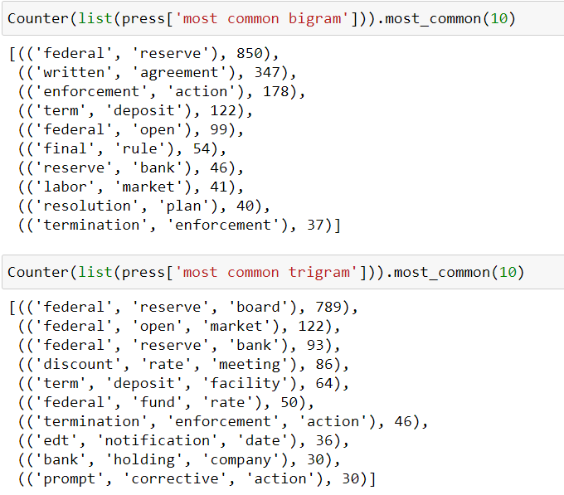
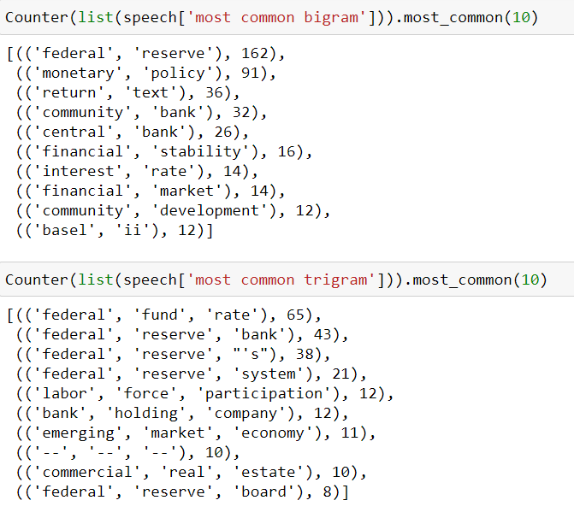
Most common bigrams and trigrams

Slide 8
models.ipynb
Two classes:
AlgorithmFinder - prints MSE for train and test dataset, finds the best set of hyperparameters for each model using Pipelines and GridSerachCV, methods:
find_the_best_tree (DecisionTreeRegressor)
find_the_best_xgboost (GradientBoostingRegressor)
find_the_best_net (MLPRegressor)
AlgorithmPresenter - visualises the results of algorithm for the dataset. Methods:
plot_importance - shows importance of features in the model
plot_true_and_prediction - shows the true values of y and the predicted y in one plot

Slide 9
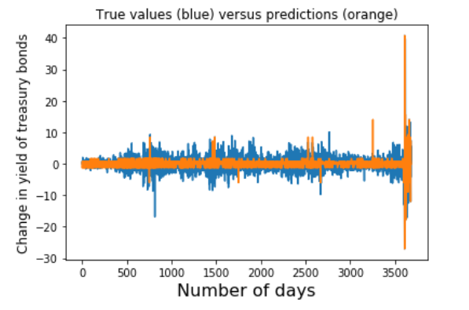
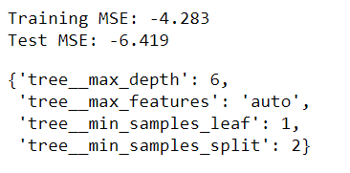
Decision trees (1)
Decision: remove outliers

Slide 10
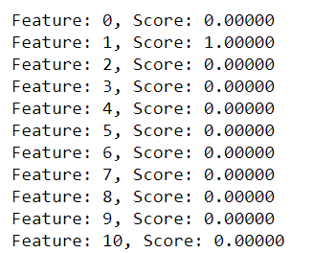
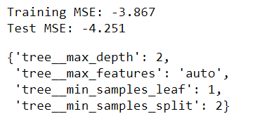
Decision trees (2)
Decision: remove Feature 1 (NASDAQ change)

Slide 11
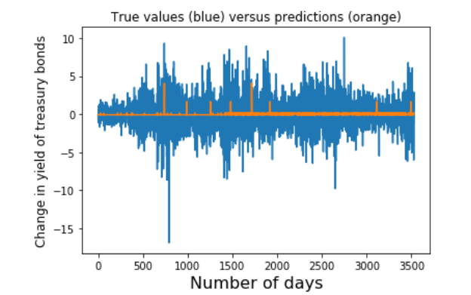
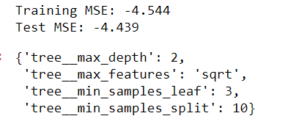
Decision trees (3)
And only 3 features important.
Decision: go to xgboost

Slide 12
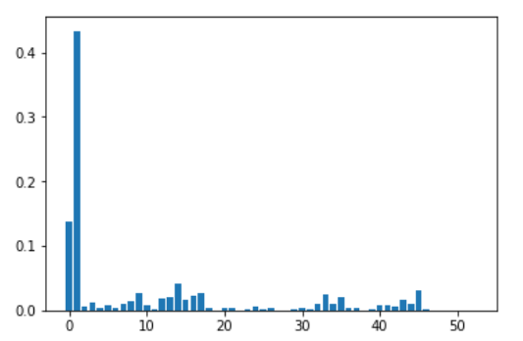

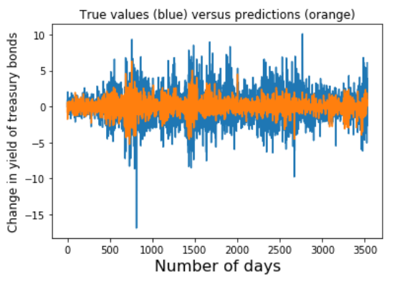
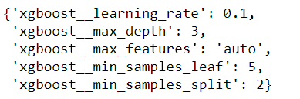
2. Xboost (1)
Feature importance
(1 + 2 -> financial indexes!)
What would happen for the whole dataset?

Slide 13
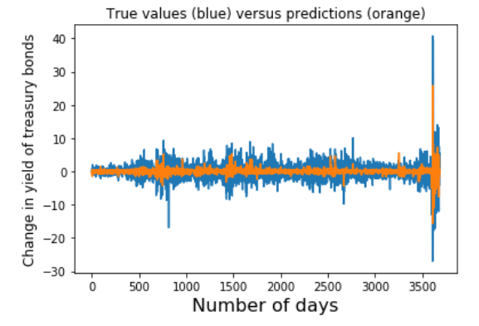

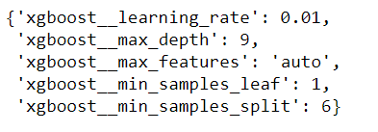
2. Xgboost (2)

Slide 14
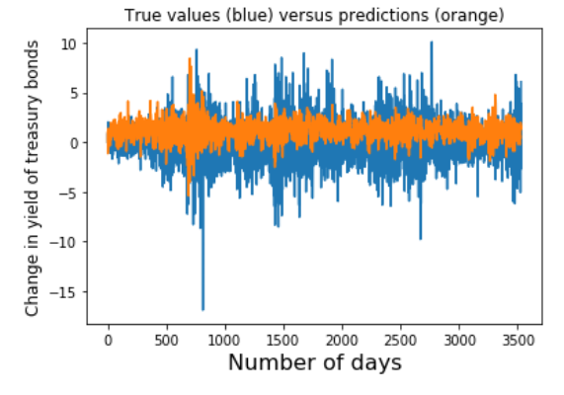

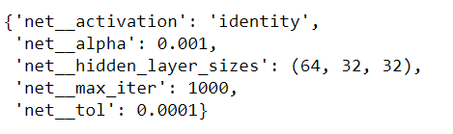
3. Neural net

Slide 15
The best model? - xgboost (1)
Model without outliers.
The lowest MSE among all models.
Feature importance visible.
But the hipotesis about text features impact on change in yields of 10 years treasury bonds not confirmed.

Slide 16
Areas of improvements?
Higher number of observations.
Finding sources with API instead of relatively slow Selenium.
Other Sentiment Scoring than Vader.
More financial indexes as features.

Slide 17
Thank you!

