Slide 1
ENGI 301 USB Audio Player PCB Proposal
11/15/21
Kevin Sun

Slide 2
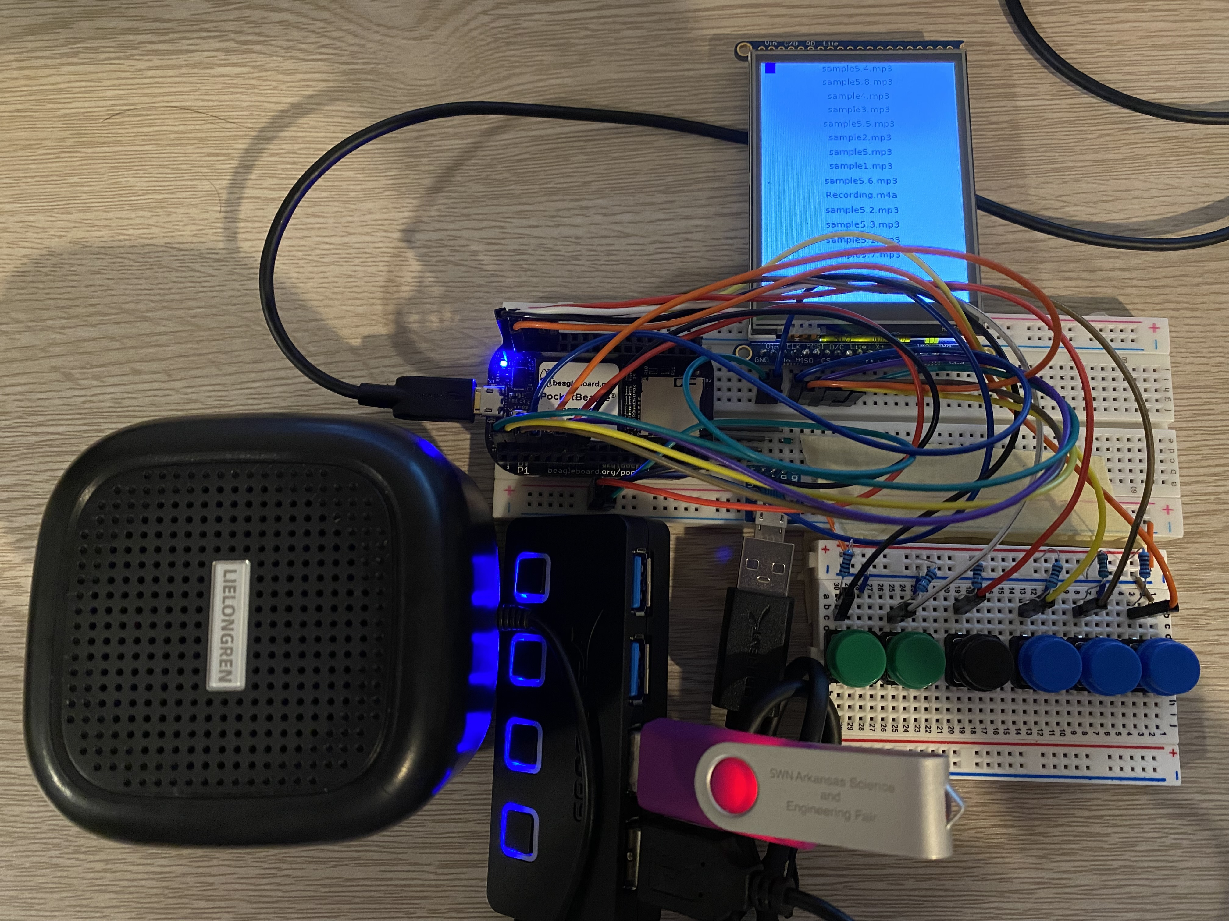
Background Information
The goal of this project is to create a PCB that will be used in a device which will read, display, and play songs from a USB drive.
The PCB will connect the Pocket Beagle buttons, Powered USB ports, and SPI screen of the device.
A detailed description of the previous build using the PocketBeagle on breadboards can be found here: https://www.hackster.io/432580/usb-music-player-with-the-pocketbeagle-0b1624
The code needed to run the project can be found here: https://github.com/ks76rice/ENGI301/tree/main/project_01

Slide 3
System Block Diagram
USB Speaker
USB Hub
USB Port
GPIO_IN (P2.02)
Button (Down)
USB
GPIO_IN (P2.04)
Button (Up)
GPIO_IN (P2.06)
Button (Play)
GPIO_IN (P2.08)
Button (Pause)
CLK (P1.08)
MISO (P1.10)
MOSI (P1.12)
CS (P1.06)
D/C (P1.04)
LCD (ILI9341)
Notes:
Going to need a USB speaker or could get a USB hub
Buttons will just user digital input
Look for libraries – aplay, adafruit for SPI SREENS

Slide 4
Components Required
Component List:
4X push buttons
LCD display
Power supply USB port
2x USB port
Pocket Beagle

Slide 5
Mechanical Block Diagram
5”
.1”
.1”
SPI Display
Button
.05”
Pocket Beagle
2”
.5”
USB
3”
3”
.1”
Button
Power Supply USB Port
USB Port
USB Port
.5”
.05”
.5”
.1”
.5”
.01”
FRONT
BACK

