Slide 1
ENGI 301 Soundboard Proposal
10/2/2021
Kevin Sun

Slide 2
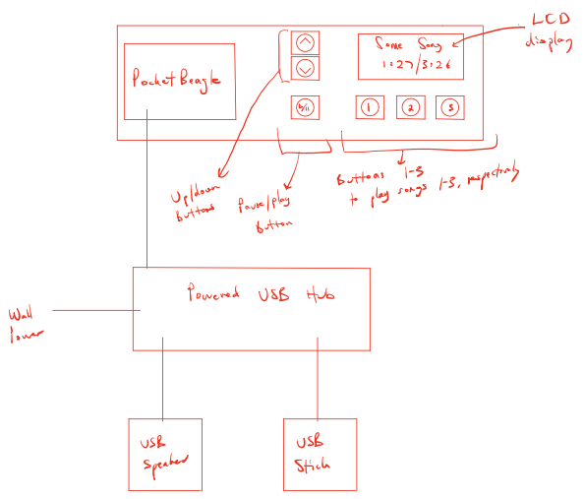
Background Information
Music has always been a large part of my life and I am constantly listening to it throughout the day. The way I listen to music is that I will find a few songs that I am really enjoying, then repeatedly play them. So, I thought it would be cool if I could create a soundboard that could save several songs, then replay each one with a respective button press.
The goal of this project is to create a soundboard that can save and playback audio samples when a button is pressed.
Features of the soundboard:
3 buttons that are each linked to a sound file
A display to show the name of the song and the length of the song
A start and stop button
Up/Down Selector Buttons for the user to scroll and select songs

Slide 3
Initial Sketch of Device

Slide 4
User Interface/Management
1. The user will download their music onto a folder on a USB drive.
2. The USB drive will be plugged into the powered USB hub, which will be recognized and read by the Pocket Beagle.
3. The LCD screen will display the songs on the USB, and the up/down selector buttons will allow the user to scroll through the song list to highlight songs.
4. The user will map a song to a button by highlighting the desired song, then holding the desired button down for 3 seconds.
5. The Pocket Beagle will save the song to its SD drive and map the song to the indicated button.
6. Once a song button is pressed, its mapped song will be played through the USB speakers.

Slide 5
System Block Diagram
USB Speaker
USB Hub
USB Port
GPIO_IN (P2.02)
Button (Down)
USB
GPIO_IN (P2.04)
Button (Up)
GPIO_IN (P2.06)
Button (Play/Pause)
GPIO_IN (P1.18)
Button (Song 1)
CLK (P1.08)
MISO (P1.10)
MOSI (P1.12)
CS (P1.06)
D/C (P1.04)
GPIO_IN (P1.20)
Button (Song 2)
LCD (ILI9341)
GPIO_IN (P1.22)
Button (Song 3)
Notes:
Going to need a USB speaker or could get a USB hub
Buttons will just user digital input
Look for libraries – aplay, adafruit for SPI SREENS

Slide 6
Power Block Diagram
3.3 Volts Components (Up to 6 mA)
Wall Power (5V)
3.3 Volts
Button
GPIO_IN (P2.02)
USB Speaker
3.3 Volts
Button
GPIO_IN (P2.02)
5V, 350mA
5 Volts Component (Up to 900 mA)
5 Volts
3.3 Volts
Button
USB
GPIO_IN (P2.02)
5V, 350mA
USB Hub
3.3 Volts
Button
GPIO_IN (P2.02)
3.3 Volts
Button
USB
5 Volts Component (Up to 150 mA)
GPIO_IN (P2.02)
5 Volts
3.3 Volts
Button
VOUT (P1.24)
GPIO_IN (P2.02)
LCD
Notes:
NEED 5v COMING IN FROM THE WALL TO HUB AND POCKETBEAGLE.

Slide 7
Components / Budget
Component | Need to Buy | Cost
USB Speaker (https://www.amazon.com/Logitech-S150-Speakers-Digital-Sound/dp/B000ZH98LU) | 1 | 11.99
Button x 6 | 0 (included in kits) | -
Powered USB Port: https://www.amazon.com/Apanage-Splitter-Charging-Individual-Extension/dp/B08XXP29YX/ref=sr_1_14?dchild=1&keywords=powered+usb+hub&qid=1633591108&s=electronics&sr=1-14 | 1 | 28.99
LCD Screen (https://www.adafruit.com/product/1770) | 1 | 29.95
Need all components to be purchased by instructor listed; additional components may be purchased by student

