Slide 1
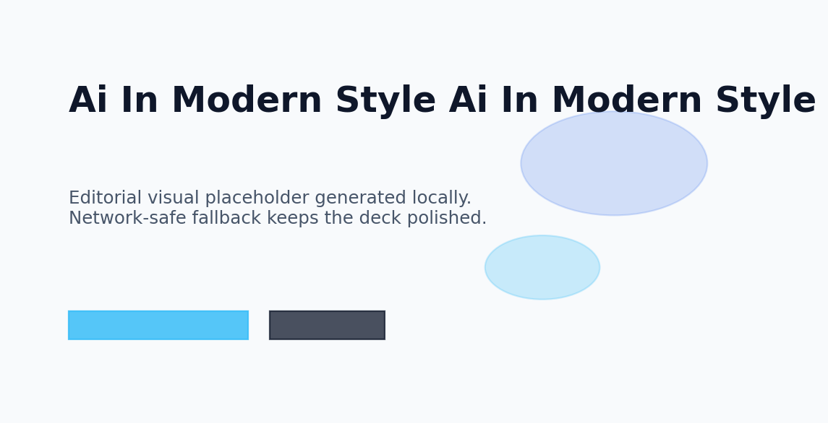
JARVIS
Ai In Modern Style
Professional overview for general audience
10 May 2026
Jarvis AI Presentation Engine

Slide 2
Agenda
JARVIS
Designed and composed automatically by Jarvis.
A clear roadmap keeps the story focused and easy to follow.
01
Why Ai In Modern Style Matters
Outcome
A presentation that moves from orientation to insight and finishes with a confident takeaway.
02
Understanding Ai In Modern Style
03
How Ai In Modern Style Works
04
Applications of Ai In Modern Style
05
Ai In Modern Style in Focus

Slide 3
Why Ai In Modern Style Matters
JARVIS
Designed and composed automatically by Jarvis.
Ai In Modern Style creates clearer decisions across teams
Why Ai In Modern Style Matters connects strategy with practical execution
General Audience benefit from simple, structured framing
Strong fundamentals improve confidence and adoption
Focused examples make ai in modern style easier to apply
Strategic Lens
Why Ai In Modern Style Matters should feel practical, digestible, and ready for discussion.
Keep the audience oriented with clean hierarchy and one clear idea per region.
Why Ai In Modern Style Matters frames Ai In Modern Style as a practical, high-value capability. The goal is to move from awareness to action with confident, understandable decisions.

Slide 4
Understanding Ai In Modern Style
JARVIS
Designed and composed automatically by Jarvis.
Ai In Modern Style creates clearer decisions across teams
Understanding Ai In Modern Style connects strategy with practical execution
General Audience benefit from simple, structured framing
Strong fundamentals improve confidence and adoption
Focused examples make ai in modern style easier to apply
Strategic Lens
Understanding Ai In Modern Style should feel practical, digestible, and ready for discussion.
Keep the audience oriented with clean hierarchy and one clear idea per region.
Understanding Ai In Modern Style frames Ai In Modern Style as a practical, high-value capability. The goal is to move from awareness to action with confident, understandable decisions.

Slide 5
How Ai In Modern Style Works
JARVIS
Designed and composed automatically by Jarvis.
Ai In Modern Style creates clearer decisions across teams
How Ai In Modern Style Works connects strategy with practical execution
General Audience benefit from simple, structured framing
Strong fundamentals improve confidence and adoption
Focused examples make ai in modern style easier to apply
Strategic Lens
How Ai In Modern Style Works should feel practical, digestible, and ready for discussion.
Keep the audience oriented with clean hierarchy and one clear idea per region.
How Ai In Modern Style Works frames Ai In Modern Style as a practical, high-value capability. The goal is to move from awareness to action with confident, understandable decisions.

Slide 6
Applications of Ai In Modern Style
JARVIS
Designed and composed automatically by Jarvis.
Ai In Modern Style creates clearer decisions across teams
Applications of Ai In Modern Style connects strategy with practical execution
General Audience benefit from simple, structured framing
Strong fundamentals improve confidence and adoption
Focused examples make ai in modern style easier to apply
Strategic Lens
Applications of Ai In Modern Style should feel practical, digestible, and ready for discussion.
Keep the audience oriented with clean hierarchy and one clear idea per region.
Applications of Ai In Modern Style frames Ai In Modern Style as a practical, high-value capability. The goal is to move from awareness to action with confident, understandable decisions.

Slide 7
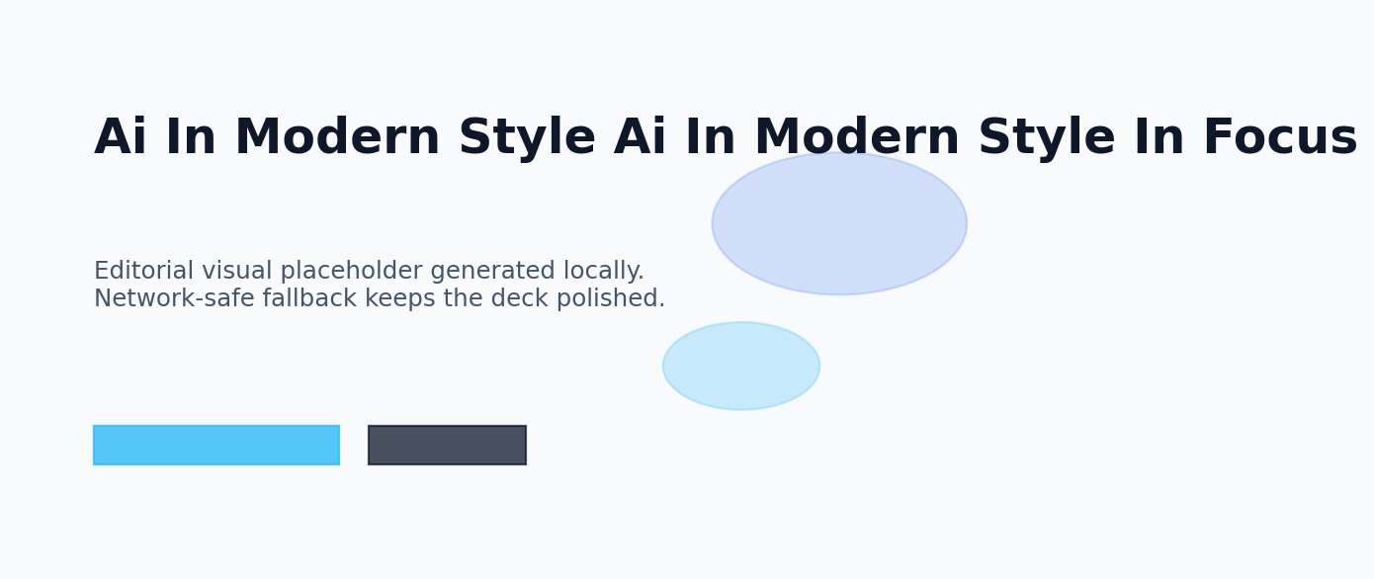
Ai In Modern Style in Focus
JARVIS
Designed and composed automatically by Jarvis.
A visual narrative showing how ai in modern style shapes outcomes.
Modern editorial illustration around ai in modern style with layered depth.
VISUAL

Slide 8
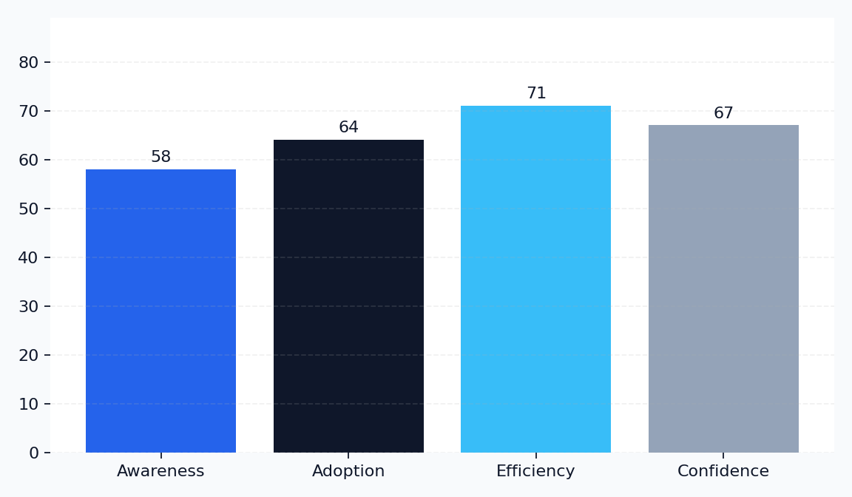
Ai In Modern Style by the Numbers
JARVIS
Designed and composed automatically by Jarvis.
Key Metrics
Awareness: 58%
Adoption: 64%
Efficiency: 71%
Confidence: 67%
Momentum around ai in modern style is strongest where clarity, adoption, and trust align.

Slide 9

Comparing Approaches in Ai In Modern Style
JARVIS
Designed and composed automatically by Jarvis.
Current State
Preferred Direction
Ai In Modern Style handled inconsistently
Manual effort slows decision cycles
Limited visibility across stakeholders
Reactive improvements only
Ai In Modern Style managed strategically
Clear workflows accelerate delivery
Shared metrics improve alignment
Proactive decisions raise confidence

Slide 10
The Future of Ai In Modern Style
JARVIS
Designed and composed automatically by Jarvis.
Ai In Modern Style creates clearer decisions across teams
The Future of Ai In Modern Style connects strategy with practical execution
General Audience benefit from simple, structured framing
Strong fundamentals improve confidence and adoption
Focused examples make ai in modern style easier to apply
Strategic Lens
The Future of Ai In Modern Style should feel practical, digestible, and ready for discussion.
Keep the audience oriented with clean hierarchy and one clear idea per region.
The Future of Ai In Modern Style frames Ai In Modern Style as a practical, high-value capability. The goal is to move from awareness to action with confident, understandable decisions.

Slide 11
Key Takeaways
JARVIS
Designed and composed automatically by Jarvis.
Ai In Modern Style creates clearer decisions across teams
Key Takeaways connects strategy with practical execution
General Audience benefit from simple, structured framing
Strong fundamentals improve confidence and adoption
Focused examples make ai in modern style easier to apply
Strategic Lens
Key Takeaways should feel practical, digestible, and ready for discussion.
Keep the audience oriented with clean hierarchy and one clear idea per region.
Key Takeaways frames Ai In Modern Style as a practical, high-value capability. The goal is to move from awareness to action with confident, understandable decisions.

Slide 12
Thank You
JARVIS
Designed and composed automatically by Jarvis.
Strategic Lens
Thank You should feel practical, digestible, and ready for discussion.
Keep the audience oriented with clean hierarchy and one clear idea per region.

Slide 13
JARVIS
Thank You
Questions on Ai In Modern Style are welcome.
JARVIS AI

