Slide 1
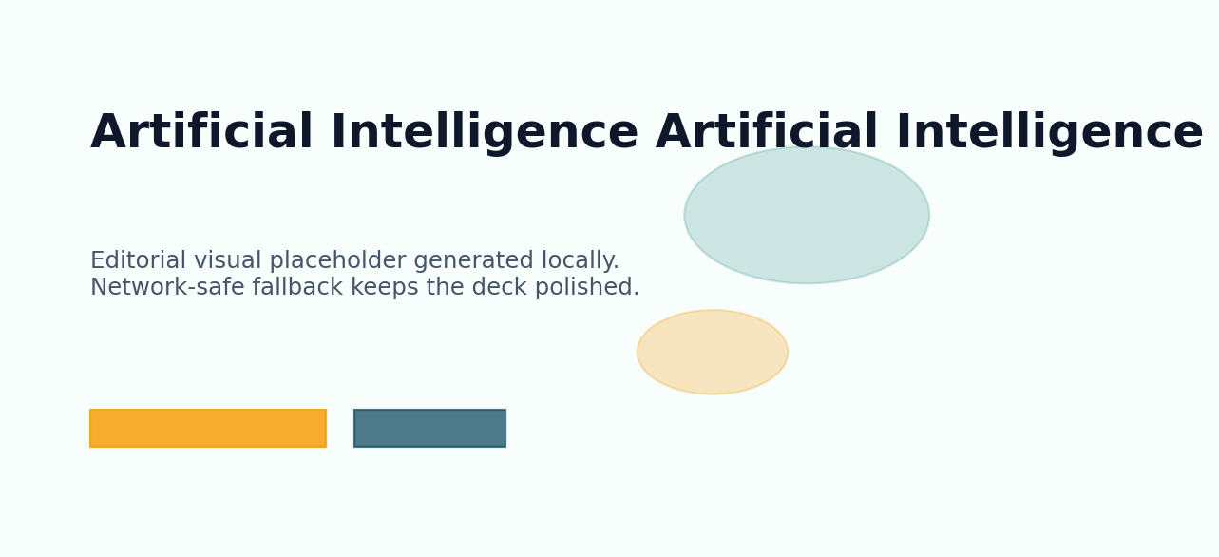
JARVIS
Artificial Intelligence
Educational overview for students
09 May 2026
Jarvis AI Presentation Engine

Slide 2
Agenda
JARVIS
Designed and composed automatically by Jarvis.
A clear roadmap keeps the story focused and easy to follow.
01
Why Artificial Intelligence Matters
Outcome
A presentation that moves from orientation to insight and finishes with a confident takeaway.
02
Introducing Artificial Intelligence
03
Core Principles of Artificial Intelligence
04
Artificial Intelligence in Focus
05
Artificial Intelligence by the Numbers

Slide 3
Why Artificial Intelligence Matters
JARVIS
Designed and composed automatically by Jarvis.
Artificial Intelligence becomes easier through familiar examples
Start with concepts before advanced detail
Patterns help learners remember core ideas
Questions deepen understanding and curiosity
Simple comparisons reveal how systems behave
Strategic Lens
Why Artificial Intelligence Matters should feel practical, digestible, and ready for discussion.
Keep the audience oriented with clean hierarchy and one clear idea per region.
Why Artificial Intelligence Matters introduces Artificial Intelligence in approachable language so learners can connect ideas, remember the essentials, and build toward deeper understanding.

Slide 4
Introducing Artificial Intelligence
JARVIS
Designed and composed automatically by Jarvis.
Artificial Intelligence becomes easier through familiar examples
Start with concepts before advanced detail
Patterns help learners remember core ideas
Questions deepen understanding and curiosity
Simple comparisons reveal how systems behave
Strategic Lens
Introducing Artificial Intelligence should feel practical, digestible, and ready for discussion.
Keep the audience oriented with clean hierarchy and one clear idea per region.
Introducing Artificial Intelligence introduces Artificial Intelligence in approachable language so learners can connect ideas, remember the essentials, and build toward deeper understanding.

Slide 5
Core Principles of Artificial Intelligence
JARVIS
Designed and composed automatically by Jarvis.
Artificial Intelligence becomes easier through familiar examples
Start with concepts before advanced detail
Patterns help learners remember core ideas
Questions deepen understanding and curiosity
Simple comparisons reveal how systems behave
Strategic Lens
Core Principles of Artificial Intelligence should feel practical, digestible, and ready for discussion.
Keep the audience oriented with clean hierarchy and one clear idea per region.
Core Principles of Artificial Intelligence introduces Artificial Intelligence in approachable language so learners can connect ideas, remember the essentials, and build toward deeper understanding.

Slide 6
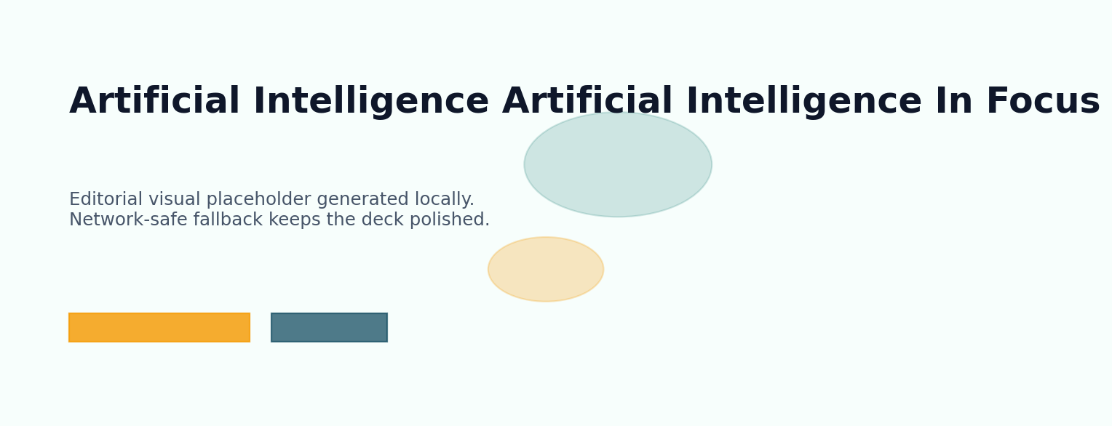
Artificial Intelligence in Focus
JARVIS
Designed and composed automatically by Jarvis.
A visual narrative showing how artificial intelligence shapes outcomes.
Modern editorial illustration around artificial intelligence with layered depth.
VISUAL

Slide 7
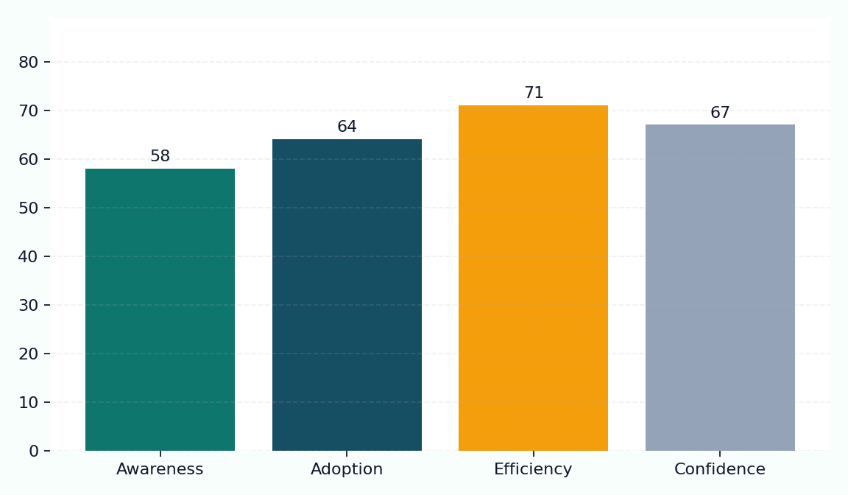
Artificial Intelligence by the Numbers
JARVIS
Designed and composed automatically by Jarvis.
Key Metrics
Awareness: 58%
Adoption: 64%
Efficiency: 71%
Confidence: 67%
Momentum around artificial intelligence is strongest where clarity, adoption, and trust align.

Slide 8

Comparing Approaches in Artificial Intelligence
JARVIS
Designed and composed automatically by Jarvis.
Current State
Preferred Direction
Artificial Intelligence handled inconsistently
Manual effort slows decision cycles
Limited visibility across stakeholders
Reactive improvements only
Artificial Intelligence managed strategically
Clear workflows accelerate delivery
Shared metrics improve alignment
Proactive decisions raise confidence

Slide 9
The Future of Artificial Intelligence
JARVIS
Designed and composed automatically by Jarvis.
Artificial Intelligence becomes easier through familiar examples
Start with concepts before advanced detail
Patterns help learners remember core ideas
Questions deepen understanding and curiosity
Simple comparisons reveal how systems behave
Strategic Lens
The Future of Artificial Intelligence should feel practical, digestible, and ready for discussion.
Keep the audience oriented with clean hierarchy and one clear idea per region.
The Future of Artificial Intelligence introduces Artificial Intelligence in approachable language so learners can connect ideas, remember the essentials, and build toward deeper understanding.

Slide 10
Key Takeaways
JARVIS
Designed and composed automatically by Jarvis.
Artificial Intelligence becomes easier through familiar examples
Start with concepts before advanced detail
Patterns help learners remember core ideas
Questions deepen understanding and curiosity
Simple comparisons reveal how systems behave
Strategic Lens
Key Takeaways should feel practical, digestible, and ready for discussion.
Keep the audience oriented with clean hierarchy and one clear idea per region.
Key Takeaways introduces Artificial Intelligence in approachable language so learners can connect ideas, remember the essentials, and build toward deeper understanding.

Slide 11
Thank You
JARVIS
Designed and composed automatically by Jarvis.
Strategic Lens
Thank You should feel practical, digestible, and ready for discussion.
Keep the audience oriented with clean hierarchy and one clear idea per region.

Slide 12
JARVIS
Thank You
Questions on Artificial Intelligence are welcome.
JARVIS AI

