Slide 1
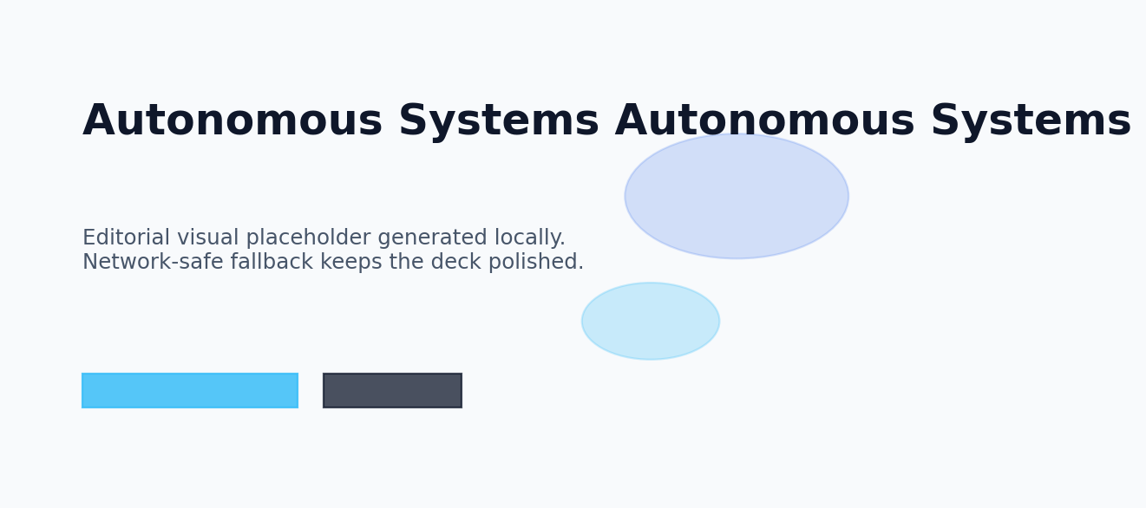
JARVIS
Autonomous Systems
Technical overview for engineers
10 May 2026
Jarvis AI Presentation Engine

Slide 2
Agenda
JARVIS
Designed and composed automatically by Jarvis.
A clear roadmap keeps the story focused and easy to follow.
01
Why Autonomous Systems Matters
Outcome
A presentation that moves from orientation to insight and finishes with a confident takeaway.
02
Autonomous Systems System Overview
03
Autonomous Systems Architecture and Flow
04
Autonomous Systems in Focus
05
Autonomous Systems by the Numbers

Slide 3
Why Autonomous Systems Matters
JARVIS
Designed and composed automatically by Jarvis.
Autonomous Systems depends on reliable architecture choices
Clear interfaces reduce integration friction
Observability improves performance and resilience
Trade-offs should be explicit and measurable
Scalable patterns support long-term maintainability
Strategic Lens
Why Autonomous Systems Matters should feel practical, digestible, and ready for discussion.
Keep the audience oriented with clean hierarchy and one clear idea per region.
Why Autonomous Systems Matters explains how Autonomous Systems behaves in real systems, where architecture, data flow, and operational reliability matter as much as the concept itself.

Slide 4
Autonomous Systems System Overview
JARVIS
Designed and composed automatically by Jarvis.
Autonomous Systems depends on reliable architecture choices
Clear interfaces reduce integration friction
Observability improves performance and resilience
Trade-offs should be explicit and measurable
Scalable patterns support long-term maintainability
Strategic Lens
Autonomous Systems System Overview should feel practical, digestible, and ready for discussion.
Keep the audience oriented with clean hierarchy and one clear idea per region.
Autonomous Systems System Overview explains how Autonomous Systems behaves in real systems, where architecture, data flow, and operational reliability matter as much as the concept itself.

Slide 5
Autonomous Systems Architecture and Flow
JARVIS
Designed and composed automatically by Jarvis.
Autonomous Systems depends on reliable architecture choices
Clear interfaces reduce integration friction
Observability improves performance and resilience
Trade-offs should be explicit and measurable
Scalable patterns support long-term maintainability
Strategic Lens
Autonomous Systems Architecture and Flow should feel practical, digestible, and ready for discussion.
Keep the audience oriented with clean hierarchy and one clear idea per region.
Autonomous Systems Architecture and Flow explains how Autonomous Systems behaves in real systems, where architecture, data flow, and operational reliability matter as much as the concept itself.

Slide 6
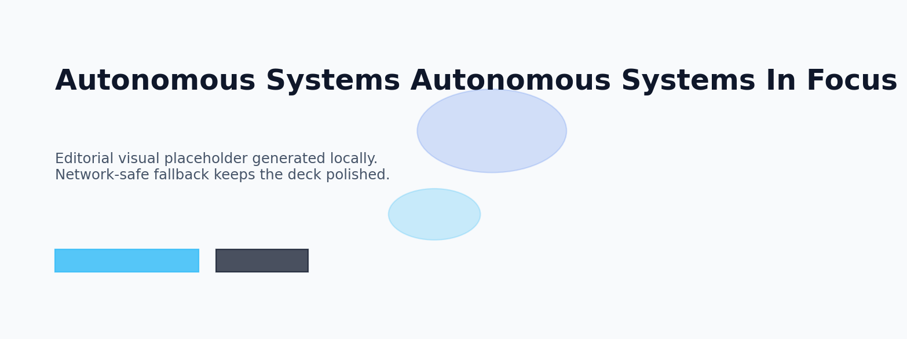
Autonomous Systems in Focus
JARVIS
Designed and composed automatically by Jarvis.
A visual narrative showing how autonomous systems shapes outcomes.
Modern editorial illustration around autonomous systems with layered depth.
VISUAL

Slide 7
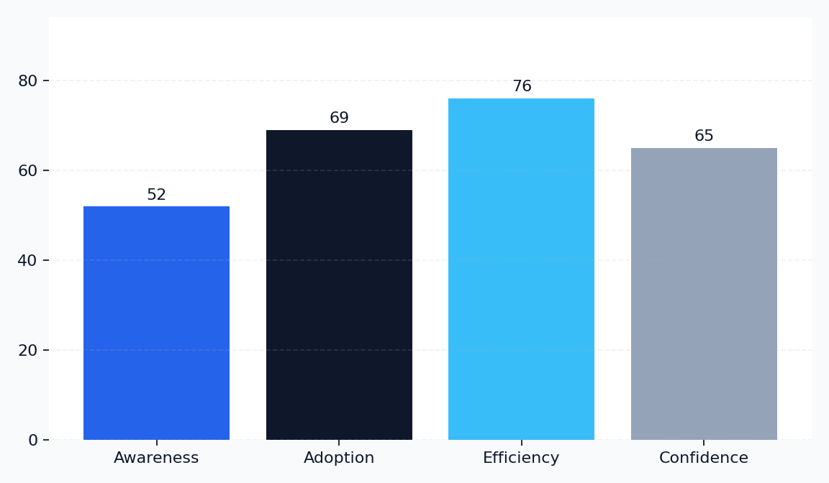
Autonomous Systems by the Numbers
JARVIS
Designed and composed automatically by Jarvis.
Key Metrics
Awareness: 52%
Adoption: 69%
Efficiency: 76%
Confidence: 65%
Momentum around autonomous systems is strongest where clarity, adoption, and trust align.

Slide 8

Comparing Approaches in Autonomous Systems
JARVIS
Designed and composed automatically by Jarvis.
Current State
Preferred Direction
Autonomous Systems handled inconsistently
Manual effort slows decision cycles
Limited visibility across stakeholders
Reactive improvements only
Autonomous Systems managed strategically
Clear workflows accelerate delivery
Shared metrics improve alignment
Proactive decisions raise confidence

Slide 9
The Future of Autonomous Systems
JARVIS
Designed and composed automatically by Jarvis.
Autonomous Systems depends on reliable architecture choices
Clear interfaces reduce integration friction
Observability improves performance and resilience
Trade-offs should be explicit and measurable
Scalable patterns support long-term maintainability
Strategic Lens
The Future of Autonomous Systems should feel practical, digestible, and ready for discussion.
Keep the audience oriented with clean hierarchy and one clear idea per region.
The Future of Autonomous Systems explains how Autonomous Systems behaves in real systems, where architecture, data flow, and operational reliability matter as much as the concept itself.

Slide 10
Key Takeaways
JARVIS
Designed and composed automatically by Jarvis.
Autonomous Systems depends on reliable architecture choices
Clear interfaces reduce integration friction
Observability improves performance and resilience
Trade-offs should be explicit and measurable
Scalable patterns support long-term maintainability
Strategic Lens
Key Takeaways should feel practical, digestible, and ready for discussion.
Keep the audience oriented with clean hierarchy and one clear idea per region.
Key Takeaways explains how Autonomous Systems behaves in real systems, where architecture, data flow, and operational reliability matter as much as the concept itself.

Slide 11
Thank You
JARVIS
Designed and composed automatically by Jarvis.
Strategic Lens
Thank You should feel practical, digestible, and ready for discussion.
Keep the audience oriented with clean hierarchy and one clear idea per region.

Slide 12
JARVIS
Thank You
Questions on Autonomous Systems are welcome.
JARVIS AI

