Slide 1
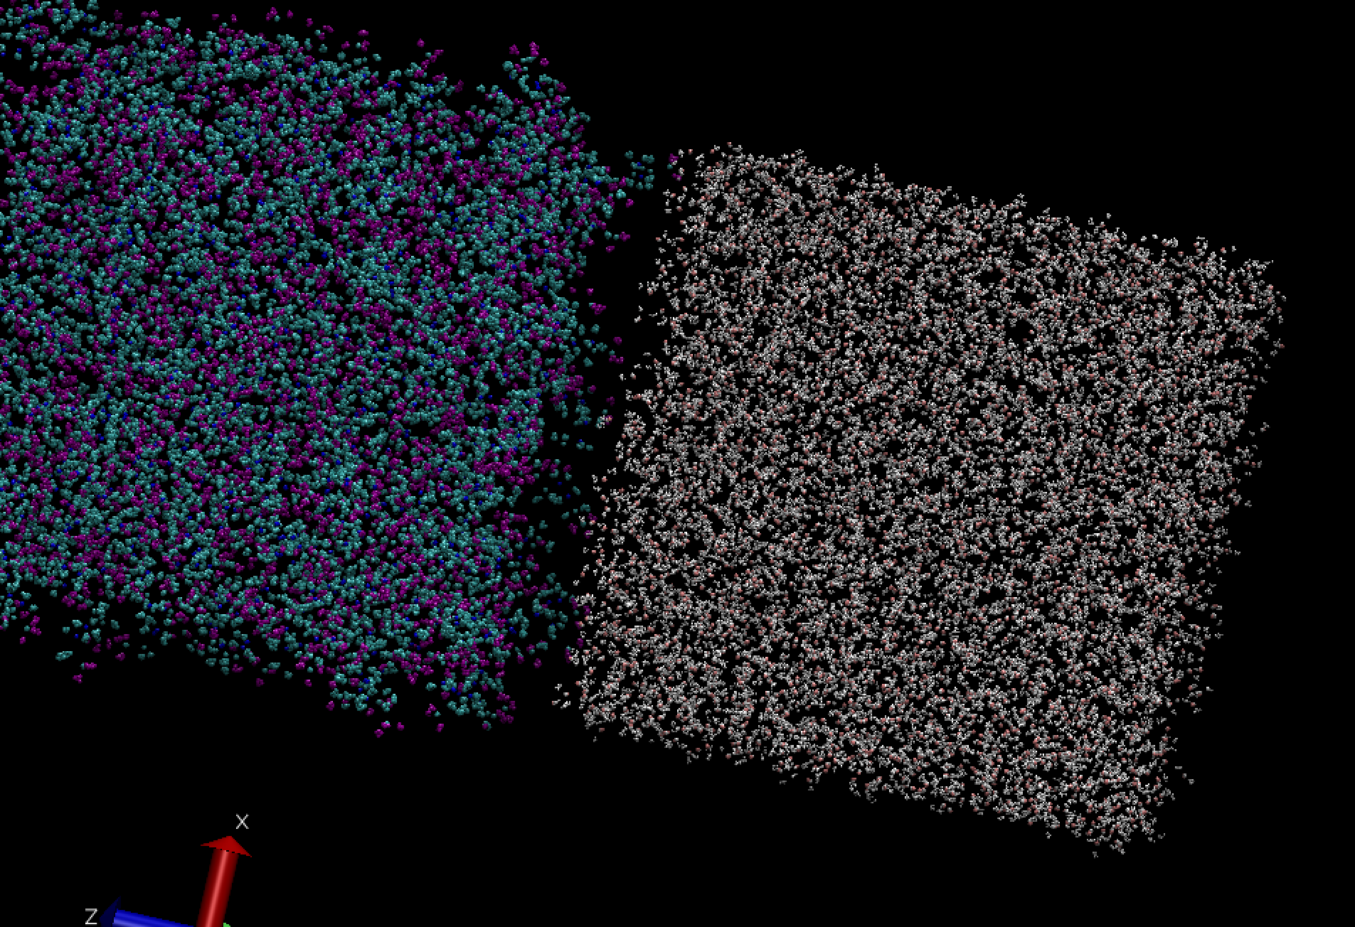
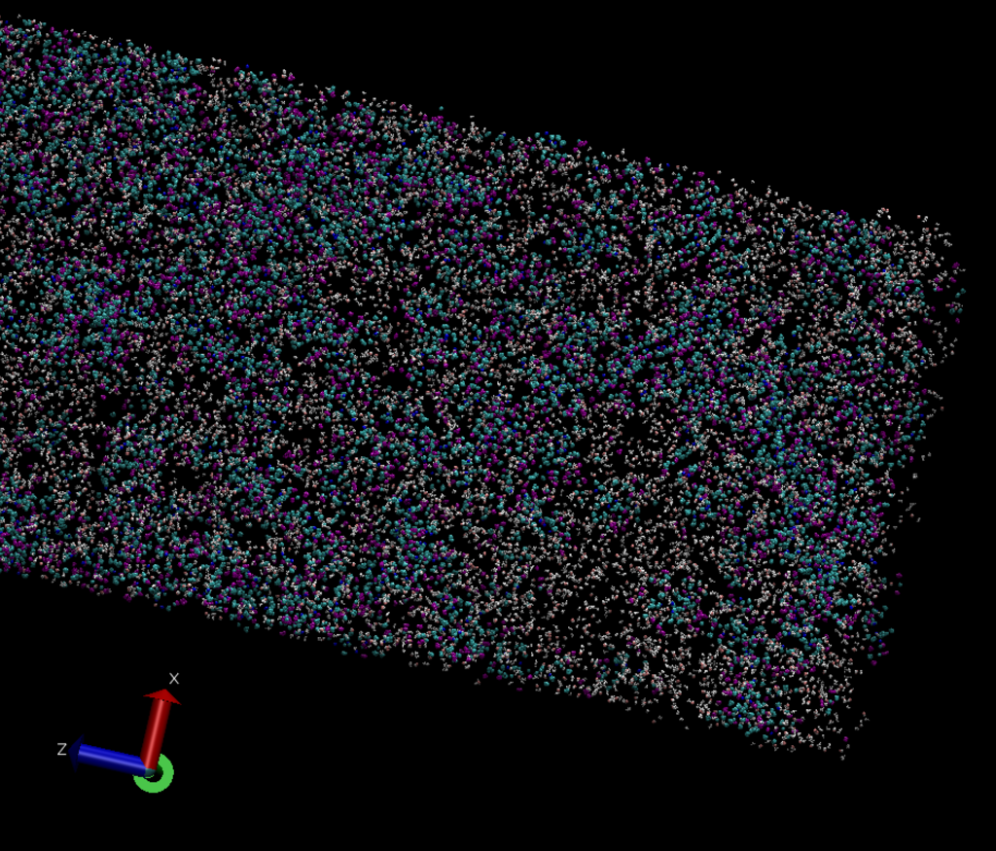
Previous Progress: DASH
t = 0 fs
t = 200,000 fs

Slide 2
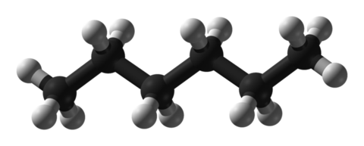
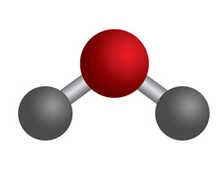
Previous Progress: DASH
Next Steps:
Implement q-TIP4P/F in LAMMPS to check interactions with TAFFI
In DASH, using TAFFI + q-TIP4P/F, check:
Arithmetic mixing
Geometric mixing
Waldman-Hagler mixing
One versus multiple beads
OPLS interaction parameters for hexane
Once simulation problem is diagnosed, move on to measuring fundamental interfacial properties

Slide 3
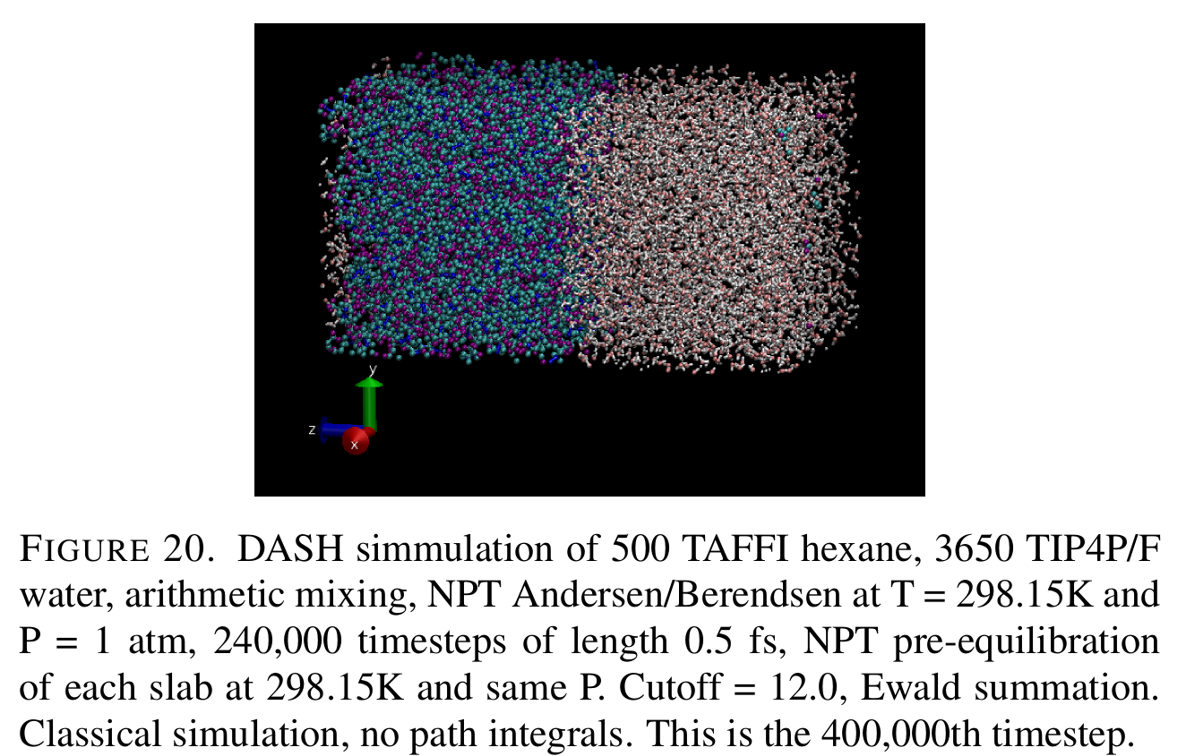
Current Progress: DASH
Diagnosed Problem:
Issue with adding long-range electrostatics (Ewald) correctly in DASH script
Now, system appears to be working correctly for both classical and path integral systems

Slide 4
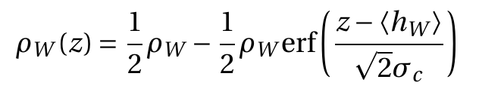
Current Progress: Calculating Density Profiles
Calculation of Water Density Profile:
NPT simulation, 300 ps equilibration and 1 ps production run, computing density in 200 slabs along the z-axis every 5 fs
Fit the water density profile to:

Slide 5
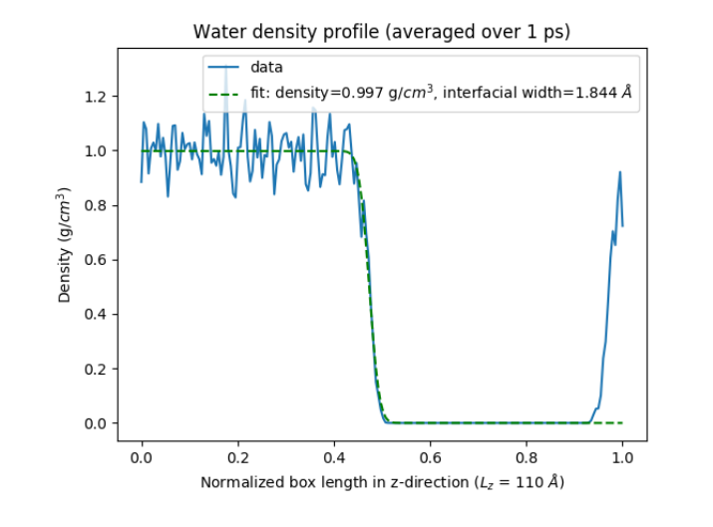
Current Progress: Calculating Density Profiles
Calculation of Water Density Profile:
NPT simulation, 300 ps equilibration and 1 ps production run, computing density in 200 slabs along the z-axis every 5 fs
Fit the water density profile to:
Interfacial width of close to 2 Angstroms, which is in line with previous theoretical and experimental work that places the width between 2 and 4 Angstroms

Slide 6
Next Steps
Calculate Full Density Profile
Add hexane
Run over longer production trajectory (~200 ps)
Compute Interfacial Tension
Compute Molecular Orientation

