Slide 1
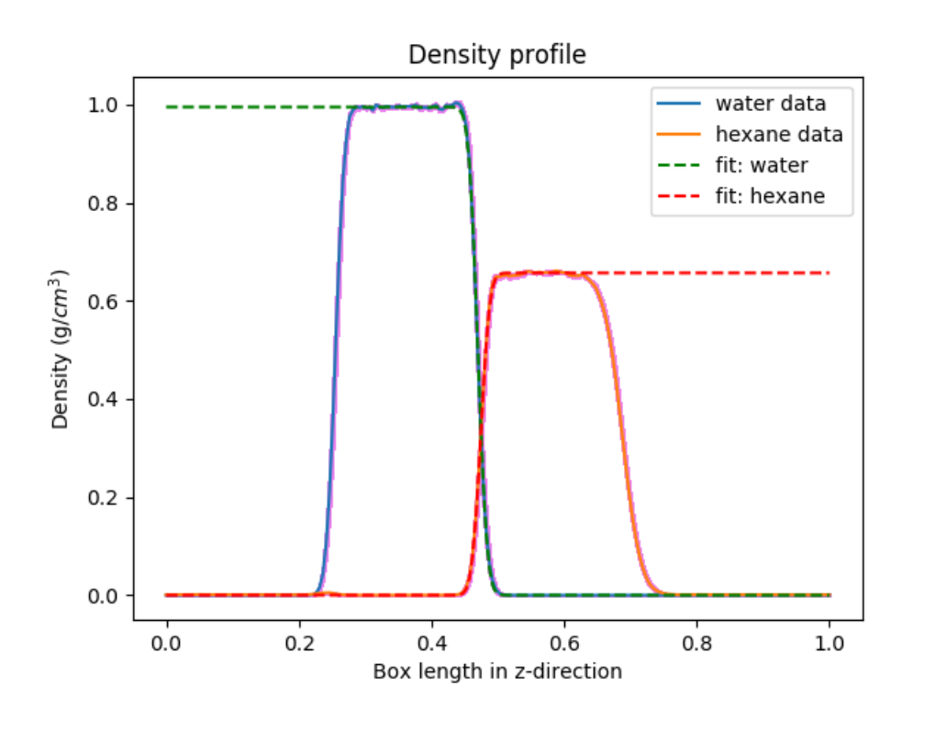
We performed an NVT simulation with an expanded box size using:
1, 16, and 32 beads

Slide 2
Nuclear quantum effects might not influence the interfacial width
Property | Our System 1 Bead | Our System 16 Beads | Our System 32 Beads | Patel and Brooks (2006) | Wick et al. (2012)
Bulk water density (g/ml) | 0.995 | 0.990 | 0.991 | 0.986 | 1.00
Bulk hexane density (g/ml) | 0.657 | 0.636 | 0.636 | 0.684 | 0.65
Intrinsic width (Angstroms) | 0.656 +/- .007 | 0.677 +/- 0.009 | 0.685 +/- 0.015 | 0.366 | 0.498
Average thermal width (Angstroms) | 1.533 +/- 0.047 | 1.459 +/- 0.043 | 1.507 +/- 0.073 | 1.89 | 3.00
Simulation Details:
- q-TIP4P/F and TAFFI force fields
- NVT Andersen T = 298.15 K equilibration for 1000 ps
- NVT production run for 2000 ps
- rcut = 12 Angstroms
- 500 hexane molecules, 3650 water molecules

Slide 3
Primary Next Steps
Currently running the analysis for molecular orientation
Simulate at lower temperatures
3. Confirm implementation of force fields by calculating radial distribution functions

