Slide 1
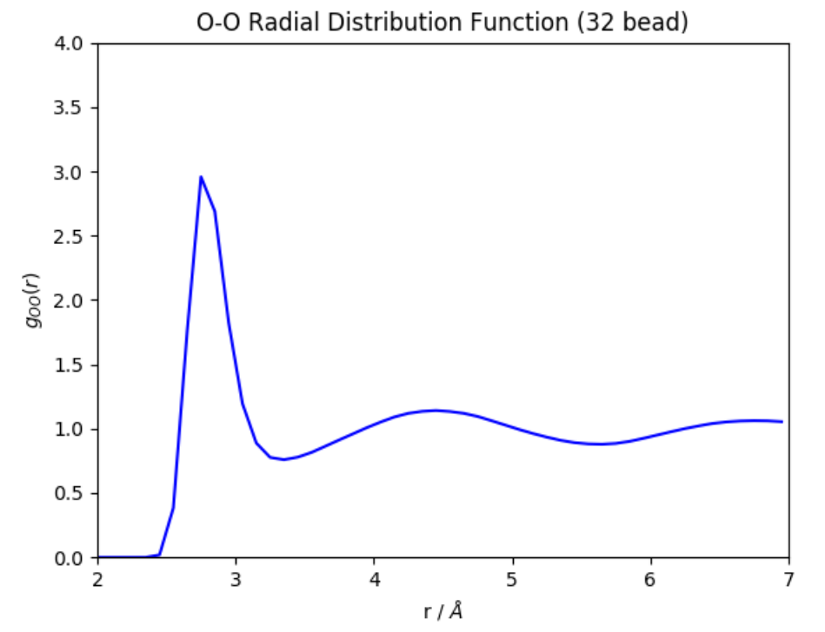
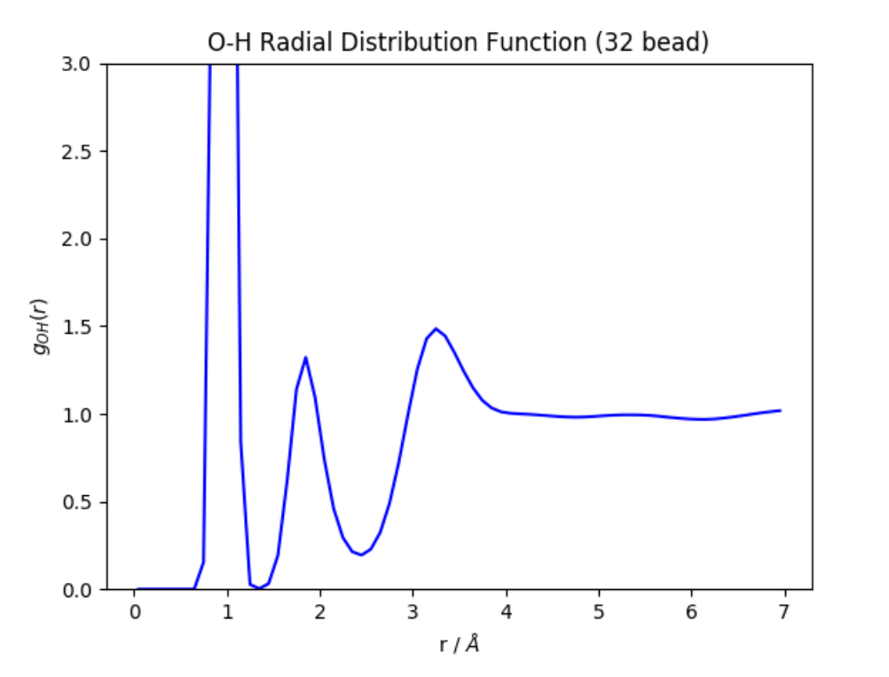
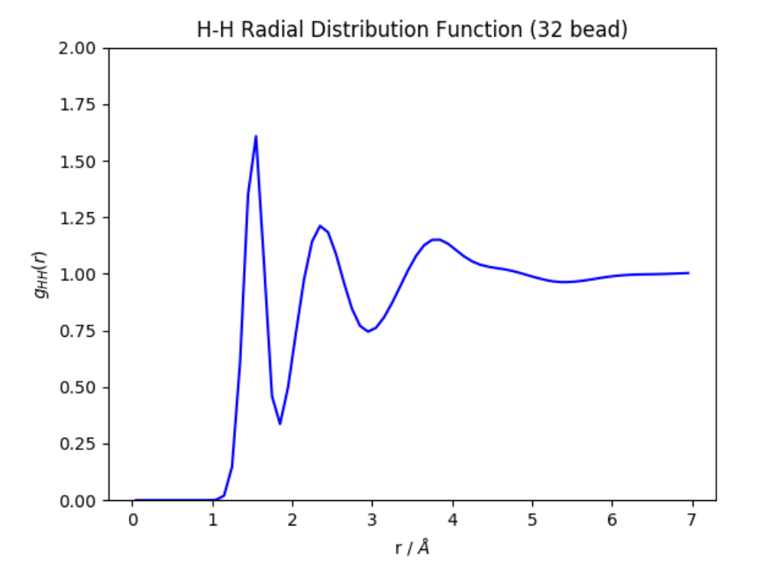
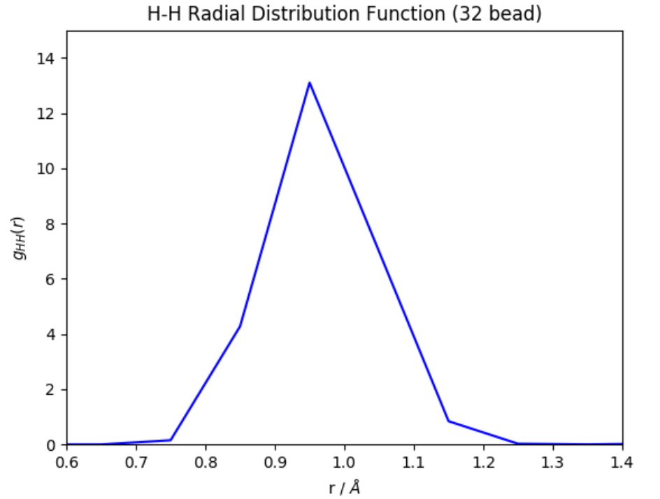
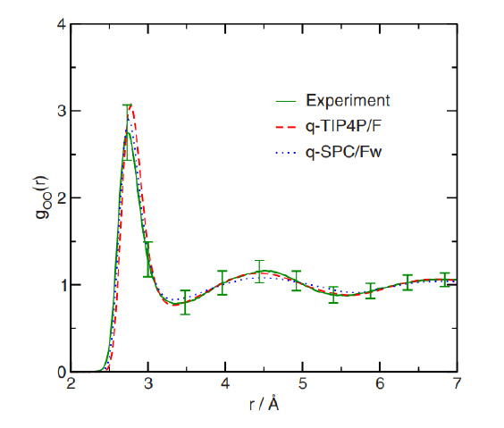
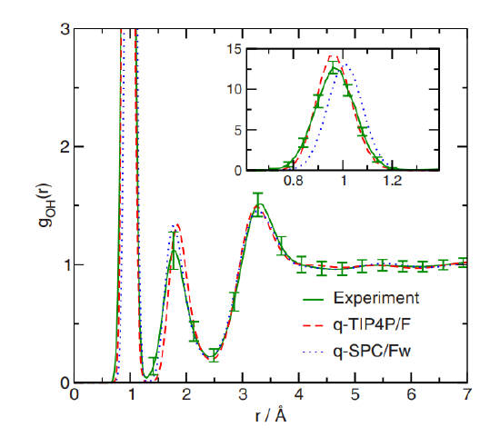
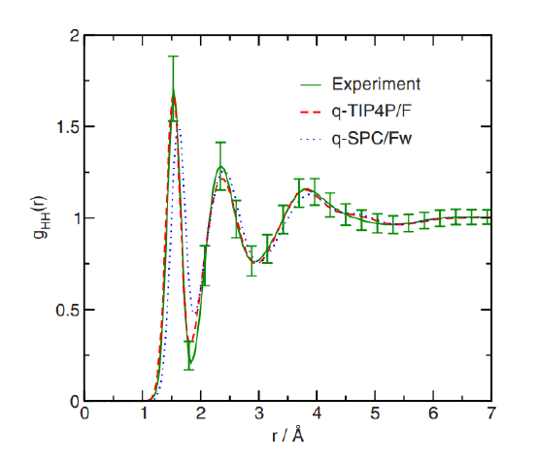
TIP4P/F RDFs using 32 beads are in agreement with the original TIP4P/F paper
Simulation Details:
216 TIP4P/F molecules with an initial density of 0.997 g/ml - NVT Andersen at T = 298 K
100 ps equilibration and 250 ps production - 32 path integral beads
O-O RDF
O-H RDF
H-H RDF
DASH
Markland

Slide 2
TIP4P/F densities using 1 bead are relatively accurate, but we cannot validate using 32 beads without a working path integral barostat
Simulation Details:
3650 TIP4P/F molecules - NPT Berendsen + Andersen at P = 1.0 atm
950 ps equilibration and 50 ps production - 1 path integral bead
Temperature (K) | TIP4P/F Density (g/ml) | NIST Experimental Density (g/ml) | Percent Error (%)
298.15 | 0.98919 | 0.99705 | - 0.788
300 | 0.98771 | 0.99656 | - 0.889
320 | 0.98157 | 0.98943 | - 0.750
In the original paper, TIP4P/F density was parametrized and validated using 32 beads in an NPT ensemble
Currently, DASH does not support constant pressure PIMD, so we do not have a means to appropriately validate TIP4P/F density using 32 beads
A MC barostat compatible with path integrals in DASH is in development but not yet functional

Slide 3
Similarly, TAFFI hexane densities using 1 bead are relatively accurate, but we do not have results for multiple beads
Simulation Details:
500 TAFFI hexane molecules - NPT Berendsen + Andersen at P = 1.0 atm
1950 ps equilibration and 50 ps production - 1 path integral bead
Temperature (K) | TAFFI Hexane Density (g/ml) | NIST Experimental Density (g/ml) | Percent Error (%)
270 | 0.68196 | 0.68025 | + 0.2500
298.15 | 0.65166 | 0.65478 | - 0.4760
320 | 0.62475 | 0.63434 | - 1.5118
RDFs for TAFFI hexane are in progress

Slide 4
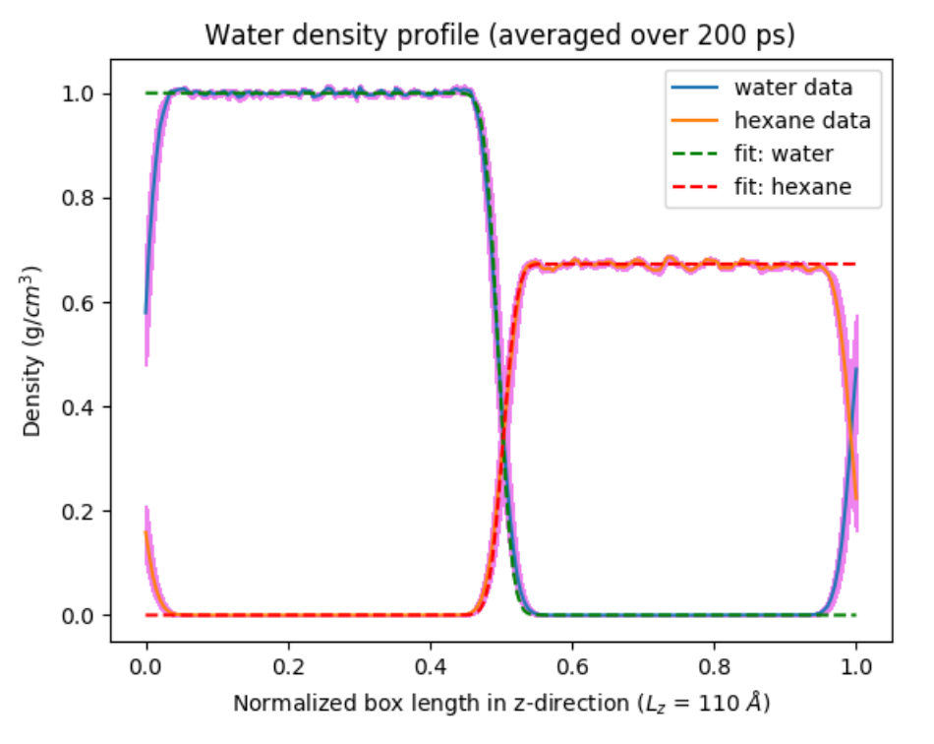
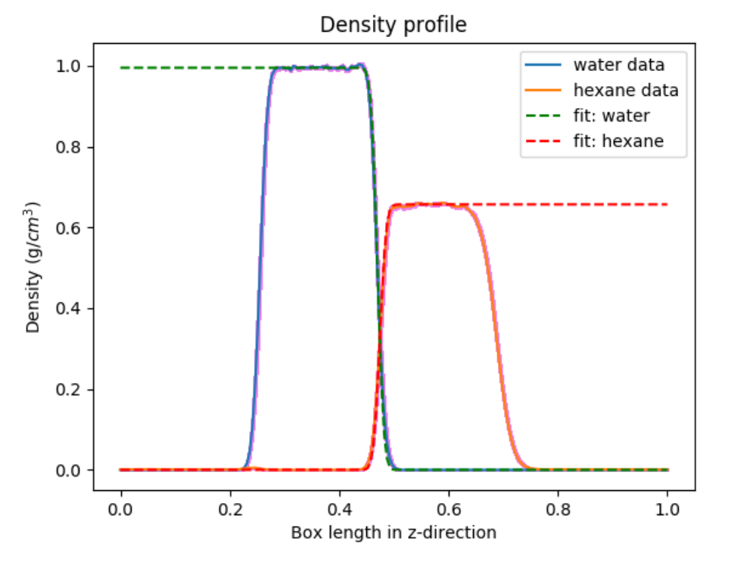
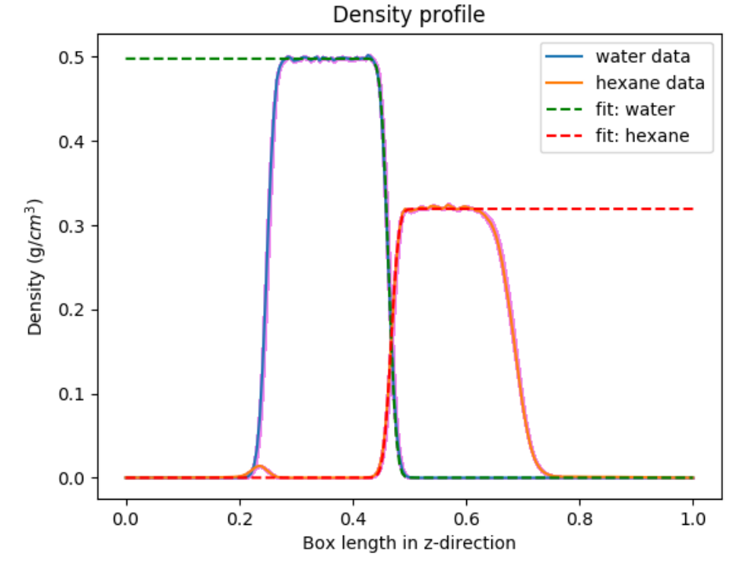
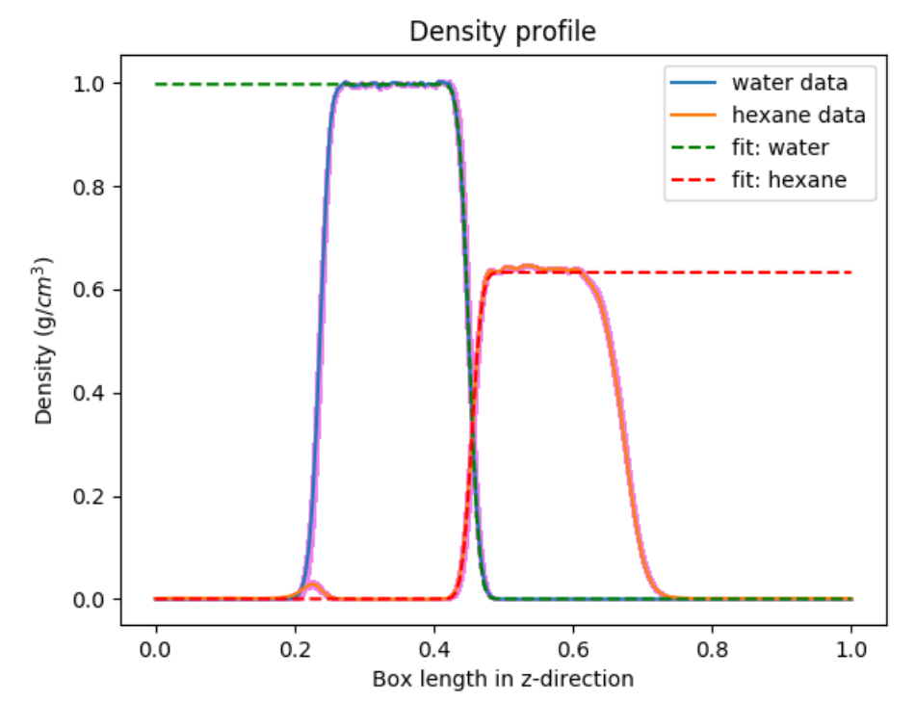
To compute interfacial properties using multiple beads without a barostat, we extended the z-dimension and simulated in the NVT ensemble
1 bead
16 beads
32 beads

Slide 5
Analysis of these simulations shows that nuclear quantum effects might not influence the interfacial width
Simulation Details:
3650 TIP4P/F and 500 TAFFI hexane molecules - NVT Andersen at T = 298.15 K
1 ns equilibration and 2 ns production
Property | DASH 1 Bead | DASH 16 Beads | DASH 32 Beads | Patel and Brooks (2006) | Wick et al. (2012)
Bulk water density (g/ml) | 0.995 | 0.996 | 0.997 | 0.986 | 1.00
Bulk hexane density (g/ml) | 0.657 | 0.639 | 0.633 | 0.684 | 0.65
Intrinsic width (Angstroms) | 0.656 +/- .007 | 0.658 +/- 0.018 | 0.626 +/- 0.022 | 0.366 | 0.498
Average thermal width (Angstroms) | 1.533 +/- 0.047 | 1.567 +/- 0.030 | 1.564 +/- 0.031 | 1.89 | 3.00
Interfacial Tension (mN/m) | 57.29 | In progress | In progress | 43.24 +/- 0.4 | 50.3 +/- 0.8

Slide 6
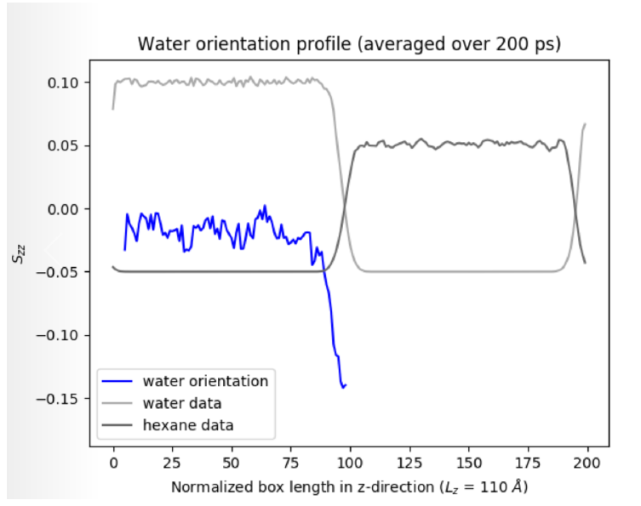
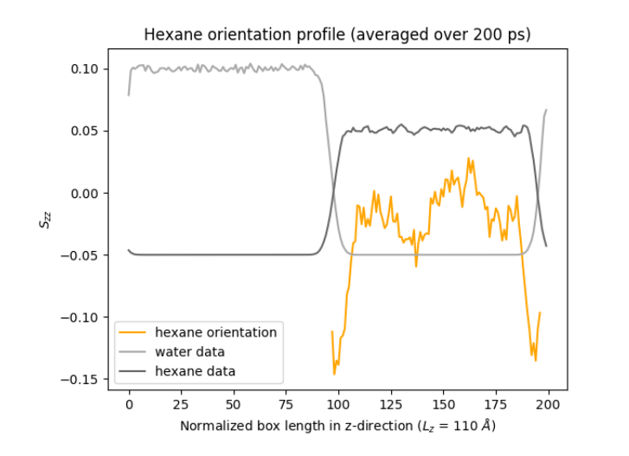
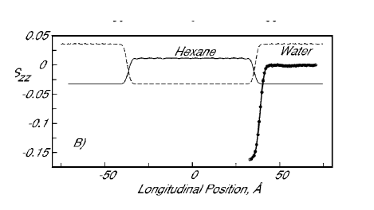
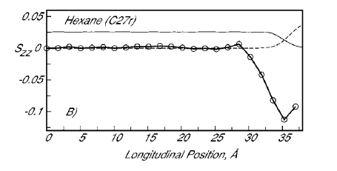
Molecular orientation for 1 bead is comparable to results in the literature, and results for multiple beads are in progress
Simulation Details:
3650 TIP4P/F and 500 TAFFI hexane molecules - NPT Berendsen + Andersen at P = 1.0 atm T = 298.15 K
300 ps equilibration and 200 ps production
Water Orientation
Hexane Orientation
DASH
Patel and Brooks (2006)

Slide 7
Initially we will continue validate force fields and finalize initial analysis of the interface, but we also need to consider new questions
Validation:
Fix RDF calculator to work on depablo node
Compute RDFs for TAFFI hexane
Re-compute RDFs for water using finer bin size
Validate that standard errors are computed rigorously
Compare results from DASH to results from OpenMM code (Markland group, Stanford)
Compare density results using Nose-Hoover barostat
Obtain a working PIMD or PIMC barostat? (Work on this myself)
Initial Analysis:
Compute interfacial tension using multiple beads
Compute molecular orientation using multiple beads
Complete simulations at lower temperatures
Use Elastic bath method (with Kevin van Warkum) to compute pressure in NVT system
Analyze the H-bonding network (e.g. number of H-bonds per molecule at bulk versus interface)
New Questions:
How do nuclear quantum effects impact orientation of heavy versus light water at the hexane-water interface? Is it similar to the water-vapor interface?
Connect PIMD code to E3B model from Skinner
Further Questions?
Read Markland papers
Discuss with Prof. Galli and Prof. Skinner
Water-vapor calculations?

