Slide 1
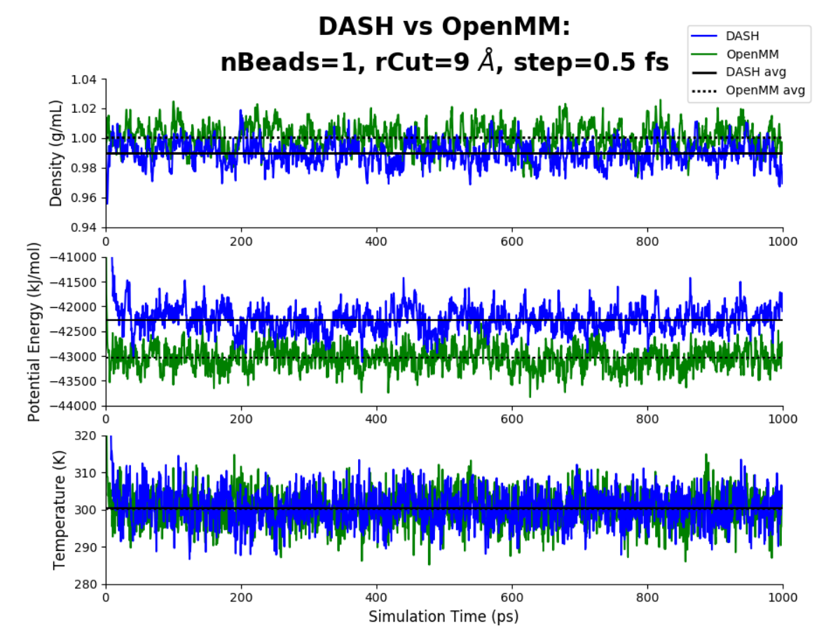
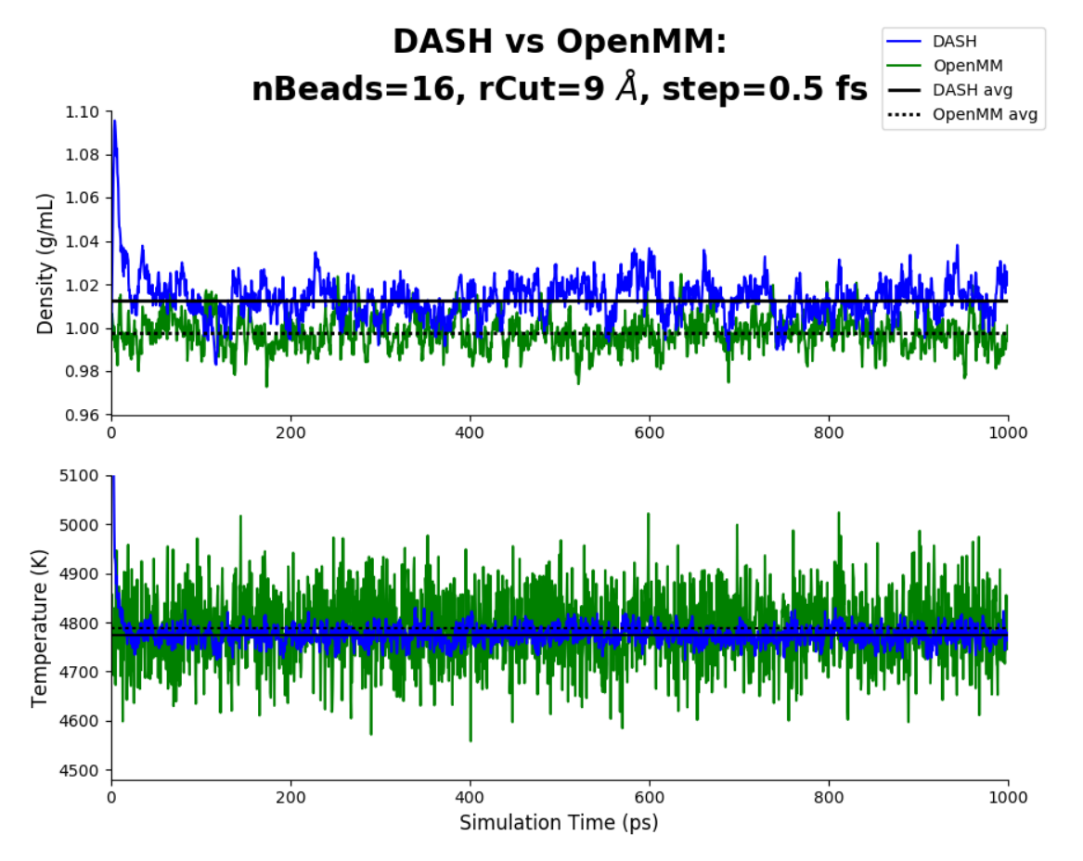
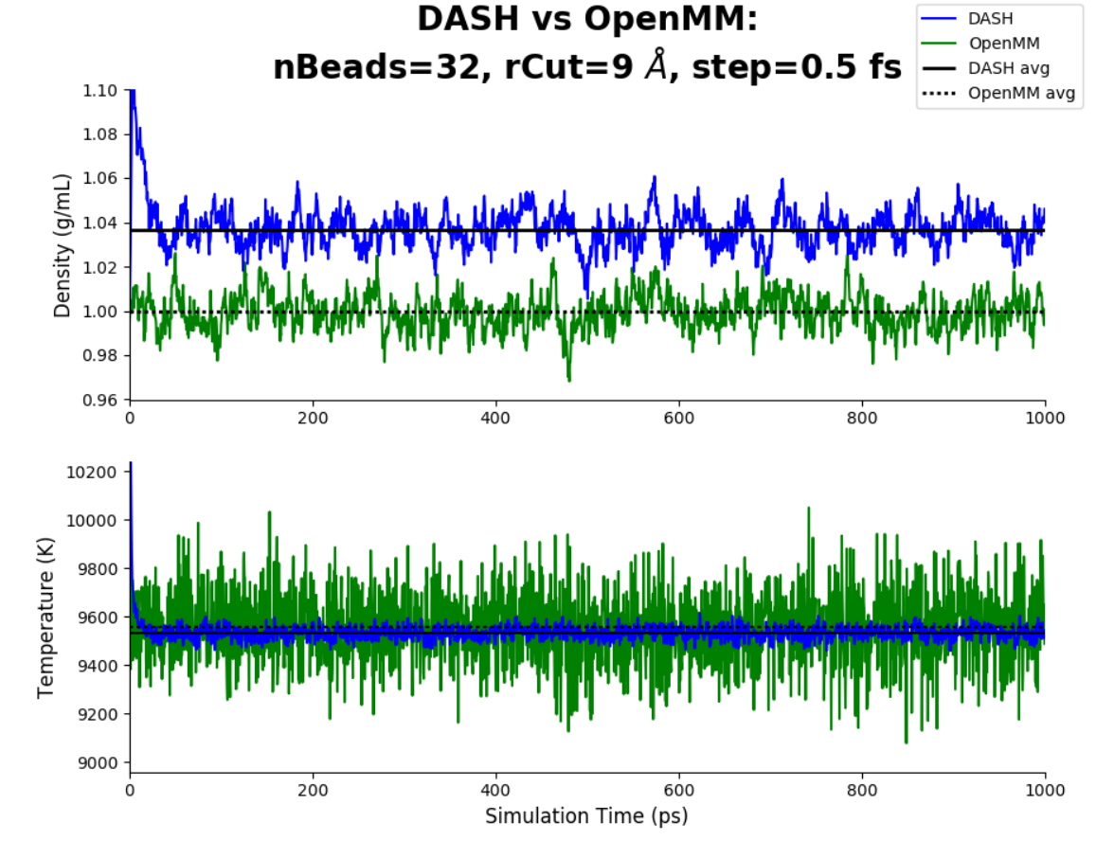
DASH (Monte Carlo Barostat) vs OpenMM: nBeads=1, rCut=9, step=0.5 fs

Slide 2
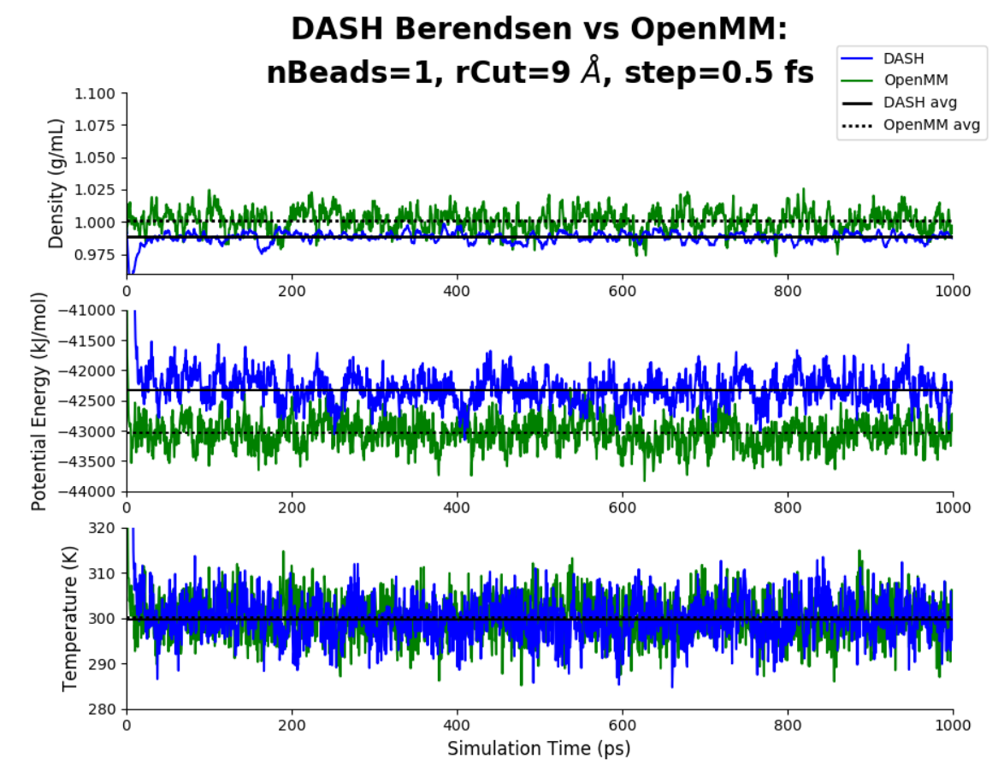
DASH (Berendsen Barostat) vs OpenMM: nBeads=1, rCut=9, step=0.5 fs

Slide 3
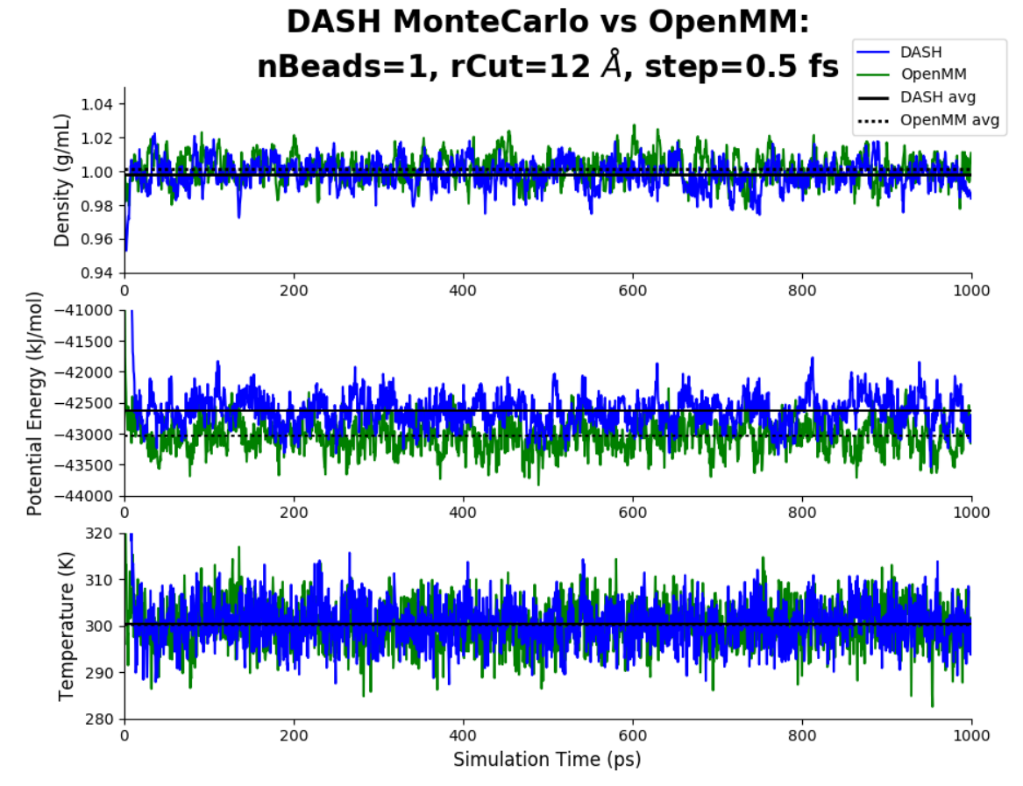
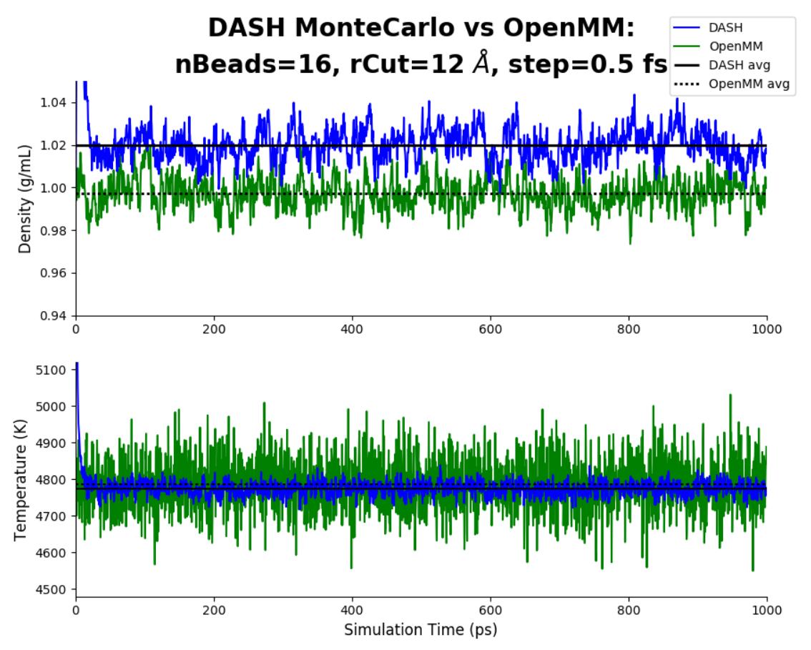
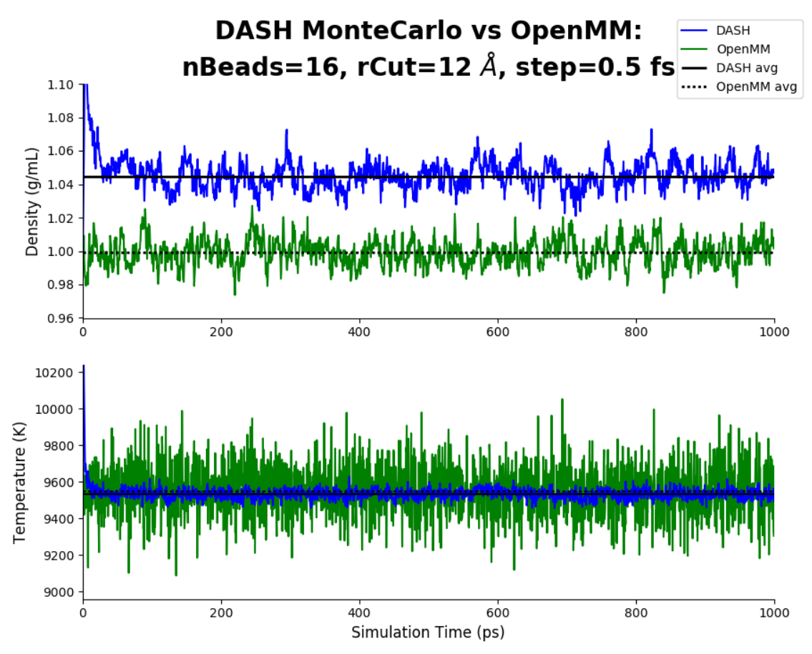
DASH (Berendsen Barostat) vs OpenMM: nBeads=1, rCut=12, step=0.5 fs

