Slide 1
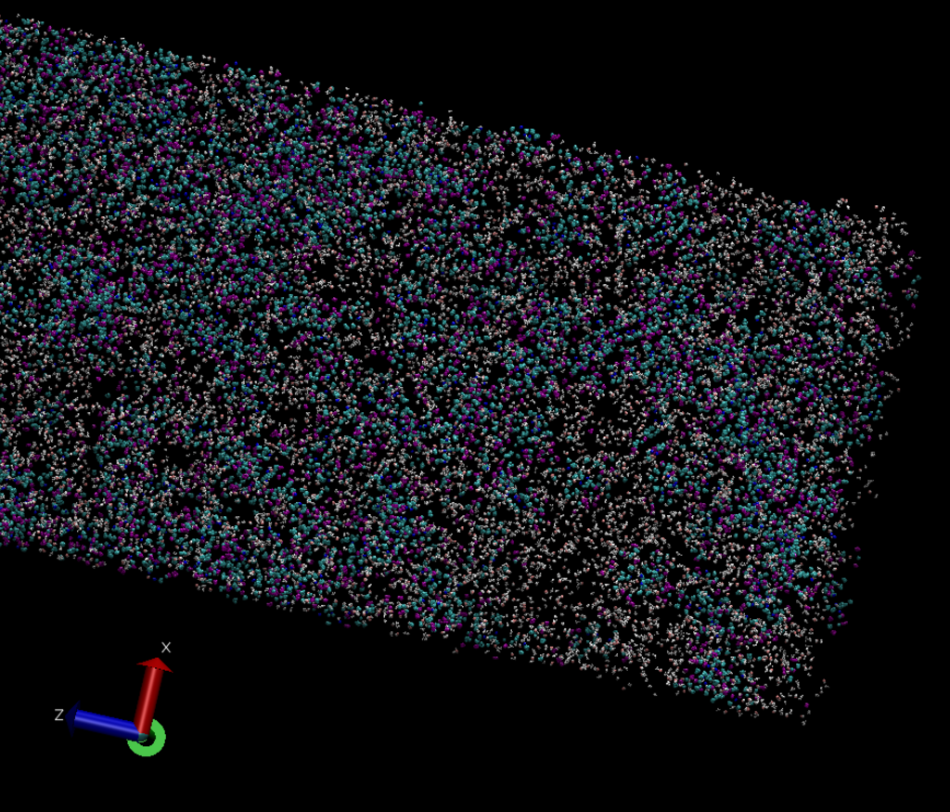
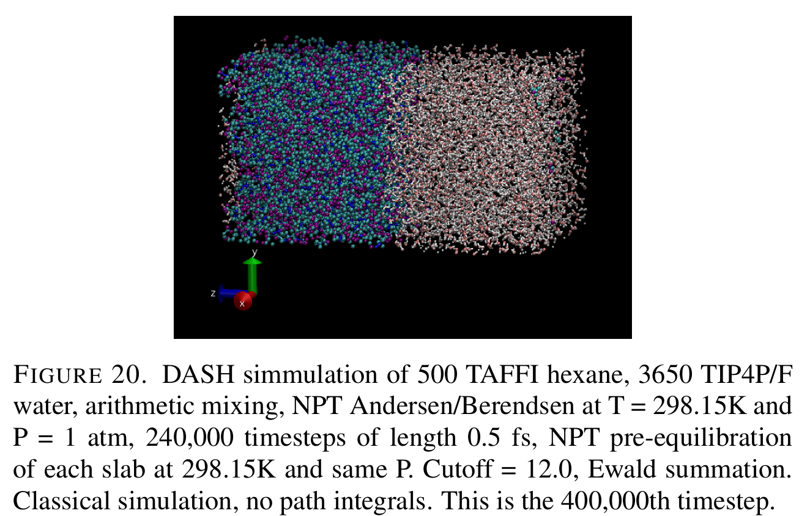
Previous Progress: Fixing DASH errors

Slide 2
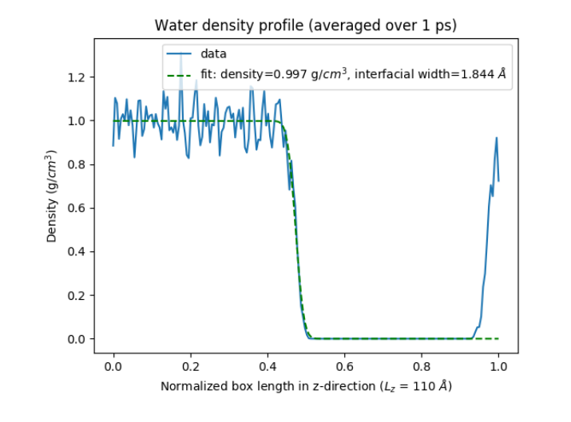
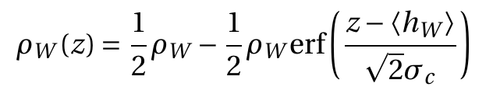
Previous Progress: Calculating Water Density Profile
NPT simulation, 300 ps equilibration and 1 ps production run, computing density in 200 slabs along the z-axis every 5 fs
Fit the water density profile to:
Interfacial width of close to 2 Angstroms, which is in line with previous theoretical and experimental work that places the width between 2 and 4 Angstroms

Slide 3
Current Progress: Benchmarking Density
Temperature (K) | TAFFI Hexane Density (g/ml) | NIST Experimental Density (g/ml) | Percent Error (%)
270 | 0.68196 | 0.68025 | + 0.2500
298.15 | 0.65166 | 0.65478 | - 0.4760
320 | 0.62475 | 0.63434 | - 1.5118
Simulation Details:
- TAFFI force field
- NPT Andersen/Berendsen at P = 1.0 atm
- rcut = 12 Angstroms
- 500 hexane molecules
- 2,000 ps simulation
- Mean and standard deviation values calculated from the final 50 ps
- Standard deviations on the order of 0.0001 g/ml

Slide 4
Current Progress: Benchmarking Density
Temperature (K) | q-TIP4P/F Density (g/ml) | NIST Experimental Density (g/ml) | Percent Error (%)
298.15 | 0.98919 | 0.99705 | - 0.00788
300 | 0.98771 | 0.99656 | - 0.00889
320 | 0.98157 | 0.98943 | - 0.00750
Simulation Details:
- q-TIP4P/F force field
- NPT Andersen/Berendsen at P = 1.0 atm
- rcut = 9 Angstroms
- 3650 water molecules
- 1,000 ps simulation
- Mean and standard deviation values calculated from the final 50 ps
- Standard deviations on the order of 0.001 g/ml

Slide 5
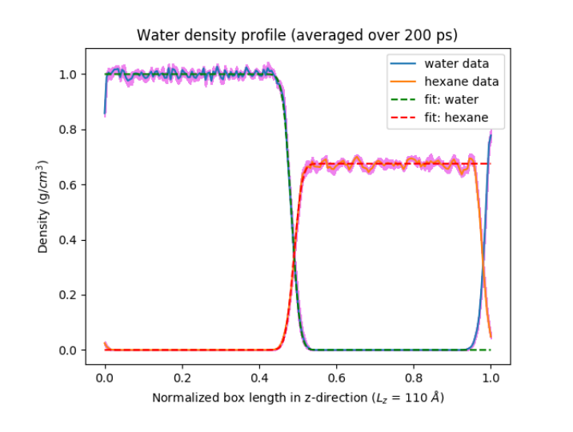
Current Progress: Calculating Full Density Profiles
Eliminated DASH production run errors by adding “synchronous = True” in density computation PythonOperation
Extended production run to 200 ps, computing density in 200 slabs along the z-axis every 1 ps
Fit the water and hexane density profile to an error function profile with this functional form:
Computed the standard error of mean density in each of the 200 slabs for both water and hexane
SE in pink
Simulation Details:
- q-TIP4P/F and TAFFI hexane force fields
- NPT Andersen/Berendsen at P = 1.0 atm and T = 298.15
- rcut = 12 Angstroms
- 3650 water, 500 hexane molecules
- 300 ps equilibration, 200 ps production
- Density computed every 1 ps

Slide 6
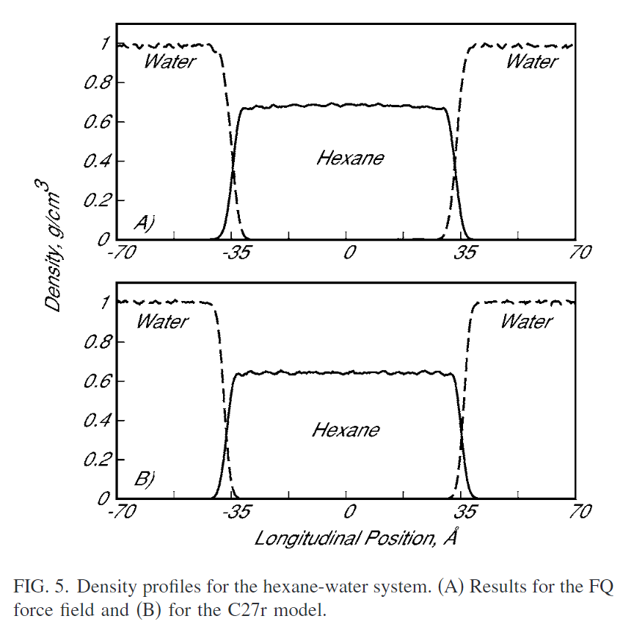
Current Progress: Literature Comparison
Our Simulation
Patel and Brooks (2006)

Slide 7
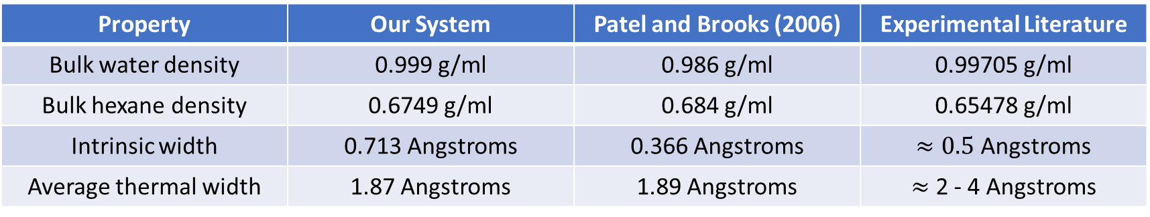
Current Progress: Literature Comparison
Property | Our System | Patel and Brooks (2006) | Experimental Literature
Bulk water density | 0.999 g/ml | 0.986 g/ml | 0.99705 g/ml
Bulk hexane density | 0.6749 g/ml | 0.684 g/ml | 0.65478 g/ml
Intrinsic width | 0.713 Angstroms | 0.366 Angstroms | $≈0.5$ Angstroms
Average thermal width | 1.87 Angstroms | 1.89 Angstroms | $≈$ 2 - 4 Angstroms

Slide 8
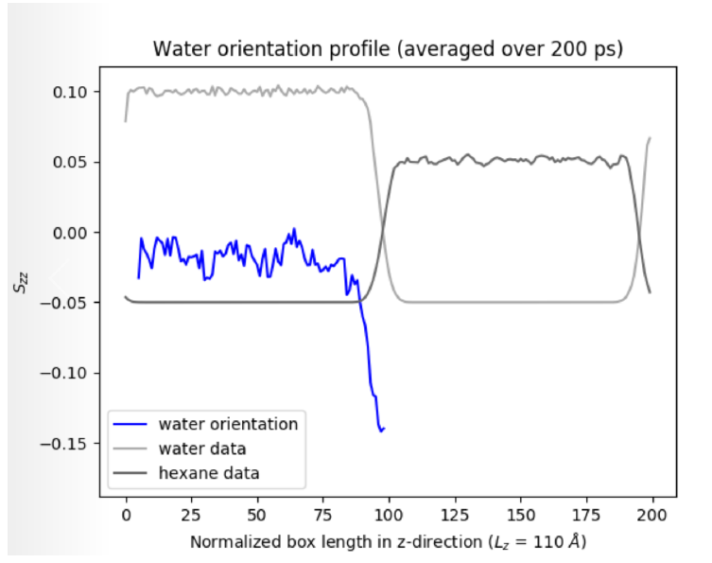
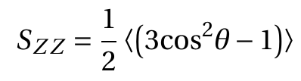
Current Progress: Molecular Orientation
Orientation order parameter:
Water: angle is taken between the water dipole moment vector and the interface normal, averaged over all molecules
Profile shows that water is approximately isotropic in the bulk but orients parallel to the interface in the interfacial region

Slide 9
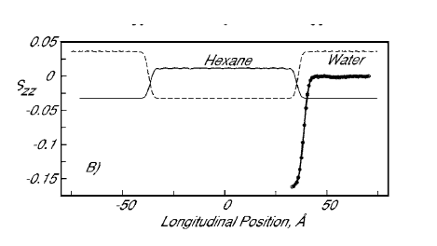
Current Progress: Literature Comparison
Our Simulation
Patel and Brooks (2006)

Slide 10
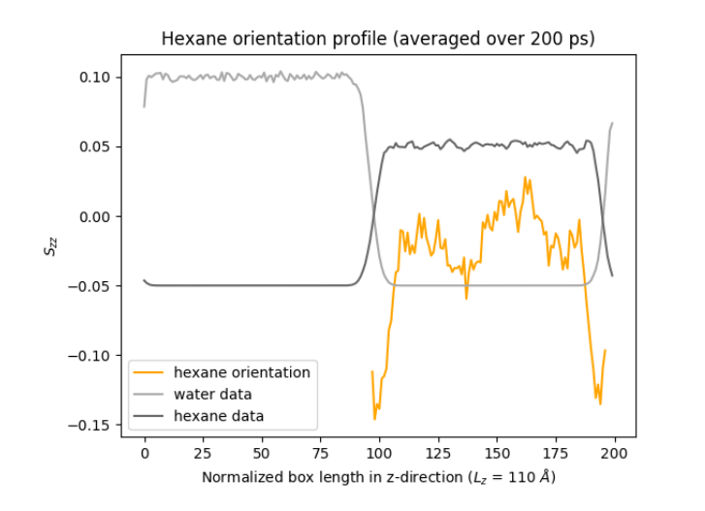
Current Progress: Molecular Orientation
Orientation order parameter:
Hexane: angle is taken between carbon Cn and carbon Cn+2, averaged over all vectors and molecules
Profile shows that hexane is approximately isotropic in the bulk but orients parallel to the interface in the interfacial region

Slide 11
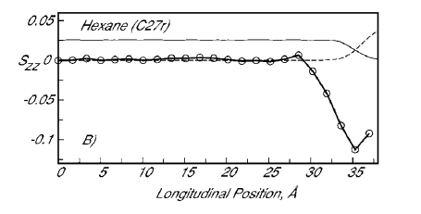
Current Progress: Literature Comparison
Our Simulation
Patel and Brooks (2006)

Slide 12
Primary Next Steps
1. Calculate interfacial tension
2. Update measurements using simulation with longer production run (1-3 ns)
3. Optimize interaction parameters to match experimental values

