Slide 1
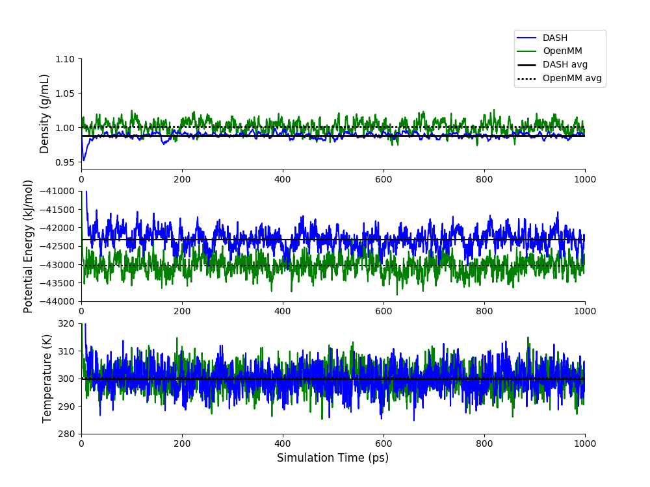
DASH Berendsen Barostat vs OpenMM
# beads=1, rCut=9.0 Å, time step=0.5 fs
Data | DASH | OpenMM
Density (g/mL) | 0.98832 ± 0.00058 | 1.00073 ± 0.00132
Energy (kJ/mol) | -42320.03482± 35.48798 | -43041.14116 ± 33.45556
Temperature (K) | 299.70865 ± 0.45264 | 300.09525± 0.386
Notes:
100 ps equilibration, 900 ps production used for SE analysis (9 bocks of size 100 ps), 2*SE reported in table
DASH simulation in dash_work/water using run_9-26-2018.sh and tip4pF_9-26-2018.py, 1000 q-TIP4P/F water molecules, 2M steps with time step 0.5, rCut 9 A, NPT Berendsen/Andersen at 298 K and 1.0 atm, initial density 0.997, PI 1 bead, data every 1000, restart/traj every 50,000, filename B-1
OpenMM simulation in /home/swansonk1/openmm using run_openmm.sh and pimd_modified.py, 1000 q-TIP4P/F water molecules, 2M steps with time step 0.0005 ps, rCut 0.9 nanometers, NPT RPMDMonteCarlo at 298 K and 1.01325 bar, initial density 0.9979734044480487, PI 1 bead, data every 1000, restart/traj every 50,000, filename MM-1

Slide 2
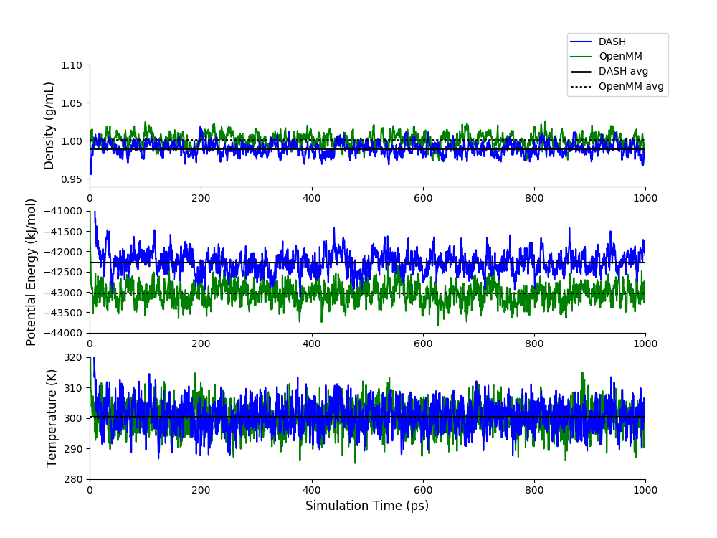
DASH Monte Carlo Barostat vs OpenMM
# beads=1, rCut=9.0 Å, time step=0.5 fs
Data | DASH | OpenMM
Density (g/mL) | 0.98974 ± 0.00072 | 1.00073 ± 0.00132
Energy (kJ/mol) | -42276.85961 ± 35.38552 | -43041.14116 ± 33.45556
Temperature (K) | 300.30567 ± 0.27942 | 300.09525± 0.386
Notes:
100 ps equilibration, 900 ps production used for SE analysis (9 bocks of size 100 ps), 2*SE reported in table
DASH simulation in dash_work/water using run_9-26-2018.sh and tip4pF_9-26-2018.py, 1000 q-TIP4P/F water molecules, 2M steps with time step 0.5, rCut 9 A, NPT MonteCarlo/Andersen at 298 K and 1.0 atm, initial density 0.997, PI 1 bead, data every 1000, restart/traj every 50,000, filename MC-1
OpenMM simulation in /home/swansonk1/openmm using run_openmm.sh and pimd_modified.py, 1000 q-TIP4P/F water molecules, 2M steps with time step 0.0005 ps, rCut 0.9 nanometers, NPT RPMDMonteCarlo at 298 K and 1.01325 bar, initial density 0.9979734044480487, PI 1 bead, data every 1000, restart/traj every 50,000, filename MM-1

Slide 3
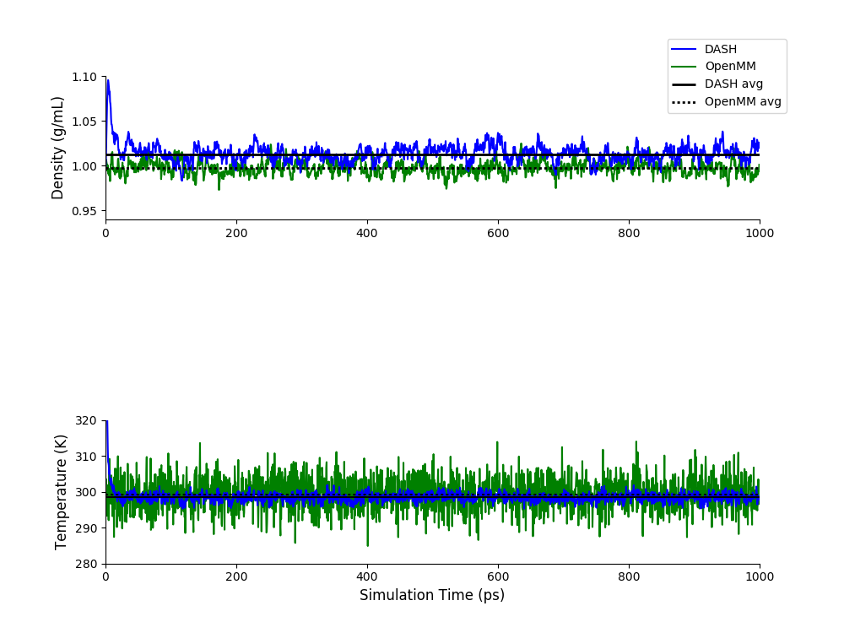
DASH Monte Carlo Barostat vs OpenMM
# beads=16, rCut=9.0 Å, time step=0.5 fs
Data | DASH | OpenMM
Density (g/mL) | 1.01268 ± 0.00176 | 0.99751 ± 0.00104
Temperature (K) | 298.37789 ± 0.11965 | 299.25769 ± 0.16236
Notes:
DASH reported simulation energies on the order of 2M kJ/mol, while OpenMM reported simulation energies on the order of -20,000 kJ/mol, so until this is resolved, we are leaving it out of the plots
100 ps equilibration, 900 ps production used for SE analysis (9 bocks of size 100 ps), 2*SE reported in table
DASH simulation in dash_work/water using run_9-26-2018.sh and tip4pF_9-26-2018.py, 1000 q-TIP4P/F water molecules, 2M steps with time step 0.5, rCut 9 A, NPT MonteCarlo/Andersen at 298 K and 1.0 atm, initial density 0.997, PI 16 bead, data every 1000, restart/traj every 50,000, filename MC-2
OpenMM simulation in /home/swansonk1/openmm using run_openmm.sh and pimd_modified.py, 1000 q-TIP4P/F water molecules, 2M steps with time step 0.0005 ps, rCut 0.9 nanometers, NPT RPMDMonteCarlo at 298 K and 1.01325 bar, initial density 0.9979734044480487, PI 16 bead, data every 1000, restart/traj every 50,000, filename MM-2

Slide 4
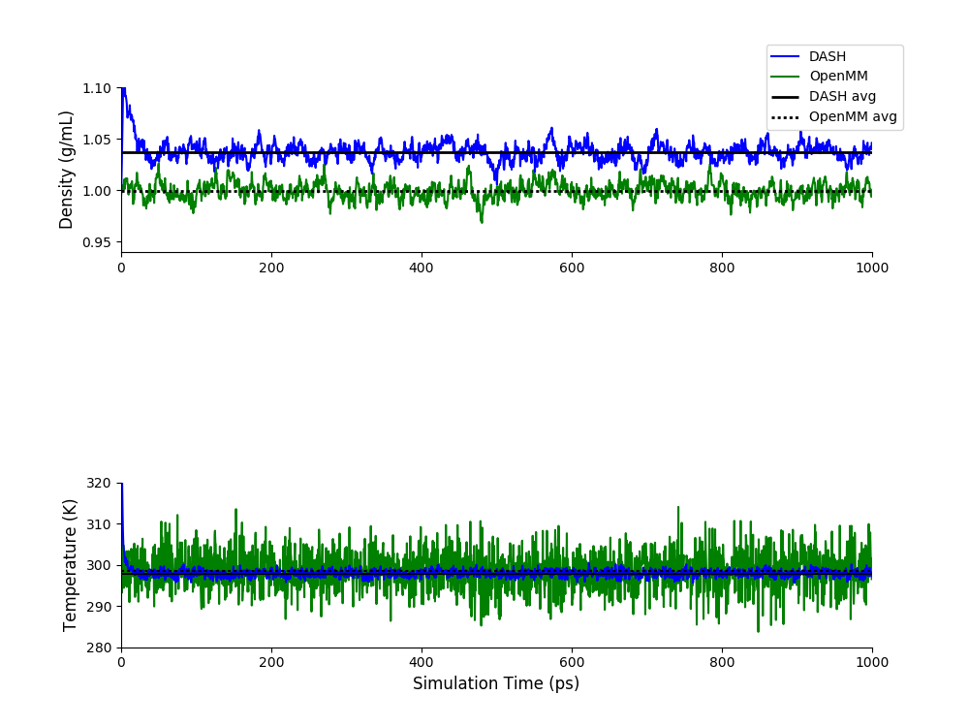
DASH Monte Carlo Barostat vs OpenMM
# beads=32, rCut=9.0 Å, time step=0.5 fs
Data | DASH | OpenMM
Density (g/mL) | 1.03649 ± 0.00082 | 0.9995 ± 0.00176
Temperature (K) | 297.87545 ± 0.08041 | 298.60068 ± 0.21764
Notes:
DASH reported simulation energies on the order of 2M kJ/mol, while OpenMM reported simulation energies on the order of -20,000 kJ/mol, so until this is resolved, we are leaving it out of the plots
100 ps equilibration, 900 ps production used for SE analysis (9 bocks of size 100 ps), 2*SE reported in table
DASH simulation in dash_work/water using run_9-26-2018.sh and tip4pF_9-26-2018.py, 1000 q-TIP4P/F water molecules, 2M steps with time step 0.5, rCut 9 A, NPT MonteCarlo/Andersen at 298 K and 1.0 atm, initial density 0.997, PI 16 bead, data every 1000, restart/traj every 50,000, filename MC-2
OpenMM simulation in /home/swansonk1/openmm using run_openmm.sh and pimd_modified.py, 1000 q-TIP4P/F water molecules, 2M steps with time step 0.0005 ps, rCut 0.9 nanometers, NPT RPMDMonteCarlo at 298 K and 1.01325 bar, initial density 0.9979734044480487, PI 16 bead, data every 1000, restart/traj every 50,000, filename MM-2

Slide 5
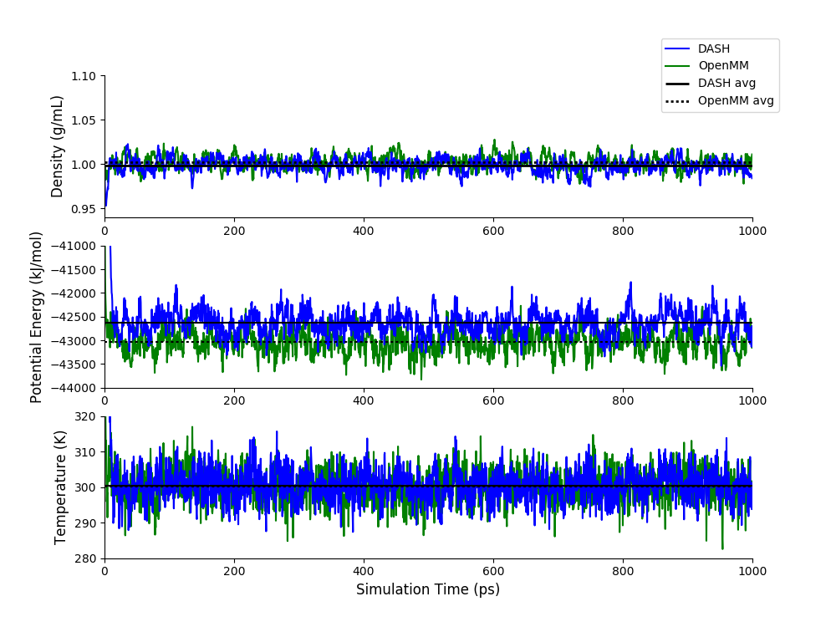
DASH Monte Carlo Barostat vs OpenMM
# beads=1, rCut=12.0 Å, time step=0.5 fs
Data | DASH | OpenMM
Density (g/mL) | 0.99837 ± 0.0012 | 1.00162 ± 0.00092
Energy (kJ/mol) | -42634.1723 ± 34.76596 | -43037.889 ± 22.094
Temperature (K) | 300.37583 ± 0. 0.39688 | 300.22983 ± 0.526
Notes:
100 ps equilibration, 900 ps production used for SE analysis (9 bocks of size 100 ps), 2*SE reported in table
DASH simulation in dash_work/water using run_9-26-2018.sh and tip4pF_9-26-2018.py, 1000 q-TIP4P/F water molecules, 2M steps with time step 0.5, rCut 9 A, NPT Berendsen/Andersen at 298 K and 1.0 atm, initial density 0.997, PI 1 bead, data every 1000, restart/traj every 50,000, filename B-1
OpenMM simulation in /home/swansonk1/openmm using run_openmm.sh and pimd_modified.py, 1000 q-TIP4P/F water molecules, 2M steps with time step 0.0005 ps, rCut 0.9 nanometers, NPT RPMDMonteCarlo at 298 K and 1.01325 bar, initial density 0.9979734044480487, PI 1 bead, data every 1000, restart/traj every 50,000, filename MM-1

Slide 6
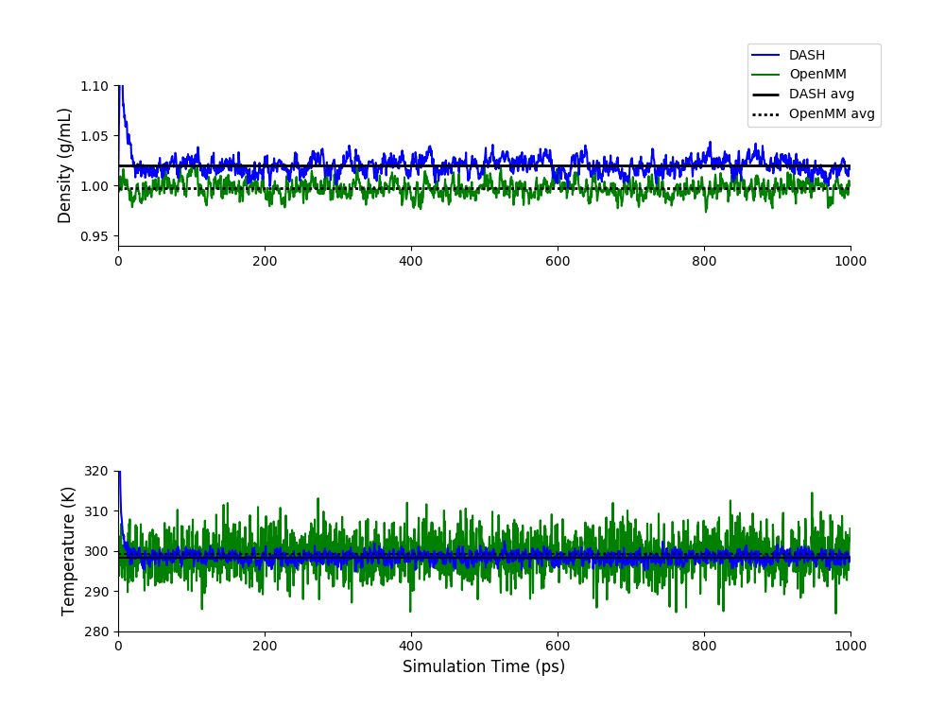
DASH Monte Carlo Barostat vs OpenMM
# beads=16, rCut=12.0 Å, time step=0.5 fs
Data | DASH | OpenMM
Density (g/mL) | 1.01984 ± 0.00176 | 0.99702 ± 0.00106
Temperature (K) | 295.85173 ± 0.09516 | 299.08107 ± 0.27247
Notes:
DASH reported simulation energies on the order of 2M kJ/mol, while OpenMM reported simulation energies on the order of -20,000 kJ/mol, so until this is resolved, we are leaving it out of the plots
100 ps equilibration, 900 ps production used for SE analysis (9 bocks of size 100 ps), 2*SE reported in table
DASH simulation in dash_work/water using run_9-26-2018.sh and tip4pF_9-26-2018.py, 1000 q-TIP4P/F water molecules, 2M steps with time step 0.5, rCut 9 A, NPT MonteCarlo/Andersen at 298 K and 1.0 atm, initial density 0.997, PI 16 bead, data every 1000, restart/traj every 50,000, filename MC-2
OpenMM simulation in /home/swansonk1/openmm using run_openmm.sh and pimd_modified.py, 1000 q-TIP4P/F water molecules, 2M steps with time step 0.0005 ps, rCut 0.9 nanometers, NPT RPMDMonteCarlo at 298 K and 1.01325 bar, initial density 0.9979734044480487, PI 16 bead, data every 1000, restart/traj every 50,000, filename MM-2

Slide 7
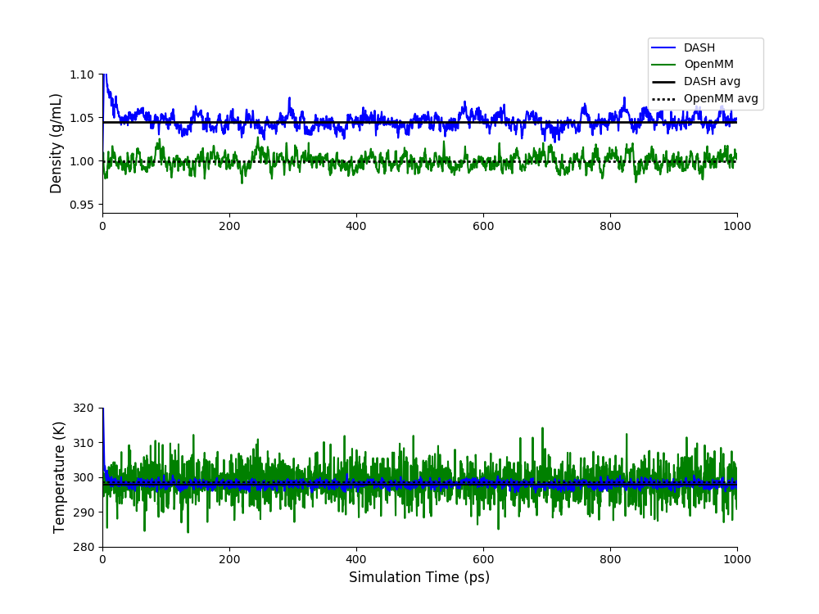
DASH Monte Carlo Barostat vs OpenMM
# beads=32, rCut=12.0 Å, time step=0.5 fs
Data | DASH | OpenMM
Density (g/mL) | 1.04464 ± 0.00154 | 0.99902 ± 0.0005
Temperature (K) | 299.43744 ± 0.09375 | 298.42921 ± 0.23208
Notes:
DASH reported simulation energies on the order of 2M kJ/mol, while OpenMM reported simulation energies on the order of -20,000 kJ/mol, so until this is resolved, we are leaving it out of the plots
100 ps equilibration, 900 ps production used for SE analysis (9 bocks of size 100 ps), 2*SE reported in table
DASH simulation in dash_work/water using run_9-26-2018.sh and tip4pF_9-26-2018.py, 1000 q-TIP4P/F water molecules, 2M steps with time step 0.5, rCut 9 A, NPT MonteCarlo/Andersen at 298 K and 1.0 atm, initial density 0.997, PI 16 bead, data every 1000, restart/traj every 50,000, filename MC-2
OpenMM simulation in /home/swansonk1/openmm using run_openmm.sh and pimd_modified.py, 1000 q-TIP4P/F water molecules, 2M steps with time step 0.0005 ps, rCut 0.9 nanometers, NPT RPMDMonteCarlo at 298 K and 1.01325 bar, initial density 0.9979734044480487, PI 16 bead, data every 1000, restart/traj every 50,000, filename MM-2

Slide 8
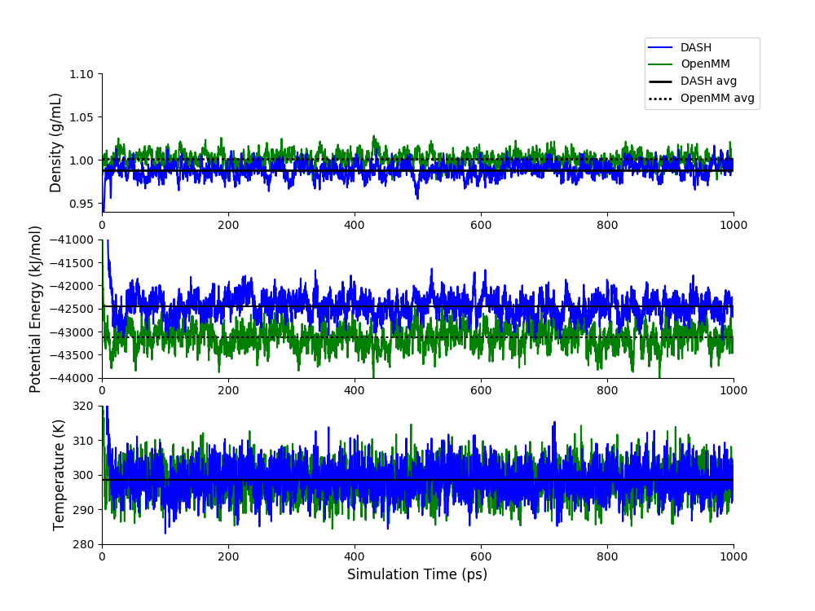
DASH Monte Carlo Barostat vs OpenMM
# beads=1, rCut=9.0 Å, time step=0.25 fs
Data | DASH | OpenMM
Density (g/mL) | 0.98814 ± 0.00115 | 1.0007 ± 0.0008
Energy (kJ/mol) | -42444.13902 ± 35.19276 | -43114.43317± 29.3608
Temperature (K) | 298.5529 ± 0.3806 | 298.44123 ± 0.26228
Notes:
100 ps equilibration, 900 ps production used for SE analysis (9 bocks of size 100 ps), 2*SE reported in table
DASH simulation in dash_work/water using run_9-26-2018.sh and tip4pF_9-26-2018.py, 1000 q-TIP4P/F water molecules, 4M steps with time step 0.25, rCut 9 A, NPT MonteCarlo/Andersen at 298 K and 1.0 atm, initial density 0.997, PI 1 bead, data every 1000, restart/traj every 50,000, filename MC-7
OpenMM simulation in /home/swansonk1/openmm using run_openmm.sh and pimd_modified.py, 1000 q-TIP4P/F water molecules, 4M steps with time step 0.00025 ps, rCut 0.9 nanometers, NPT RPMDMonteCarlo at 298 K and 1.01325 bar, initial density 0.9979734044480487, PI 1 bead, data every 1000, restart/traj every 50,000, filename MM-7

Slide 9
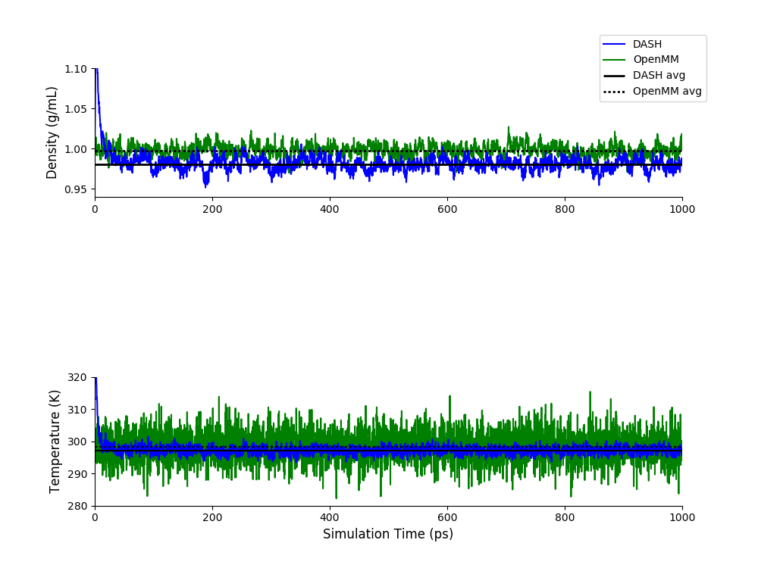
DASH Monte Carlo Barostat vs OpenMM
# beads=16, rCut=9.0 Å, time step=0.25 fs
Data | DASH | OpenMM
Density (g/mL) | 0.98032 ± 0.0011 | 0.99773 ± 0.001188
Temperature (K) | 297.083 ± 0.0226 | 298.3412 ± 0.1347
Notes:
100 ps equilibration, 900 ps production used for SE analysis (9 bocks of size 100 ps), 2*SE reported in table
DASH simulation in dash_work/water using run_9-26-2018.sh and tip4pF_9-26-2018.py, 1000 q-TIP4P/F water molecules, 4M steps with time step 0.25, rCut 9 A, NPT MonteCarlo/Andersen at 298 K and 1.0 atm, initial density 0.997, PI 16 bead, data every 1000, restart/traj every 50,000, filename MC-8
OpenMM simulation in /home/swansonk1/openmm using run_openmm.sh and pimd_modified.py, 1000 q-TIP4P/F water molecules, 4M steps with time step 0.00025 ps, rCut 0.9 nanometers, NPT RPMDMonteCarlo at 298 K and 1.01325 bar, initial density 0.9979734044480487, PI 16 bead, data every 1000, restart/traj every 50,000, filename MM-8

Slide 10
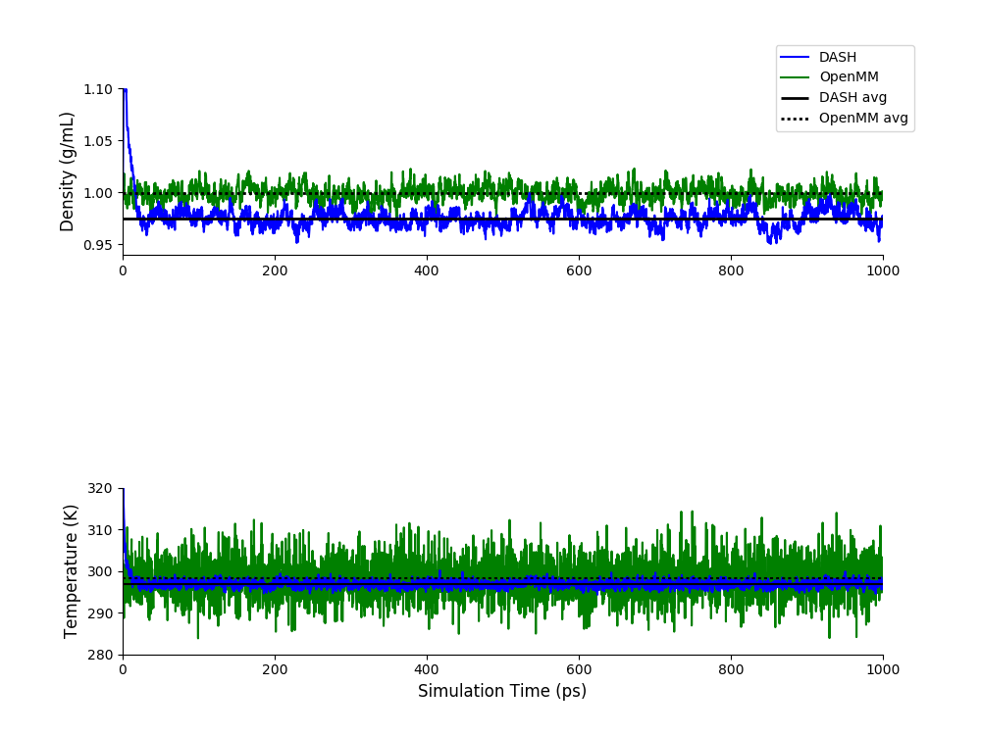
DASH Monte Carlo Barostat vs OpenMM
# beads=32, rCut=9.0 Å, time step=0.25 fs
Data | DASH | OpenMM
Density (g/mL) | 0.97463 ± 0.00156 | 0.99888 ± 0.0011
Temperature (K) | 296.85178 ± 0.078387 | 298.212148 ± 0.16234
Notes:
100 ps equilibration, 900 ps production used for SE analysis (9 bocks of size 100 ps), 2*SE reported in table
DASH simulation in dash_work/water using run_9-26-2018.sh and tip4pF_9-26-2018.py, 1000 q-TIP4P/F water molecules, 4M steps with time step 0.25, rCut 9 A, NPT MonteCarlo/Andersen at 298 K and 1.0 atm, initial density 0.997, PI 32 bead, data every 1000, restart/traj every 50,000, filename MC-9
OpenMM simulation in /home/swansonk1/openmm using run_openmm.sh and pimd_modified.py, 1000 q-TIP4P/F water molecules, 4M steps with time step 0.00025 ps, rCut 0.9 nanometers, NPT RPMDMonteCarlo at 298 K and 1.01325 bar, initial density 0.9979734044480487, PI 32 bead, data every 1000, restart/traj every 50,000, filename MM-9

Slide 11
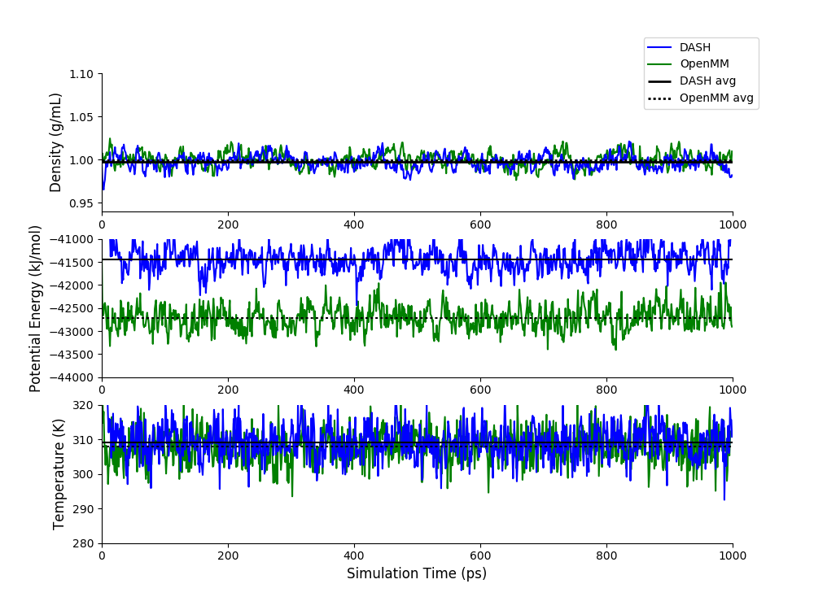
DASH Monte Carlo Barostat vs OpenMM
# beads=1, rCut=9.0 Å, time step=1.0 fs
Data | DASH | OpenMM
Density (g/mL) | 0.99712 ± 0.00159 | 0.99966 ± 0.00214
Energy (kJ/mol) | -41438.529 ± 42.6877 | -42710.35912± 32.50538
Temperature (K) | 309.13899 ± 0.43108 | 307.90749 ± 0.438
Notes:
100 ps equilibration, 900 ps production used for SE analysis (9 bocks of size 100 ps), 2*SE reported in table
DASH simulation in dash_work/water using run_9-26-2018.sh and tip4pF_9-26-2018.py, 1000 q-TIP4P/F water molecules, 1M steps with time step 1.0, rCut 9 A, NPT MonteCarlo/Andersen at 298 K and 1.0 atm, initial density 0.997, PI 1 bead, data every 1000, restart/traj every 50,000, filename MC-10
OpenMM simulation in /home/swansonk1/openmm using run_openmm.sh and pimd_modified.py, 1000 q-TIP4P/F water molecules, 1M steps with time step 0.001 ps, rCut 0.9 nanometers, NPT RPMDMonteCarlo at 298 K and 1.01325 bar, initial density 0.9979734044480487, PI 1 bead, data every 1000, restart/traj every 50,000, filename MM-10

Slide 12
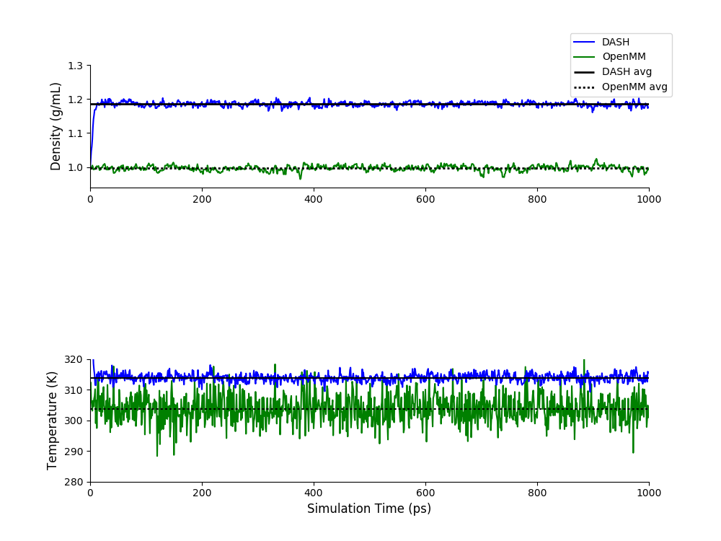
DASH Monte Carlo Barostat vs OpenMM
# beads=16, rCut=9.0 Å, time step=1.0 fs
Data | DASH | OpenMM
Density (g/mL) | 1.18474 ± 0.0009 | 0.996576 ± 0.00175
Temperature (K) | 313.89341 ± 0.14455 | 303.714367 ± 0.30905
Notes:
100 ps equilibration, 900 ps production used for SE analysis (9 bocks of size 100 ps), 2*SE reported in table
DASH simulation in dash_work/water using run_9-26-2018.sh and tip4pF_9-26-2018.py, 1000 q-TIP4P/F water molecules, 1M steps with time step 1.0, rCut 9 A, NPT MonteCarlo/Andersen at 298 K and 1.0 atm, initial density 0.997, PI 16 bead, data every 1000, restart/traj every 50,000, filename MC-11
OpenMM simulation in /home/swansonk1/openmm using run_openmm.sh and pimd_modified.py, 1000 q-TIP4P/F water molecules, 1M steps with time step 0.001 ps, rCut 0.9 nanometers, NPT RPMDMonteCarlo at 298 K and 1.01325 bar, initial density 0.9979734044480487, PI 16 bead, data every 1000, restart/traj every 50,000, filename MM-11

Slide 13
DASH Monte Carlo Barostat vs OpenMM
# beads=32, rCut=9.0 Å, time step=1.0 fs
“nan” values in DASH trajectory file as well as potential energy and temperature values. Density values did print, but showed that density dropped from 0.997 to 0.855 after about 190,000 turns. Simulation was also extremely slow and did not finish in 24 hours
For time steps 0.9 fs and higher (tested 0.7, 0.9, 1.0, 1.5, 2.0 fs), this “nan” issue continued to occur
No such issues detected in OpenMM
Data | DASH | OpenMM
Density (g/mL) | N/A | 0.99617 ± 0.00085
Temperature (K) | N/A | 301.93122 ± 7.58815
Notes:
100 ps equilibration, 900 ps production used for SE analysis (9 bocks of size 100 ps), 2*SE reported in table
DASH simulation in dash_work/water using run_9-26-2018.sh and tip4pF_9-26-2018.py, 1000 q-TIP4P/F water molecules, 1M steps with time step 1.0, rCut 9 A, NPT MonteCarlo/Andersen at 298 K and 1.0 atm, initial density 0.997, PI 32 bead, data every 1000, restart/traj every 50,000, filename MC-12
OpenMM simulation in /home/swansonk1/openmm using run_openmm.sh and pimd_modified.py, 1000 q-TIP4P/F water molecules, 1M steps with time step 0.001 ps, rCut 0.9 nanometers, NPT RPMDMonteCarlo at 298 K and 1.01325 bar, initial density 0.9979734044480487, PI 32 bead, data every 1000, restart/traj every 50,000, filename MM-12

Slide 14
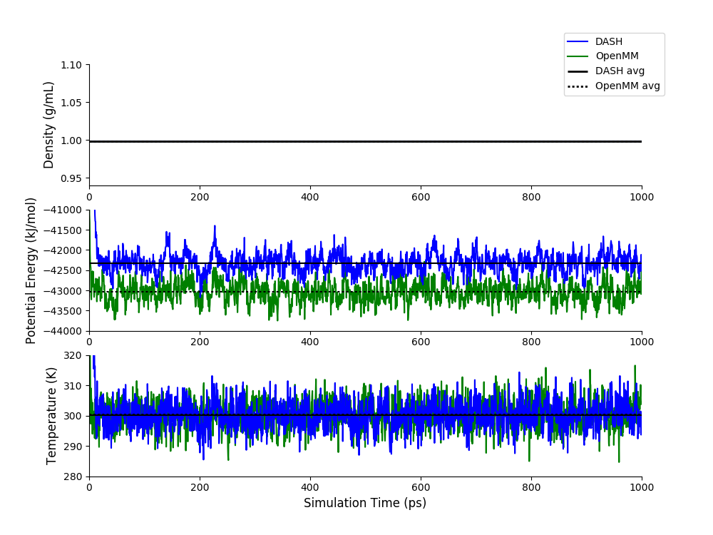
DASH NVT vs OpenMM NVT
# beads=1, rCut=9.0 Å, time step=0.5 fs
Data | DASH | OpenMM
Energy (kJ/mol) | -41438.529 ± 42.6877 | -42710.35912± 32.50538
Temperature (K) | 309.13899 ± 0.43108 | 307.90749 ± 0.438
Notes:
100 ps equilibration, 900 ps production used for SE analysis (9 bocks of size 100 ps), 2*SE reported in table
DASH simulation in dash_work/water using run_9-26-2018.sh and tip4pF_9-26-2018.py, 1000 q-TIP4P/F water molecules, 2M steps with time step 0.5, rCut 9 A, NVT Andersen at 298 K, initial density 0.9979734044480487, PI 1 bead, data every 1000, restart/traj every 50,000, filename MC-NVT-1bead
OpenMM simulation in /home/swansonk1/openmm using run_openmm.sh and pimd_modified.py, 1000 q-TIP4P/F water molecules, 2M steps with time step 0.0005 ps, rCut 0.9 nanometers, NVT RPMD/PILE at 298 K, initial density 0.9979734044480487, PI 1 bead, data every 1000, restart/traj every 50,000, filename MM-NVT-1bead

Slide 15
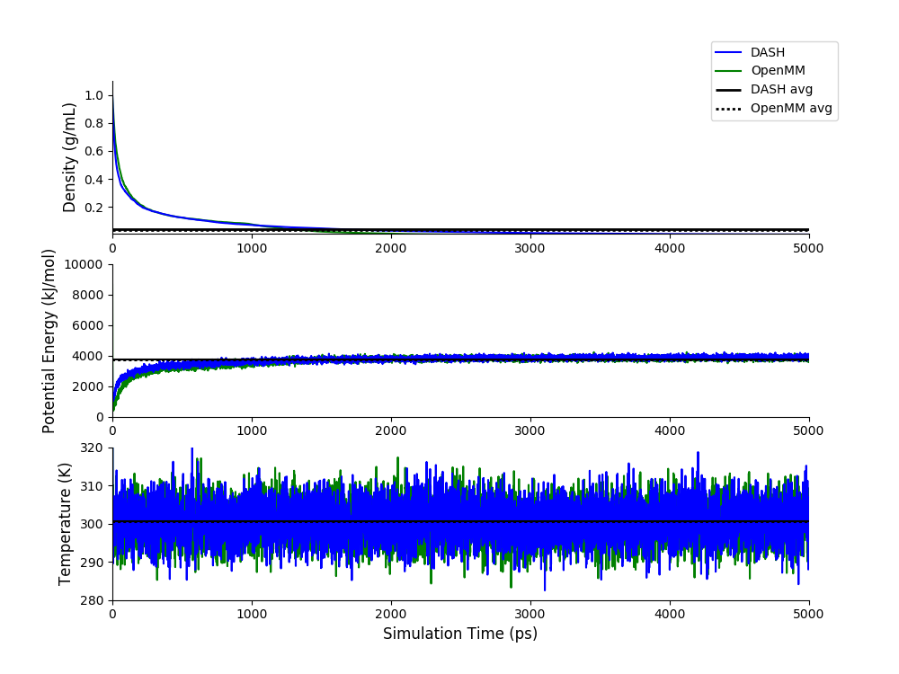
DASH NVT vs OpenMM 0 charge
# beads=1, rCut=9.0 Å, time step=0.5 fs
Data | DASH | OpenMM
Density (g/mL) | 0.049276 ± 0.055271 | 0.042175 ± 0.062486
Energy (kJ/mol) | 3706.58614 ± 222.6355 | 3635.81484 ± 289.05871
Temperature (K) | 300.54083 ± 0.19621 | 300.42003 ± 0.19215
Notes:
All data used for SE analysis (6 bocks), 2*SE reported in table
DASH simulation in dash_work/water using run_9-26-2018.sh and tip4pF_9-26-2018.py, 1000 q-TIP4P/F water molecules, 10M steps with time step 0.5, rCut 9 A, coulomb False, NPT MonteCarlo/Andersen at 298 K and 1.0 atm, initial density 0.9979734044480487, PI 1 bead, data every 1000, restart/traj every 50,000, filename MC-0charge
OpenMM simulation in /home/swansonk1/openmm using run_openmm.sh and pimd_modified.py, 1000 q-TIP4P/F water molecules, 10M steps with time step 0.0005 ps, rCut 0.9 nanometers, coulomb False, NPT RPMDMonteCarlo/PILE at 298 K and 1.01325 bar, initial density 0.9979734044480487, PI 1 bead, data every 1000, restart/traj every 50,000, filename MM-0charge

Slide 16
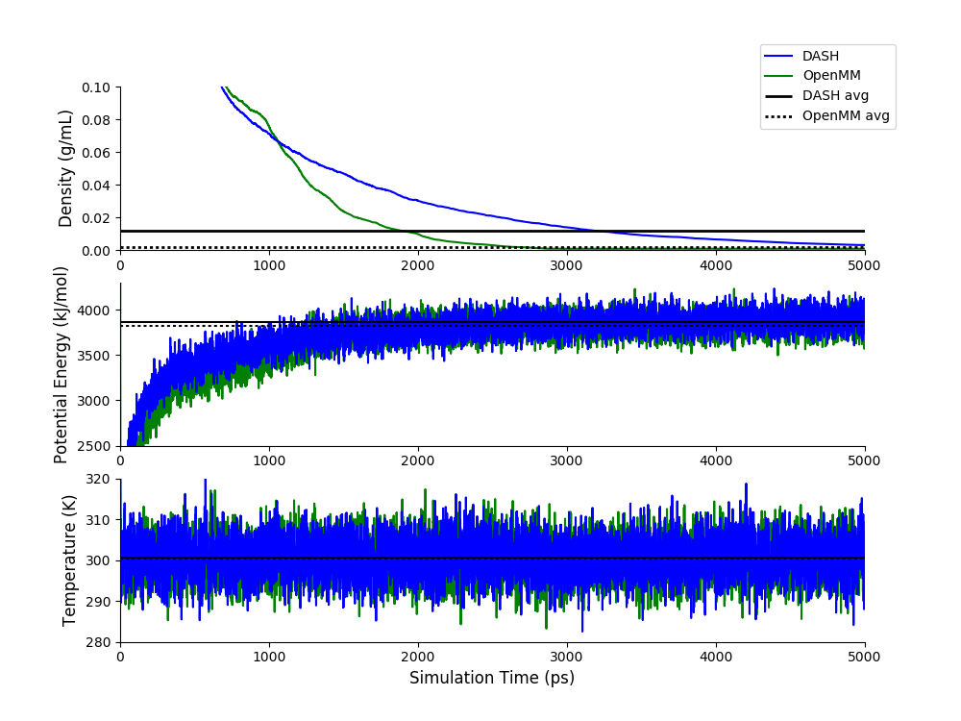
DASH NVT vs OpenMM 0 charge
# beads=1, rCut=9.0 Å, time step=0.5 fs
Data | DASH | OpenMM
Energy (kJ/mol) | 3878.93275 ± 18.3898 | 3930.67033 ± 6.60727
Temperature (K) | 300.4556 ± 0.37655 | 300.36912 ± 0.190716
Notes:
6000 ps equilibration, 4000 production for SE analysis (4 bocks), 2*SE reported in table
DASH simulation in dash_work/water using run_9-26-2018.sh and tip4pF_9-26-2018.py, 1000 q-TIP4P/F water molecules, 10M steps with time step 0.5, rCut 9 A, coulomb False, NPT MonteCarlo/Andersen at 298 K and 1.0 atm, initial density 0.9979734044480487, PI 1 bead, data every 1000, restart/traj every 50,000, filename MC-0charge
OpenMM simulation in /home/swansonk1/openmm using run_openmm.sh and pimd_modified.py, 1000 q-TIP4P/F water molecules, 10M steps with time step 0.0005 ps, rCut 0.9 nanometers, coulomb False, NPT RPMDMonteCarlo/PILE at 298 K and 1.01325 bar, initial density 0.9979734044480487, PI 1 bead, data every 1000, restart/traj every 50,000, filename MM-0charge

Slide 17
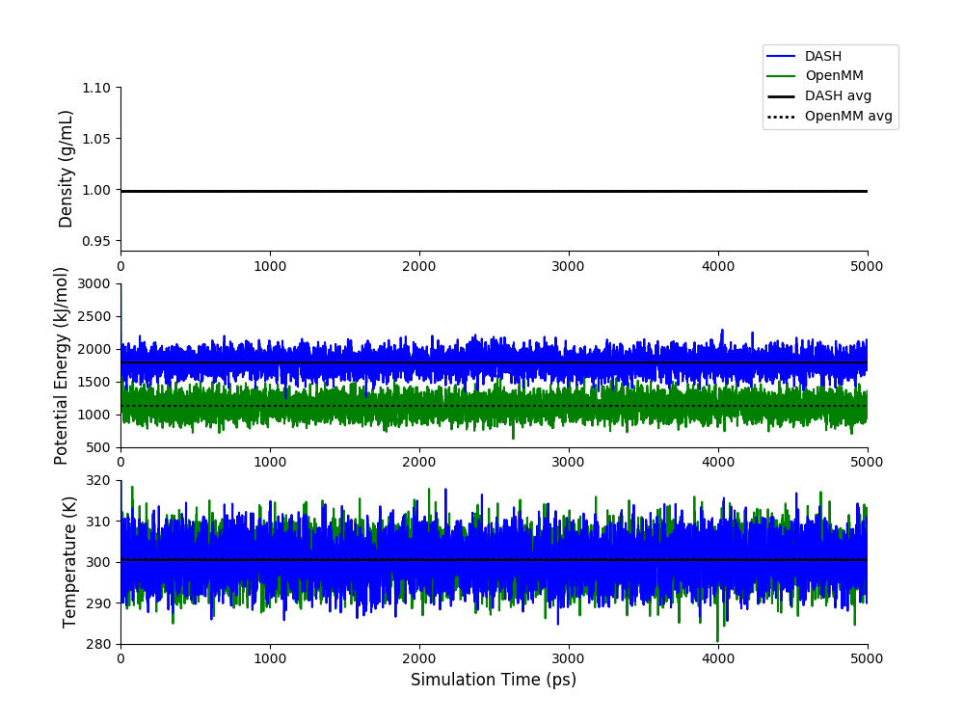
DASH NVT vs OpenMM 0 charge NVT
# beads=1, rCut=9.0 Å, time step=0.5 fs
Data | DASH | OpenMM
Energy (kJ/mol) | 1787.64728 ± 3.91321 | 1124.83421 ± 5.52062
Temperature (K) | 300.41357 ± 0.20056 | 300.54907 ± 0.20918
Notes:
All data used for SE analysis (10 bocks of size 1000 ps), 2*SE reported in table
DASH simulation in dash_work/water using run_9-26-2018.sh and tip4pF_9-26-2018.py, 1000 q-TIP4P/F water molecules, 10M steps with time step 0.5, rCut 9 A, coulomb False, NVT Andersen at 298 K, initial density 0.9979734044480487, PI 1 bead, data every 1000, restart/traj every 50,000, filename MC-0charge-NVT
OpenMM simulation in /home/swansonk1/openmm using run_openmm.sh and pimd_modified.py, 1000 q-TIP4P/F water molecules, 10M steps with time step 0.0005 ps, rCut 0.9 nanometers, coulomb False, NVT RPMD/PILE at 298 K, initial density 0.9979734044480487, PI 1 bead, data every 1000, restart/traj every 50,000, filename MM-0charge

Slide 18
Future Steps
Fully understand energy computations in DASH vs OpenMM for multiple beads
Investigate potential energy discrepancy in NVT simulations DASH vs OpenMM
Compute similar properties in LAMMPS to generate another baseline comparison
Compute properties in NVT with multiple beads
Implement a different water model, e.g. q-SPC/Fw, optimized for path integral simulations, which does not include a massless M-site
Implement a nonlinear 1D potential from a 1999 paper by Martyn, Hughes, and Tuckerman, which has PIMD Barostat results
Notes:
All data used for SE analysis (10 bocks of size 1000 ps), 2*SE reported in table
DASH simulation in dash_work/water using run_9-26-2018.sh and tip4pF_9-26-2018.py, 1000 q-TIP4P/F water molecules, 10M steps with time step 0.5, rCut 9 A, coulomb False, NVT Andersen at 298 K, initial density 0.9979734044480487, PI 1 bead, data every 1000, restart/traj every 50,000, filename MC-0charge-NVT
OpenMM simulation in /home/swansonk1/openmm using run_openmm.sh and pimd_modified.py, 1000 q-TIP4P/F water molecules, 10M steps with time step 0.0005 ps, rCut 0.9 nanometers, coulomb False, NVT RPMD/PILE at 298 K, initial density 0.9979734044480487, PI 1 bead, data every 1000, restart/traj every 50,000, filename MM-0charge

