Slide 1
Optimizing Quality and Performance Using Six Sigma Methodologies in Automotive Systems
Course instructor: Dr. Behin Elahi
ISE 250 : Leading the Six Sigma Improvement Project
Team 03
Aashish Rao Pragati Mandrupkar Gargee Ganesh Auti
Mahima Korad Siddalinga Prasad Ruturaj Sajane

Slide 2

Six Sigma in Automotive Manufacturing
Six Sigma improves manufacturing precision, reduces waste, and enhances product quality.
Widely adopted by automotive leaders to meet strict safety and reliability standards.
Helps minimize defects in assembly lines, improving vehicle durability and customer satisfaction.

Slide 3

Six Sigma for EV Battery Systems
Battery performance and reliability are critical in electric vehicles (EVs).
Six Sigma identifies and reduces defects in battery production and operation.
Optimizing battery quality improves EV range, safety, and long-term performance.

Slide 4
Goals and Methodology
Improve EV battery reliability by identifying key fault causes and performance issues.
Applied Six Sigma DMAIC approach to analyze EV battery dataset.
Excel, Minitab, correlation analysis, boxplots, Cp/Cpk capability metrics.
State of Charge (SoC), Voltage, and Temperature as fault indicators.

Slide 5
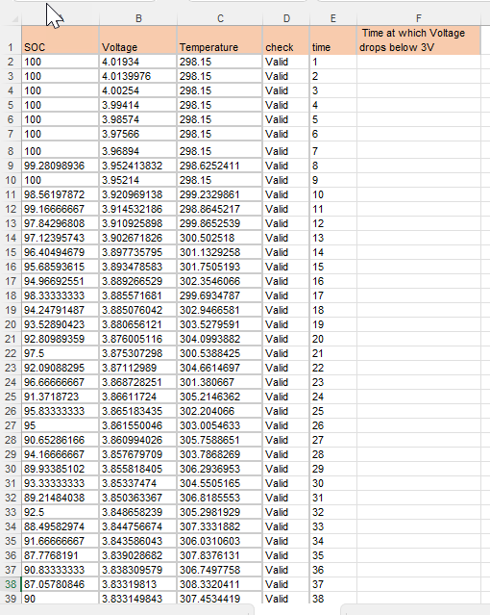
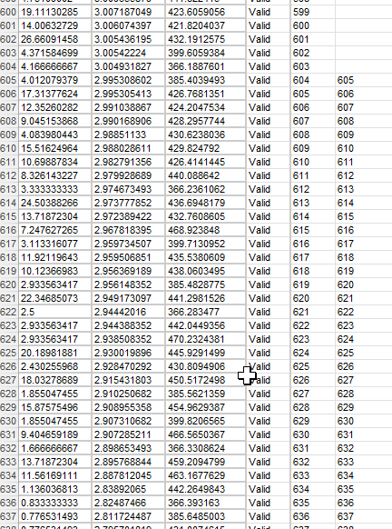
EV Battery Discharge Analysis: Voltage vs. State of Charge (SoC)
Performance Simulation Using EV Fault Dataset
With some calculated metrics
Objective and Significance
Analyze voltage behavior as State of Charge (SoC) decreases.
Simulate EV battery performance degradation during discharge.
Critical for consistent power delivery and reliability in automotive systems.

Slide 6
Voltage vs. SoC
Methodology
Data sorted by SoC (100% ➔ 0%) to simulate discharge sequence.
Voltage vs. SoC plotted to observe performance changes.
Key Observations
Voltage declines consistently with decreasing SoC.
Pattern reflects real-world EV battery behavior that performance degrades progressively during discharge.
Highlights importance of performance monitoring and Six Sigma initiatives.

Slide 7
Temperature Behavior During Discharge
Methodology
Monitored temperature changes during battery discharge cycle.
Recorded initial and final temperatures across the full discharge period.
Key Observations
Temperature increased significantly as battery discharged.
Highlights the critical need for effective thermal management in EV systems.
Excessive heat buildup can accelerate battery degradation, affecting safety and performance.

Slide 8
Calculated Performance Metrics
1.Voltage Drop per Hour
Calculated Performance Metrics
First Voltage = 4.0193
Last Voltage = 2.7816
Time = 639 (assuming it's in seconds)
Convert time to hours:
Time (hours)= 639\3600=0.1775 hours
Voltage drop per hour:
Voltage drop per hour = 4.0193 − 2.7816 / 0.1775 ​≈ 6.97 V/hour​

Slide 9
Calculated Performance Metrics
2. Temperature Increase Rate
Calculated Performance Metrics
Initial Temperature: 298.15 K
Final Temperature: 470.57 K
Total Discharge Time: 639 seconds (~0.1775 hours)
Temperature Increase Rate: = 470.570 − 298.150 / 0.1775 ≈ 971.1 ∘C per hour
Indicates the need for effective thermal management.

Slide 10
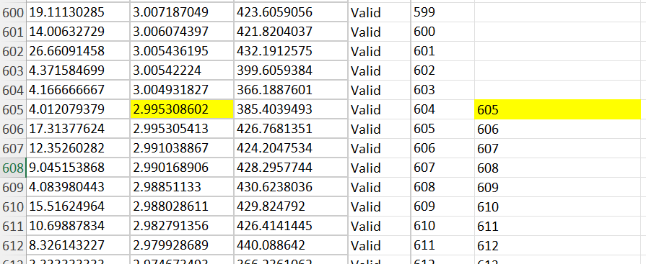
Calculated Performance Metrics
Time at Which Voltage Drops Below 3V
Identifies the critical discharge point where voltage falls below 3V.
Important for understanding performance thresholds and safety limits.

Slide 11

Identification of Critical Process Parameters using ANOVA
What ANOVA Does?
ANOVA stands for Analysis of Variance. Are the means of a feature (like SOC, Temperature, Voltage) statistically different across different battery health conditions?
If YES → that feature significantly impacts performance/faults.
ANOVA gives two key outputs:
F-statistic: Ratio of "variation between groups" to "variation within groups." Higher F = more difference between groups.
p-value: Probability that any observed difference is due to random chance.
If p-value < 0.05, it’s statistically significant (not random).
If p-value > 0.05, the factor does not significantly impact.

Slide 12
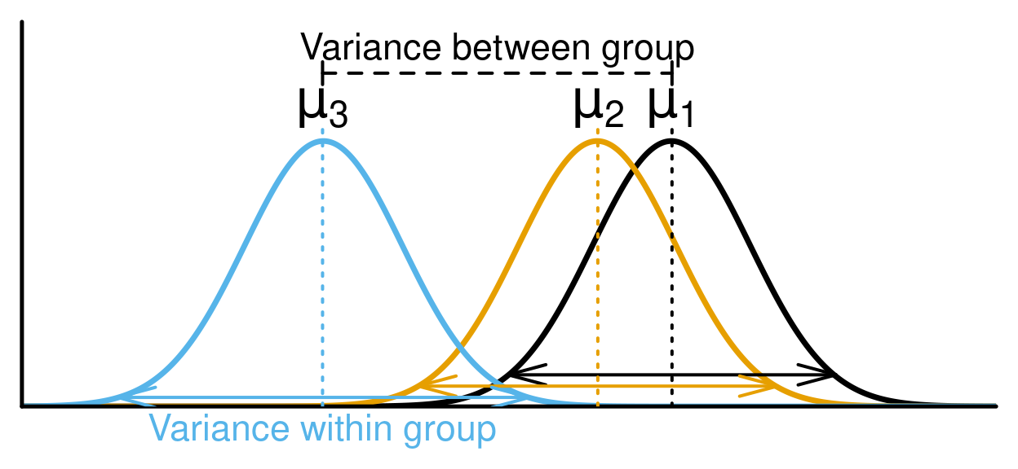
ANOVA Analysis
Define Hypotheses
Null Hypothesis (H₀): There is no difference in the mean SOC, Temperature, or Voltage between different health conditions (healthy vs faulty).
Alternative Hypothesis (H₁): At least one group's mean is significantly different.
Calculate Group Means and Variances
Calculate mean inside each group (healthy, unhealthy, fault type).
Calculate variability inside each group.

Slide 13
ANOVA Analysis
Partition Variance
Between Group Variance: Measures differences between group means.
Within Group Variance: Measures differences among individuals inside the same group.
If between group variance is much bigger than within group variance, it suggests real differences between groups (i.e., feature matters).
Calculate F-statistic and p-value
The F-statistic formula:
F = Between Group Variance / Within Group Variance
Then, using F-distribution, find the p-value associated.
Lower p-value (<0.05) → Reject Null Hypothesis → Feature is significant.

Slide 14
ANOVA Results Summary
Dataset | Feature | F-Statistic | p-value | Significant?
Simple Classification | SOC | 62.20 | 1.14e-14 | ✅ Yes
Simple Classification | Temperature | 139.77 | 1.28e-29 | ✅ Yes
Simple Classification | Voltage | 132.01 | 3.44e-28 | ✅ Yes
Multiple Classification | SoC | 730.91 | 1.64e-205 | ✅ Yes
Multiple Classification | Temperature | 806.04 | 1.79e-219 | ✅ Yes
Multiple Classification | Voltage | 20587.26 | 0.0 | ✅ Yes

Slide 15
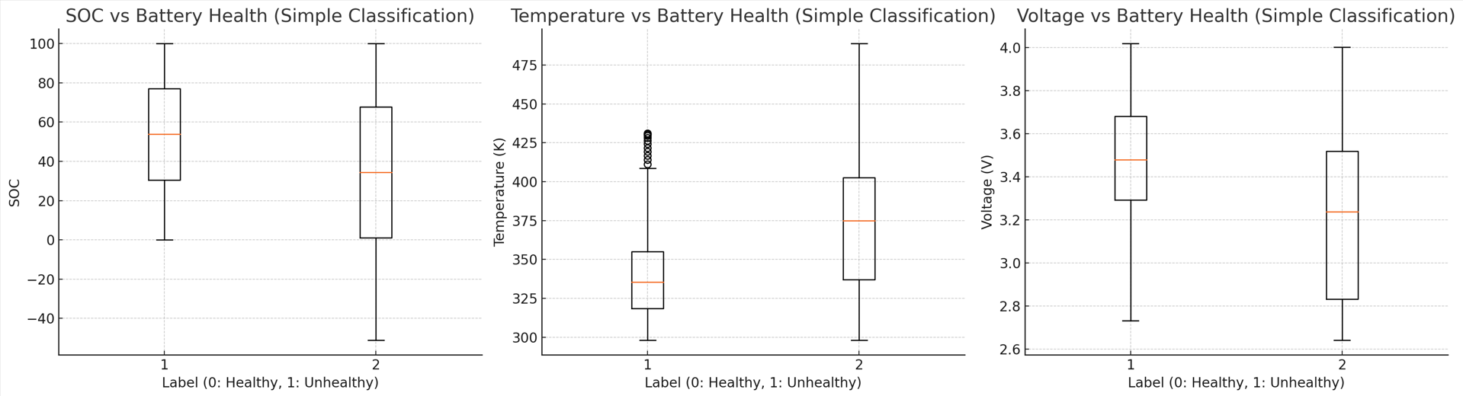
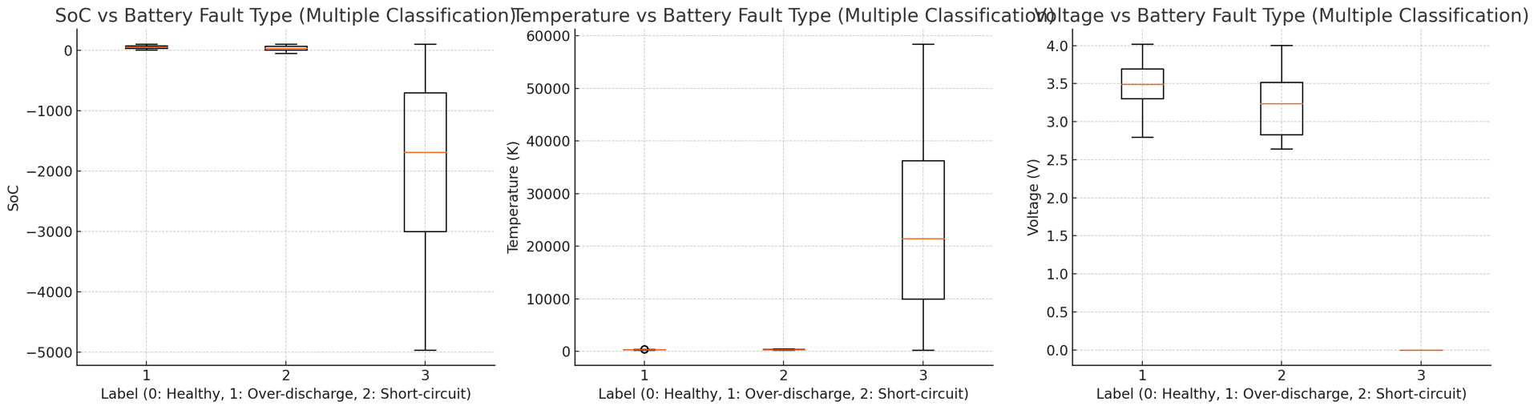
Boxplots

Slide 16
Variability Metrics
Simple Classification Variability Metrics
 | SOC | SOC | SOC | Temperature | Temperature | Temperature | Voltage | Voltage | Voltage
 | mean | std | CV | mean | std | CV | mean | std | CV
Label
0 | 53.49475 | 27.46277 | 0.513373 | 340.5519812 | 29.66752576 | 0.087115998 | 3.47909 | 0.25642 | 0.073703
1 | 33.50977 | 39.78618 | 1.187301 | 374.1297116 | 45.34431011 | 0.121199436 | 3.206821 | 0.372356 | 0.116114
Multiple Classification Variability Metrics
 | SoC | SoC | SoC | Temperature | Temperature | Temperature | Voltage | Voltage | Voltage
 | mean | std | CV | mean | std | CV | mean | std | CV
Label
0 | 52.23497 | 28.07908615 | 0.537553409 | 337.046559 | 26.7226636 | 0.079284784 | 3.490761 | 0.259722 | 0.074403
1 | 33.50977 | 39.78618203 | 1.187301002 | 374.1297116 | 45.34431011 | 0.121199436 | 3.206821 | 0.372356 | 0.116114
2 | -1922.67 | 1442.915115 | -0.750475703 | 23889.77815 | 16455.96352 | 0.688828646 | 0 | 0

Slide 17
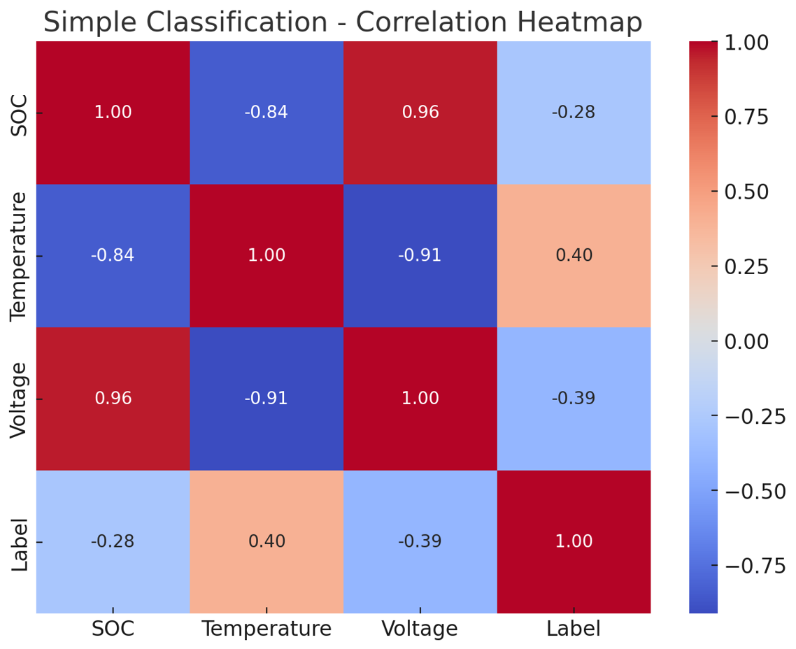
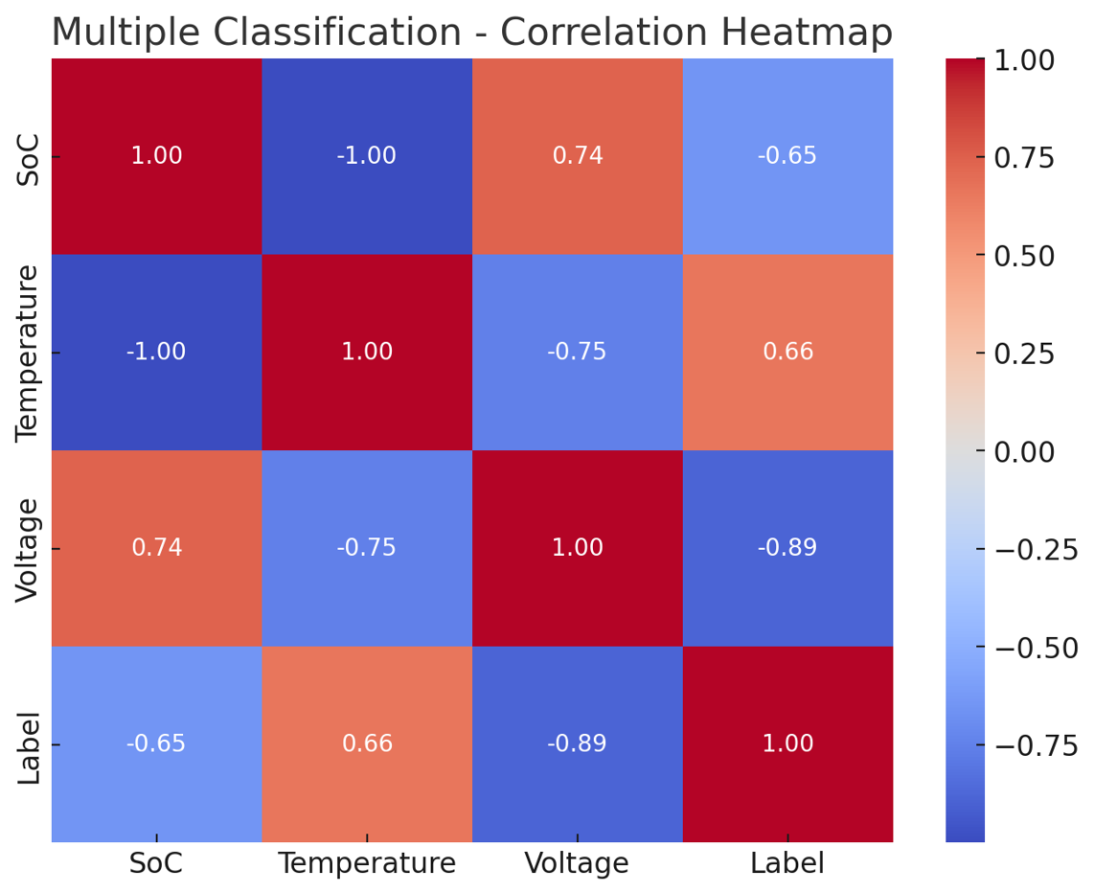
Correlation Analysis
Simple Classification Correlation Matrix
Multiple Classification Correlation Matrix
 | SOC | Temperature | Voltage | Label
SOC | 1 | -0.842520843 | 0.95718052 | -0.280926118
Temperature | -0.84252 | 1 | -0.912155662 | 0.401793896
Voltage | 0.957181 | -0.912155662 | 1 | -0.392247476
Label | -0.28093 | 0.401793896 | -0.392247476 | 1
 | SoC | Temperature | Voltage | Label
SoC | 1 | -0.999460559 | 0.74007083 | -0.651353977
Temperature | -0.99946 | 1 | -0.751943369 | 0.662471745
Voltage | 0.740071 | -0.751943369 | 1 | -0.888890224
Label | -0.65135 | 0.662471745 | -0.888890224 | 1

Slide 18
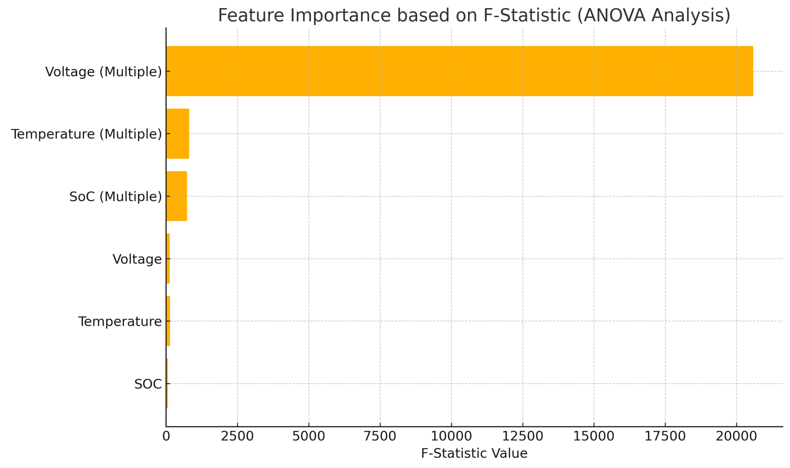
ANOVA Conclusion
"The ANOVA results clearly show that SOC, Temperature, and Voltage are statistically significant contributors to battery health classification. All three had p-values far below 0.05, and Voltage, in particular, showed extremely high F-statistics — indicating it’s the most sensitive to fault detection. This confirms these parameters should be considered critical inputs in any battery monitoring or diagnostic system."

Slide 19
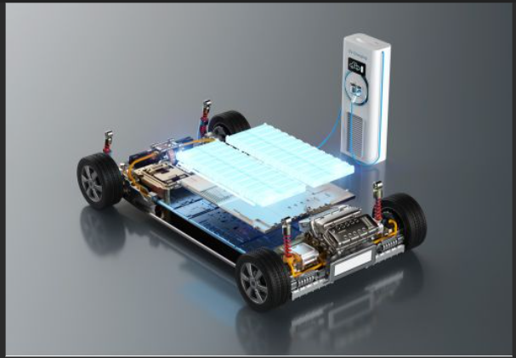
Statistical Analysis of Process Capability for EV Battery Health and Fault Diagnosis
Objective: Identify differences in process stability between healthy and faulty batteries based on critical parameters.
Methodology:
Selected the Simple Classification Dataset for EV Battery Fault Analysis.
Focused on Cp and Cpk Analysis to assess process capability.
Classified data:
Label 0 →Healthy Batteries
Label 1 → Faulty Batteries

Slide 20
Statistical Analysis of Process Capability for EV Battery Health and Fault Diagnosis
USL and LSL determination:
Used the statistical approach (Mean ± 3 × Sigma) to define control limits for healthy batteries.
Applied the same control limits to analyze the faulty battery group for consistent comparison.
Analysis Scope:
Conducted Cp and Cpk calculations for both Temperature and Voltage variables.
Calculations and validations were performed using Excel and Minitab.

Slide 21
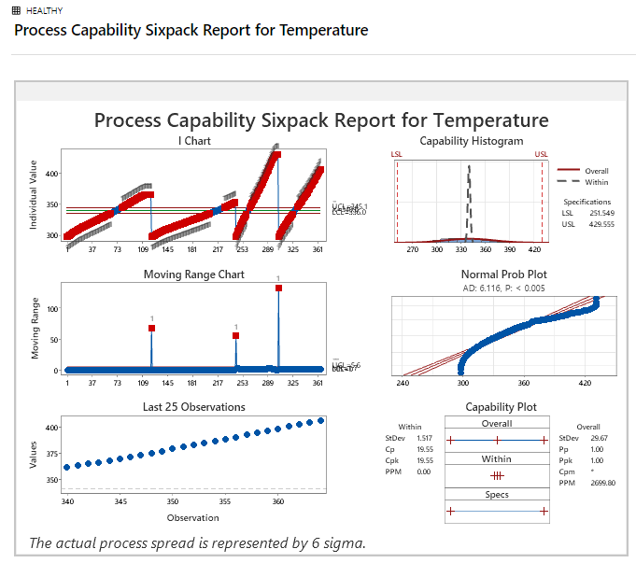
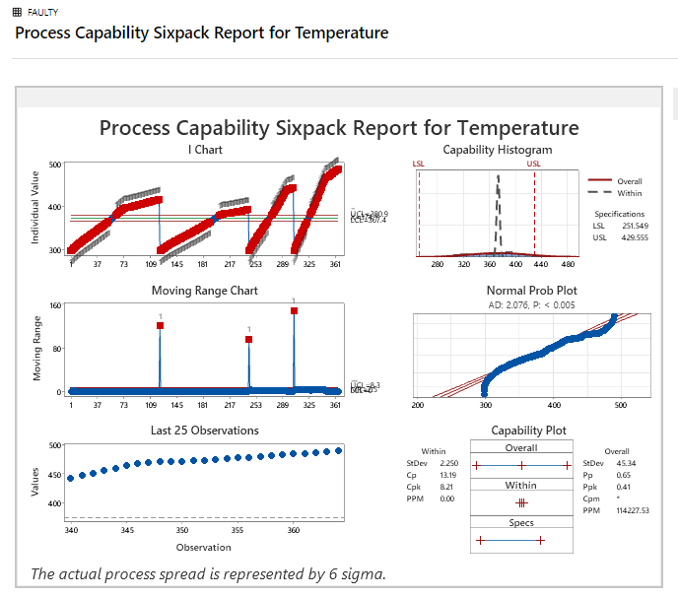
Minitab Analysis for Temperature (healthy vs Faulty)

Slide 22
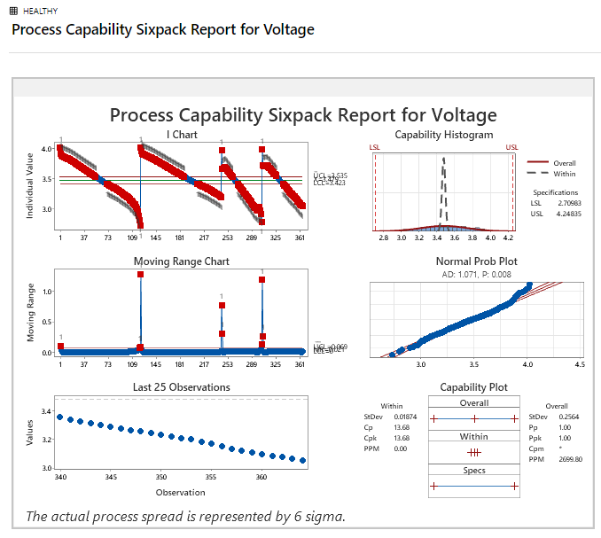
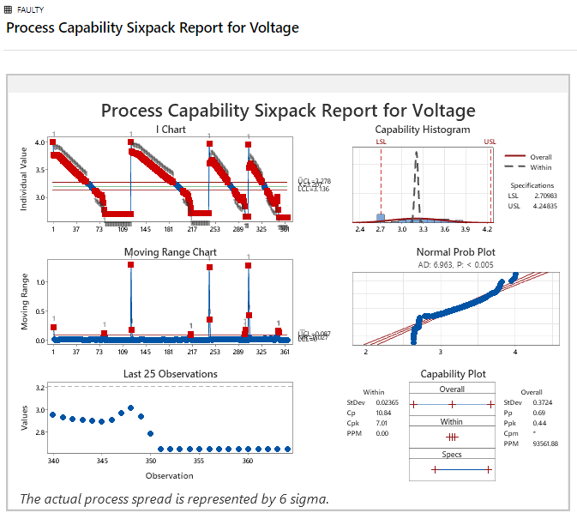
Minitab Analysis for Voltage(healthy vs Faulty)

Slide 23
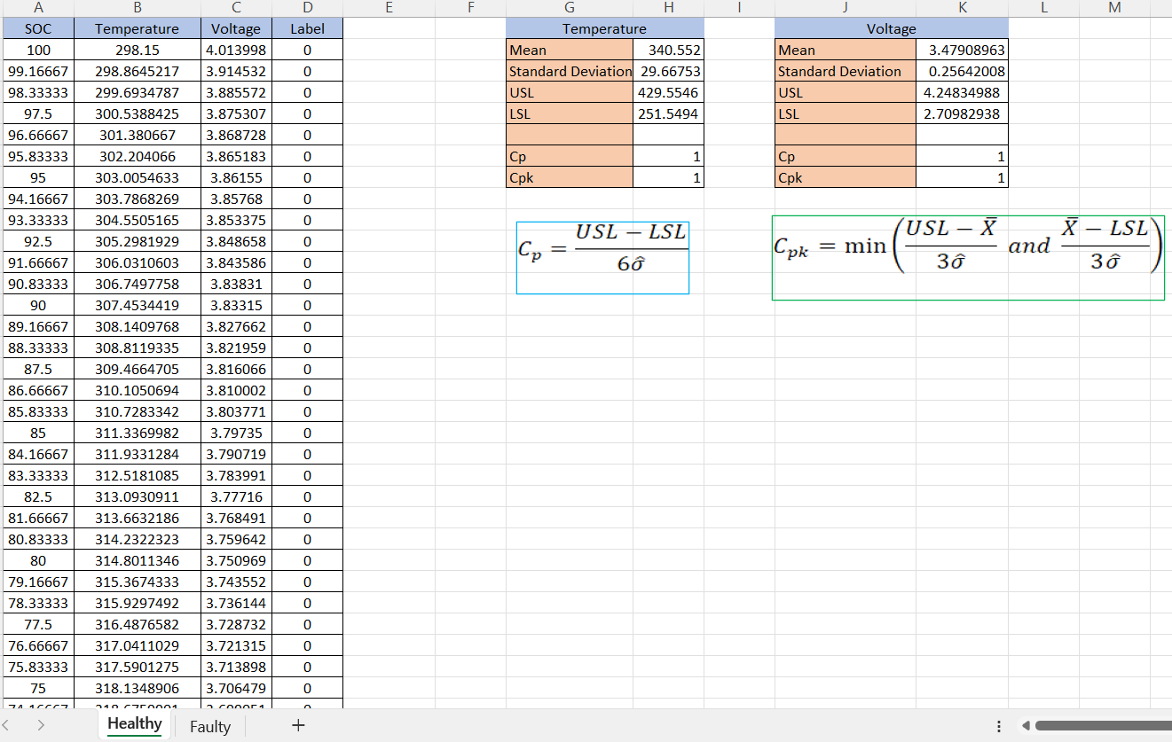
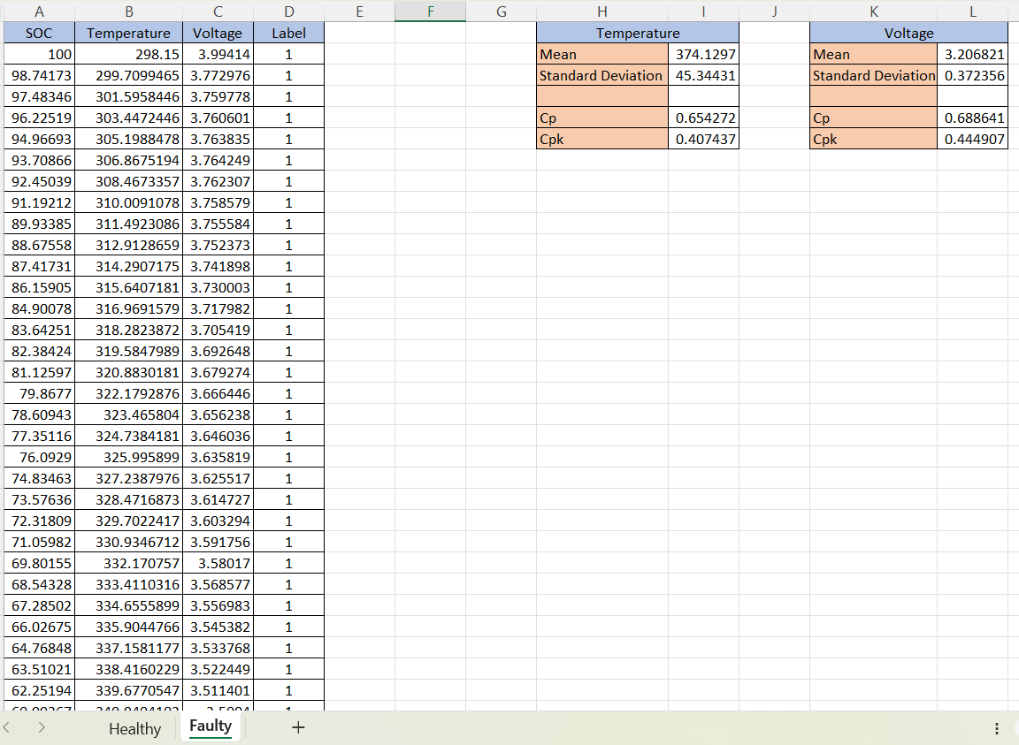
Excel Analysis for Temperature and Voltage

Slide 24
Healthy Battery Conclusion
For Healthy Batteries:
Excel Analysis:
Cp = 1
Cpk = 1
Process is stable and capable.
Centered well between USL and LSL.
Temperature and Voltage are well controlled (very low variation).
Minitab Analysis:
Cp ≈ 19.55, Cpk ≈ 19.55 (for Temperature)
Extremely high process capability.
Normality approximately maintained.
Very narrow spread; almost no defects (very low PPM).

Slide 25
Faulty Battery Conclusion
For Faulty Batteries:
Excel Analysis:
Cp ≈ 0.65, Cpk ≈ 0.41 (for Temperature)
Cp ≈ 0.68, Cpk ≈ 0.44 (for Voltage)
Process is not capable — much below acceptable limits (Cp, Cpk < 1).
Center is shifted toward USL (higher temperature).
Minitab Analysis:
Cp ≈ 13.19, Cpk ≈ 8.21 (for Temperature) — high within capability, but overall process stability is poor.
High standard deviation; shifting of process toward USL.
Normality not achieved well; unstable behavior observed in I-Chart and MR-Chart.
Defect rate (PPM) very high (> 112,000).

Slide 26
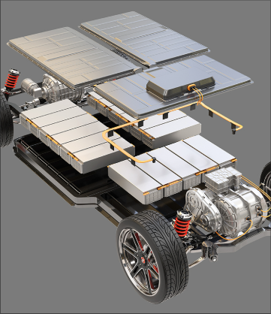
Inference
The process capability analysis shows that faulty batteries have unstable and highly variable behavior, unlike healthy batteries which are much more controlled. This instability leads to frequent shifts, poor reliability, and a much higher chance of faults. This study is one of the implementations of Six Sigma principles, focusing on improving process capability and reducing defects.

Slide 27
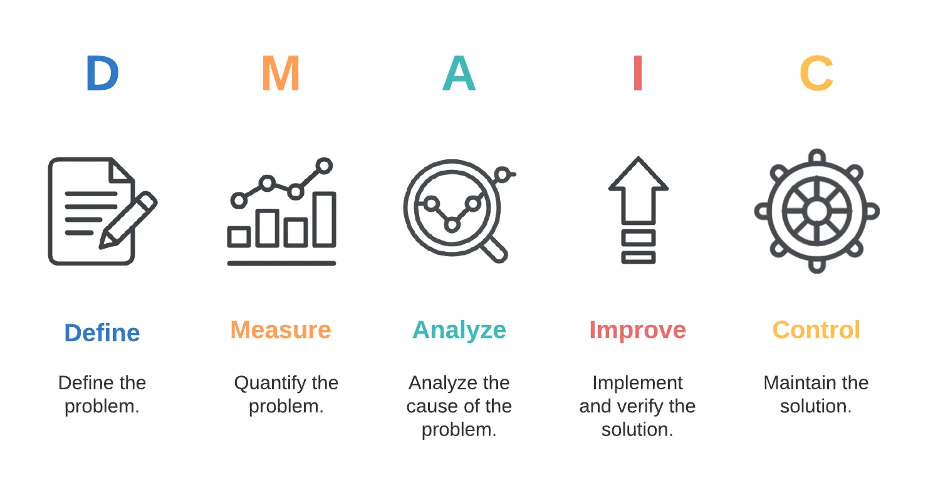
Using DMAIC for Battery Fault Analysis
Applying Six Sigma DMAIC methodology to analyze and optimize EV battery performance:
DEFINE: Establish fault reduction objectives.
MEASURE: Understand dataset variables (SOC, Temperature, Voltage).
ANALYZE: Identify key fault drivers using statistical and visual tools.
IMPROVE: Propose actionable thresholds and predictive models.
CONTROL: Implement monitoring systems to sustain improvements.

Slide 28
DMAIC Phase 1: Define
Applying Six Sigma DMAIC methodology to analyze and optimize EV battery performance:
Objective: To optimize EV Battery Quality by Reducing Fault Occurrence.
Dataset: EV Battery Faults Dataset (SOC, Temperature, Voltage, Label).
Problem: High variability in Voltage, SOC, and Temperature leads to faults.
Goal: Analyze correlation, reduce fault rate (Label = 1) and improve battery reliability.
Stakeholders: Battery manufacturers, automotive engineers, QA teams.

Slide 29
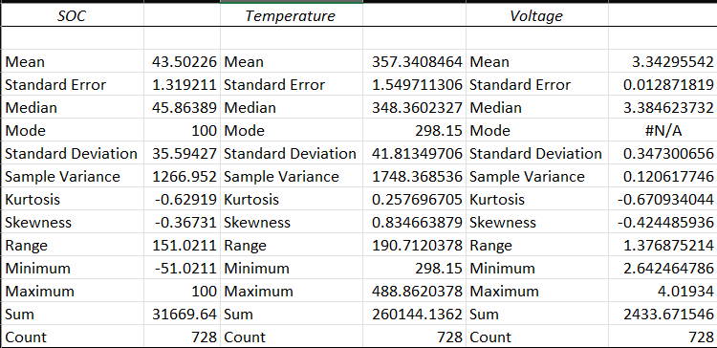
DMAIC Phase 2: Measure
Applying Six Sigma DMAIC methodology to analyze and optimize EV battery performance:
728 Samples: 50% Healthy (Label 0), 50% Faulty (Label 1).
Variables: SOC (%), Temperature (K), Voltage (V).
Balanced Dataset: No class imbalance.
Descriptive Statistics: Calculated for all variables.

Slide 30
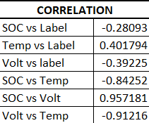
DMAIC Phase 3a: Analyze
a. CORRELATION ANALYSIS:
SOC vs Label (-0.2809): ➔ Weak negative correlation — Lower SOC slightly increases fault risk.
Temperature vs Label (0.4018): ➔ Moderate positive correlation — Higher Temperature moderately increases fault risk.
Voltage vs Label (-0.3922): ➔ Moderate negative correlation — Lower Voltage moderately increases fault risk.
SOC vs Temperature (-0.8425): ➔ Strong negative correlation — As SOC decreases, Temperature tends to increase.
SOC vs Voltage (0.9572): ➔ Very strong positive correlation — Higher SOC is strongly associated with higher Voltage.
Voltage vs Temperature (-0.9122): ➔ Very strong negative correlation — As Voltage drops, Temperature rises.
Voltage and SOC are crucial - as they drop, faults increase.
Temperature rise also moderately contributes to faults.

Slide 31
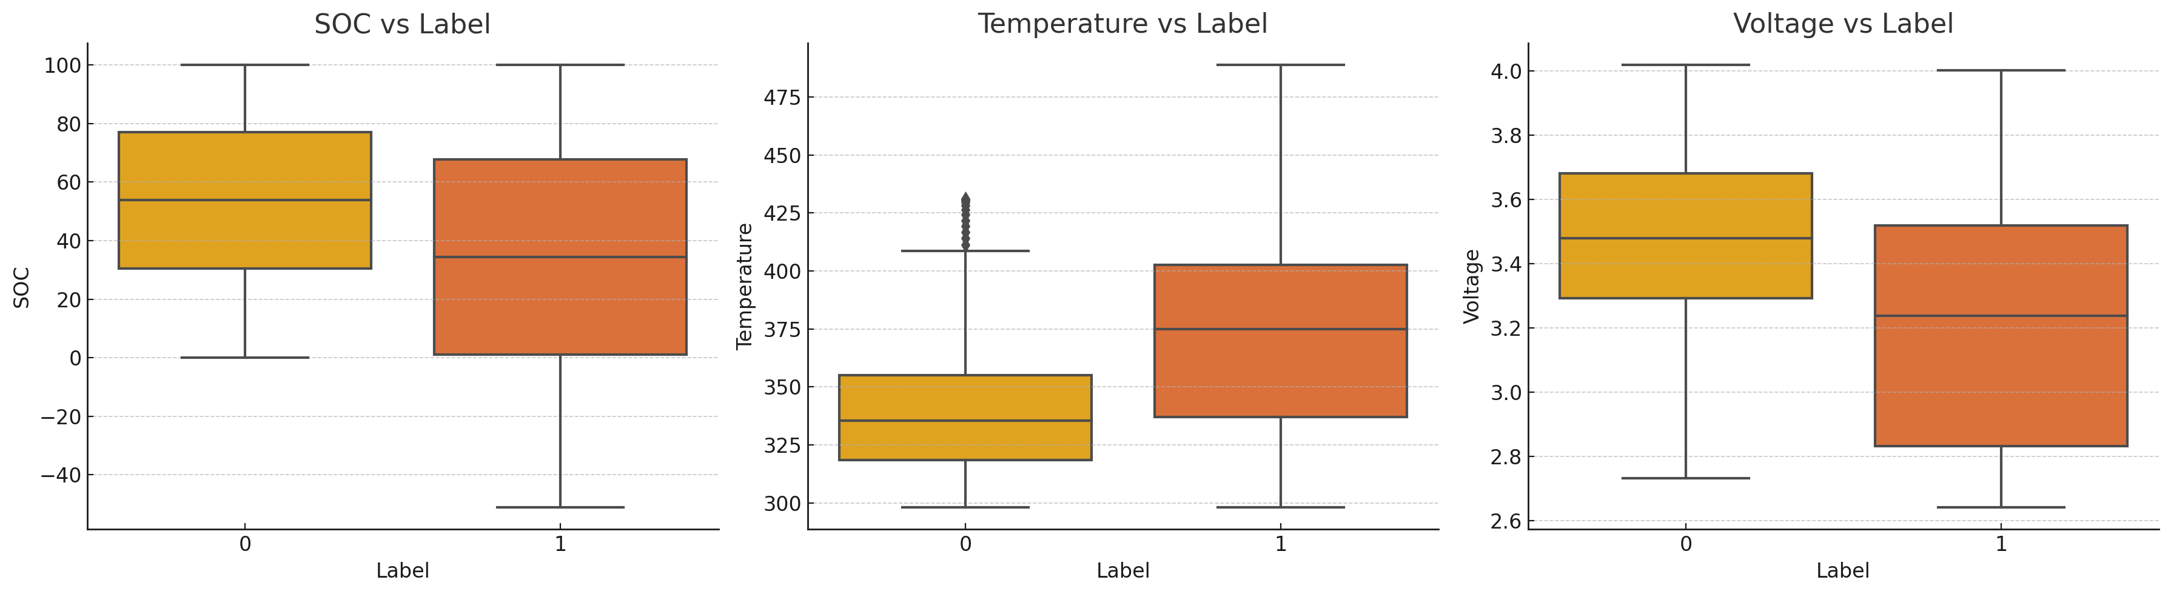
DMAIC Phase 3b: Analyze
b. BOXPLOT ANALYSIS:
SOC: Faulty batteries show lower SOC levels.
Temperature: Faulty batteries exhibit slightly higher temperatures.
Voltage: Faulty batteries have lower voltage ranges.
Visual trends confirm correlation results;
Lower SOC and Voltage, and higher Temperature, relate to faults.

Slide 32
DMAIC Phase 4: Improve
Recommendations to Improve:
Threshold Alerts:
Voltage < 3.5V triggers maintenance.
SOC < 30% requires charge intervention.
Actionable Improvement Plans:
Design preventive maintenance schedules when Voltage/SOC approach risky thresholds.
Implement warning systems based on real-time data for Voltage and SOC drops.
Implement Real-time Dashboards: For continuous proactive monitoring and early intervention.
Develop SOPs: Document standardized actions when parameters approach critical thresholds based on correlation and boxplot findings.

Slide 33
DMAIC Phase 5: Control
Control Charts: X-bar and R Charts for continuous monitoring of Voltage and Temperature variability.
P-Charts: Monitor ongoing battery fault rates (Label = 1 occurrences) over time.
Establish Monitoring Frequencies: Daily control chart reviews and weekly fault rate reports.
Model and Threshold Updates: Periodic reevaluation of alert thresholds every quarter based on new data.
Operator Training and Internal Audits: Regular workforce training sessions and process audits to verify adherence.
Align with Six Sigma: Maintain low variation, enhance battery reliability, and drive defect reduction initiatives.

Slide 34
DMAIC: Inferences and Summary
✅ Voltage Behavior: Lower Voltage values are strongly associated with battery faults.
✅ SOC Impact: Lower SOC (<30%) significantly increases fault likelihood.
✅ Temperature Role: Slightly higher Temperature correlates moderately with fault occurrence.
✅ Process Monitoring Results:
Voltage X-bar Chart: Process is stable, no major variation.
Fault P-Chart: No out-of-control signals, but high defect rate is a concern.
✅ Improvement Strategy: Set operational thresholds, real-time monitoring dashboards, and early warning SOPs.

Slide 35
Key Findings
Low Voltage and SoC are strongly linked to battery faults
High Temperature moderately increases fault risk during discharge.
Faulty batteries showed poor process capability (low Cp, Cpk) compared to healthy ones.
Real-time monitoring and threshold alerts can help prevent critical faults.

Slide 36
Future Scope
Integrate machine learning models to predict faults based on real-time battery parameters.
Extend Six Sigma analysis to other EV subsystems like charging modules and power inverters.
Collaborate with industry partners to validate findings on real-world EV battery platforms.
Automate data collection and control chart updates for continuous quality improvement.

Slide 37
Thank You

