Slide 1

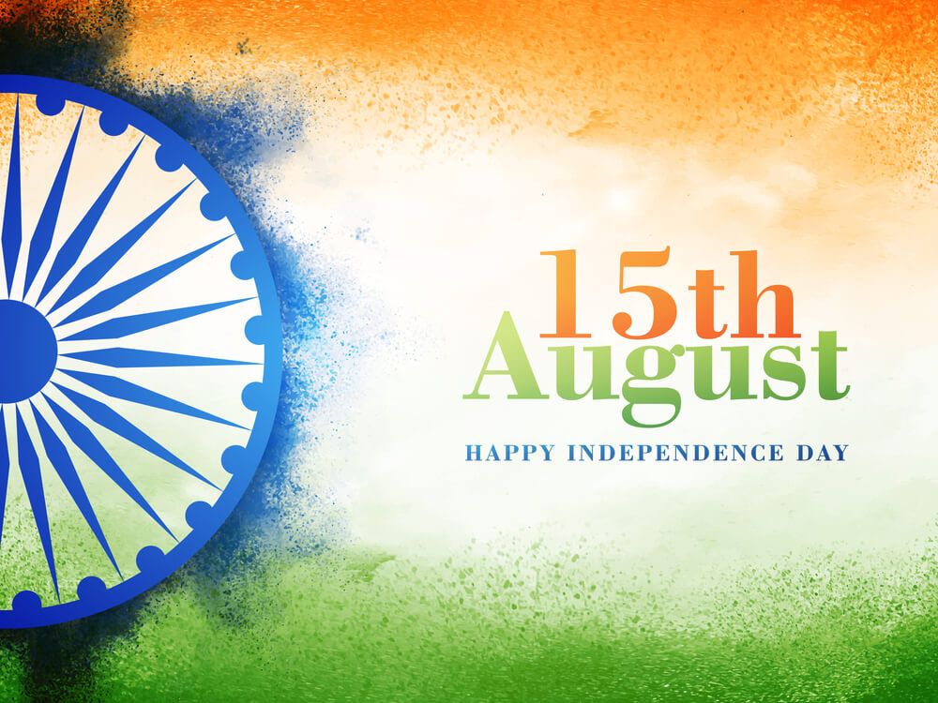
Home About Us Buy Tickets Glimpse Newsletter
F
F
F
Search
15 DAYS
37HOUR
23MINS
HAPPY INDEPENDENCE
DAY

Slide 2
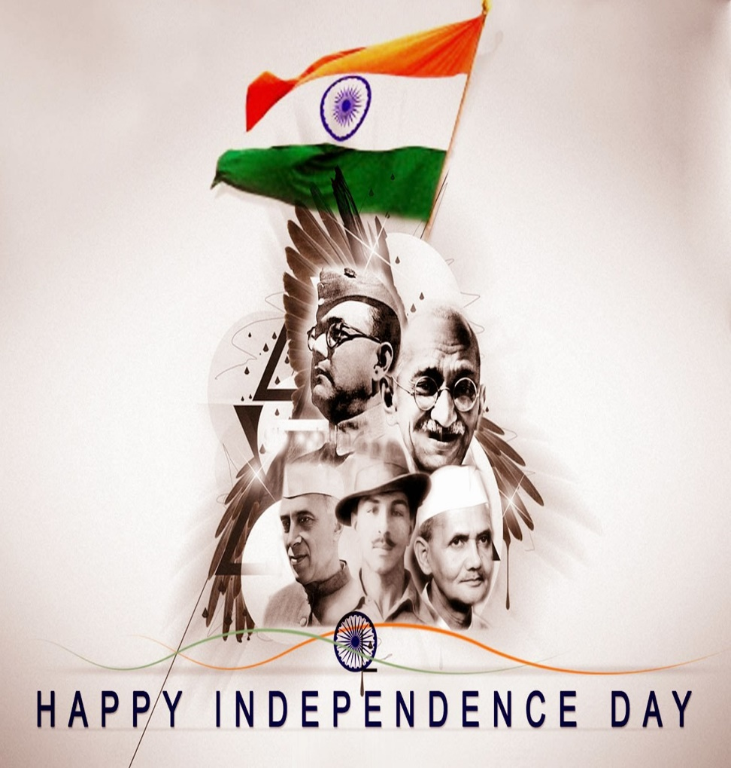
INDEPENDENCE DAY
Independence Day is annually celebrated on 15 August, as a national holiday in India commemorating the nation's independence from the United Kingdom on 15 August 1947, the UK Parliament passed the Indian Independence Act 1947 transferring legislative sovereignty to the Indian Constituent Assembly.
LEARN MORE

Slide 3
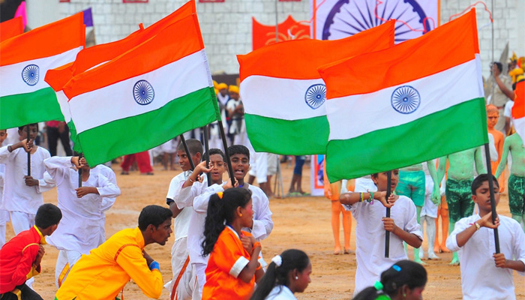
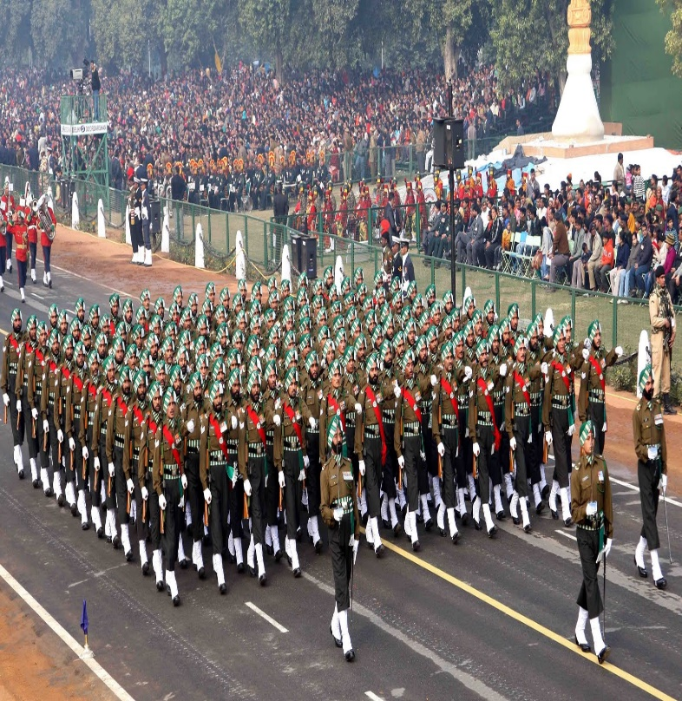
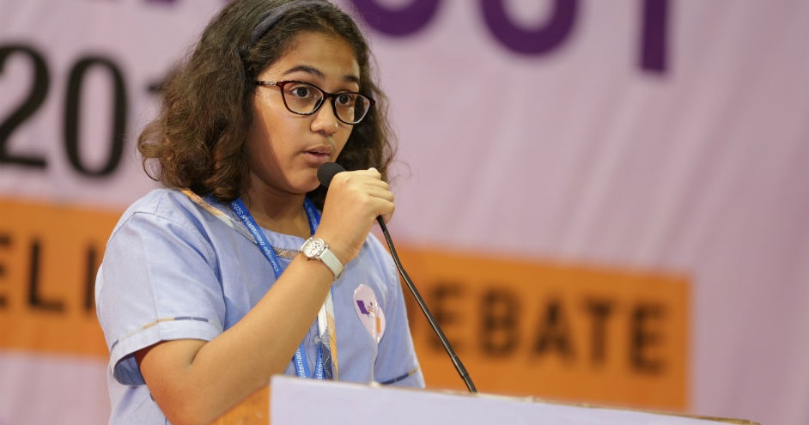
PROGRAMS DETAILS
This day is celebrated with great pride, enthusiasm and high spirits across the country and is marked as a very important day in Indian History and so called INDEPENDENCE DAY or 'SWADHINTA DIWAS'.
FLAG HOSTING
PARADE
QUIZ

Slide 4
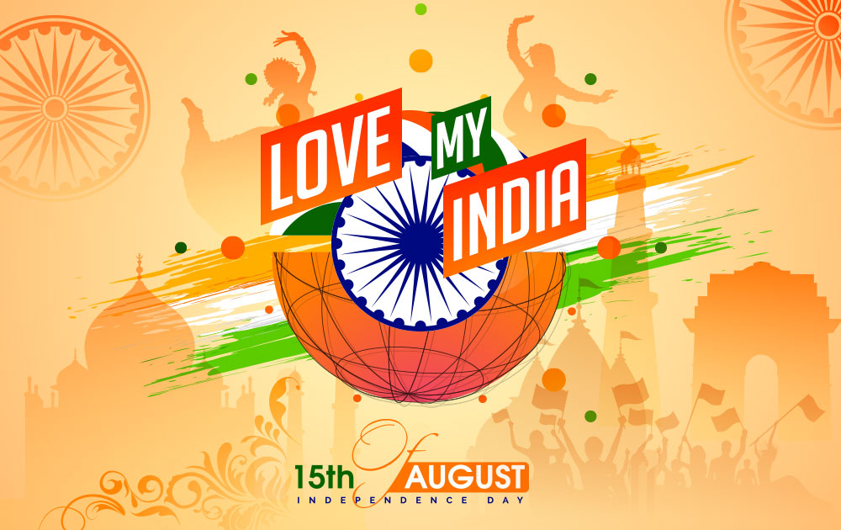
BOOK YOUR TICKETS NOW
ENTER YOUR NAME
TIMING:-
MOBILE NO.
FLAG HOSTING
NO. OF TICKETS
9 AM - 10:30 AM
EMAIL ADDRESS
PARADE
BOOK NOW
10:45 AM - 11:45 AM

Slide 5

GLIMPSE
SUBSCRIBE TO OUR NEWS LETTERS
SUBSCRIBE

Slide 6
On this day of Indian Independence, the nation attained freedom from the governing British Rule. This day is celebrated with great pride, enthusiasm and high spirits across the country and is marked as a very important day in Indian History and so called INDEPENDENCE DAY or 'SWADHINTA DIWAS'.
CONTACT INFORMATION
IMPORTANT LINKS
HOME
ABOUT US
BUY TICKETS
GLIMPSE
NEWSLETTER
C
NEWS 18 INDIA

