Slide 1
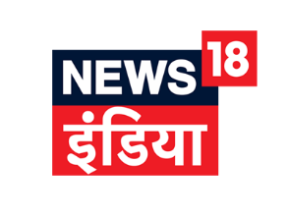
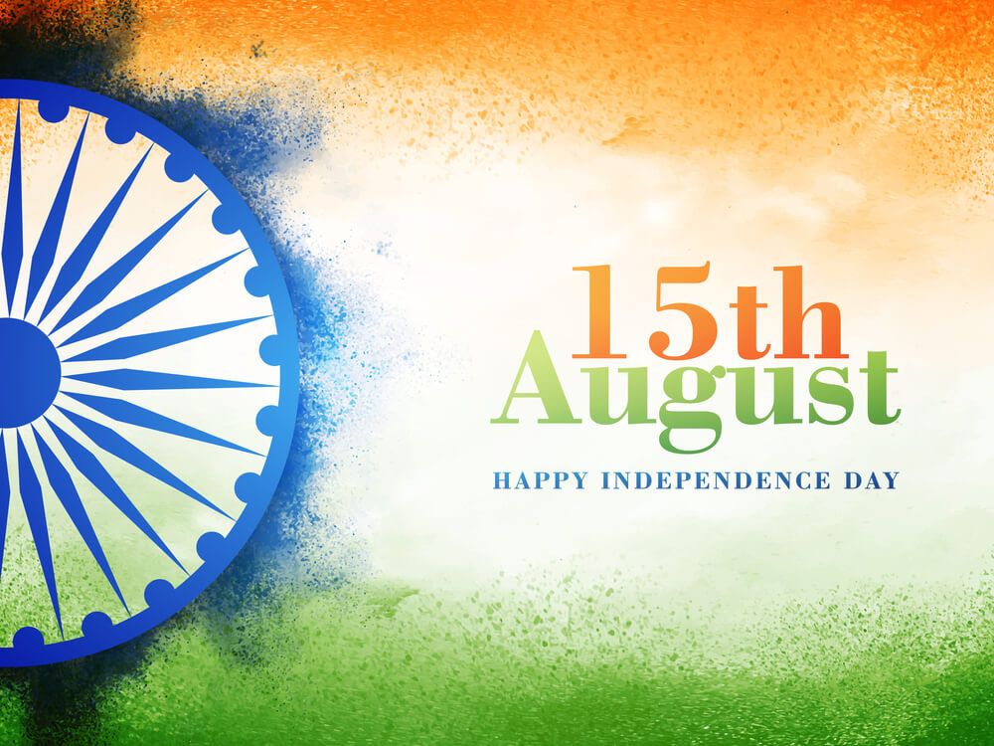
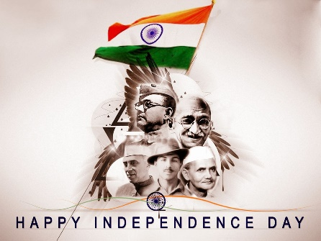
INDEPENDENCE DAY
Independence Day is annually celebrated on 15 August, as a national holiday in India commemorating the nation's independence from the United Kingdom on 15 August 1947

Slide 2
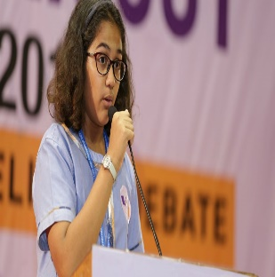
EVENTS
TIMING
TIMING
TIMING

