Slide 1
Tsuen Wan government secondary school
Teacher user guide for
Wikiglass (PBworks Analytical Site)
Faculty of Education
University of Hong Kong
Notes:
Hello. This is a tutorial guide of Wikiglass, the PBworks Analytical site, for teachers, prepared by the Faculty of Education at HKU.

Slide 2
Video tutorial
There is a video tutorial for Wikiglass:
https://youtu.be/vVj4g4JlgjQ
It’s 5 mins 55 second
It covers all the content of this slides.

Slide 3
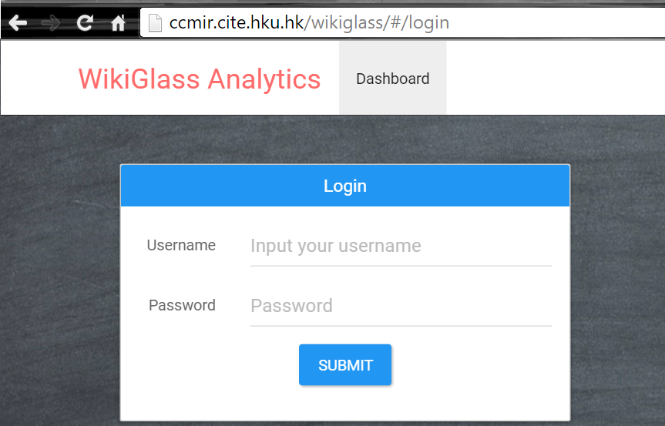
Login
Please go to :
To protect student personal data,
please use your login.
http://ccmir.cite.hku.hk/wikiglass/
Username:
Password:
(will be given separately)
Notes:
Firstly, to access the Wikiglass tool, please visit the link. It is suggested that you can Bookmark it for convenience.
As student personal data should be protected, you are required to login in order to view the statistics.
The username and password will be given to teachers separately.

Slide 4
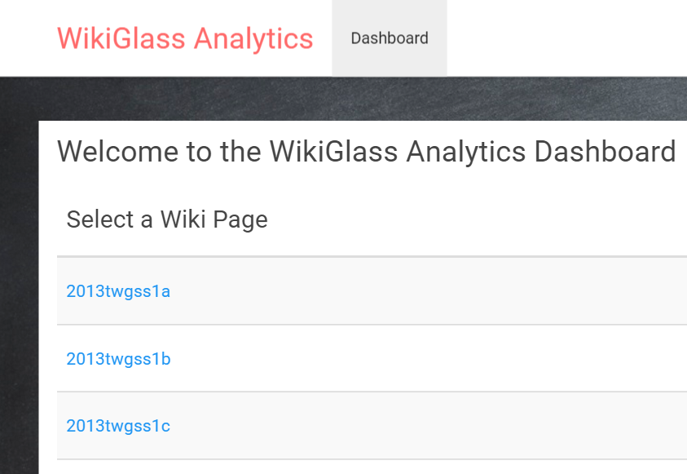
List of class
After login,
you can see a list of classes.
Click on the class that
you wish to view contributions and progress
of the groups and individuals
For example, click “2013twgss1c”
Notes:
After you’ve logged in, there is a of classes, e.g. [year-schoolname-class].
Then, click on the class that you’d like to view the contributions and progress of its groups and individual students
E.g. click 2013twgss1c

Slide 5
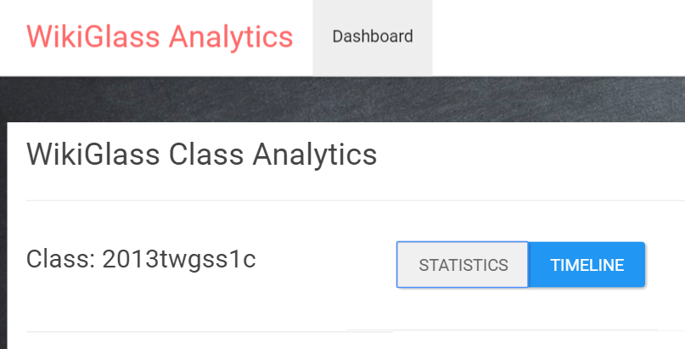
Statistics and Timeline Modes
Each class has two visualization modes
Statistics mode shows
Revision counts
Word counts
of each group
and students
Timeline mode shows
Weekly changes of revision counts and word amendment counts along the time
of each group and students
Notes:
For each class, there are TWO modes of visualizing students’ contributions and progress – Statistics mode & Timeline mode
Statistics mode shows the revision counts & word counts of each group and each student, whereas
Timeline mode shows the weekly changes of revision counts and word amendment counts of each group and student along the time

Slide 6
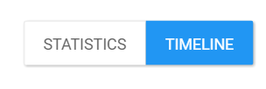
Statistics mode
Notes:
Let’s first look at how students’ contributions and progress are visualized through the Statistics Mode.

Slide 7
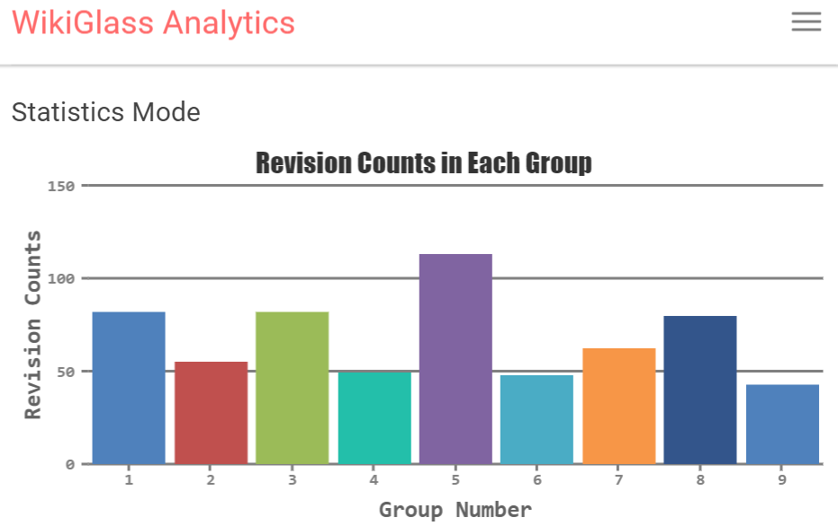
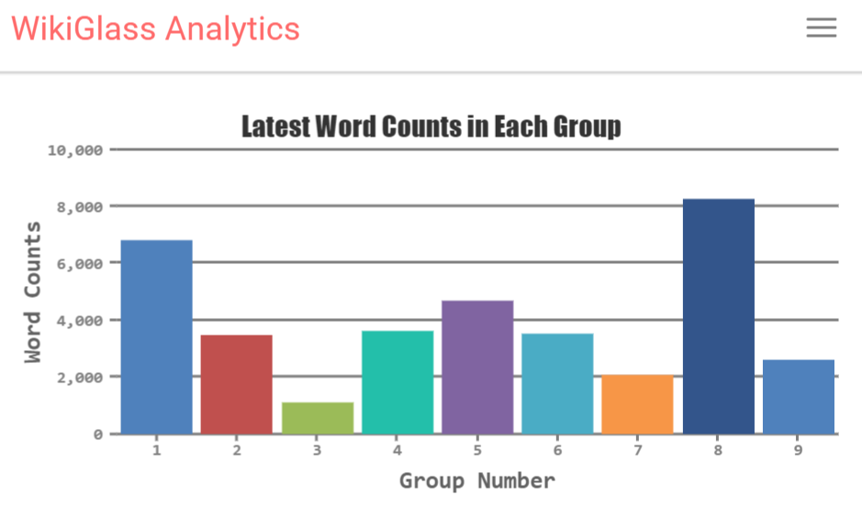
Statistics of the group (1)
In the Statistic mode, you can see the performance comparison among different groups in this class.
For example, the revision counts and latest word counts in each group.
Notes:
In the Statistics Mode, you can easily compare the performance among different groups in the class.
For example, the first two charts respectively show the revision counts and the latest word counts in each group.

Slide 8
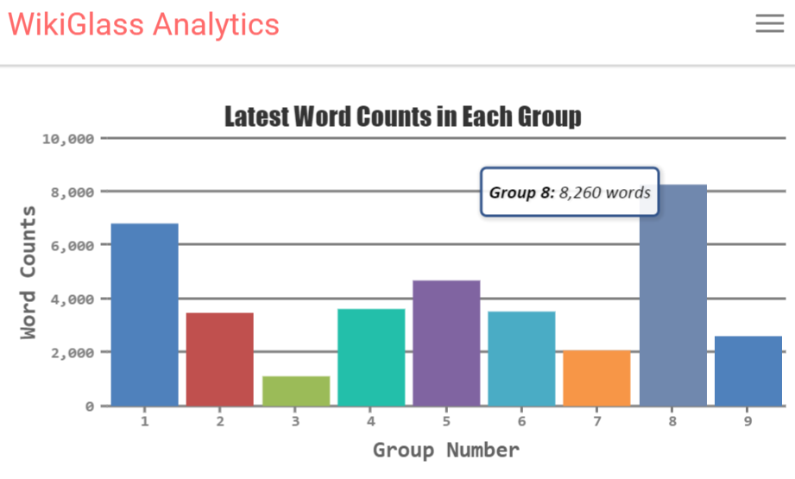

Statistics of the group (2)
For the actual values of the statistics, please hover the cursor over the bar of any group.
Hover over
Notes:
To view the exact word count, that is the actual value of the statistics, you can hover your cursor over each bar on the chart. And the exact number of words will appear.

Slide 9
Statistics of the group (3)
If you wish to know the details of a specific group, please single-click the bar of that group.
For example, click the bar representing group 8.
Single-click
Notes:
Moving on. If you would like to know the statistical details of one specific group, you can single-click that bar. For example, click the bar representing Group 8.

Slide 10
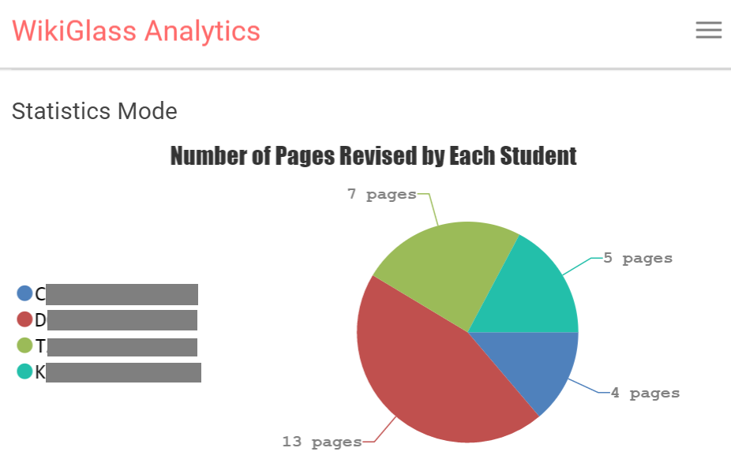
Statistics of group Members (1)
After you clicked the bar, it will show contributions (in pie charts) of each individual students in the group.
Number of pages revised by each student
Number of revisions made by each student
Number of words
added by each
student
Number of words
deleted by each
Student
Notes:
Clicking the Group 8 bar → shows the contributions of EACH individual student in the group. The different colours on the pie chart represent different students in the group.
The information shown includes No. of pages revised by each student; no. of revisions made by each student; No. of words added by each student & No. of words deleted by each student.

Slide 11
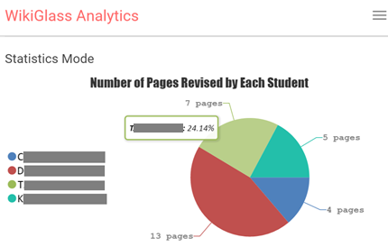
Statistics of group MEMBERS (2)
For the percentage of the student contribution to the group, please hover the cursor over the pie of that student.
Hover over
Notes:
You can also view the percentage of how much a student has actually contributed to the group. To do so, please hover your cursor over the portion of that student on the pie, e.g. Student T.

Slide 12
Statistics of A Student (1)
If you wish to view student’s individual contribution to all pages, please single click the pie of that student.
For example, click on the green section that represents student “T”.
Single-click
Notes:
Let’s continue. If you want to look into a particular student’s individual contribution to all pages, you can single-click his/her portion of the pie. For instance, click on the green section representing Student T.

Slide 13
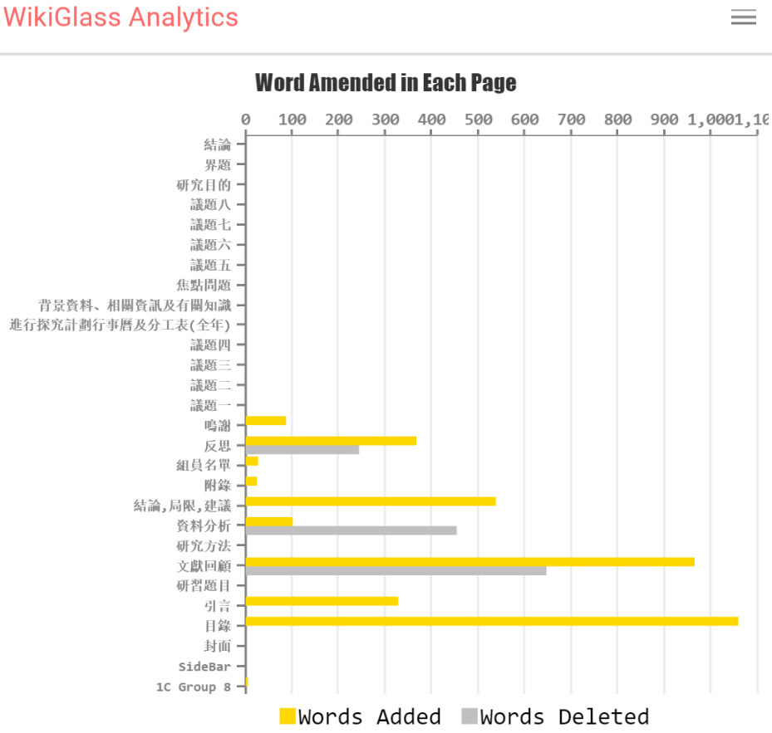
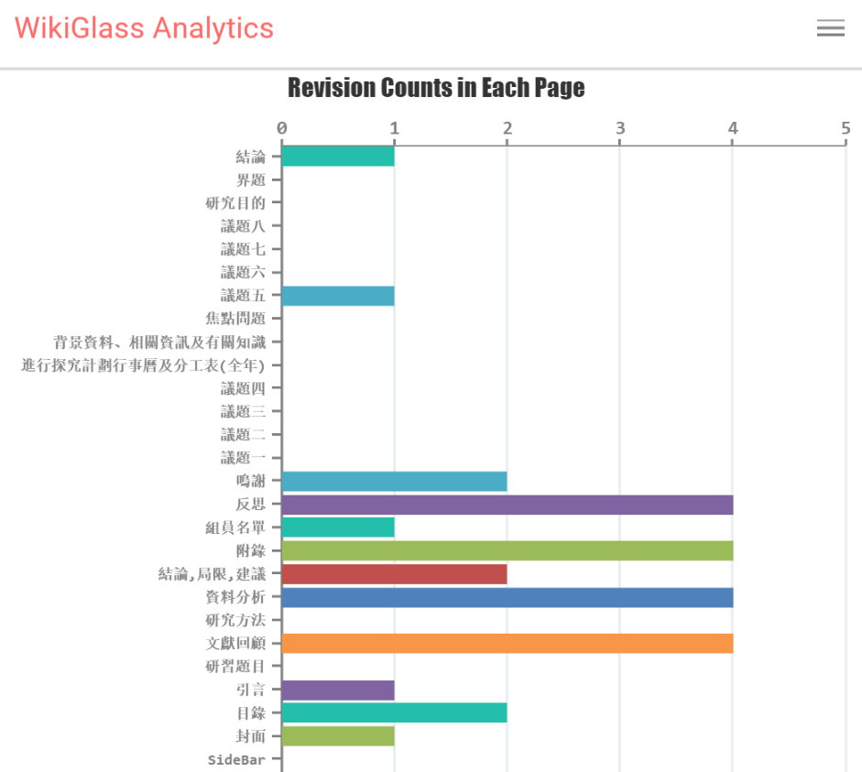
Statistics of A Student (2)
Then, you can view the revision counts and word amendments (addition and deletion) made by this student on each page.
Notes:
Then, you can view the revision counts and word amendments made by this student on each section or page. Note that word amendments mean both addition and deletion of words.

Slide 14
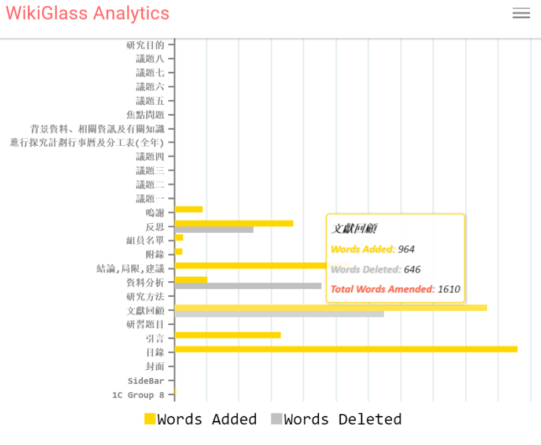
Statistic of A Student (3)
Hover the cursor over a bar, you will see how many words added/deleted for each page by this student
Hover over
Notes:
Going forward. Again, when you hover your cursor over a bar, you will get to see how many words this student added or deleted on each page.

Slide 15
Timeline mode
Notes:
That’s all for the Statistics Mode. Now let’s see what the Timeline Mode does.

Slide 16

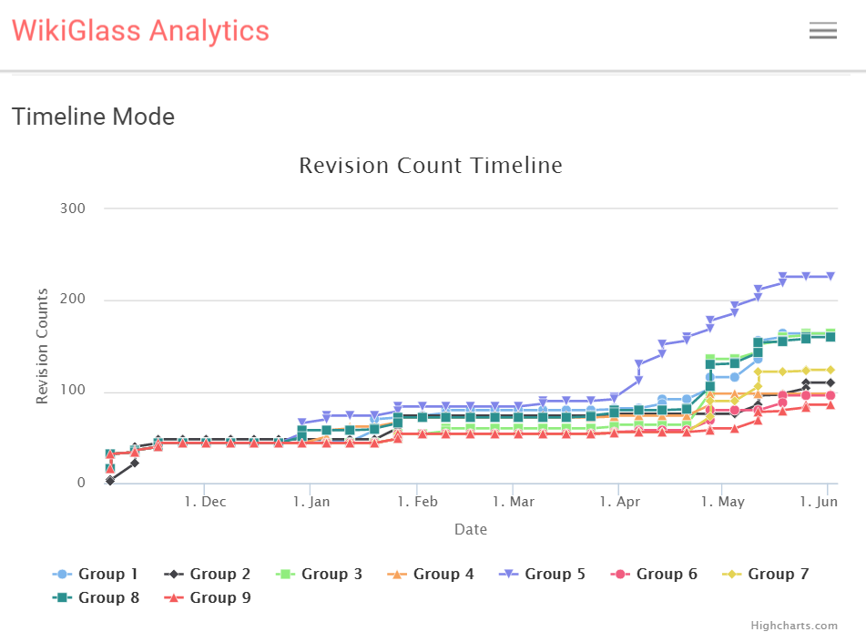
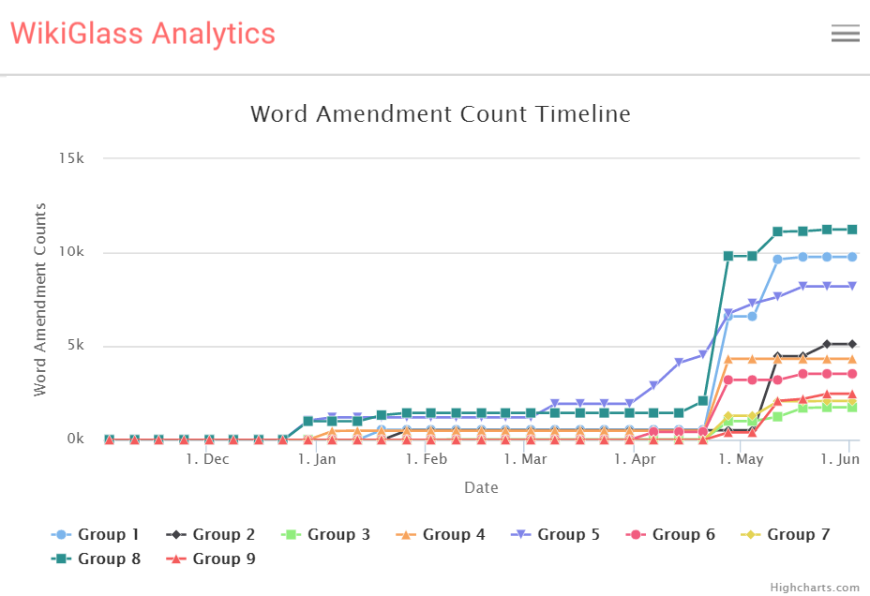
Timeline of the group (1)
Click TIMELINE button, you will see comparisons among different groups in this class, along the weeks of the project
Revision count and Word amendment count
Notes:
Click the blue Timeline button right next to the Statistics button.
You can then compare the revision counts and word amendment counts along the weeks of the project, among different groups in the class.

Slide 17
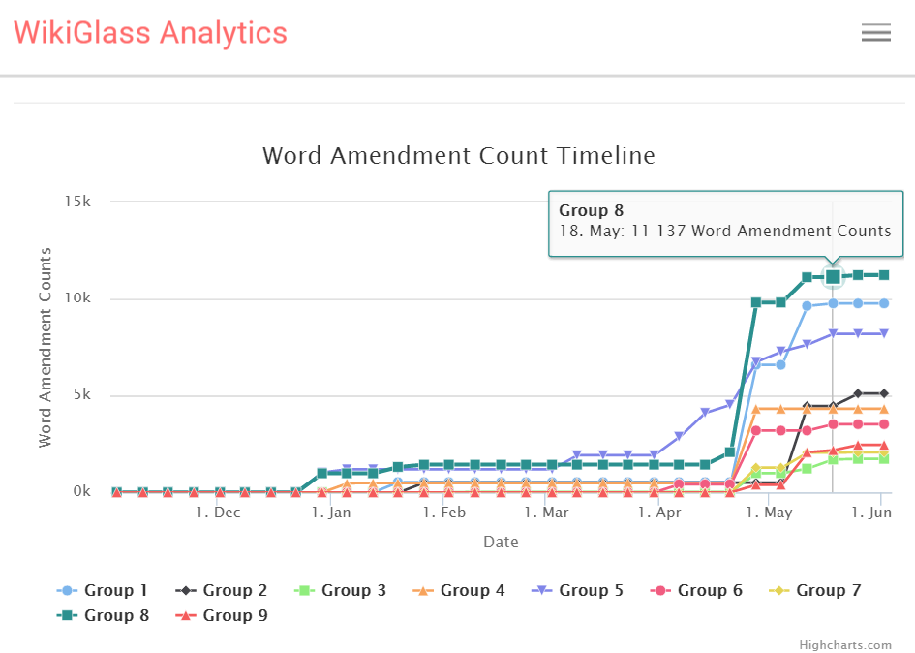
Timeline of the group (2)
For the actual values of the statistics, please hover the cursor over the line of any group.
Hover
over
Notes:
To get the actual values of the statistics, the all-time tip again, you can hover the cursor over any point on the line of any group. Then, you’ll see an exact date & the word amendment counts as at that date.

Slide 18
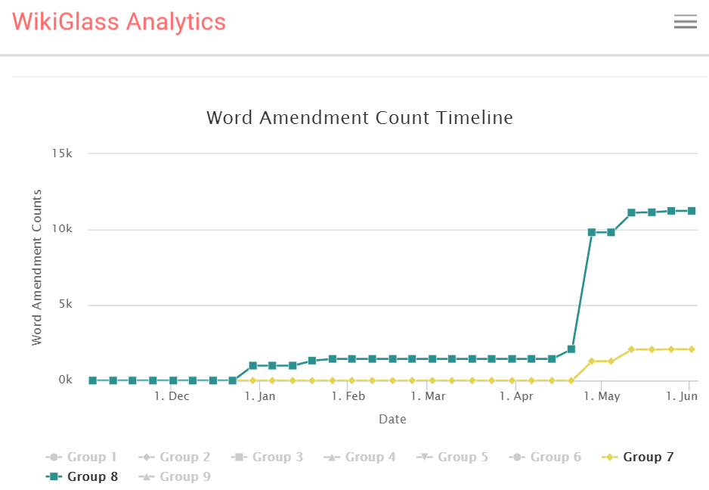
TIMELINE of The Group (3)
Single clicking a group in the legend area will hide the line of the group. Single clicking it again will bring the group line back
For easier view of particular groups
Single
click
Notes:
When you’re viewing the line chart, if you single-click a group in the legend area, that group’s line will be hidden. Single-clicking it will bring that line back.
This function is for you to view particular groups easily.

Slide 19
TIMELINE of the group (4)
If you wish to know the details of a specific group, please single-click the line of that group.
For example, click the line representing group 8.
Single
Click
19
Notes:
To acquire the details of a specific group, you can single-click any points on that group’s line. For example, click the line for Group 8.

Slide 20
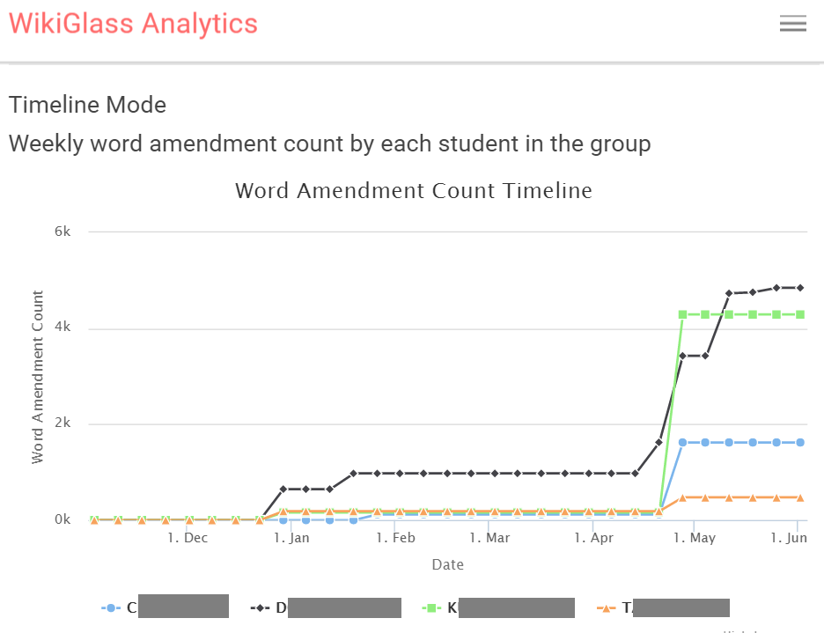
Timeline of group Members (1)
After clicking the line, you will see comparisons on Word amendment counts among different students in this group, along the weeks of the project
Notes:
You’ll then see the comparison on word amendment counts among different students within the group, along the weeks of the project.

Slide 21
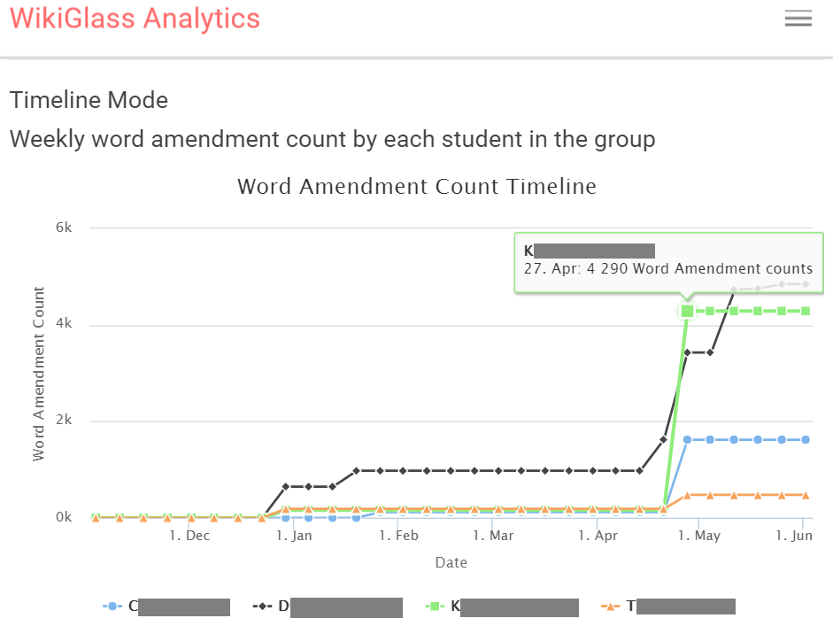
Timeline of group MEMBERS (2)
For the actual values of the word amendment counts, please hover the cursor over the line of any student
Hover
over
Notes:
To get the actual values of the Word amendment counts, please hover the cursor over the line of any student. The Word Amendment count as at an exact date will be shown.

Slide 22
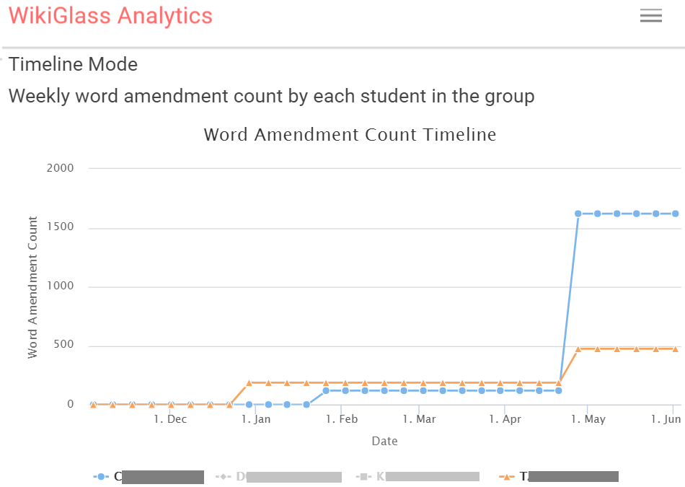
TIMELINE of Group Members (3)
Single clicking a student in the legend area will hide the line of the student. Single clicking it again will bring the line representing that student back
For easier view of particular students
Single
click
Notes:
For an easier view of particular students’ statistics, single-click a student’s name in the legend area, his/her name will be hidden. Single-clicking it again brings that student’s line back.

Slide 23
Timeline of group MEMBERS (4)
Single click the line of a student, you will go to the statistics page of that student.
Single-click
Notes:
Going into further details. If you single-click the line of a student, you’ll be directed to the statistics page of that individual student.

Slide 24
Statistics of A Student
This is the same page you saw after clicking the pie of the student in any pie chart on the group’s statistics page
Notes:
If you’ve remembered, this page is actually the same one we saw when we clicked on the pie chart in the Statistics Mode. This means that both the Statistics mode and Timeline mode can lead you to the page showing an individual student’s statistics.

Slide 25
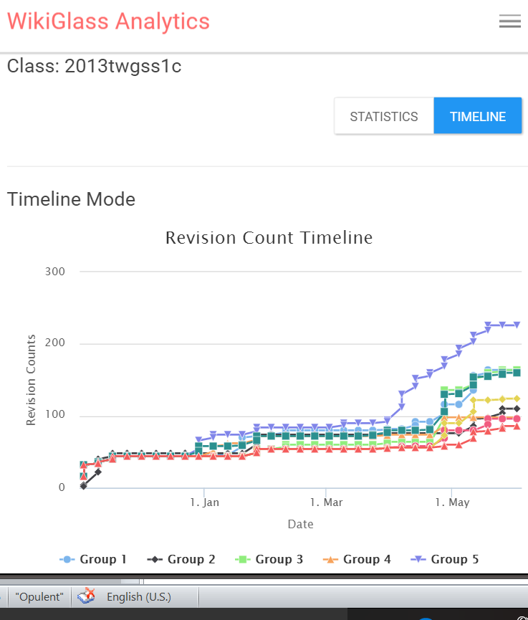
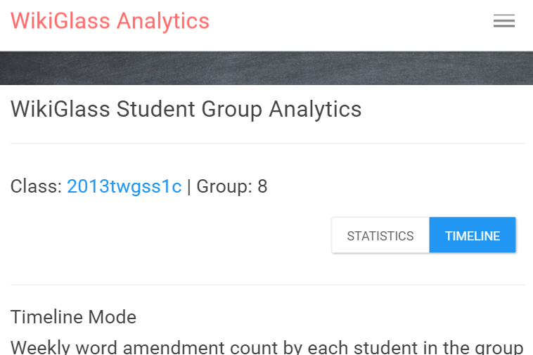
Navigation (1)
On any page, you can click the class name to get to the class page
Single Click
Notes:
In terms of the navigation: no matter which page you are on, whenever you want to get to the class page, you can click the class name.

Slide 26
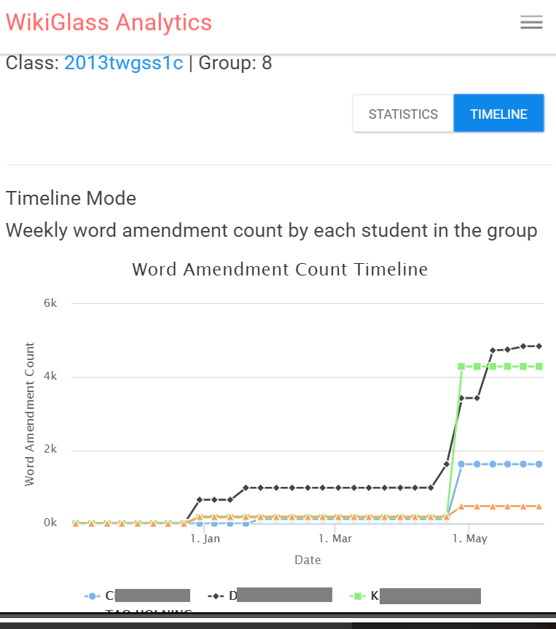
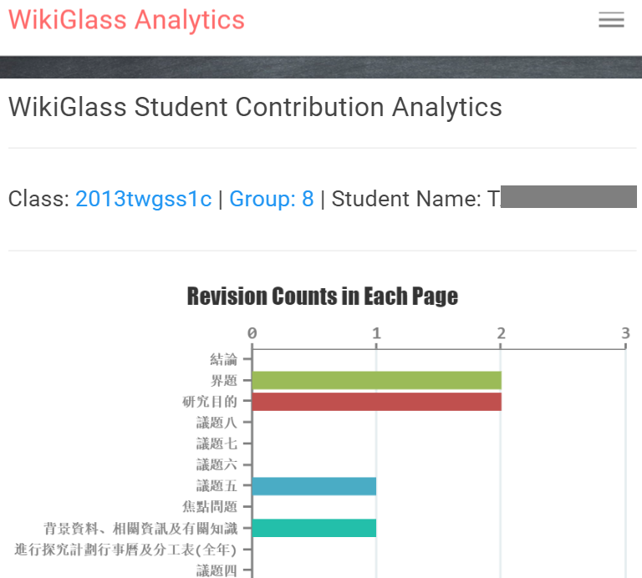
Navigation (2)
On a student page, you can click the group name to get to the group page
Single Click
Notes:
However, when you’re on a student’s page, you can click the group name in order to get to that particular group page.

Slide 27
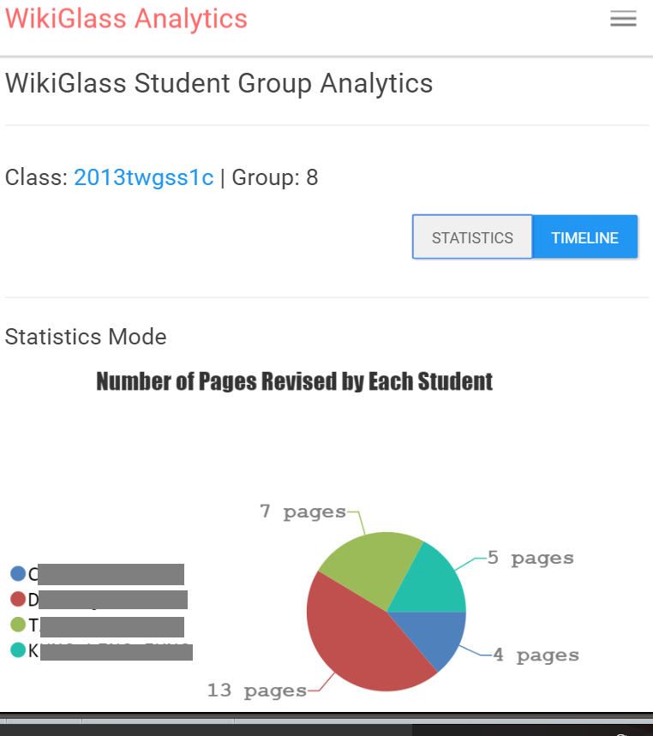
Navigation (3)
On any page, you can click “Statistics” or “Timeline” to switch between the two modes
Notes:
On any page, you can switch between the two modes by clicking either Statistics (the white button) or Timeline (the blue one)

Slide 28
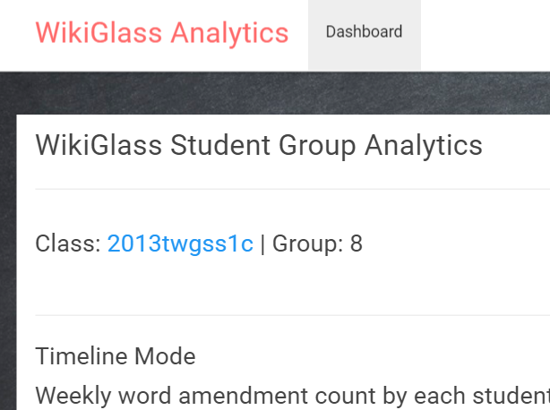
Back to Class List
Clicking the “Dashboard” button on any page will lead you back to class list.
Notes:
Finally, if you wish to go back to the class list, you can click the Dashboard button at the top.

Slide 29
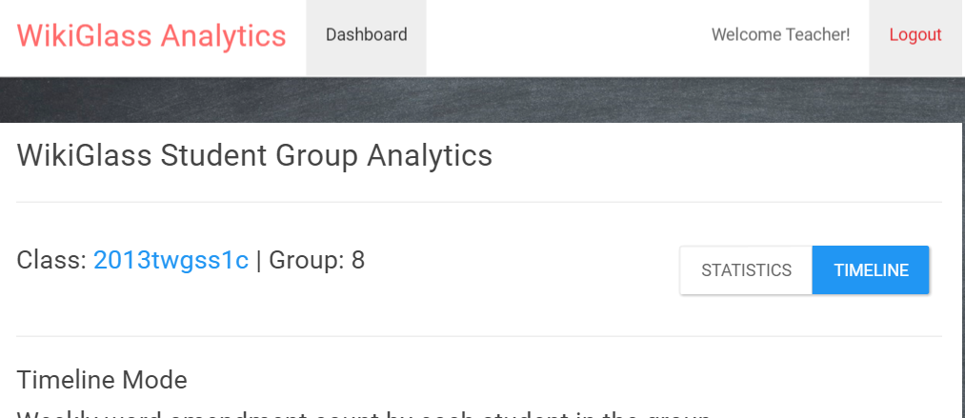
Log out
Please click Logout on the top right after using Wikiglass
Click
Notes:
And you are advised to log out by clicking the Logout button on the top right corner, after using Wikiglass.

Slide 30
Weekly summary in email
Every week, the system will send an email to teachers summarizing the statistics of the groups and students in the past week. The email includes:
Average number of revisions per group
Top groups
Top students
Those who didn’t make any progress
The link to Wikiglass for more details
This serves as a reminder for you to keep track of students’ progress.

Slide 31
Please let us know if you have any comments and suggestions!
Dr. Xiao Hu xiaoxhu@hku.hk
Dr. Sam Chu samchu@hku.hk
Notes:
That’s all for this tutorial video. Thank you for watching this! We hope you’ll enjoy using this tool to help your teaching.
Please feel free to contact Dr. Xiao Hu or Dr. Sam Chu from the Faculty of Education if you’ve got any comments or suggestions.

