Slide 1
Concentrated Poverty, Selective Migration, and Place-Based Policy
Evan Mast
(Notre Dame)
Davin Reed
(Philadelphia Fed)
Disclaimer: The views expressed here are those of the presenter and do not necessarily reflect those of the Federal Reserve Bank of Philadelphia or the Federal Reserve System.

Slide 2
Motivation
Concentrated neighborhood poverty has negative effects on labor market, education, and health outcomes of residents (Chyn and Katz 2021)
While we’d like to get rid of high poverty neighborhoods, we’re limited by a poor understanding of the dynamics—migration, income changes—that generate them and make them persistent
It could be a static story—poor people stay poor and stay put. Fits with idea of household poverty traps, intergenerational persistence (e.g. Durlauf 1996)
But also evidence in other direction: poverty spells tend to be short (Bane and Ellwood 1986) and migration across nbhd types is large (Quillian 2004, Massey et al. 1994)

Slide 3
This paper: break out the migration and income churn underlying concentrated poverty
We use new data to illustrate how concentrated poverty results from a dynamic process
Individuals frequently see income changes, even in very poor neighborhoods
But they tend to move to a richer neighborhood when their income goes up (and vice versa)
This means that high-poverty neighborhoods attract poor migrants from elsewhere and lose their residents who see income improvements
We argue that this is a fundamental feature of high-poverty neighborhoods that makes them resistant to both policy interventions and macroeconomic changes
We then consider how this churn affects place-based policy outcomes and how to better design these policies

Slide 4
(Preliminary) results preview 1 of 2—Basic statistics
There is significant migration across neighborhoods of different types
XX% of people residing in high (>30%) poverty neighborhoods in year t lived in a neighborhood with poverty below 20% in year t-3
There is also significant income growth even for households in high-poverty nbhds
For people living in high-poverty in year t, median change in income between year t and year t+3 is XX%. This is much higher than the growth in average income of the neighborhoods
However, the migration is highly selective. People who see different income changes make different migration decisions
Among people who lived in high-poverty nbhd in year t, those who made >$40,000 in year t+1 had a XX% chance of exiting high poverty, versus YY% for <$40,000

Slide 5
(Preliminary) results preview 2 of 2—Model
We build a mechanical model to illustrate how dynamics affect evolution of nbhds.
Calibrate income process and neighborhood choices based on data
Simulate neighborhood characteristics over time
Examine how tweaks to income process/migration affect neighborhoods
Find that small changes to either can generate large effects on neighborhoods—suggests that both are key factors in creating/preserving concentrated poverty
Simulate “place-based” policies targeting high-poverty neighborhoods
Selective migration changes the neighborhood effect of PBP that successfully boost income
Policies can be equally effective by boosting income or by improving retention of “naturally occurring” income improvements

Slide 6
Related literature and contribution
Past literature uses PSID to study household income change (Bane and Ellwood 1986, Stevens 1994) and migration (Massey et al. 1994, Quillian 2004)
We first update their results with larger sample, more granularity
We then put together these patterns to show how they matter for neighborhoods
Many papers evaluate policy attempts to address CP (e.g. Busso et al. 2013)
We provide new evidence on mechanisms that moderate/generate the effect of PBPs
Recent surge of interest in neighborhood effects (Kling et al. 2013, Chetty, Hendren, and Katz 2016, Chyn 2018)
We provide some insight on how high-poverty nbhds are formed/preserved

Slide 7
Outline
Data and descriptive statistics
Statistics on income and migration dynamics
Statistics on selective migration
Model set-up and calibration
Model results

Slide 8
Combine several restricted files from U.S. Census Bureau
Starting point: MAFARF provides 2000-2019 address history for close to 100% sample
Draws from tax, health, and housing data from federal agency records
Add responses to the 2000 and 2010 decennial censuses
100% samples with age, sex, family type, race/ethnicity, and rent/own housing
2000 Census long-form—information on education and earnings for a 16% sample
Link to all waves of the American Community Survey (ACS) from 2005 to 2019.
Demographic info for a 2% sample.
In this paper, use this data to construct neighborhood characteristics that are not in standard Census products and to observe individual migration

Slide 9
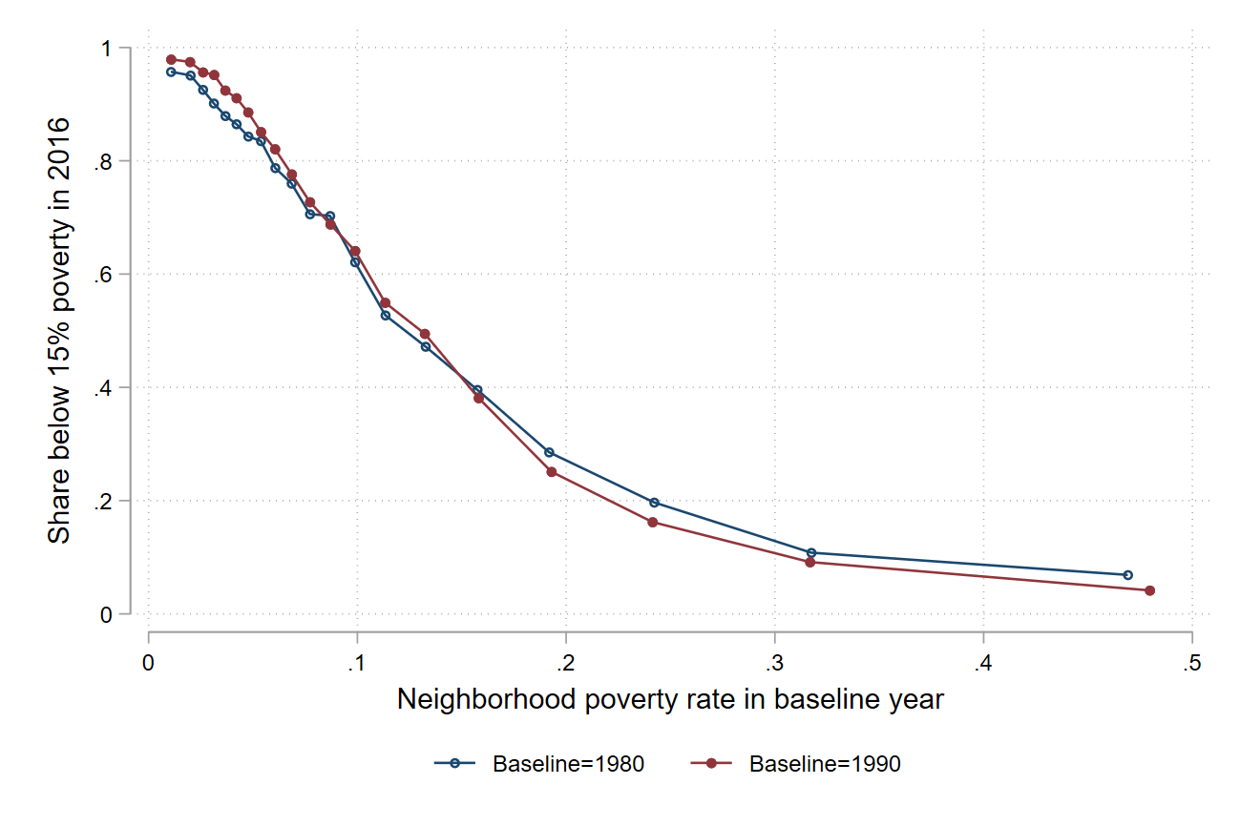
Motivating fact: concentrated poverty is very persistent
Sample note: this just includes 40 largest metros
Note that this spans large macroeconomic fluctuations and shifts, as well as numerous local, state, and federal policies that target concentrated poverty either directly or indirectly

Slide 10
Outline
Data
Statistics on income and migration dynamics
Statistics on selective migration
Model set-up and calibration
Model results

Slide 11
Fact 1: There is a lot of churn across different types of neighborhoods
Stacked area chart showing the share of residents that are incumbents/arrivals from various origins versus neighborhood poverty rate
Interpretation:
Even very high poverty neighborhoods have a lot of people who recently lived in a less poor place
It’s inaccurate to think of poor neighborhoods as consisting of a static set of individuals. You need to understand the in-flows and out-flows in order to understand how these neighborhoods end up with the average characteristics that they do.

Slide 12
Fact 2: Income is not stagnant (even in very poor nbhds)
Three-year change in income for initial residents of nbhds with diff pov bins
Interpretation
Stagnant incomes cannot totally explain persistence of neighborhood characteristics. People living in poor neighborhoods at any given point in time see future income growth on average.
Not claiming that this would lead to rapid improvement—but it would be something instead of the nothing that we currently see. And there could be feedback effects that reinforce that small growth

Slide 13
Outline
Data
Statistics on income and migration dynamics
Statistics on selective migration
Model set-up and calibration
Model results

Slide 14
Fact 3: People moving up the neighborhood ladder have higher income than people moving down
Median income of people making different transitions
Interpretation:
The successes move away, and they’re replaced by people who are in a downturn. This is going to tend to keep poor neighborhoods poor, even if things improve for some of their initial residents

Slide 15
Alternative way to show this: neighborhood transitions conditional on income
Easy things: P(stay in high poverty | income) and direct comparison of two different matrices
Interpretation:
Same thing as previous slide, but another perspective that provides a bit more detail.

Slide 16
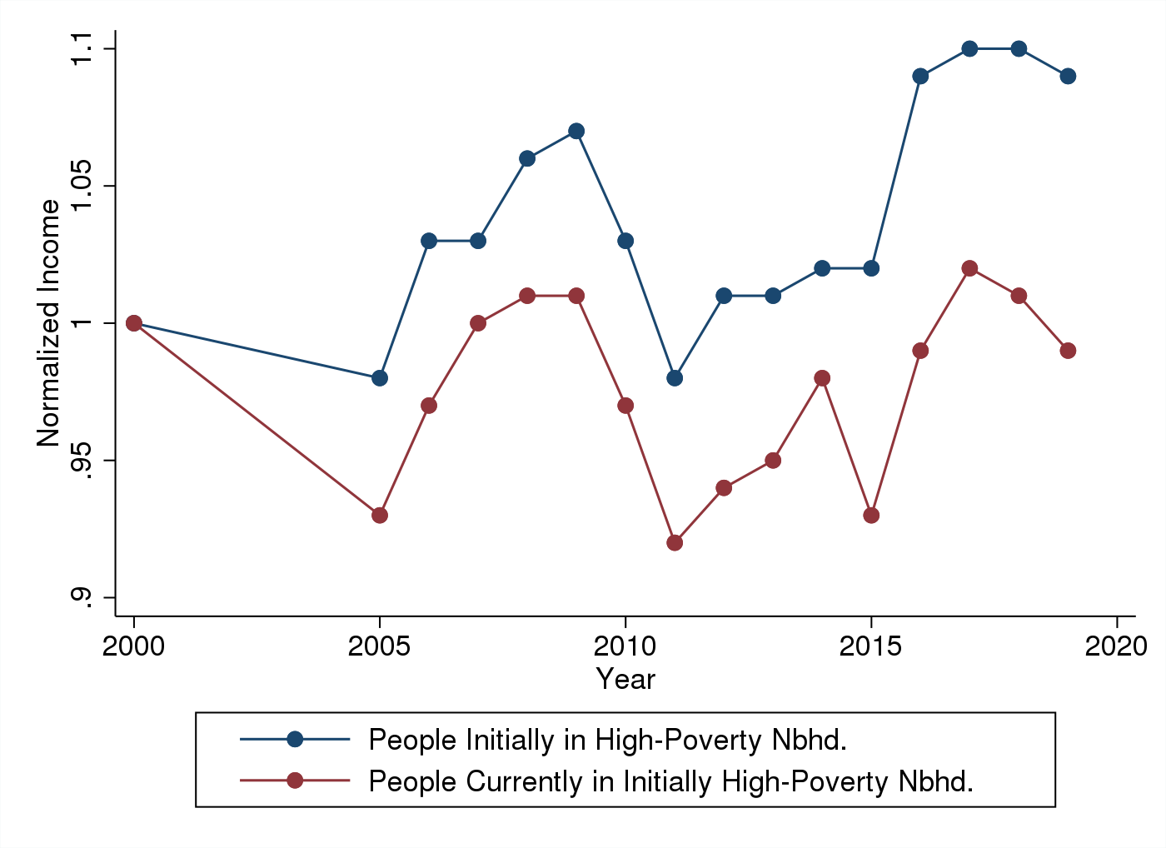
Fact 4: Poor neighborhoods’ average income improve slower than average income of a cohort of their residents
This helps put a number on how important selective migration is. It depresses income growth from about 11% to roughly 0.
All the selective migration, accumulating over time, ends up having a relatively big effect.

Slide 17
Outline
Data
Statistics on income and migration dynamics
Statistics on selective migration
Model set-up and calibration
Model results

Slide 18
Model overview
We use a mechanical model to examine the quantitative importance of the income changes and selective migration that we just documented
Mechanical: Assume that income distribution in nbhd type will change according to observed process, then that people change nbhds according to new income, then iterate
We then change income process and nbhd choices and see how nbhd outcomes change
Last, use model to simulate neighborhood effects of different place-based policies
What would be effect of PBPs that target: incomes versus migration versus both?
How does migration moderate effect of PBP that successfully boosted incomes?

Slide 19
Simulation method (1 of 2)
Start with the observed distribution of income types across neighborhood poverty bins
Individual income types = $10,000 bins, top coded at $100,000
Neighborhood poverty bins = 0-10, 10-20, 20-30, 30+
Shift the income distribution in each neighborhood poverty bin. To calibrate:
Compute the income distributions in (e.g.) 2012 and 2013 for people who lived in a given poverty bin in 2012.
Compute the change in the share of households in each income bin
Assume that this would always be the change in distribution experienced by that neighborhood poverty bin
We will be able to improve this in the future

Slide 20
Simulation method (2 of 2)
3. Given the new income distribution, move households according to the observed neighborhood choices of people in the same situation
Example calibration: use distribution of neighborhoods in 2013 for households who earned $55,000 in 2013 and lived in 20-30% poverty in 2012
4. Add/subtract “births”/“deaths” in each nbhd type X income bin
Births = turning 25 or appearing in data for first time
Deaths = turning 65 or disappearing from the data
5. Iterate for multiple periods, tracking characteristics of each neighborhood bin

Slide 21
Model caveats
Note that our calibration is just based on observed values. For example, we don’t have the causal effect of income changes on migration.
We hold all parameters constant even as neighborhood characteristics change over the course of the simulation
For example, no endogenous amenity effects
Many different types of high-poverty and low-poverty neighborhoods. Some of our transitions could be picking up neighborhoods that are kind of mischaracterized—perhaps a census tract that has a public housing development that drives up its poverty but is part of a much larger wealthy area

Slide 22
Outline
Data and descriptive statistics
Statistics on income and migration dynamics
Statistics on selective migration
Model set-up and calibration
Model results

Slide 23
Example: first period to second period
Baseline distribution is given by:
[]
After one period, the new distribution is:
[]
Next, consider 10 periods and track population and low-income share (defined as share of individuals with household income below $30,000)

Slide 24
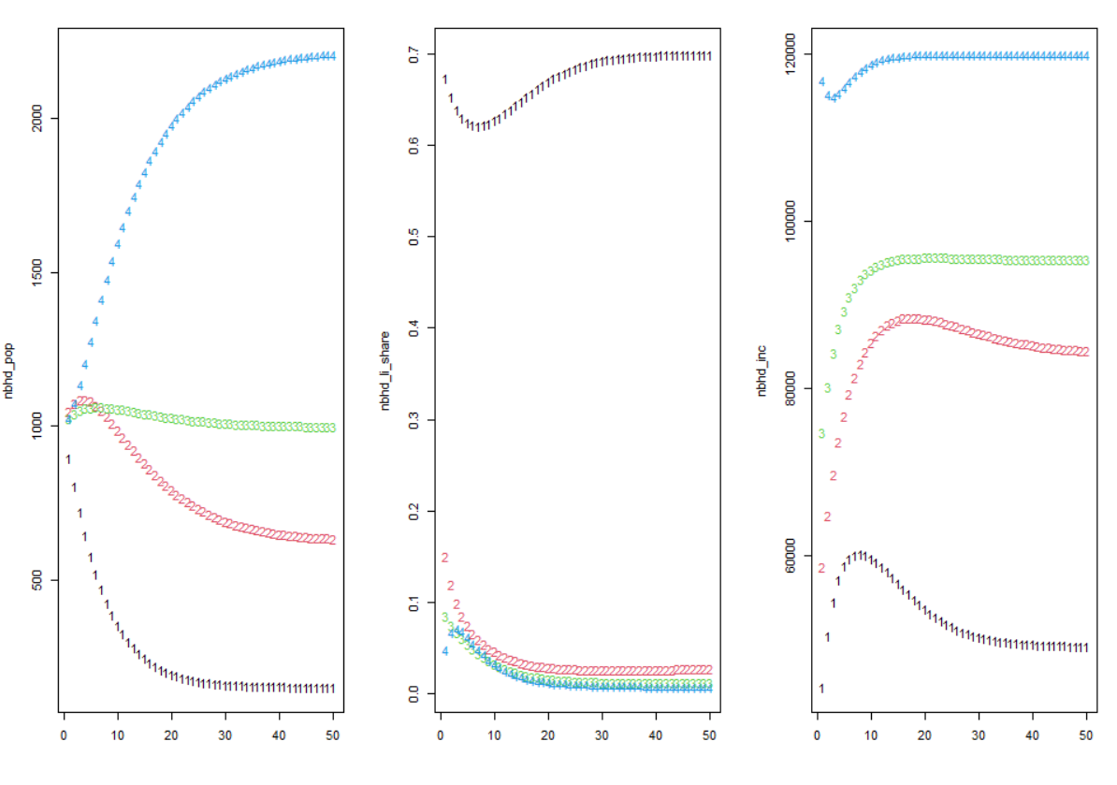
Baseline: pop alone first, then low-income share, then median income

Slide 25
Discussion of baseline
Mechanical model illustrates how the churn in individual outcomes produces stagnant neighborhood outcomes
Next, let’s change elements of simulation and see how neighborhood trajectory changes.
Increase baseline number of non-poor households in HP neighborhood
Improve income process in HP neighborhood
Increase retention rate of middle-income people in HP neighborhood
Improve both income process and retention rate in HP neighborhood
This sheds light on the role of each force in generating persistence, and we can also extrapolate and pretend like these are effects of a PBP

Slide 26
Result 1/4: Changing baseline LI share
The boost is immediately migrated away

Slide 27
Result 2/4: Changing income process
It does improve poverty rate in the HP neighborhood, but note that the second-lowest bin actually gets a bigger boost. A lot of these gains are migrated away.

Slide 28
Result 3/4: Changing retention
Suppose that income process remains the same, but HP retains all of its middle-income residents.
Get about the same thing as boosting the income process. Highlights a large potential role for PBP that harness these naturally occurring income changes.

Slide 29
Result 4/4: Changing process and retention
Really big effects—more than double (I think)

Slide 30
Result 5/4: Changing attraction to HP
Really increases population and income. There’s no housing stock in this model, so we can get to unrealistic places, but it highlights how even small improvements in attraction to HP neighborhoods could have a big effect. This is largely because HP neighborhoods are a pretty small share of the population.

Slide 31
Discussion
What’s notable?
Changing retention and changing income process have about same effect
Suggests that selective migration is about half of the story in what makes concentrated poverty persistent
Also points to selective migration as (1) something that will work against PBP targeting labor markets and (2) something that PBP could target!
Extensions:
Estimate causal effect of income change on migration to better approximate PBP
Endogenize neighborhood retention/attraction to depend on characteristics, generating feedback effects
Write and estimate micro-founded model

Slide 32
Conclusion and next steps
We’ve got some preliminary evidence on how this dynamic process creates concentrated poverty and makes it a hard problem to change.
Future steps:
Refine the basic things we’ve shown you today
Get causal estimates of how income change affects neighborhood choice
Enrich model with, for example, endogenous neighborhood quality

Slide 33
Motivation
Concentrated poverty has negative effects on labor market, education, and health outcomes of residents
While we’d like to get rid of concentrated poverty, it’s unfortunately n to be highly persistent.
In large U.S. metropolitan areas, only 2.8% of neighborhoods with poverty rate above 30% in 1990 saw that rate fall below 15% by 2016.
It’s resistant to macroeconomic changes and place-based policies that target it.
We don’t understand why it’s such a sticky problem, and, relatedly, we don’t have a good idea of how to structure policies to get rid of it.

Slide 34
Contribution and relationship to literature
Show the importance of these processes for persistent poverty, expanding our knowledge of neighborhood formation and how to address it with policy
Past literature has shown that this churn exists for individuals
Bane and Ellwood (1986), Stevens (1994) show average poverty spell is short
Massey et al. (1994), Quillian (2003) show migration across neighborhood types
We build on this by:
Bringing together these facts, along with a coherent quantitative framework and way better data, to show how they explain persistence neighborhood characteristics
Showing how they influence place-based policies

