Slide 1
Ferroelectric Capacitance and Charge Measurement System
K S Ahilan (210070045), Yash Udayan Paritkar (210070096), Zala Mayursinh Meghrajsinh (210070099), Aditya Kumar Roy (21D070008)
A modular device to measure the capacitance and charge of Ferroelectric material. It is helpful as lab equipment, e.g., for characterizing dynamic capacitors.
Notes:
Good afternoon to all. This is team Mon-06. We will be presenting our project, "Ferroelectric Capacitance and Charge Measurement System" which is useful to characterize dynamic capacitors.

Slide 2
Demo Video
Notes:
We show a quick demo of this device.

Slide 3
Methodology
We mainly referred to the circuit design discussed in the research paper by A.F. Vakulenko, S.B. Vakhrushev, and A.V. Filimonov.
An FPGA produced triangular signals in different modes (triangular, double triangular, triangular burst) with 500 samples per period.
Notes:
We are trying to measure the capacitance of a ferroelectric material and we do know that polarization of the material

Slide 4
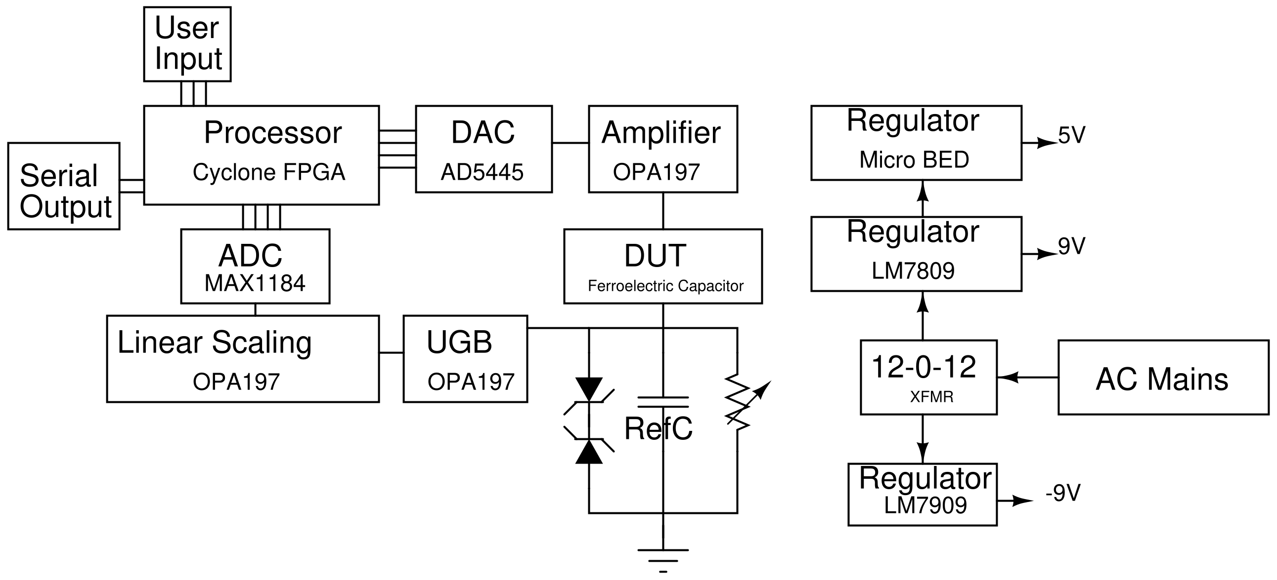
Methodology: Block Diagram

Slide 5
Challenges and their Solution
Challenge | Solution | Remark
Microcontroller not able to supply high frequency signal with sufficient samples | FPGA is used instead | Successful
Charge pump (MAX680) failed | Power is taken from the mains through a rectifying circuit and voltage regulator | Successful
Post DUT circuit was not working. ADC got damaged. | Circuit is made on Pegboard and used spare ADC | Successful
High Ringing was present at the output of an opamp | A resistor (2 ohm) was connected in series with capacitor at input | Successful
LM7805 failed to bring down 12 Vrms to 5 V DC | Used Matek Micro bec | Successful
Notes:
Which drastically reduced the ringing
(6.7 V)

Slide 6
Individual Distribution
Member | Contributions | Average Hours spent per week 1st Half 2nd Half
Ahilan | CAD Design, Documentation, Testing, Final Assembly build | 4 | 7
Yash | PCB Design, Soldering, Testing, Breadboarding, Final Assembly Build | 6 | 9
Mayur | FPGA Programming, Testing, Final Assembly Build | 6 | 7
Aditya | GUI, FPGA Testing | 3 | 3

Slide 7
Conclusion
We calculate capacitance from the supply and post-DUT signal. We can also plot the charge vs voltage graph for capacitance.
We can use higher frequency FPGA (preferably microcontroller), higher precision Opamps, ADC and DAC. We were limited by budget consideration.
The setup can be made more user friendly with single file which will program FPGA
Number of reference capacitors should be larger for better accuracy.

Slide 8
Reference
[1] : A.F. Vakulenko and S.B. Vakhrushev, and A.V. Filimonov, "An Automatic System for Measuring the Ferroelectric Hysteresis Loops using the modified Sawyer-Tower circuit", St. Petersburg State Polytechnical University Journal, Vol 12, No. 4, 2019
[2]

Slide 9
Thank You!

