Slide 1


Even Semester 2024
Continuous Assessment 1
Presentation On :
Aggregate Set In ERD
Presented By :
Name University Roll Number
Khalid Saifulla 21301222054
Sayor Sengupta 21301222018
Tapamita Mondal 21301222045
Moupriya Dutta Banik 21301222070
Dipanjan Gupta 21301222039
BCA 2nd Year
Semester : 4th
Paper Name : Database Management System
Paper Code: BCAC 401
College name : The Heritage Academy
University Name : Maulana Abul Kalam Azad University Of Technology, West Bengal

Slide 2
TABLE OF CONTENTS
Serial Number | Topics | Slide Number
1. | INTRODUCTION | 3
2. | KEY ELEMENTS OF ERD | 4
3. | AGGREGATION AND AGGREGATE SETS IN ERD | 5
3. | REPRESENTATION OF AGGREGATE SET IN ERD | 6
4. | EXAMPLE TO SHOW AGGREGATION IN ERD | 7
5. | PURPOSE OF USING AGGREGATE SETS | 8
6. | CHALLENGES IN WORKING WITH AGGREGATE SETS | 9
7. | BEST PRACTICES FOR DESIGNING AGGREGATE SETS IN ERD | 10
8. | CONCLUSION | 11
9. | REFERENCES | 12

Slide 3
INTRODUCTION
An Entity-Relationship Diagram (ERD) is a visual representation of the data model that depicts the relationships among entities in a database.
It is a useful tool for designing databases and understanding the structure of information within an organization.
ERDs use various symbols to represent entities, attributes, relationships, and cardinality.
Aggregation is a concept in ERD to depict entity relationships in an effective manner.

Slide 4
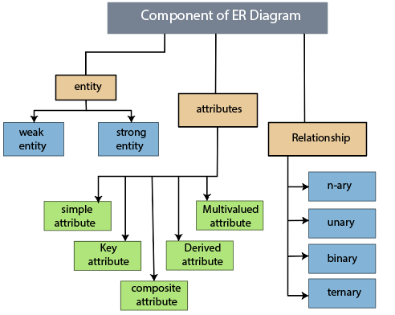
KEY ELEMENTS OF ENTITY-RELATIONSHIP DIAGRAM (ERD)
Entities
Relationships
Cardinality
Primary Keys
Foreign Keys

Slide 5
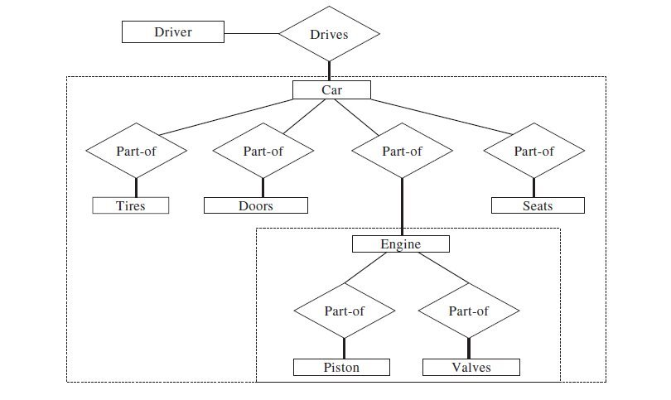
AGGREGATION AND AGGREGATE SETS IN ERD
Aggregation in database design consolidates relationships between entities into a unified
higher-level entity.
This concept is used to simplify complex relationships
in an Entity Relationship Diagram (ERD).
Hence, an Aggregate Set in an Entity-Relationship
Diagram (ERD), is the higher level entity that has been formed from the aggregation of
entities.

Slide 6
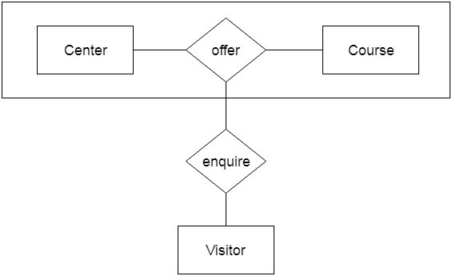
REPRESENTATION OF AGGREGATE SET IN ERD
Entities:
Identify the entities involved in the aggregate set.
Attributes:
Define the attributes for each entity.
Relationships:
Draw lines between related entities to represent relationships.
Aggregation Notation:
Use a diamond shape to indicate the aggregate set. Place the diamond shape on the line connecting the entities that are part of the aggregate.

Slide 7
EXAMPLE TO SHOW AGGREGATION IN AN ERD
Project
Project guide
Instructor
Student
for
Evaluation

Slide 8
PURPOSE OF USING AGGREGATE SETS
Modeling Complex Relationships :
An aggregate set helps in modeling the complex relationships between entities.
Abstraction :
They provide a level of abstraction, allowing us to hide the internal details of a complex structure.
Reduced Redundancy
They minimize data duplication, ensuring more efficient data storage and retrieval.
Support for Nested Structures:
In cases where entities have hierarchical or nested structures, aggregate sets are utilized.
Enhanced Clarity
They contribute to a clearer and more understandable ERD structure.

Slide 9
CHALLENGES IN WORKING WITH AGGREGATE SETS
Maintainability:
Changes to the structure of an aggregate set or the relationships within it can be challenging to manage.
Loss of Detail:
While abstraction is a benefit, it can also be a drawback if too much detail is lost. Over-reliance on aggregates may hinder comprehension.
Data Integrity Risks
Ensuring the integrity of data within aggregate sets can be challenging .
Querying Challenges:
Aggregates may introduce challenges when querying the database .
Overuse and Misuse:
There's a risk of overusing aggregate sets, which leads to an overly complex ERD.

Slide 10
BEST PRACTICES FOR DESIGNING AGGREGATE SETS IN ERD
Clear Naming Conventions and Definitions : Use descriptive and intuitive names for aggregate sets and the entities contained within them. Also define the purpose of aggregate sets.
Consistency in Relationships : Ensure uniformity and clarity in representing relationships and dependencies involving aggregate sets.
Use Visualization Tools Effectively : Leverage ERD visualization tools effectively.
Consider Implementation Implications: We should be aware of the potential implementation implications when translating the ERD into an actual database schema.

Slide 11
CONCLUSION
In conclusion, the use of aggregate sets in Entity-Relationship Diagrams (ERDs) plays a valuable role in modeling complex relationships and enhancing the clarity of database designs.
We can easily visualize our database with each of the tables define and their relation among different tables
Regular reviews and iterations are necessary to ensure that aggregate sets continue to accurately reflect the evolving understanding of the ERDs and system requirements.

Slide 12
REFERENCES
https://www.geeksforgeeks.org/generalization-specialization-and-aggregation-in-er-model/ Last accessed on 31/1/2024 6.48 pm
https://www.studytonight.com/dbms/generalization-and-specialization.php Last accessed on 31/1/2024 7.28 pm
https://www.studytonight.com/dbms/generalization-and-specialization.php Last accessed on 31/1/2024 8.32 pm
https://www.javatpoint.com/dbms-er-model-concept Last accessed on 31/1/2024 9.32 pm

Slide 13
THANK YOU

