Slide 1


Even Semester 2024
Continuous Assessment 1
Presentation On :
Use of type() in Python
Presented By
Name : Dipanjan Gupta
University Roll-no: 21301222039
Registration no. : 22213010038 Year : of 2022-2023
BCA - 2nd Year
Semester - 4th Sem
Paper Name : Python Programming
Paper Code: BCAC 403
University Name: Maulana Abul Kalam Azad University Of Technology, West Bengal
College name : The Heritage Academy

Slide 2
TABLE OF CONTENTS
Serial Number | Topics | Slide Number
1. | INTRODUCTION | 3
2. | UNDERSTANDING THE RETURN VALUES OF type() | 4
3. | DYNAMIC TYPING IN PYTHON | 5
3. | SYNTAX FOR type() – type() with single parameter | 6
4. | EXAMPLE PROGRAM | 7
5. | type() with three parameters | 8
6. | EXAMPLE PROGRAM | 9
7. | COMMON ERRORS WHEN USING type() | 10
8. | APPLICATIONS OF type() | 11
9. | CONCLUSION | 12
10. | REFERENCES | 13

Slide 3
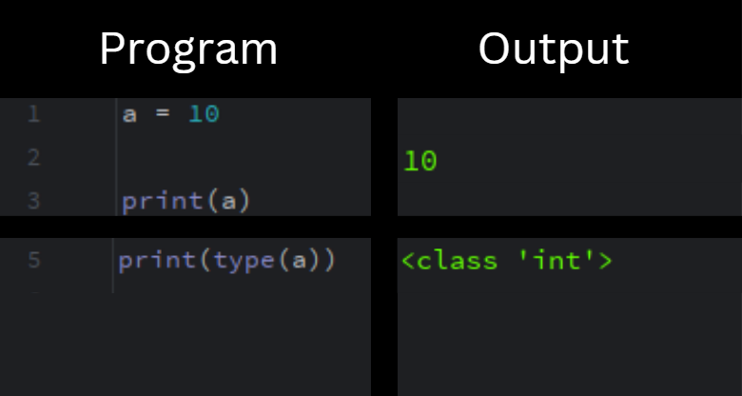
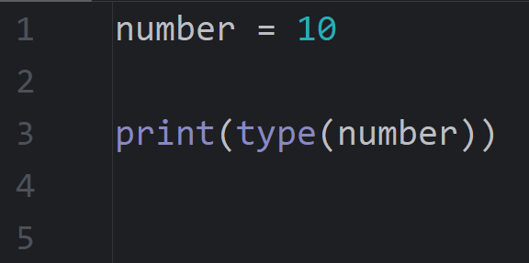
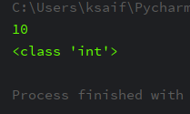
INTRODUCTION
In Python, data types for variables are not explicitly specified.
To identify the data type stored in a variable, we use the built-in type() function.
The type() function is a powerful tool in Python, providing insights into the nature of various data types.

Slide 4
UNDERSTANDING THE RETURN VALUE OF type()
Class Type Identification:
type() reveals the class or built-in type of the object.
Object Inspection:
The return value aids in inspecting and understanding an object's defined type.
Dynamic Typing Implications :
Understanding the return value helps in grasping the dynamic typing nature of Python .

Slide 5
DYNAMIC TYPING IN PYTHON
Python is a dynamically typed language, which means that the type of a variable is determined at runtime, not at compile time.
The type() function plays a role in dynamic typing by providing a way to inspect and determine the type of an object during the execution of a program.
This allows developers to write code that can adapt to different types of data without explicitly declaring the types.
For example: x = 5
print(type(x)) # Output: <class 'int’>
x = "Hello, World!"
print(type(x)) # Output: <class 'str’>

Slide 6
SYNTAX FOR type() IN PYTHON
There are 2 different forms of type() functions i.e. there are 2 different methods to pass the arguments into the type() function :
If a single argument type(obj) is passed, it returns the type of the given object.
If three argument types (name, bases, dict) are passed, it returns a new type object.
type() with single parameter –
Syntax : type (object)
In this case, the type() function returns the type of this object passed as an argument

Slide 7
EXAMPLE PROGRAM | OUTPUT
a = 10 my_list = [1 , 2, 3, 4, 5] c = True print(type(a)) print(type(b)) print(type(c)) | <class ‘int’> <class ‘list’> <class ‘bool’>
Return value of type(type) : The type is also a class of type, the statement type(type) returns “type” . For example, type(type(int)) returns <class ‘type’> ‘int’ is a class and like all classes in Python, it is an instance of the ‘type’ metaclass ,

Slide 8
type() with three parameters -
This form of type() function creates a class dynamically with given arguments. The 3 arguments passed to the function are name, bases, and dict.
Syntax: type(name, bases, dict)
Parameters :
name: a new instance is created with class ‘name’.
bases : tuple of classes from which the current class derives. Later corresponds to the __bases__ attribute.
dict : a dictionary that holds the namespaces for the class. Later corresponds to the __dict__ attribute.
Return: returns a new type class or essentially a metaclass.

Slide 9
EXAMPLE PROGRAM
a = type('Test', (object, ), dict(x = 'Hello', y = 10, z = 'World’)) print(type(a)) print(vars(a))
OUTPUT : <class 'type'> {'x': 'Hello', 'y': 10, 'z': 'World', '__module__': '__main__', '__dict__': <attribute '__dict__' of 'Test' objects>, '__weakref__': <attribute '__weakref__' of 'Test' objects>, '__doc__': None}

Slide 10
COMMON ERRORS WHEN USING type() IN PYTHON
Using type() on a variable that is not defined :
This will result in a NameError.
For example: >>> type(my_variable)
NameError: name 'my_variable' is not defined
Misuse of Parentheses:
Incorrect: type(int), type(str), etc.
Correct: type(int()), type(str()), etc.
type() requires an instance of an object, not the type itself. So, make sure to instantiate objects
before checking their type.
Confusing Types and Values:
Incorrect: type(5) == int or type("hello") == str
Correct: type(5) is int or type("hello") is str
The type() function returns a type object, so use the ‘is’ or == operators appropriately to check
for equality.

Slide 11
APPLICATIONS
Using this Python built-in function, we are able to identify which variable contains what type of data. This function is very useful for debugging purposes.
Another function of type() is that we can dynamically create classes along with their attributes during the run-time of the program. This is possible by passing 3 arguments to the type() function.
Python type() function is also useful to create tables in the database using SQL.

Slide 12
CONCLUSION
In conclusion, the type() function in Python is a powerful tool for dynamically determining the type of an object.
It provides valuable information about the nature of a variable or expression at runtime, enabling developers to write more flexible and generic code.
However, it’s important to use type() judiciously and be aware of potential errors.
Developers must balance the use of type() with other object-oriented principles and for all type validations.

Slide 13
REFERENCES
https://www.geeksforgeeks.org/python-type-function/ Last accessed on 30/1/2024 1.21 pm
https://www.w3schools.com/python/ref_func_type.asp Last accessed on 30/1/2024 2.28 pm
https://www.geeksforgeeks.org/python-data-types/ Last accessed on 30/1/2024 4.49 pm
https://www.toppr.com/guides/python-guide/references/methods-an0d-functions/methods/built-in/type/python-type/#:~:text=Python%20type()%20is%20a,data%20elements%20in%20a%20program Last accessed on 30/1/2024 6.38 pm.

