Slide 1
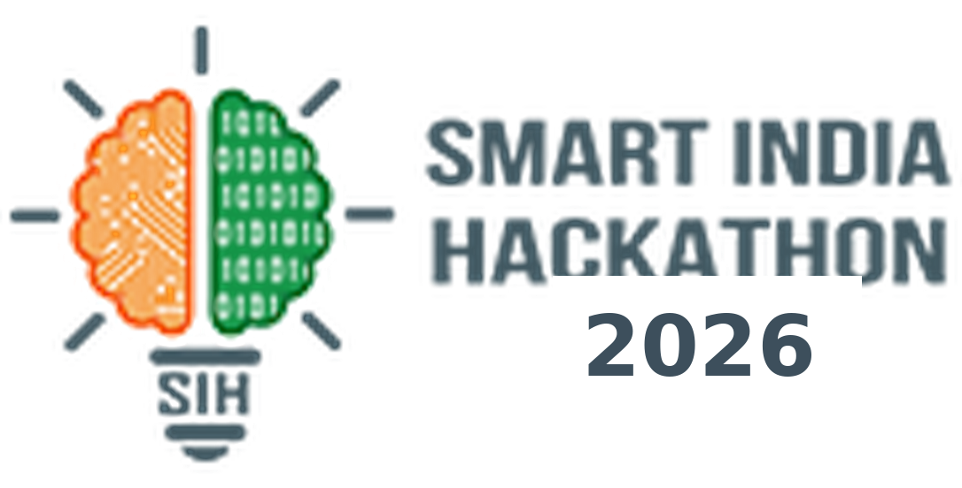
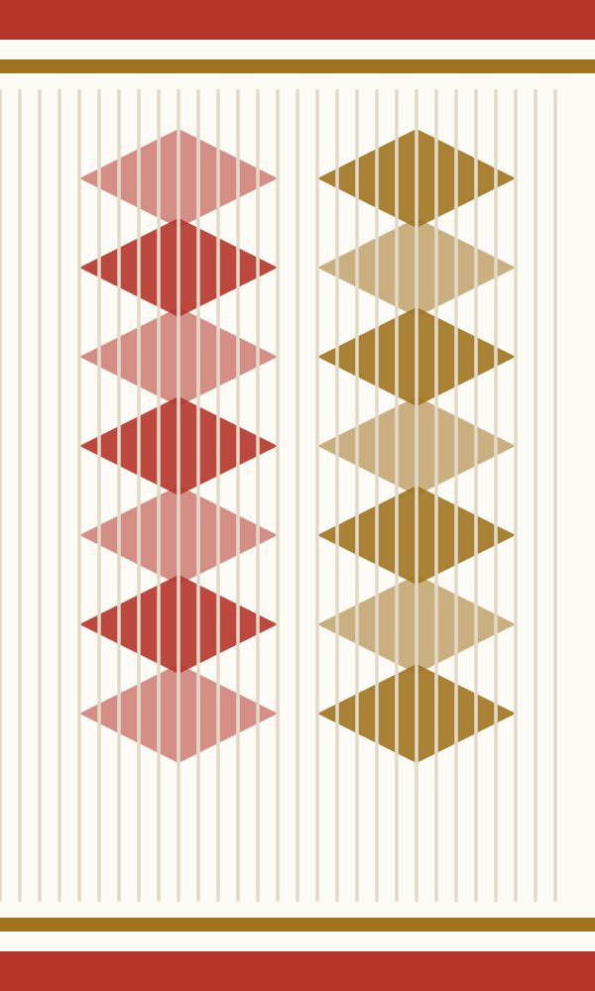




SMART INDIA HACKATHON 2026
Problem Statement ID : SIH26003
Problem Statement Title : AI-Based Cognitive Gaming and Memory Assistance Platform for Elderly Dementia Patients in the North Eastern Region
Theme : MedTech / BioTech / HealthTech
PS Category : Software
Team ID : ____________
Team Name : Overfitters Anonymous
Solution name: XORAI — the brass bowl offered to an elder
Ministry of Development of North Eastern Region (MDoNER) · Submission: 20 September 2026
The gamosa border is the session progress indicator on every patient screen.
Xorai is not a diagnostic tool. It does not diagnose, stage or treat dementia. It provides cognitive engagement activities and shows changes in performance over time. Any concern about a person's memory or thinking should be discussed with a qualified doctor.
Notes:
Open with the burden, not the tech: 8.8 million Indians aged 60+ live with dementia; the North East has almost no specialist care. Xorai is a tablet that sits in the house. Say the disclaimer out loud before a judge asks — we detect change against a person's own baseline, we never diagnose.

Slide 2

02
IDEA TITLE
Overfitters Anonymous
Offline-first PWA
Currently Faced Problems :
8.8 million Indians aged 60+ live with dementia (7.4%) — rural prevalence runs above urban
The North East has almost no specialist care — few geriatricians, long travel, heavy stigma
Change is noticed years late — families act only once it is already severe
Nothing exists in NER languages, and most elders cannot read at all
Hill-district connectivity is unreliable — cloud-only apps simply do not run
Caregivers arrive at the doctor with nothing — recollection, not a record
Memory assistance
Voice-led, no literacy
Six NER languages
XORAI
Four cultural games
Our Idea :
Caregiver dashboard
Errorless by design
A 12-minute daily session that never feels like a test — tap-only, voice-led, errorless
Four games rooted in the region — kinship faces, dhol rhythm, 1950s objects, clock drawing
Fully offline — play, voice, reminders and assistance with the network off
Change against the person's own baseline, never a population norm — no diagnosis, ever
The assistance half of the problem statement — reminders, family faces, orientation, SOS
Verifiable guardian consent under DPDP, data resident in Mumbai
Personal baseline
Tap
Outbox
Sync
Baseline
Change
Caregiver
Every tap is timestamped on a monotonic clock, stored offline first, and compared only against this person's own baseline.
Hosted Website
(click here)
YouTube
(click here)
Source Code
(click here)
Figma
(click here)
Notes:
Four live links are the single highest-scoring element on this slide — hosted PWA, demo video, public repo, Figma. Attach them before export. The ring is the product in one glance; the chevron strip is the data path in one glance.

Slide 3

03
TECHNICAL APPROACH
Overfitters Anonymous
A daily session (12–15 min)
The four games
Flow of project
Caregiver signs in · patient taps own photo
Aponjon — "Our Own People"
Face–name with spaced retrieval; the prompt speaks the local kinship term, not "aunt".
Tap · stroke · tap-back
SessionClock offset (performance.now)
emit() → Dexie, synchronously
Orientation warm-up — day, date, place
memory · language → sustained retrieval interval
Familiar music from their own youth
Dhol Bator — "Rhythm Echo"
nightly-rollup Edge Function
Supabase Postgres + RLS (Mumbai)
Outbox flush · uuid v7 upsert
Tap a dhol pattern back. Span 2–7, scheduled and measured on the audio clock.
Game A (4–5 min)
attention · working memory → inter-tap variability
session_summaries — mean RT, CV
baselines frozen at 10 sessions
z-score + EWMA vs own baseline
Xorai Milan — Memory Match
Game B (4–5 min)
Deck weighted 60% to 1950s–70s everyday objects; each match speaks a caption.
attention · memory → revisit rate
Caregiver dashboard + PDF
Amber or red change flag
Suppress: illness · low effort · thin data
Close — family photo + today's reminders
Ghorir Chobi — Clock & Trace
Finger-drawn clock, full stroke trace stored. No automated scoring, ever.
The bamboo grove grows by one culm
visuospatial · executive → pre-first-stroke latency
Technologies to be used
Capture path — identical for every game
pointerdown
clock offset
emit()
Dexie outbox
flush on sync
Client — Vite 6 · React 19 · TypeScript strict · Tailwind 3.4 · shadcn/ui · Zustand · TanStack Query
Offline — Dexie 4 (IndexedDB) · vite-plugin-pwa (injectManifest) · uuid v7 idempotent upsert
Backend — Supabase — Postgres, Row Level Security, Auth, Storage, Edge Functions · ap-south-1 Mumbai
Signal — Raw Web Audio API · pointerrawupdate + getCoalescedEvents() · Recharts
Language — react-i18next · Bhashini TTS pre-generated at build time · Noto Sans
Date.now() is banned in every telemetry path — wall clock gets NTP-corrected mid-session and would poison the variability metric the whole product rests on.
Notes:
The ordering is the argument: offline sync and the telemetry clock are cross-cutting, so they are built before any game exists. Dhol Bator is built first because it validates the audio clock. If asked why not Next.js: React Server Components plus a service worker make offline unreliable, and this app has zero use for SSR.

Slide 4

04
FEASIBILITY AND VIABILITY
Overfitters Anonymous
Feasibility & Viability
Our Strategic Approach
Technical
Clinical
Financial
Operational & social
Errorless by design
Hint rate, not accuracy
No patient-facing surface ever indicates that the patient was wrong. No red, no buzzer, no score.
We prevent the error before it happens, then record that a hint was needed. Accuracy is inflated by design and we say so.
Offline PWA is a proven pattern
Bhashini TTS covers as · brx · mni · ne · hi
Supabase RLS + window functions do the analysis
Validated constructs: span, spaced retrieval, clock drawing
Digital clock test already piloted in India
Within-person design needs no published norms
One ₹8–12k Android tablet per household
No per-session inference cost — hosting only
Free tiers cover the entire pilot
ASHA workers are the last mile, not an app store
The caregiver is the retention mechanism
Gamosa, dhol and kinship terms make it feel local
Variability as the signal
Honest about the AI
Reaction-time variability is the marker. Dhol Bator measures it with almost no cognitive load layered on top.
Rule-based adaptive difficulty today, on a telemetry schema deliberately built so a model can be trained on it later.
Challenges → how we answer them
Adherence — ~43% attrition even in supervised trials
Personal content, caregiver as co-user, a grove that grows and never a streak
No published norms for these games in NER languages
Every comparison is within-person: we report change, not a diagnosis
Consent that holds up
A real deployment path
Verifiable guardian consent under DPDP 2023 + Rules 2025, scoped toggles, audit trail, data resident in Mumbai.
NPHCE as the channel and ASHA workers as the last mile — not an app store listing.
Low literacy, tremor, presbyopia, weak network
Voice-led, tap-only, 60 px targets, 7:1 contrast, fully offline
Over-claiming — FTC v. Lumos Labs, January 2016
Explicit non-diagnostic scope, disclaimer on dashboard, PDF and slide 1
Notes:
Lead with the Lumosity precedent — it shows we know exactly which claim gets a product fined, and we are refusing to make it. The adherence number is the honest weak point: name it before a judge does, then show the three levers we pull against it.

Slide 5
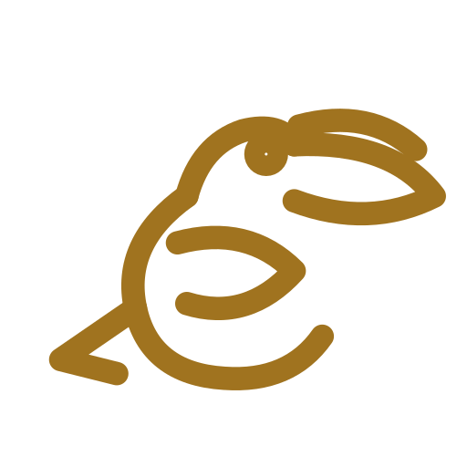
05
IMPACT AND BENEFITS
Overfitters Anonymous
Solution Benefits
Target Audience Impacts
Daily cognitive engagement
Patients
routine, orientation, familiar faces
Dignity and calmer days
Memory assistance at home
Family caregivers
trends, reminders, plain-language flags
Less guesswork, less burden
Key benefit:
earlier, cheaper detection of change — and real daily support at home
XORAI
An objective longitudinal record
Doctors — NEIGRIHMS / AIIMS
a PDF the family carries in
Earlier referral
Runs with no network at all
ASHA workers / NPHCE
last-mile onboarding of families
Reach into rural districts
A caregiver who is not guessing
MDoNER / State health
aggregate, consented insight
Evidence for policy
Deployment, funding and scale-up
Funding & sustainability
Cost model
Scale-up path
NPHCE (MoHFW) as the deployment channel
MDoNER schemes for North East delivery
CSR from telecom and IT partners
State health budgets for tablet supply
One ₹8–12k Android tablet per household
No per-session inference cost — rule-based
Hosting and storage are the only recurring cost
Free tiers cover the full pilot
20–30 dyads, 12 weeks, one district
ASHA-onboarded cohort across Assam
All eight NER states
Open telemetry schema for researchers
Notes:
The primary metric is adherence — sessions completed over sessions offered — not improvement in game scores. Rising scores would mean difficulty is mis-calibrated, not that dementia improved. Say that; it is the line that separates us from every brain-training pitch.

Slide 6

06
RESEARCH AND REFERENCES
Overfitters Anonymous
Epidemiology — the burden
Sample UI built by the team
Prevalence of dementia in India: national and state estimates (LASI-DAD), Alzheimer's & Dementia 2023 pubmed 36637034
10/66 Dementia Research Group — rural prevalence above urban in India
Digital cognitive measurement — the method
Patient home — tap your own photo
Dhol Bator — rhythm echo
Digital clock assessment in a South Asian setting (CARRS, n = 303), npj Dementia nature.com/s44400-025-00056-6
Digital Clock Drawing Test — latency features, not the finished drawing, carry the signal
Sea Hero Quest — population-scale cognitive data from a game
Intervention evidence — why these four games
Cognitive stimulation therapy and serious games in dementia care
Caregiver trend vs personal baseline
Clock replay, two months side by side
Errorless learning and spaced retrieval in memory rehabilitation
Preserved musical memory in dementia — the basis for Dhol Bator
Law, policy and precedent — why we do not over-claim
Reference products — and where we differ
Digital Personal Data Protection Act 2023 and DPDP Rules 2025, MeitY meity.gov.in
FTC v. Lumos Labs (Lumosity) 2016 — human clinical evidence required for cognition claims ftc.gov
Lumosity — Consumer games, no clinical framing, fined in 2016 for the claim we refuse to make.
Bhashini (MeitY) · NPHCE (MoHFW) — the public infrastructure we build on
Linus Health DCTclock — FDA-cleared but clinician-administered, licensed, English. We take the method, not the product.
Sea Hero Quest — Proved game telemetry is a cognitive marker at scale. A research instrument, online, not care.
8.8 M
7.4 %
10.6 / 7.5
99.3 %
Indians 60+ with dementia
prevalence at 60+
rural vs urban %
tablet clock tests analysable
CST / ARDSI paper programmes — Strong evidence, but facilitator-led and unavailable in any North Eastern language.
Notes:
If a judge pushes on evidence: the constructs are validated, but our claim is deliberately narrow — change against the person's own baseline. Anything stronger is what got Lumosity fined. The four reference products are the honest competitive map: none of them work offline, in an NER language, in a family's house.

