Slide 1
Get-Testers
Accelerate the Growth of your app and get valuable user feedback

Slide 2
What is Get-Testers?
Get-Tester is a platform aiming to connect Testers, Technology Enthusiasts and Freelancers to young Startups who want a great start, big user base and brand recognition.
The Testers provide valuable feedback to the products of the company and in return they can get stipend/perks.

Slide 3
Our Impact
The scope of testing, holds huge importance in IT industries in today’s world. With Cyber attacks at a rise, it is more important then ever for a company to know its possible fugs or vulnerabilities. No company wants to get hacked or deleted before they even launch fully. With Get-Testers, the company get a community of Testers each having different skillsets.
The Company can choose the appropriate testers according to their market which could provide technical as well as business related feedback.

Slide 4
Our Feedback System
Testers can provide three levels of feedback –
A – Simple MCQ based forms for consumer feedback
A+ - A more thorough way of getting information with testers including Bug Report
A++ - This level provides the most value. Very well versed paragraphs explaining the possible changes, and errors. Only given by highly ranked testers.

Slide 5
Testers
Testers get rated on the basis of their reviews that the Company gives and the value score. As the rating starts to rise, the Tester can rank up.
A higher ranked Tester could earn much more than a lower ranked tester.
Testers can make substantial income while getting their hands on the new unreleased Tech.
No degree or formal education needed. The only requirement is to be able to express their views.

Slide 6
How Get-Testers is Ground Breaking?
WE USE AI!!
Use of an in-house sophisticated matching algorithm to match the skills between the testers and the requirements of the Companies. This makes sure that only the people whom the company wants, will test it. (Makes sure a photography app is tested by photographer).
A bot which checks the authenticity of the articles and gives a value score. The rank up of the Tester depends on this score and the rating by the companies.

Slide 7
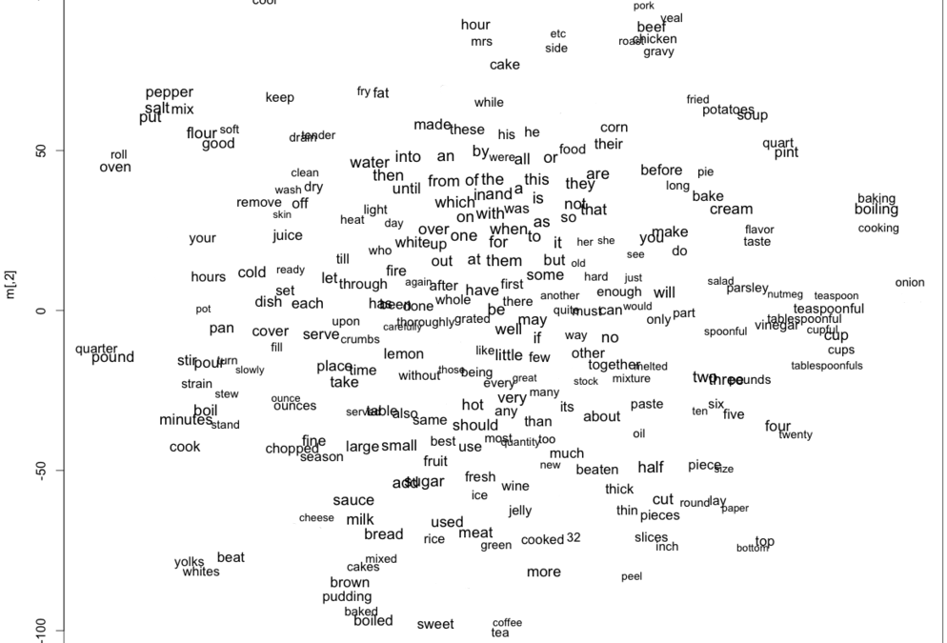
Word2Vec
Given enough data, usage and contexts, Word2vec can make highly accurate guesses about a word’s meaning based on past appearances. Those guesses can be used to establish a word’s association with other words

Slide 8
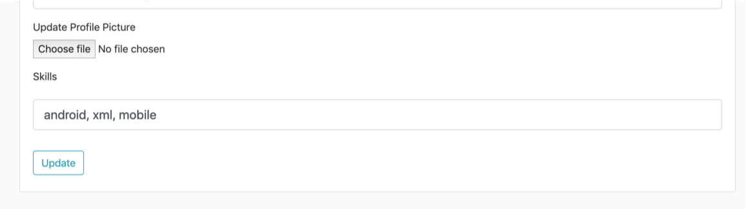
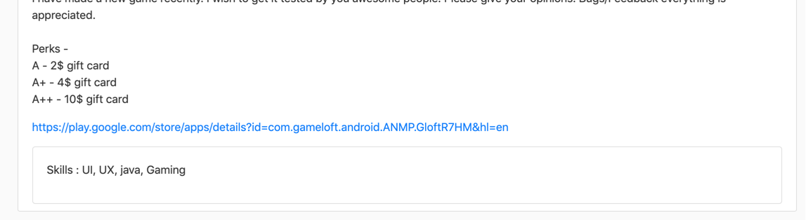
A User who knows android is matched with requirements of Java
A Tester’s Profile
Suggested because Java is similar to Android

Slide 9
For Startups
Get your products in the hands of its users
Get valuable feedback from tech enthusiasts
Know your market better
Get the right testers for your products
Market your product with the famous testers
Get informative inputs

Slide 10
For Individuals
Earn Rewards
Grow your presence
The more value a Review provides, more are the earnings
Become a renowned reviewer
Get early access to amazing new products

Slide 11
Thank You

