Slide 1





Code
Bust
.

Slide 2



theme
Recruitment and employee benefits

Slide 3

Recruiters has to go through each profile of a candidate
Example : Resume, Github, LinkedIn
Check if they meet job description
Yes?
Should they be interviewed?
Have we overlooked someone, who is better?
Shouldn’t they be interviewed first?
They don’t?
Should the profile be saved for future use?
Current Hiring Scenario

Slide 4
Analyse all of candidate’s profile at a click
Resume, LinkedIn, Github, Behance, Dribble
Visualisation of core competencies
Analytics related to job description
Creation of a priority list
Comprehensive grading system
What can make this easier?

Slide 5

What are we doing?
Exactly, that!
.

Slide 6
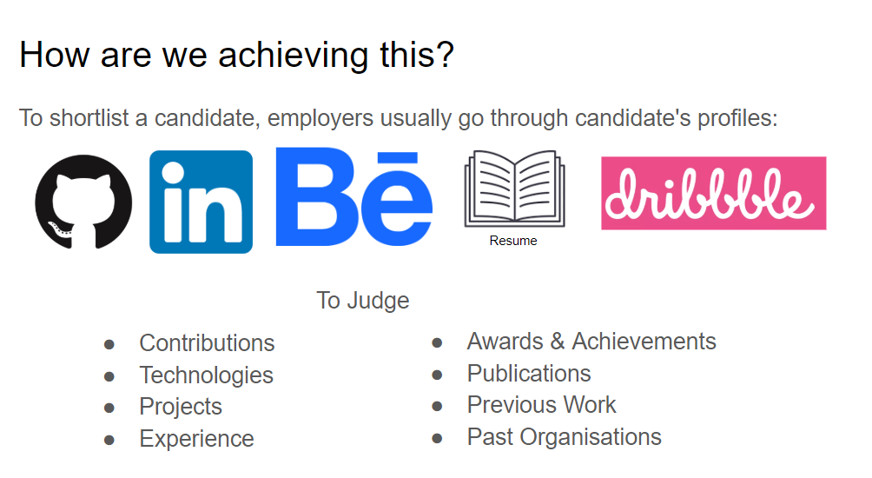
What are we doing?
Exactly, that!
.

Slide 7
WHAT WE DO?
WE DO THE EXACT SAME THING
EVERYTHING IS ACCESSIBLE WITH A FEW CLICKS!!!
EVERY Profile’s Analytics at one place with Profile Score relating to Job Description

Slide 8
Business proposition
Subscription model : $20 for first employee
+$10 for next ones

