Slide 1

City Surveillance System

Slide 2

features

Slide 3

Comprehensive Real-time Data Management

Slide 4

All Around Surveillance with CCTV Cameras & Drones.

Slide 5

City wide Management at HQ

Slide 6

Advance Alert System

Slide 7
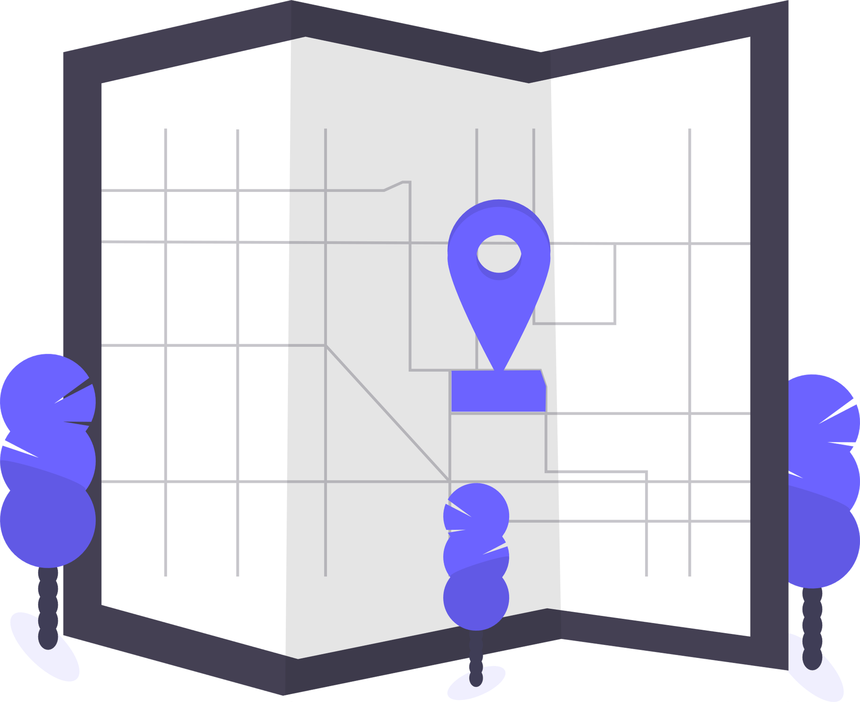
Location Checkpoint powered by mapmyindia

Slide 8

Industrial level Security: 128 Bit Encryption System

Slide 9

Deployed on Azure

Slide 10

User Friendly Chatbot Service

Slide 11

Privacy Protection

Slide 12

Team Error

