Slide 1
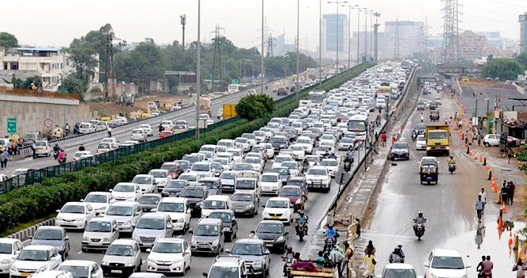
TEAM FRACTALS
GO SAFER ROADS
PRESENTS
#
Improving Road Management and lessening burden on Indian Oil Imports..
# https://www.crridom.gov.in/content/delhi-paying-one-and-half-times-more-fuel-due-bad-road-traffic-jam

Slide 2
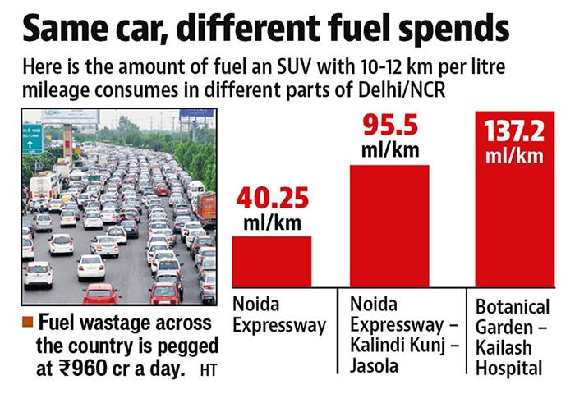
PROBLEMS
-Bad and Crowded Roads.
-Research done by CSIR-CRRI, concluded on an average Rs. 960 crores a day wasted.
-Air Quality Levels are deteriorating.
#
# https://www.crridom.gov.in/content/delhi-paying-one-and-half-times-more-fuel-due-bad-road-traffic-jam

Slide 3
SOLUTIONS
PREDICTING PATHS ON THE BASIS OF DAMAGED ROADS, AQI LEVELS
HELPING GOVERNMENT KNOWING THE PLACES WHERE ROAD IS DAMAGED
EASY SOLUTION AND GOOD PARAMETERS TO ADD TO THE ROUTING ALGORITHMS

Slide 4
HARDWARE ASSEMBLE
01
DATA TO CLOUD
04
PUTTING COORDINATES TO MAPMYINDIA API
02
DATA FROM CLOUD
STEP BY STEP SOLUTION
03
05
GETTING PATHS AND TIME REQUIRED
WRAPPER TO PREDICT PATHS
06
Sensor Network to get the AQI and Vibration Sensor
Event Hub to send data to Azure Database
Using the MapMyIndia Interactive Web API to put Air sensor and Damaged Road Data.
GET data from Storage Amount Table via Azure Storage SDK.
Getting all the paths,distance and time required to reach from host to destination.
Now on the basis of road sensor and AQI levels, predict the correct path.

Slide 5
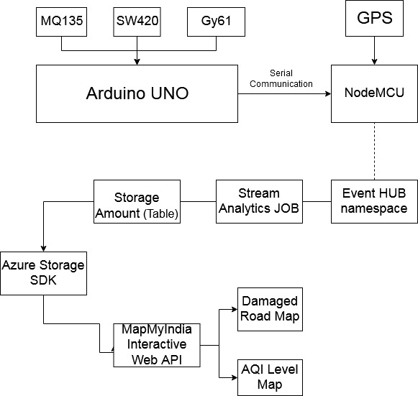
FLOWCHART

Slide 6
TECHNOLOGIES USED
HARDWARE STACK:
MQ135(AQI)
SW420(VIBRATION)
GY-61(VIBRATION)
ARDUINO UNO
NODEMCU ESP8266
GPS MODULE
FRAMEWORK & LANGUAGE STACK:
ARDUINO IDE
MICROSOFT AZURE
MAPMYINDIA API
JAVASCRIPT

Slide 7
USE CASES
NEW ROUTING PROTOCOLS
GOVERNMENT HELP
This will help to increase the accuracy and efficiency of the routing protocols.
Getting the location where the road is damaged in a faster way will help to repair the damage.

Slide 8
IMPORTANT MODIFICATION SUGGESTED BY US IN MAPMYINDIA API
Adding AQI Levels & Damaged Roads also as parameters along with distance and traffic conditions.
This will help in decreasing pollution levels as well as in saving the oil levels and cause very less damage to the vehicles.

Slide 9

LET’S HAVE A SNEAK PEEK

Slide 10
THANKS FOR YOUR TIME
Time for Q&A !

