Slide 2

WHAT’S NOT GOING WELL IN STARTUPs?
Poor Marketing
No financing/Investor interested
Why startup fails?
Pricing/Cost issues
Didn’t use network
Failed geographical expansion
No advertising content

Slide 3
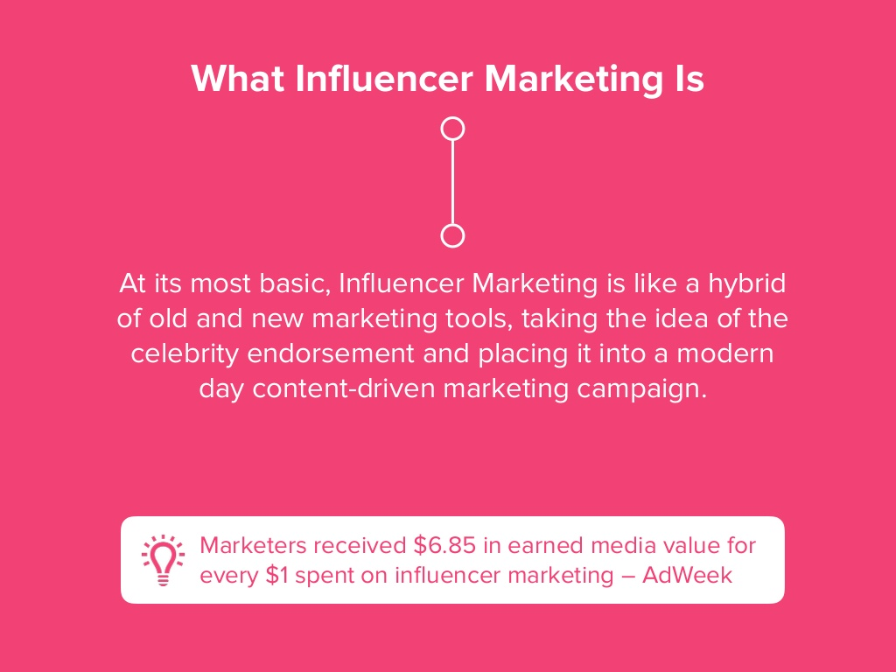

Slide 4
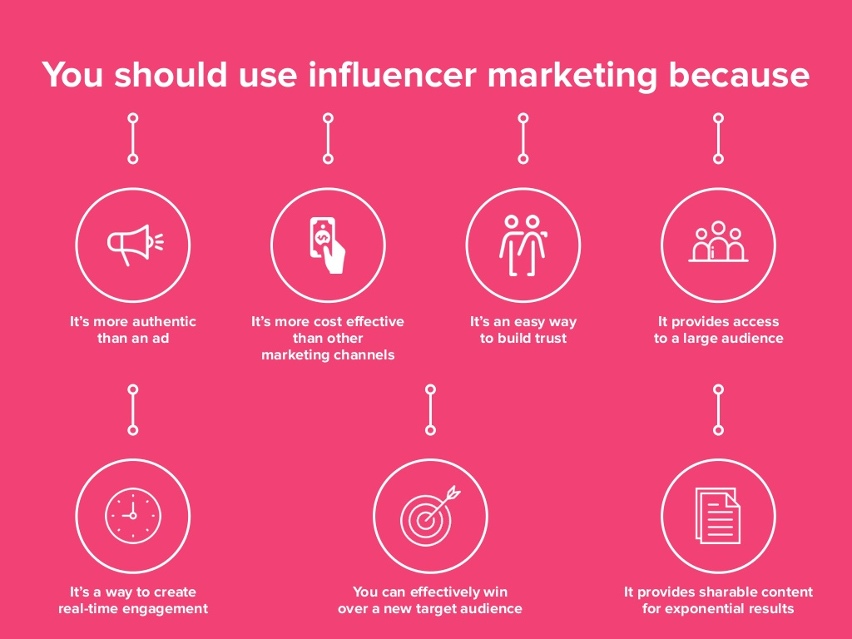

Slide 5
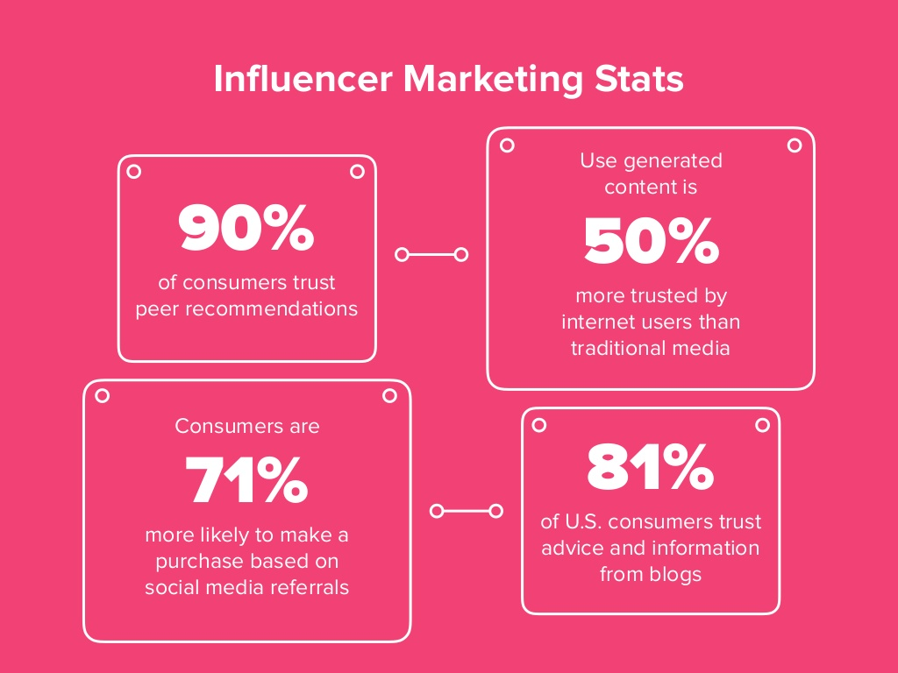

Slide 6

#socialGo

Slide 7

SAY & DO
WE COVER EVERYTHING
Amazing marketing
Manage geographical expansion
Minimizing pricing/costing
Grow your network
Give you advertising content
Notes:
Photos by unsplash

Slide 8
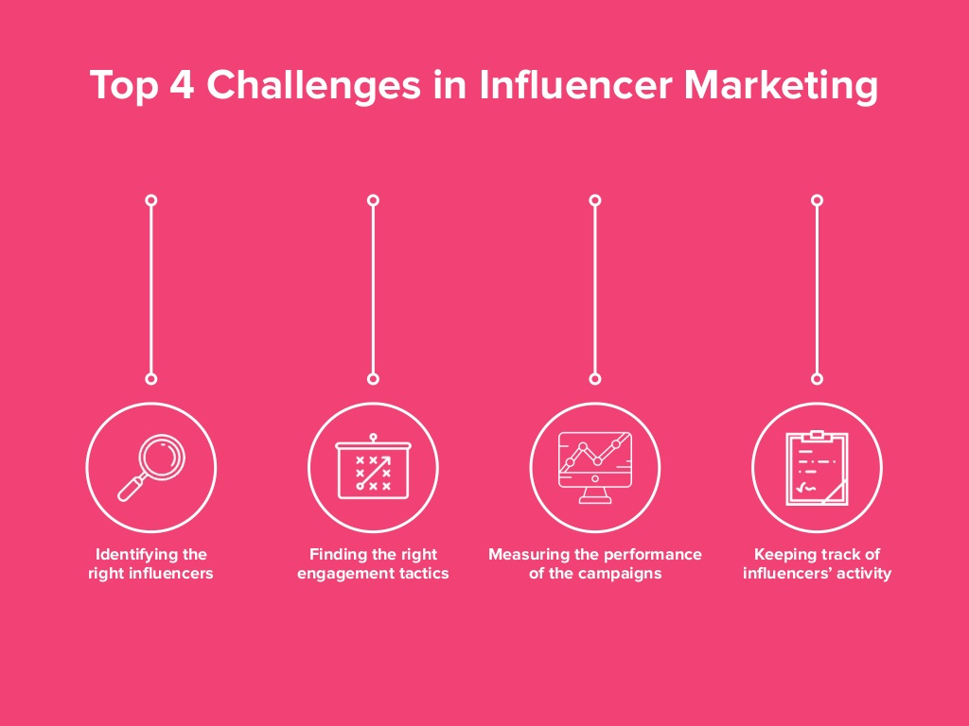

Slide 9
#socialGo
HOW WE ROLL

Slide 10
Business Model
WORK FLOW
Let user find the best influencer for endorsement
01
02
Get user details: Name of business,
Business category,
Locality of business
Play our search game
Notes:
<a href="https://www.freepik.com/free-photos-vectors/banner">Banner vector created by katemangostar - www.freepik.com</a>

Slide 11
#socialGo
LETS TALK PAISA

Slide 12
#socialGo
THINK AHEAD

Slide 13

Future plans
Feedback & Reviews
AI + ML
Will get end-user reviews and incorporate their feedbacks
Reading the comments of user and analyze their significance
06
01
Third-party integration
API to MapMyIndia
Will have tie-up with content designers for marketing content
05
Future plans
02
Provide them our API for more deep searching of nearby places and get popular faces
04
03
Followers count
Pricing Model
Deep analysis of followers and will intergrate more social handles
We will define our pricing schemes, the cuts of content providers, influencers and company

Slide 14
#socialGo
“You just have to pay attention to what people need and what has not been done”
#thanks

