Slide 1
Satark Vigilance System
Made By: Team KnowName
Sahil Sulekhiya
Vikram Singh
Tanishq Taneja
Vaibhav Bagga

Slide 2
Outline
★ Problem Statement
★ Solution Proposed
★ Technology Stack
★ DEMO
★ Future Scope

Slide 3
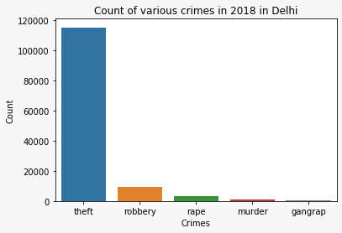
Problem Statement and Motivation
Current Method of Routing algorithms does not consider the safety of the route to be followed.
Manual processes of analysis, decision making and crime prediction is turning obsolete as the crime data to be processed continues to grow in volume.
Public is unaware of the prevailing crime patterns in their area, hence is susceptible to further misdeeds.
Intelligence led policing lacks precision and hence is inefficient with regard to resource management

Slide 4

Solution Proposed
To overcome the problems discussed, we focused on the following workflow:
1 2 3
Digital Crime Maps linked with a realtime Database can enhance the routing policy by providing comprehensive analysis of crime patterns using Machine Learning.
Predictive Policing Application that would churn the recorded crime data and relevant risk factors to to find the safest path for travel along with considering shortest time and convenient ride.
Incidents like eve teasing, encroachment etc can be reported to a crime map accessible to the general public and the police which will update the real time database.
Considering all these points we came up with a digitalised policing solution -
Satark Vigilance System

Slide 5
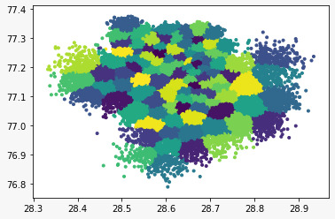
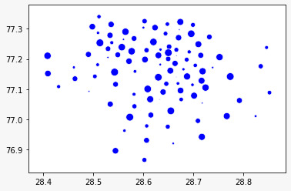
Solution Proposed
1. Crime Map and Analytics
The crimes recorded in the database would be used to find Crime Hotspot by using K means clustering algorithm and the safety of a particular coordinate can be given by the parameter inversely proportional to the distance from the Crime Hotspot.
The top four path will be fetched using the map_my_india API and the path is given to the Machine Learning Algorithm to find the safety of the given path. THe vulnerability of the given Hotspot can be found by the no of datapoints in that cluster.

Slide 6
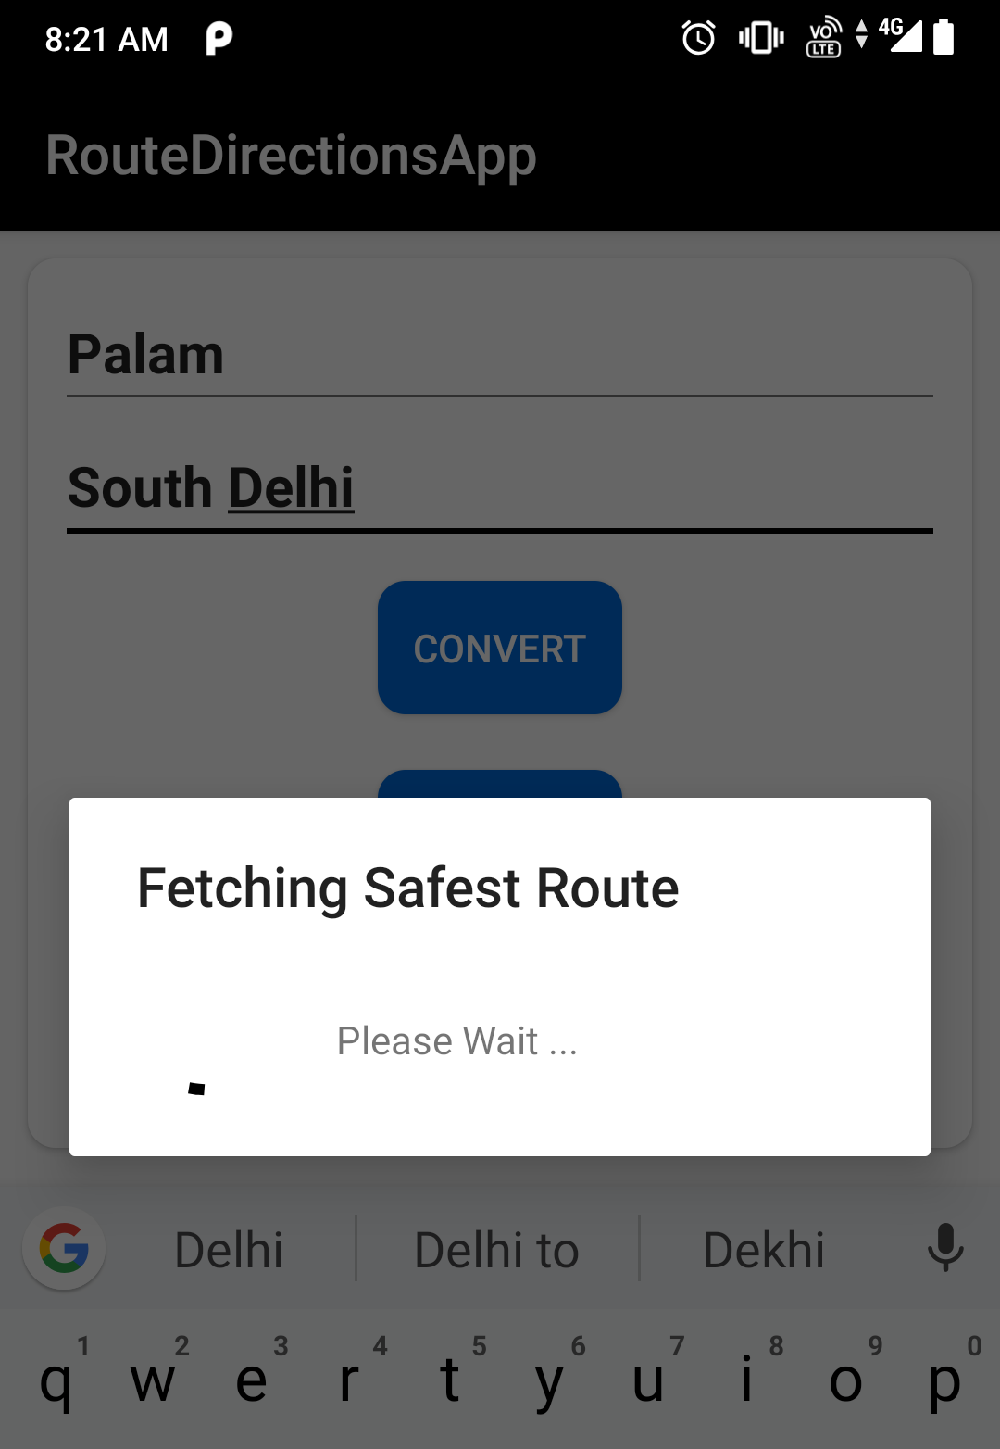
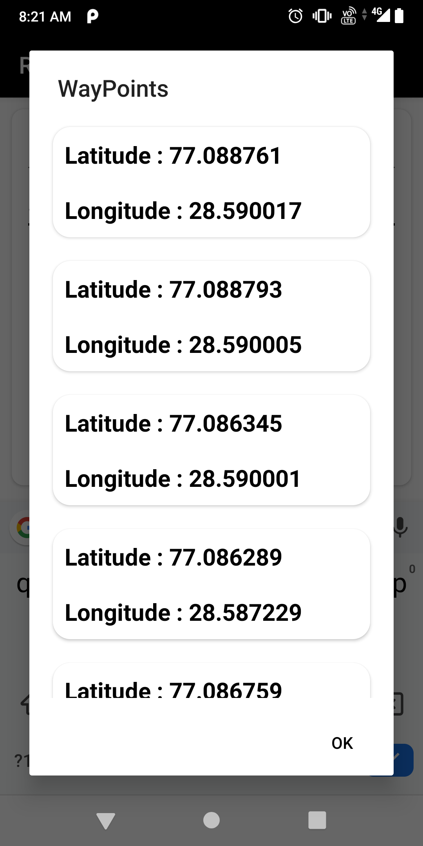
Solution Proposed
Solution Proposed
The user will upload the source and destination which will be used to fetch a list of shortest path which can be taken.
The pathway which comes across a particular path will be used to find the safety of the path by using Machine Learning Algorithm deployed on Microsoft Azure.
These path with the maximum safety value will be the required path.
4. Satark Nagrik Mobile App

Slide 7
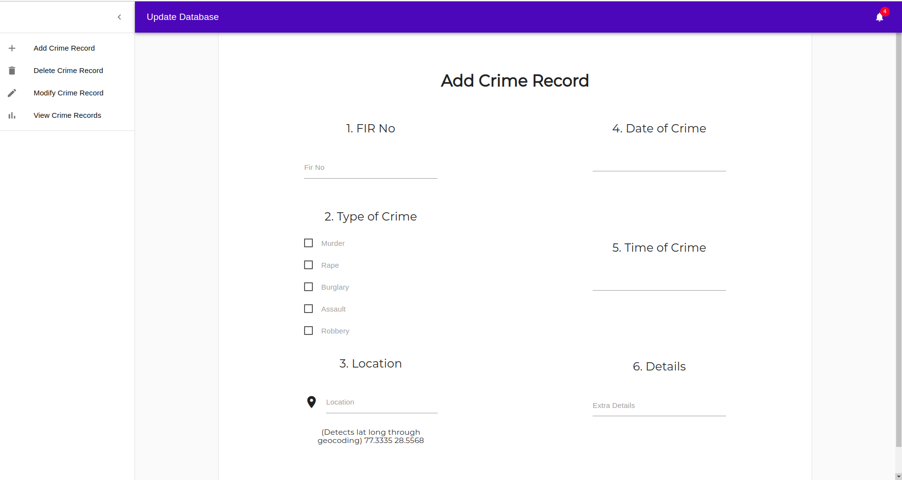
Solution Proposed
3. Crime Database supporting Geographic Information System (GIS)
The FIR number, type, time and location of each crime would be saved along with an optional detailed description regarding the incident by the Police Department.

Slide 8
DEMO

Slide 9
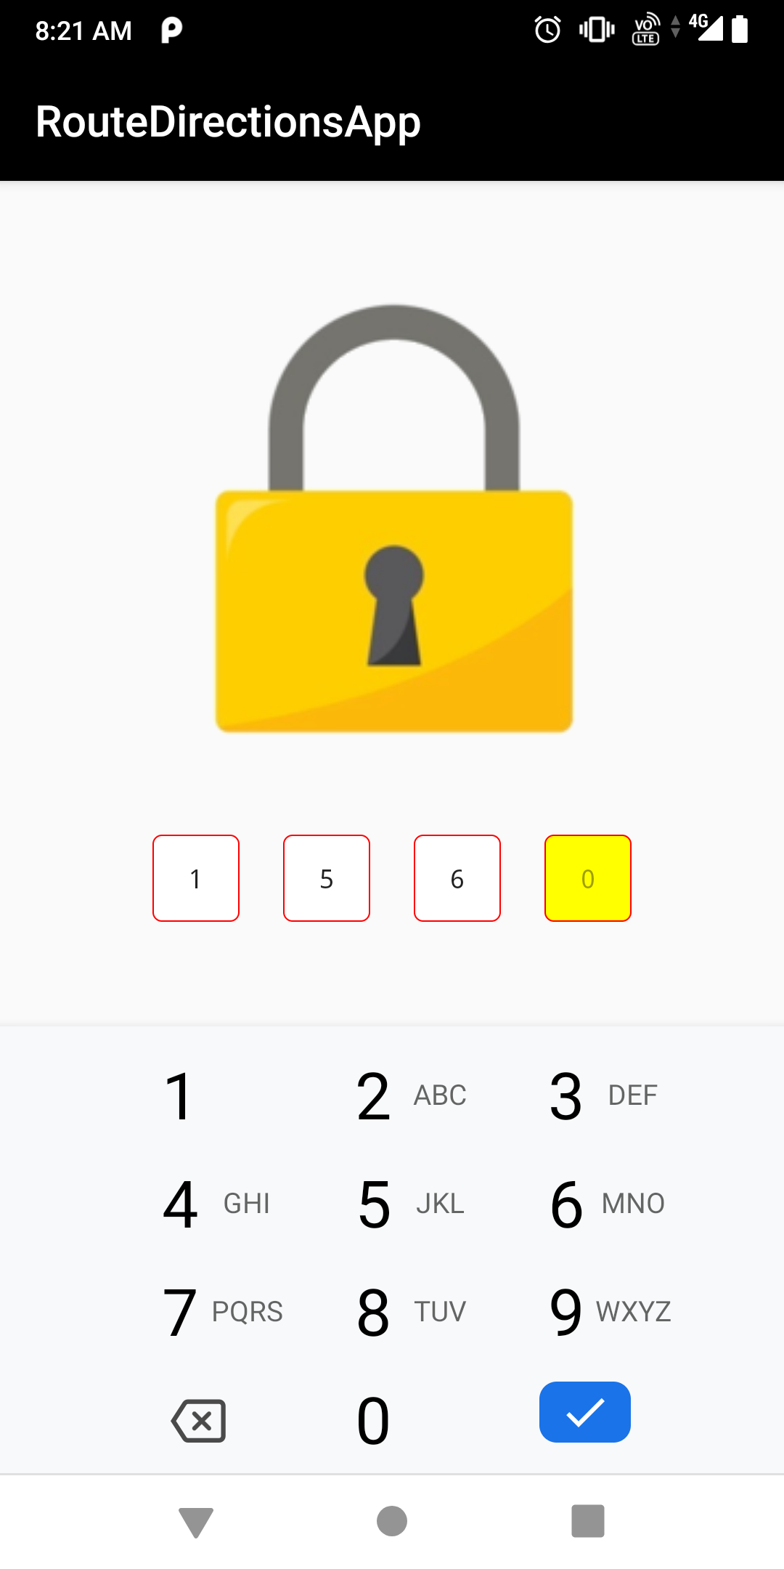
FUTURE SCOPE
Diversion from Route:
If the user of the application diverts from the predefined route, a notification
will be sent to the trusted set of people.
Silent Notification:
If the criminal tries to snatch the smartphone of the victim, and asks
the victim to fill the safety code, the victim can use the fake code which
will act as the orignal code, but will send the emergency notification to the
trusted ones.

