Slide 1

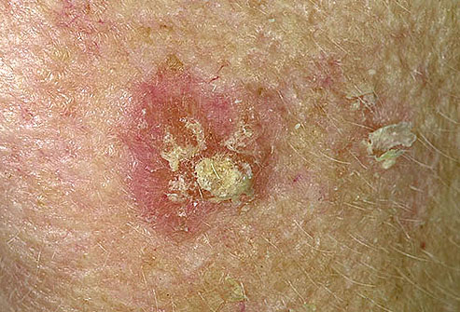
SKIN CANCER DETECTION
This Photo by Unknown Author is licensed under CC BY-SA

Slide 2

WHY??
No awareness
People Ignore
Reduces rate of death
Help doctors to focus on critical cases

Slide 3
What??
Detecting type of skin cancer and its severity.
Real time image capture or pre-existing image.
Showing near by hospitals using MapMyIndia API

Slide 4
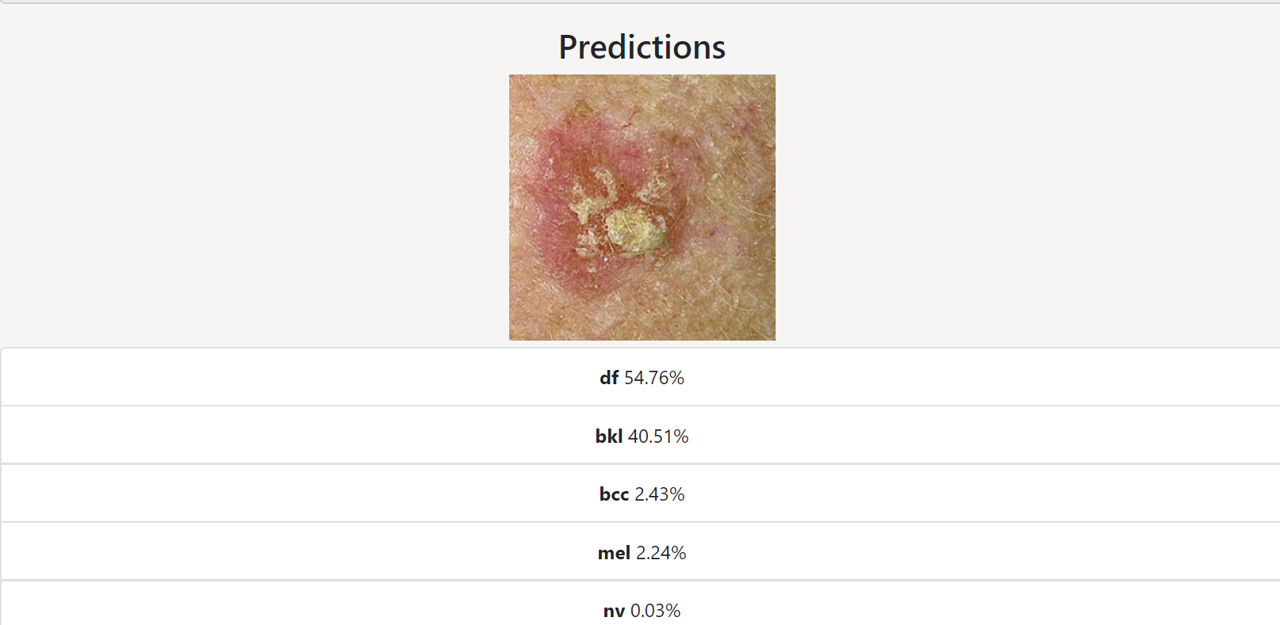

Slide 5
How?
Technology Stack
React.js/Node.js
TensorFlow.js
Python
DataSet
HAM10000 dataset

Slide 6
Deployment
Azure
Rest API
MapMyIndia Near by API

Slide 7
Machine Learning

Slide 8

Future Plans
Training Model using real time data from hospitals.
Providing feature of taking online doctor’s appointment.
Online consultancy of doctor.

Slide 9
Detect cancer early when it’s easiest to cure, before it can become dangerous, disfiguring or deadly.
Click Below:
http://skincancer.azurewebsites.net/

Slide 10
TEAM: Syntax Terror
Rajat Arora
Saloni Ojha
Nimish Jain

Slide 11

Thank You !

