Slide 1
ECOMEDS
You Save Money, We Save Earth

Slide 2
Introduction
A healthcare startup that aims to minimize the wastage of unused medicines as well as cuts slack the loss of the customer. Also, gathering the expired medicines and transporting them to respective pharmaceutical companies for appropriate destruction.

Slide 3
Problem Statement
In current scenario, unused and expired medicines in households have no utility, go in waste bins. Since they are not cheap, their wastage implies waste of good sum of money. Moreover, being dumped regularly, they are not treated as medical waste, and the by-products of its destruction are further a hazard to the environment. Mixing with water bodies, landfills, and if burnt the effervescence, all cause extreme amounts of pollution.

Slide 4
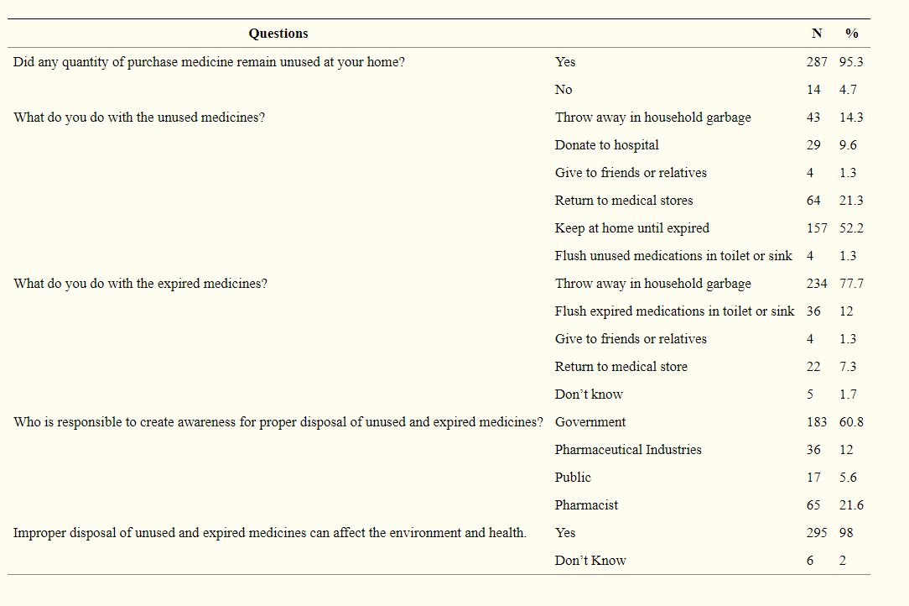
Survey Regarding Unused and Expired Medication Disposal
Reference Taken from:- as per WHO survey
https://www.ncbi.nlm.nih.gov/pmc/articles/PMC5219664/

Slide 5
Our Solution
A targeted door-to-door collection system offering various perks to people to help discard their unused and expired medicines.
After confirmation of genuinely of medicines a free pickup is arranged for them.
Active participation helps people gain rewards which are based on the condition and the quantity of medicines being given to us. The rewards can be redeemed as discount on future purchases through our app.

Slide 6
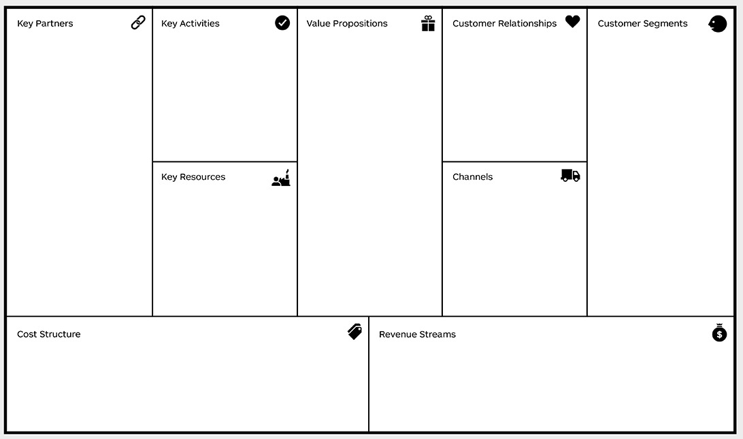
Business Model Canvas
Various takeaway locations throughout the whole city
Return of expired medicines to manufacturers
Delivery servicing companies
Manufacturers
Collection of
Unused &
expired
medicines
Cheaper
medicines as
compared to
medical stores
Eco-friendly
destruction of
medicines
24x7 customer support
Automation
(where possible)
Common man
Pharmaceutical
companies
Online Application
Dataset of all medicines from manufacturers
Online Application
Digital
Marketing
Cost for logistics
Cost for marketing
Cost in developing Online Application
Operational costs
Pharmaceutical Companies
Sponsored listing
Advertisements

Slide 7
Value Propositions(USP)
Collection of unused and expired medicines that are a liability for general public.
Providing rewards and returns to the people in lieu of those medicines.
Additional benefits based on the kind of medicines provided by users.
Devising an eco-friendly manner for destruction of medicines that minimizes hazards to the environment.

Slide 8
Procedure in respect of Return of Time Expired Drugs of Medicine
As Fresh Supply
Wholesalers
Return of Time
Two
Options
Pharmaceutical
companies
expired goods
Retailers
Issuing Credit Note
Reference Taken from:- Circular No. 72/46/2018-GST
F.No. CBEC/26/16/04/2017-GST
Dated the 26th October,2018

Slide 9
Customer Segments
Common man -
1. Getting rid of unused & expired medicines with no extra effort.
2. Earning a profit without any hassle.
3. Additional benefits on new medicines.
Pharmaceutical Companies -
1. Destruction of expired medicines becomes easy due to gathered
medicines.
2. New targeted customers which assist in increasing indirect sales.
3. Earning goodwill in industry by following correct prescribed methods of
medicine destruction.

Slide 10
Key Activities
There will be Door to Door delivery and take away locations throughout the city.
For Door to Door take away the user needs to book the slot and medicines will be taken away collectively from the area.
Return of the expired medicines to the manufactures.
Cheaper medicines for the users then any other platforms.

Slide 11
Financial Model (3 years)
Total expense = 90,00,000
Revenue generated from pharmaceutical companies = 41,75,000
Revenue generated from reselling of medicines = 28,15,000
Revenue generated from AdSense enabling = 1,50,000
INITIAL INVESTMENT = 26,00,000
Break-Even-Point = 2 years
Profit in subsequent 1 year = 7,00,000

Slide 12
Capital Management
Teams | 6 months | 12 months | 24 months
Logistics | 9,00,000 | 18,00,000 | 36,00,000
Customer service | 1,00,000 | 2,00,000 | 4,00,000
Marketing (team + adverts) | 4,50,000 | 9,00,000 | 18,00,000
Operational cost | 25,000 | 50,000 | 1,00,000
Total | 14,75,000 | 29,50,000 | 59,00,000

Slide 13
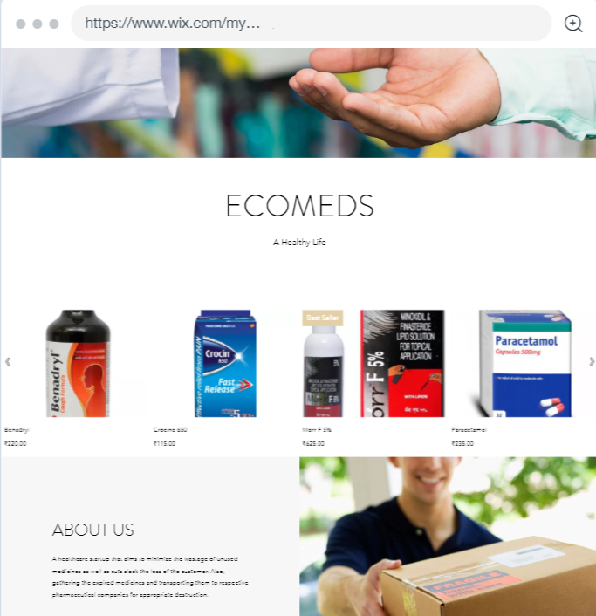
Website
Link: https://kshitizagarwal1999.wixsite.com/website

Slide 14
Thank You

