Slide 1

KODERZ
BY-
Prachi Servanshi
Mansi Gera
Ishween Kaur
Simran Kaur Bindra

Slide 2

REAL WORLD
PROBLEM
There does not exist a system in India that can predict the optimal route and time if provided with source , destination and travel date.

Slide 3
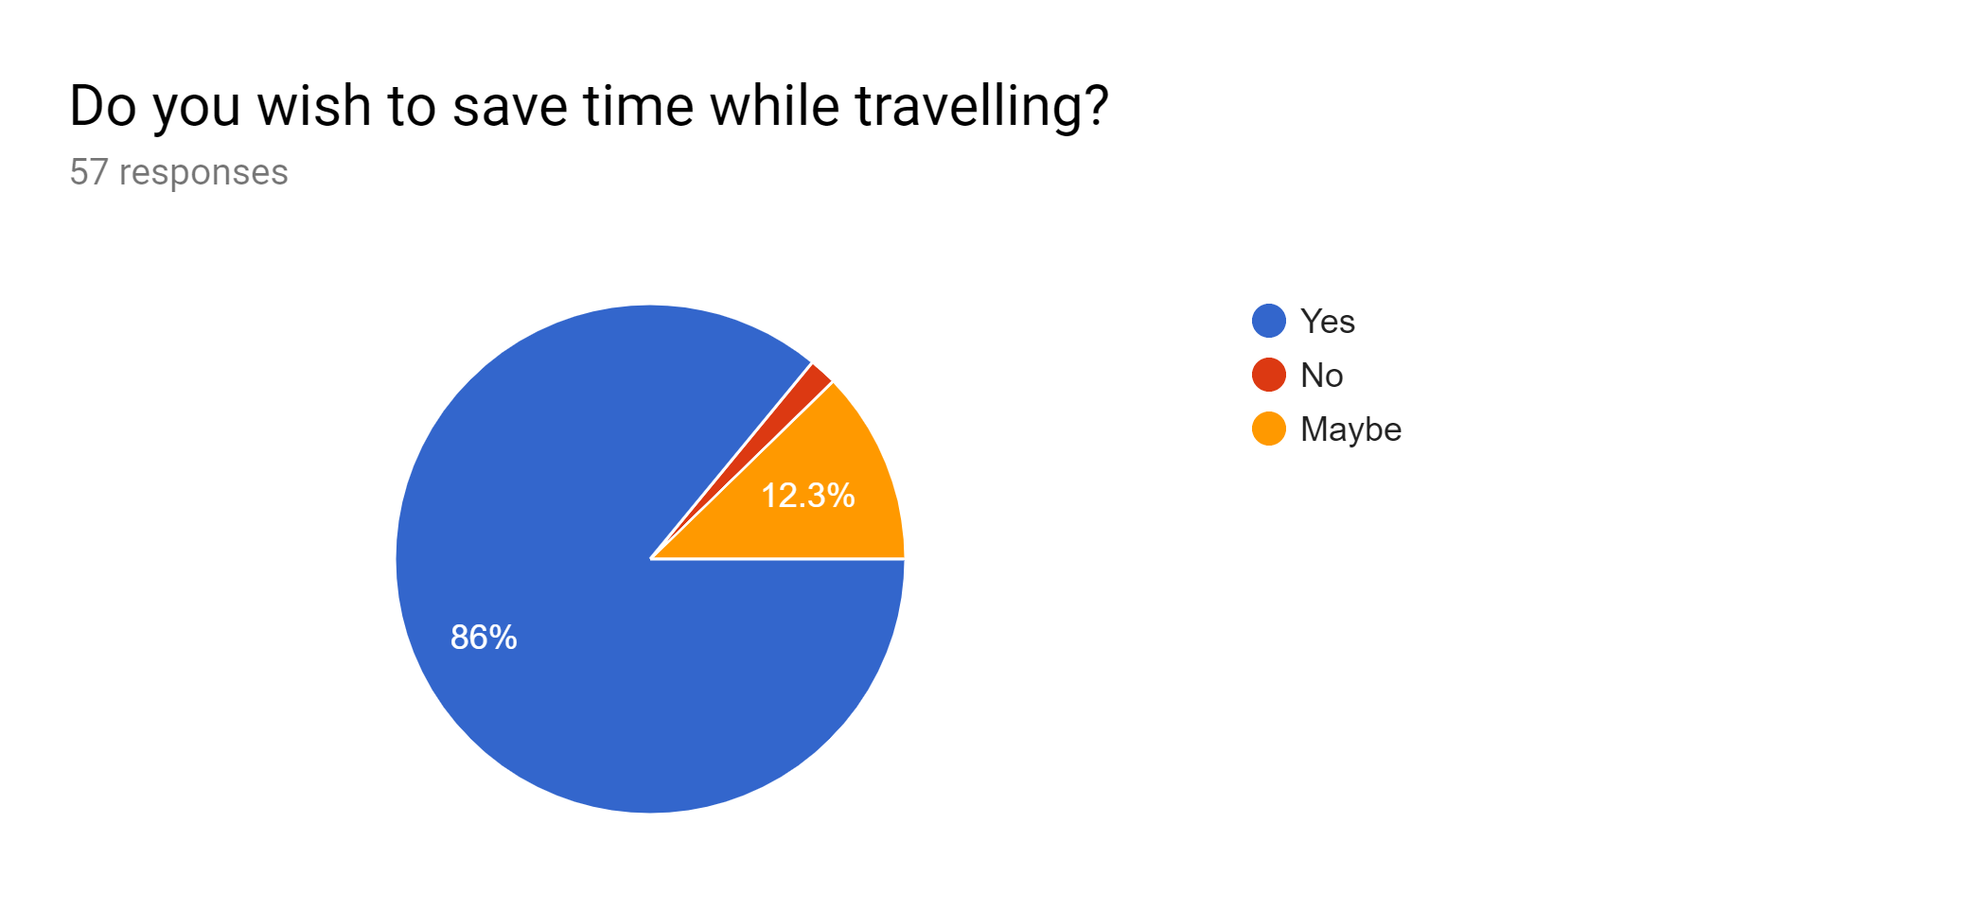
Need for this System

Slide 4
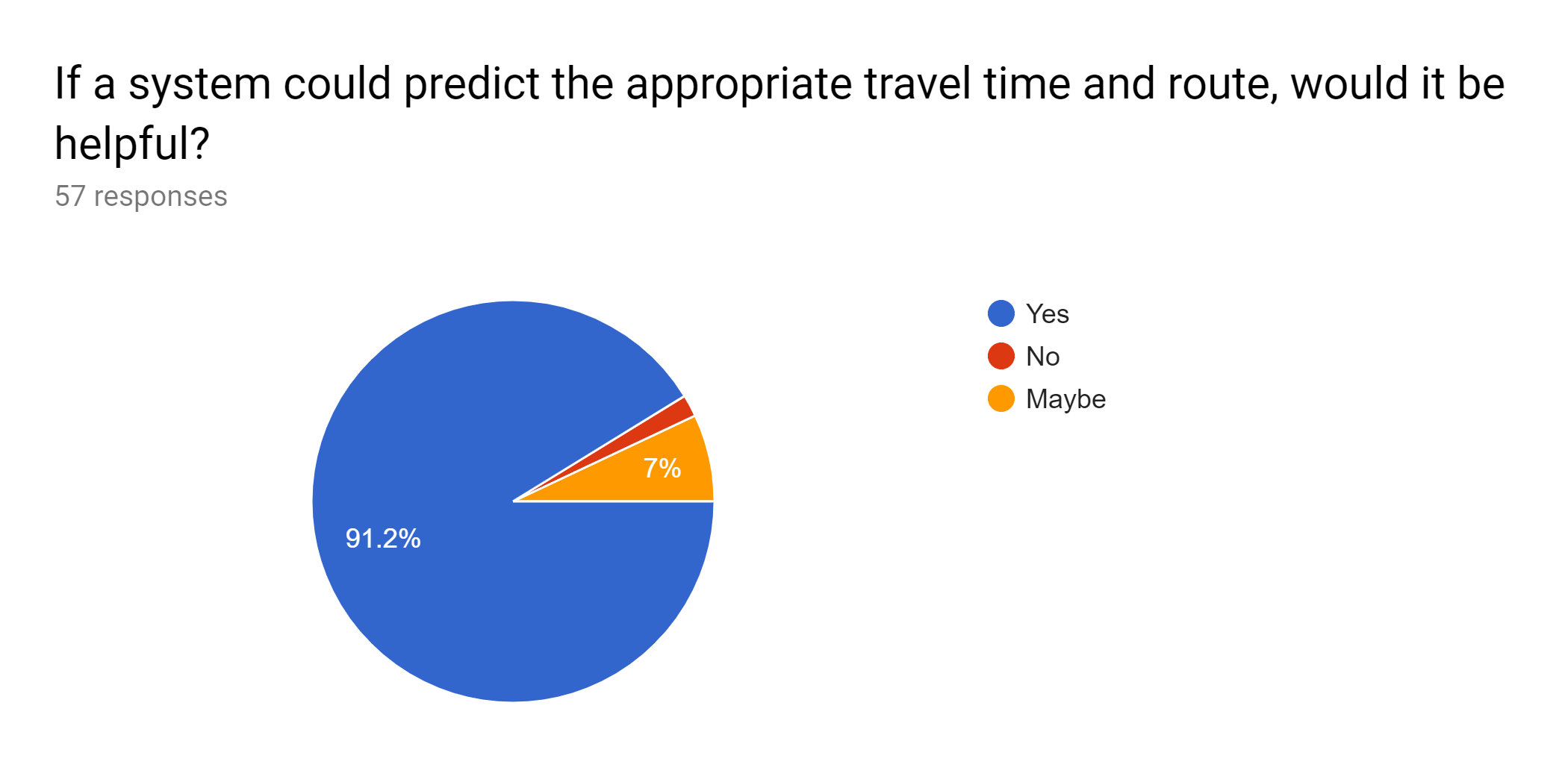

Slide 5


Slide 6
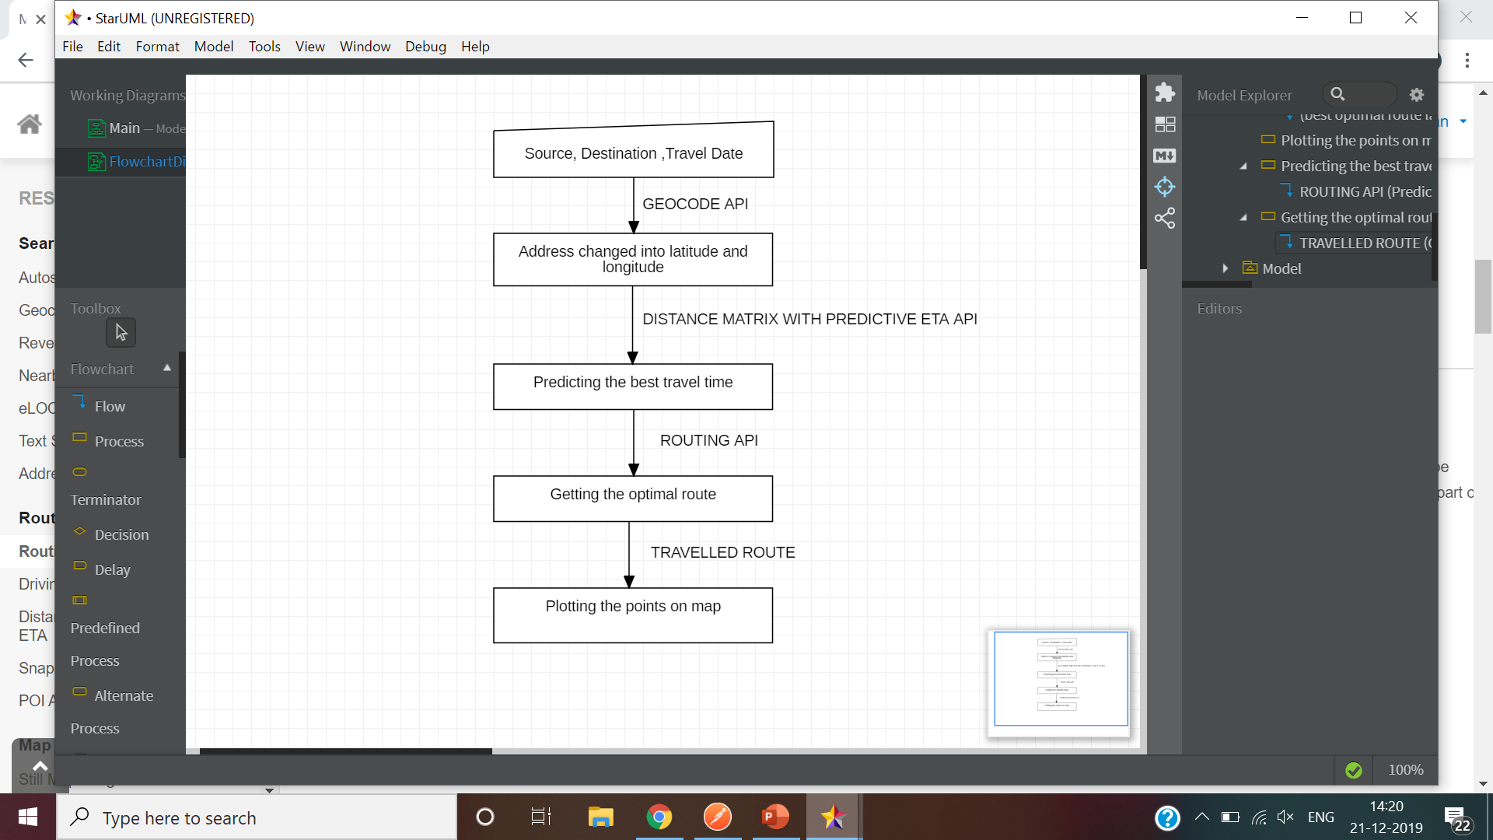
SOLUTION-
/REVERSE GEOCODING

Slide 7
FUNCTIONALITIES
Future prediction
Usage of different parameters in Routing Api-driving,walking,
biking,trucking
MORE THAN JUST DIRECTIONs
Suggests appropriate departure time

Slide 8

MAPMYINDIA receives 2.5 million requests per week and supports the scale of leading companies such as paytm, phonepe, ola etc.
OLA-cost estimation for travelling
Blocked paths
FUTURE SCOPE

Slide 9


Slide 10
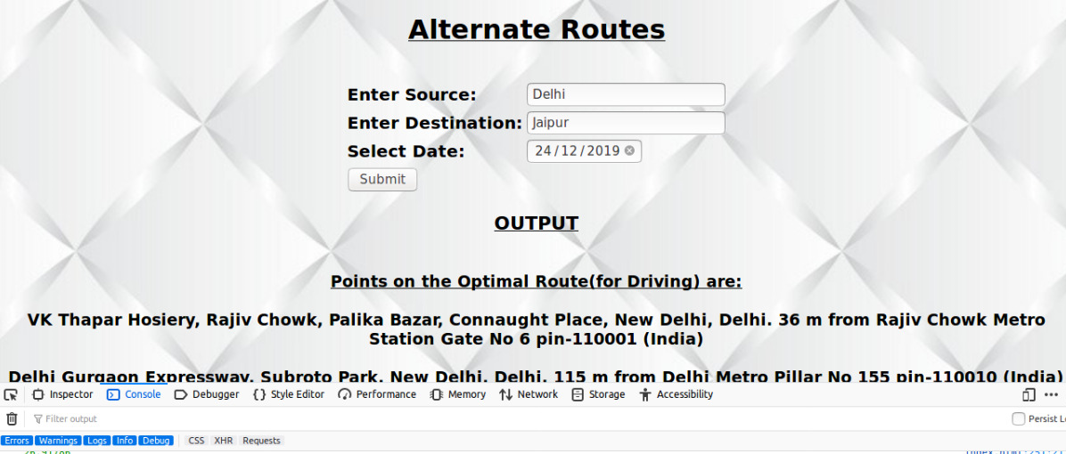

Slide 11
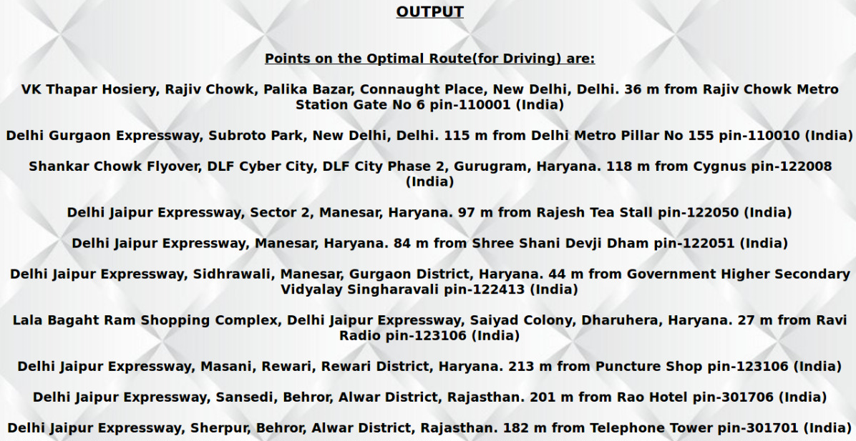

Slide 12
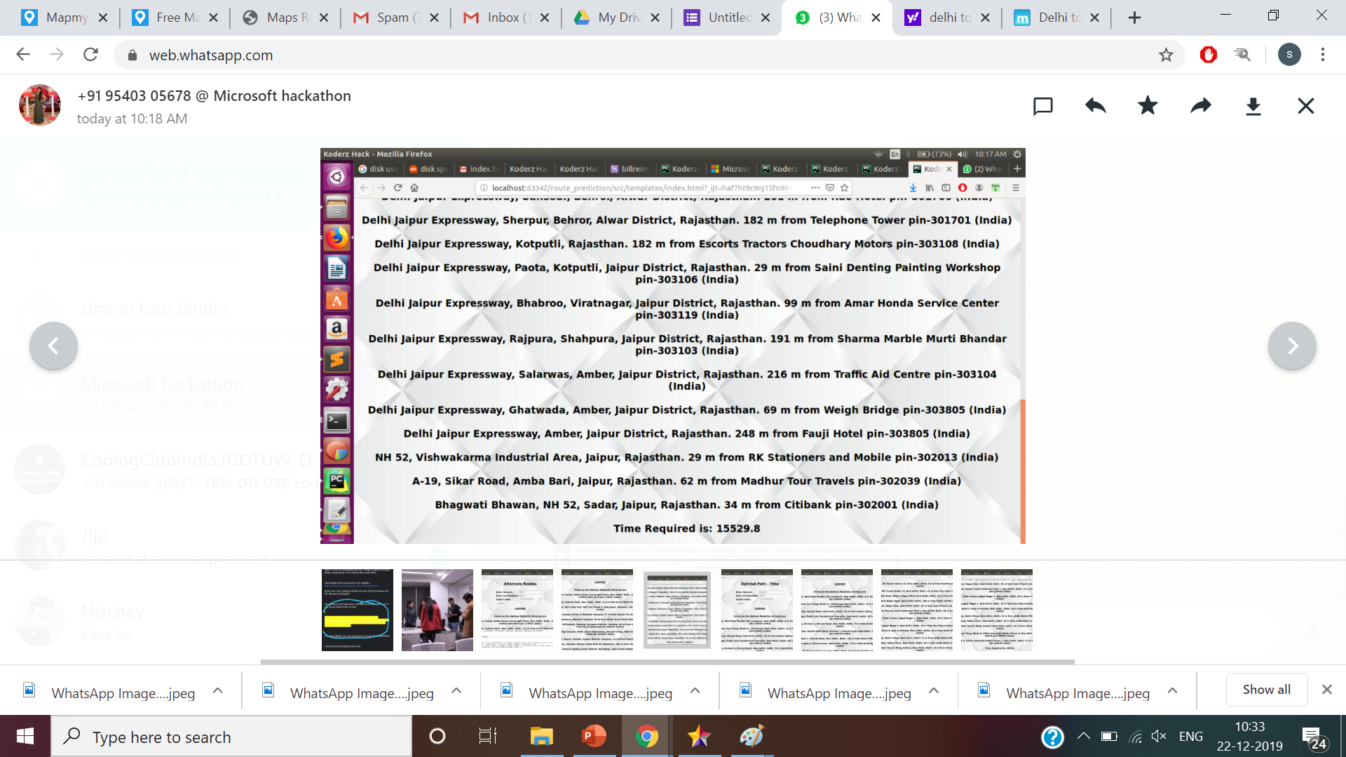

Slide 13
