Slide 1
Pepero Contest

Slide 2


x

Slide 3
Pepero Lang

Slide 4
1, I, l, |, /, _, -, +, =, !, (), {}

Slide 5
Number

Slide 6
Combination of 1

Slide 7
1, 11, 111, ...

Slide 8
1+1, 11–1, ...

Slide 9
Boolean

Slide 10
1==1, 1!=1
true
false

Slide 11
Operations

Slide 12
For Numbers,
-= 1 in Python
+, -, +=, -=, ++, --
+= 1 in Python

Slide 13
For Booleans,
or in Python
==, !=, !, ||
not in Python

Slide 14
For Booleans,
Use !, || to make and
By De Morgan

Slide 15
Print

Slide 16
_

Slide 17
_(1 + 1 + 1)
3

Slide 18
Variable

Slide 19
I, l, 1

Slide 20
I for declaration
let in Javascript

Slide 21
I ll = 1
ll = 11
ll += 11
_ll
22

Slide 22
Input

Slide 23
l has the value of input

Slide 24
Simply, think of
I l = input value
is written above code

Slide 25
Do not declare l

Slide 26
l ∈ ℕ

Slide 27
While

Slide 28
/(cond) {
execute
}

Slide 29
I ll = 1
/(ll != 1+1+1+1+1) {
_ll
ll++
}
1
2
3
4

Slide 30
if

Slide 31
No if

Slide 32
I ll = cond
/(ll) {
execute
ll = 1 != 1
}

Slide 33
Contest

Slide 34
CS team
Non-CS team
(divided by track)

Slide 35
CS team: 4 problems required
Non-CS team: 3 problems required

Slide 36
CS team: 5 problems for 1st prize
Non-CS team: 4 problems for 1st prize
(only first solve)

Slide 37
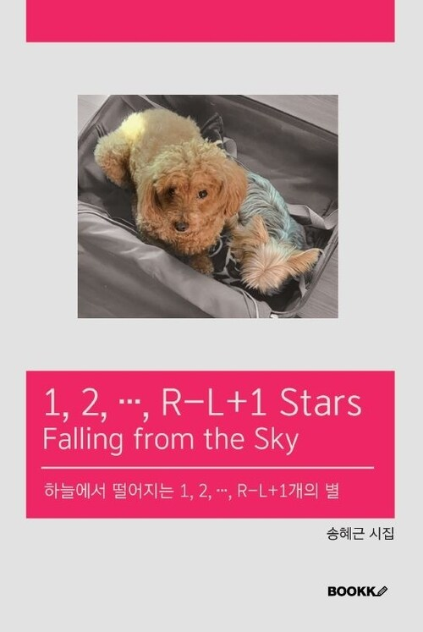
For each team, 1st prize is

Slide 38
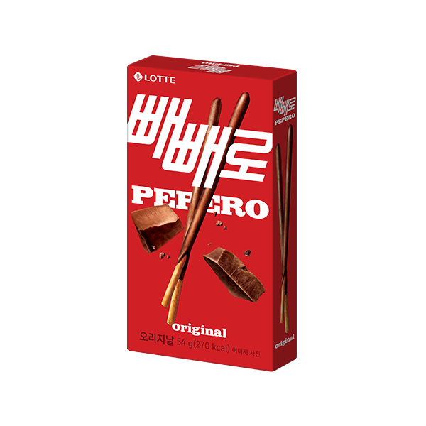
If you finish, you get

Slide 39
Question?

Slide 40
Link: www.빼빼로.kro.kr
Ref: ref.빼빼로.kro.kr

