Slide 1
EDUC 263: Managing and Manipulating Data Using R Lecture 8: Tidy data
NOV 15

Slide 2
1. Overview
Creating analysis datasets often require changing the organizational structure of data
Reshape your data –tidying
Rows ←→ Columns
Untidy → Tidy
Why tidy? 2 main advantages
one consistent way of storing data; underlying uniformity.
R’s vectorised nature; tidyverse (dplyr, ggplot2,etc)
Notes:
Two common ways to change organizational structure of data
Use group_by to perform calculations separately within groups and then use summarise to create an object with one observation per group. Examples:
Creating objects containing summary statistics that are basis for tables and graphs (focus of lecture 4)
Creating student-transcript level GPA variable from student-transcript-course level data (focus of lecture 5 problem set)
Reshape your data – called tidying in the R tidyverse world – by transforming columns (variables) into rows (observations) and vice-versa
Our topic for today
This lecture is about changing the organizational structure of your data by transforming untidy data into tidy data.
Working with tidy data has many benefits, one of them is that all the packages in the tidyverse are designed to work with tidy data.
We will perform data tidying using functions from the tidyr package, which is a package within tidyverse.
There’s a general advantage to picking one consistent way of storing data. If you have a consistent data structure, it’s easier to learn the tools that work with it because they have an underlying uniformity.
There’s a specific advantage to placing variables in columns because it allows R’s vectorised nature to shine. dplyr, ggplot2, and all the other packages in the tidyverse are designed to work with tidy data. As you learned in mutate and summary functions, most built-in R functions work with vectors of values. That makes transforming tidy data feel particularly natural. Here are a couple of small examples showing how you might work with table1

Slide 3
2. Data “structure” vs. data “concepts”
Data “structure” physical layout | Data “concepts” what should be
rows | observations
columns | variables
cell | value
= if tidy (Wickham)

Slide 4
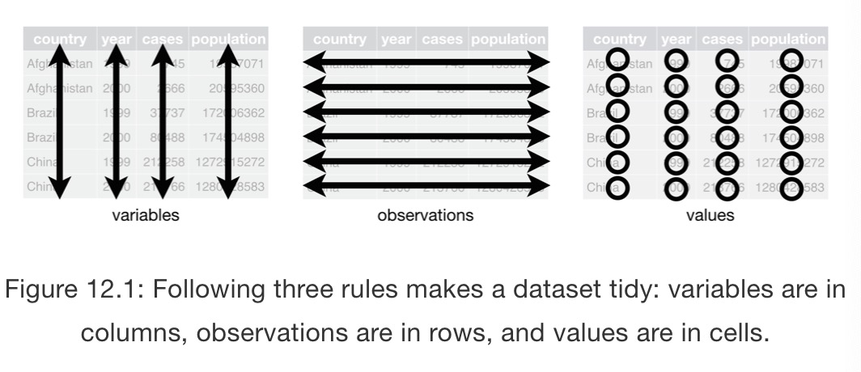
3 Tidy vs. Untidy data
Rules of tidy data
Each variable must have its own column
Each observation must have its own row
Each value must have its own cell

Slide 5
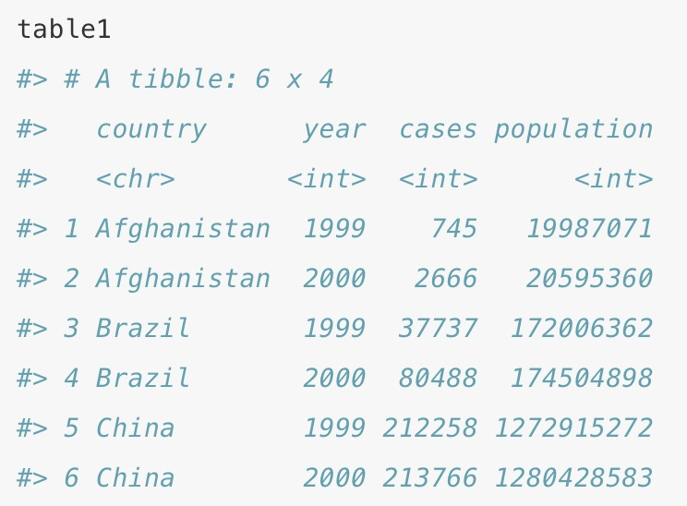
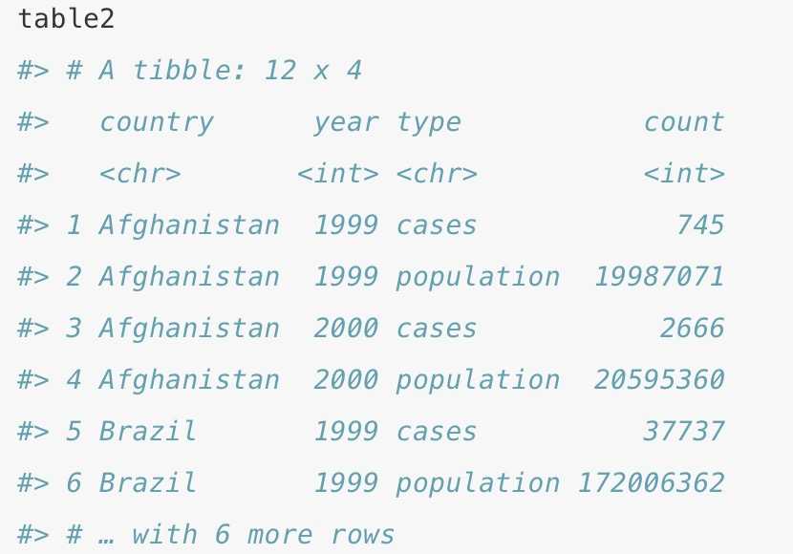
3 Tidy vs. Untidy data Example
table1 is tidy.
It’s the only representation where each column is a variable.
Question:
How to reshape untidy data to tidy data?
More untidy examples:
Digest of Education Statistics https://nces.ed.gov/programs/digest/current_tables.asp

Slide 6
4 Tidying data: Wide ←→ Long
Function {tidyr} | Description | Main Arguments
pivot_longer | wide → long (gathering) # rows ↑; # columns ↓ | Names_to | Values_to
pivot_wider | Long → wide (spreading) # rows ↓; # columns ↑ | Names_from | Values_from
Long
Wide
pivot_longer()
pivot_wider()
table1 %>% pivot_longer(cols = c('cases','population'),
names_to = 'type',
values_to = 'count')
table2 %>% pivot_wider(names_from = type,
values_from = count)

Slide 7
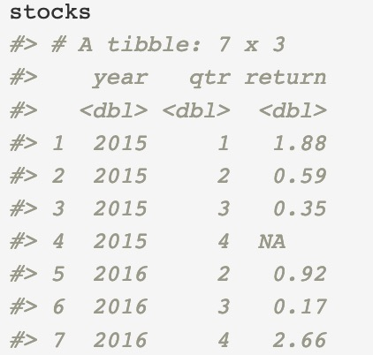
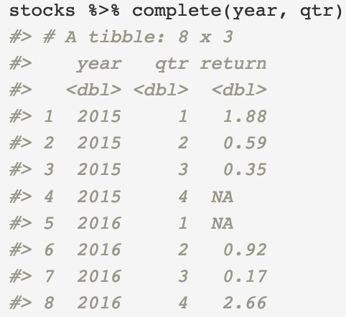
5 Missing values
Two types of missing values:
Explicit missing values: variable has the value NA for a particular row
Implicit missing values: the row is simply not present in the data
Complete() {tidyr}
turns implicit missing values into explicit missing values
1 explicit missing value
1 implicit missing value

