Slide 1

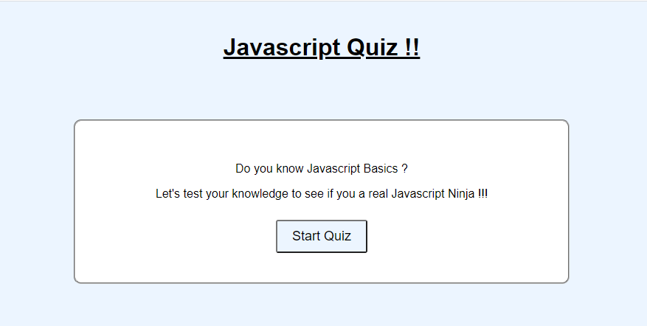
Mobile
Navigation Bar
Picture
What I do !!!
Quiz App Project
Project Description
Links to the repo and live apps
Contact me !!
Kevinsalsa@gmail.com
GithubEmail: :https://github.com/ksalcce
Linkedin: https://www.linkedin.com/in/kevin-salcce-mba-6b6831b8/

Slide 2


Tablet
Same desktop
Navigation Bar Home Projects Contact Me
Projects
Quiz App Project
Project Description
Links to the repo and live app
Contact me !!
Kevinsalsa@gmail.com
GithubEmail: :https://github.com/ksalcce
Linkedin: https://www.linkedin.com/in/kevin-salcce-mba-6b6831b8/

Slide 3
Desktop
Same as tablet
Navigation Bar Home Projects Contact Me
Projects
Quiz App Project
Project Description
Links to the repo and live app
Contact me !!
Kevinsalsa@gmail.com
GithubEmail: :https://github.com/ksalcce
Linkedin: https://www.linkedin.com/in/kevin-salcce-mba-6b6831b8/

