Slide 1
Willy The Worm VS. Hungry Birds **Working Title
Game Design Presentation
IMOG4050: Flash Game Development
Kyle Samson
W0265131
January 16th, 2015

Slide 2
Presentation Overview
High Level Concept of Game
Storyboard
Walkthrough of Each Screen

Slide 3
Game Overview
Willy the Worm is in trouble. There are some hungry birds in the area trying to eat Willy! Willy has equipped himself with an awesome bow and arrow, but needs your help to beat back these hungry predators!
Browser based - Arena style game
Survive for as long as possible
Similar to Zombies in Call of Duty
The player will attempt to survive each wave of enemies without losing all of Willy’s lives.
The player will get to the next wave by successfully defeating the displayed number of enemies.
An enemy is defeated by being hit by one of Willy’s arrows.

Slide 4
Game Overview
The number of enemies in each Wave will increase as the player progresses through the game.
The game will end when the player loses all of Willy’s lives (starts with 3) OR if the player successfully completes all 12 (or 15?) Waves.
The game will randomly generate Power-Up consumables on the arena. These will fade away from the screen after a certain amount of time (~ 5 seconds).
Extra Life
Increase Health

Slide 5
Game Overview
The player adds to their score each time they kill an enemy.
The player’s score is decreased each time they lose a life, or an enemy successfully hits Willy.

Slide 6
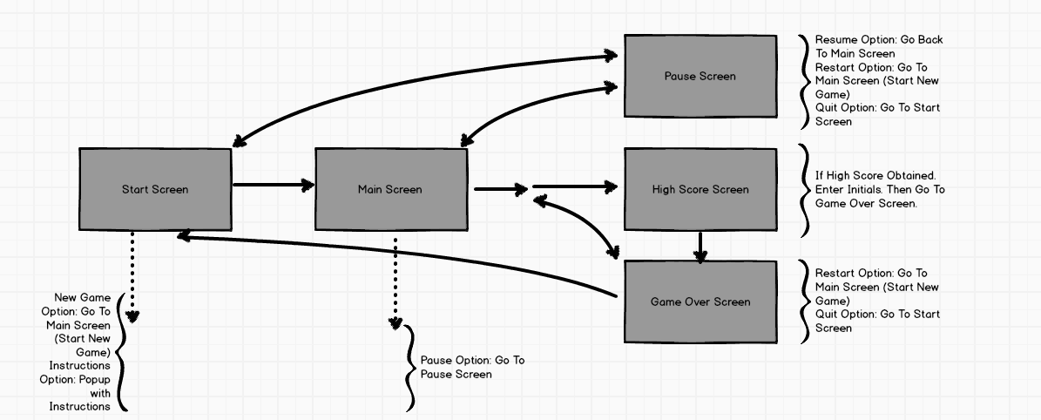
Storyboard

Slide 7
“Start” Screen Features
Player can choose to start a new game.
Player can choose to view instructions on how to play the game.
Will display High Scores.
Will display developer credits.
Link to my portfolio & social media accounts.

Slide 8
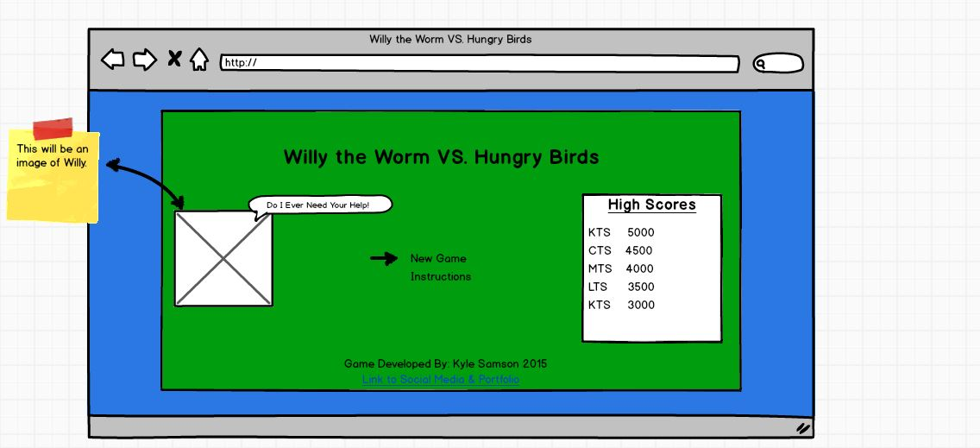
“Start” Screen Sketch

Slide 9
“Main” Screen Features
The player will have the option to see the Pause Screen.
Menu clicked, or “P” button pressed.
The player will have the option to enable/disable the sound.
The screen will display the health bar, score, # of lives, kill count, # of enemies remaining for the current Wave & Wave #.
Depending on the Wave, enemies will be randomly generated during Wave, or all at beginning.

Slide 10
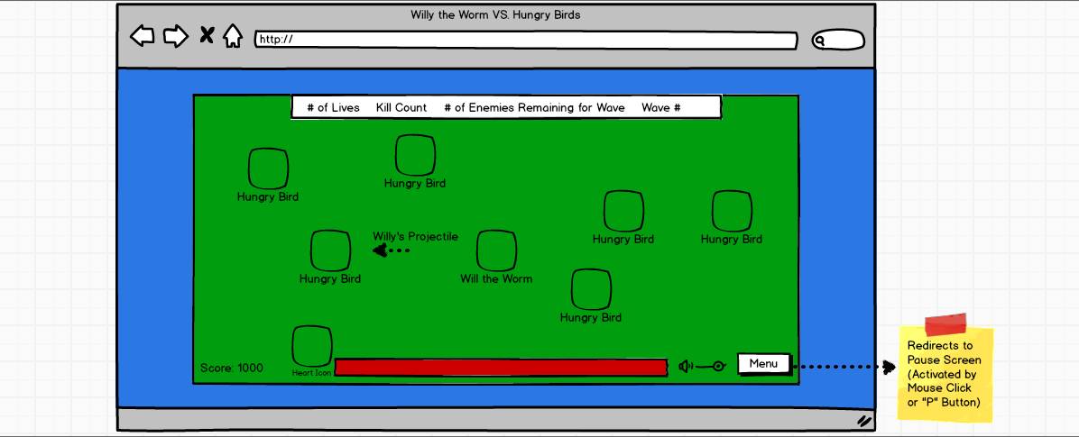
“Main” Screen Sketch

Slide 11
“Pause” Screen Features
The player will have the option to resume the game.
The player will have the option to view the instructions on how to play the game.
The player will have the option to restart the game.
Taken back to Main Screen. New Game initiated.
The player will have the option to quit the game.
Taken back to the Start Screen.
High Scores will be displayed.
Current gameplay stats will be displayed.
Kill Count, Score, Wave #, Accuracy, # of Enemies Remaining for Wave
Will display developer credits.
Link to my portfolio & social media accounts.

Slide 12
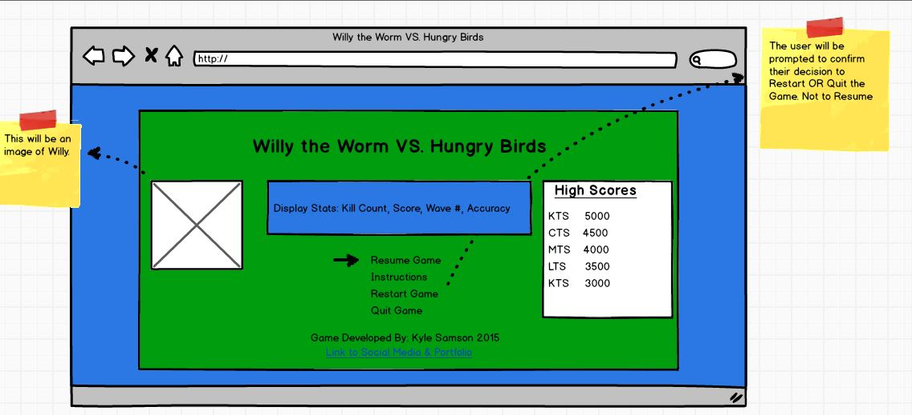
“Pause” Screen Sketch

Slide 13
“Game Over” Screen Features
The player will have the option to start a new game.
Taken back to Main Screen. New Game initiated.
The player will have the option to quit the game.
Taken back to the Start Screen.
High Scores will be displayed.
Concluding gameplay stats will be displayed.
Kill Count, Score, Wave #, Accuracy
Will display developer credits.
Link to my portfolio & social media accounts.
If the player obtains a High Score, a popup will be displayed for that player to enter their initials.

Slide 14
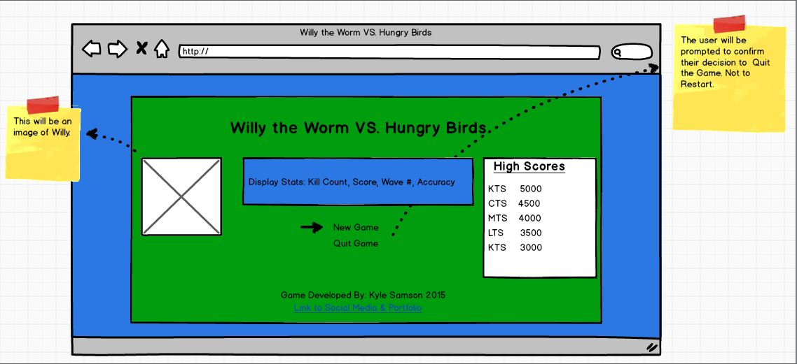
“Game Over” Screen Sketch

Slide 15
Recap
Willy the Worm needs help against some hungry birds.
Defends himself by shooting an arrow from his bow.
Arena style game – survive waves of attacks.
Game is over if all Waves are cleared, or all lives are lost.
Power ups will be generated, randomly, to help the player.
Score is increased when enemies are killed & power ups are obtained.
Score is decreased when damage is taken and lives are lost

Slide 16
Suggestions & Questions
Hit me with them.

